Slide 1
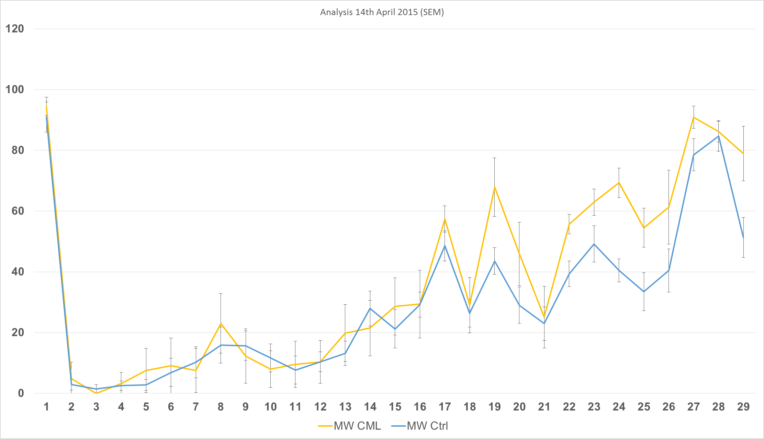
CML n=6
Healthy n=7

