Slide 1
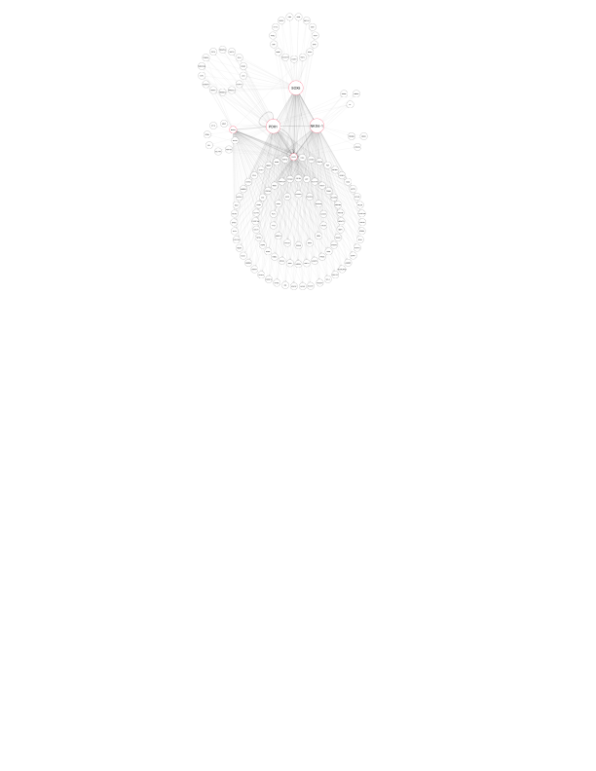
SOX5 only
SOX5 and PDX1
15 genes
14 genes
PDX1 and NKX6-1
3 genes
PDX1 only
NKX6-1 only
3 genes
8 genes
SOX5, NKX6-1 and PDX1
92 genes

