Slide 1


FIT9134 Computer architecture and operating systems
Introduction to Computers
Lecturer: Phu Le
Tel: 99032399 Room H7.39 Caulfield Campus pdle@infotech.monash.edu.au

Slide 2
Important note for this unit
Since the unit has 2 main parts (computer architecture and operating system) and we have one-hour lectures, lectures and tutes are organised in sandwich.
You may have to learn things in tutes before lectures.
You may have to do some reading or home work before lectures or tutes.

Slide 3
Outline
Classic computers
Classic computer components and basic operations
Multi-processor and parallel computers
Quantum computers

Slide 4
Your idea of a computer?
What are the main components of a machine that can do many things fast for us?
A brain?
Something for input/output?
Something to keep temporary results?
Should the transfers between components be fast?
What computer architect do you have in mind?

Slide 5
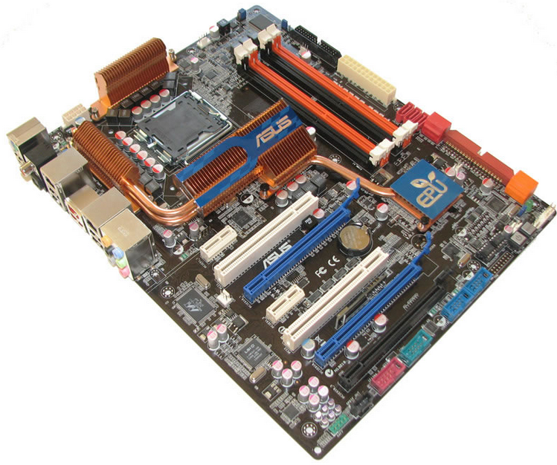
Main parts of a computer
Computer motherboard

Slide 6
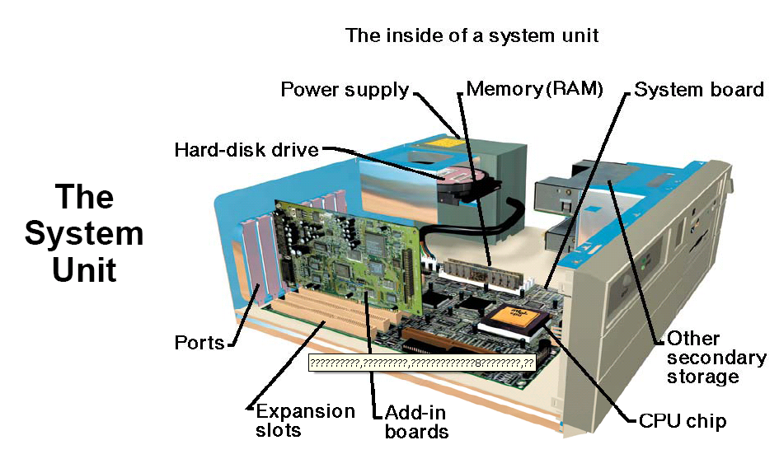
Anatomy of a Personal Computer

Slide 7
Conventional Computer Components
Basic components of a conventional computer
CPU
Central Processing Unit
Primary storage or Main Memory
Holds running programs whilst they are being executed and temporary data
A computer may have some smaller main memory closer to CPU. Why?
Secondary storage
Holds data and programs permanently (files or objects)
Bus
Connect computer main components together
Input/output devices and controllers

Slide 8
How Computers Function
Computers built to execute instructions.
Set of instructions (SOFTWARE)
Data
Main Memory
CPU
Arithmetic/Logic Operations
Instruction Decoder/Control Unit
Control Signals
Results
Notes:
Actually ALSO NEED AN I/O MODULE ALONG WITH THE CPU TO INTERACT WITH I/O DEVICES

Slide 9
The Language of Binary Computers
Binary number system (base 2)
Binary Digit (or bit): 0 or a 1
8 bits = 1 ‘byte’, eg. 0100 1001
Data and programs are represented in binary before it is executed since the language classic computers can understand is binary.
An instruction could look like :
0011 0001 1000 1111 0011 1110 1010 0101
Programs written in higher level languages like Java or C or Basic are translated into binary before it is executed.
Machine language (binary form) is the language of the computer, however there can be intermediate languages such as assembly language that stands between higher level language like C and machine language.
Are there any extra layers (intermediate languages) between Java and machine language?

Slide 10
The Fetch/Decode/Execute Cycle
Cycle
A processor can have several states, However, the following are used in conventional computers
Fetch
CPU fetches data and instructions from main memory and store it in closed memory (Registers).
Decode
CPU interprets the instruction it just fetched
Execute
The instruction is carried out on the data (executed) and temporary result is stored in a register.
A computer advances through the whole program using a program counter.

Slide 11
Interrupts
Interrupt is an important concept which allows programs to share CPU better.
An interrupt is a signal to a processor to suspend its current task and deal with whatever caused the interrupt.
Interrupts can be classified broadly as:
Program/Software
Timer
I/O
Other Hardware
Notes:
Program or Software Interrupt – typically because of an error condition or exception – illegal instruction, access to memory outside allowed area, division by zero etc
Timer – the system clock can generate regular interrupts – allows for synchronization of processing
I/O – device (through controller) can generate an interrupt indicating some operation has completed, or an error condition has occurred
Other hardware – power failure or memory read/write error etc
Why are interrupts used?
Most external devices, e.g. I/O are much slower than the processor, we do not want the CPU to wait for an I/O device to finish its operations! Interrupts allow the CPU to switch its attention to another task and be notified when the I/O has finished.

Slide 12
Interrupt and Multiprogramming
The interrupt mechanism can be used to implement multiprogramming.
Multiprogramming is the capacity to have multiple programs in memory and switch a processor between them.
In parallel computers, many programs can be executed at the same time.
The order in which programs are executed can be determined by priority or time-sharing.
Since I/O devices are slower than CPU, a program waiting for an I/O should give up its CPU.

Slide 13
Main computer architectures
There are currently two popular architectures : RISC and CISC.
Should we build computes that can execute “read data and a program from files, execute the required operation and return the result” as one instruction?
Or should we built computers which
break “read data and a program from files, execute the required operation and return the result” into many finer instruction?
Notes:
C

Slide 14
How to make computers faster?
Increase main memory?
Make its brain smarter?
Improve the speed of its bus?
Pack more CPUs?
Give it a better OS?
Create a multiple-state computers?

Slide 15
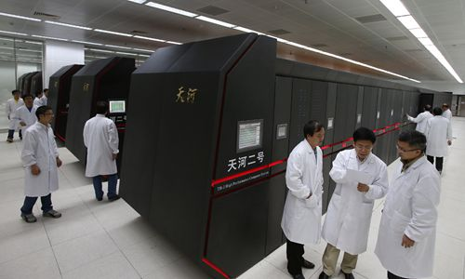
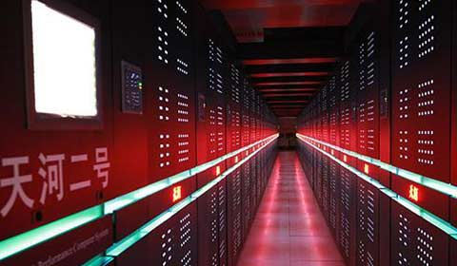
Modern computers
Tianhe-2 World’s Fastest Computer (Nov 2013) 3.3 petaflops performance Around 3.1 million cores – running Linux (Kylin)
Notes:
30-07-14
http://en.wikipedia.org/wiki/TOP500#Top_10_ranking
All top 10 runs some variant of Linux/Unix
Fastest (Nov 2013) – TianHe 2 : 33.86 petaflop/s, ~3.1 million cores, ~1,375 TiB (1 tebibyte – 1024GB)
- http://en.wikipedia.org/wiki/Tianhe-2
- http://www.engineering.com/DesignerEdge/DesignerEdgeArticles/ArticleID/6676/Tianhe-2-Tops-Supercomputer-List.aspx
- http://en.wikipedia.org/wiki/Kylin_%28operating_system%29
Around US$130 Million (Cray’s Jaquar)
http://www.top500.org/
2008-06-18 : IBM’s $100 million Roadrunner supercomputer, which is being installed at the U.S. Department of Energy’s Los Alamos National Laboratory in New Mexico, is now the world’s fastest supercomputer, according to the newly published Top 500 list, with a maximum performance of 1.026 petaflops, or more than one quadrillion calculations per second.
Nov 12 2008 : Pumping out a sustained 1.64 quadrillion mathematical calculations per second (1.64 petaflops) after a recent technological overhaul, the Cray XT Jaguar is now the world's latest fastest supercomputer (huge disclaimer coming) for non-classified research. The system is powered by 45,000 quad-core AMD Opteron processors that take advantage of 362 terabytes of memory. This and other underlaying architecture allows processors to chew on 284 gigabytes of data per second with its impressive I/O bandwidth, which has apparently been a major bottleneck in supercomputers of yesteryear. Information is stored on 750 terabytes of hard drives.
02.03.09, 12:01 AM EST The so-called Sequoia supercomputer is expected to leap-frog competitor Cray--15 times over.
On Tuesday, the computing giant announced a deal to sell a new supercomputer--one that it says will be the most powerful in the world--to the U.S. Department of Energy (DOE). boasts that its so-called Sequoia system will be capable of crunching numbers 20 times faster than IBM's last record-breaker and 15 times faster than the current fastest machine.
IBM has promised the DOE that the computer, part of its Blue Gene series and scheduled for delivery in 2011, will be capable of 20 petaflops, or 20 quadrillion floating operations per second. That's the equivalent of completing calculations in around eight hours that would take a typical Intel-powered (nasdaq: INTC - news - people ) laptop 20,000 years--or, by IBM's count, the ability to finish in one hour a series of computations that would require the entire population of the planet, armed with pocket calculators, 320 years to complete.

Slide 16
Multi-processor Computers :
Processor
Processor
Processor
Processor
L1 cache
L1 cache
L1 cache
L1 cache
L2 Cache
L2 Cache
L2 Cache
L2 Cache
Bus interface
Bus interface
Bus interface
Bus interface
Processor/
memory
b
us
I/O interf
ace
Memory controller
I/O b
us
Memory

Slide 17
Quantum Computers
A quantum computer is a computer that performs computations using the laws of quantum mechanics.
Quantum computers use qubit rather than binary in classical computers.
One "qubit“ could be both 0 and 1 at the same time. Eg. with 3 qubits of data, a quantum computer could store all eight combinations of 0 and 1 simultaneously. A 3-qubit quantum computer could be used in data representation and computations to allow eight times faster than a 3-bit in binary computers.

Slide 18
References
http://cs.stanford.edu/people/eroberts/courses/soco/projects/risc/risccisc/
http://www.cs.dartmouth.edu/~dfk/papers/kotz-pioarch.pdf
http://www.dwavesys.com/tutorials/background-reading-series/quantum-computing-primer
You can find more stuff on the Internet, some are easy to read and others are difficult. For Quantum computers, read the easy ones first.

