Slide 1


FIT9134 Computer architecture and operating systems
Note 4 Operating Systems : Memory Management

Slide 2
Outline
The need for efficient memory management
Memory types
Fixed and variable partitions
Virtual memory
Memory swapping
Memory paging

Slide 3
Acknowledgement
Some diagrams are borrowed from other authors

Slide 4
Memory Management
Programs need memory that is
fast
large enough
non volatile
easy to get and no interference with other programs
Computer memory types
small amount of fast, expensive memory: cache
some medium-size and fast-speed and medium price: main memory
gigabytes of cheap and slow: disk storage
In order to use memories effectively, the OS Kernel must have an efficient way to address memories

Slide 5
Memory management
OS needs to manage memory effectively so that processes can perform well.
How does the OS manage memory to help processes:
should the OS allocate the same memory size to all processes?
where are processes located in the memory, relative to one other?
does a process and its data need to be entirely brought into the main memory?
can the OS know in advance how much memory a process will need?
when a process is finished, what happens to the memory it used? how can the OS reclaim memory which is no longer used by any process?

Slide 6
Memory management (MM)
OS wants to have multiple processes in the memory (RAM or Cache), where the CPU can access, at the same time, because this
allows fast switching to a ready process (a process is put in a queue before it gets its next CPU).
OS divides memory (partitioning) into multiple pieces and allocate those memory pieces to processes.
If MM uses memory partitions (or blocks), then it has to provide
protection: keep processes from interfering each other, and
performance: memory accesses should not be slowed by protection or switching.

Slide 7
EG: Main memory used by OS Kernel and processes
0x000AFFFF
Free
Process 2 (200K)
address space
Process 3 (200k)
Process 1 (200K)
OS kernel (MMS)
0x00000000

Slide 8
Eg: Fixed size memory used by OS Kernel and processes
0x000AFFFF
free
Process 3 (200k)
address space
Process 2 (200k)
Process 1 (200k)
OS Kernel
0x00000000

Slide 9
Variable size memory used by OS Kernel and processes
0x0000AFFFF
free
Process 3 (150k)
Process 2 (95k)
address space
free
Process 1 (200k)
OS Kernel
0x00000000

Slide 10
Memory Addressed by Limit and Base
0x000AFFFF
Empty
Limit
Process 3 (200k)
Base
Empty
address space
Process 1 (500k)
OS Kernel
0x00000000

Slide 11
Partitioning (fixed size block) Strategy
Fixed blocks (partitions) – divide memory into equal sized pieces (except for OS)
Simple policy to implement
Each process must fit into a partition space (a block)
Find any free partition (block) and load the process into that block
Problems?
Size: what is the “right” block or partition size?
Internal Fragmentation: unused memory in a block that is not available to other processes

Slide 12
MM: Variable size blocks
Memory allocation policy:
First Fit: scan free list and allocate first block that is large enough
Next Fit: start the search from the end of the last allocation
Best Fit: find smallest block that is adequate
Worst fit: find largest block
More work for the OS.

Slide 13
Memory management
1) If the OS partitions the main memory into many fixed-size (partitions) blocks and allocate fixed-size blocks to processes. What can be problems?
A process may not use up its block but the unused memory cannot be allocated to another process.
2) If the OS partitions the main memory into many variable size (partitions) blocks and allocate variable size blocks to processes. What can be problems?
The OS has to keep track of many variable size blocks and find the most-suitable block for a program. This can slow down the system performance.
So which one is a better solution?
Another issue that the OS has to resolve: main memory is much smaller than the secondary memory. If the OS wants to use its secondary memory as if it were part of the main memory then the OS has to provide a mechanism to map the addresses of the main memory and secondary memory.

Slide 14
Fixed Versus Dynamic Partitioning
Fixed Partitioning :
main memory is divided into fix-sized partitions
the partitions may be all equal in size, or be of different sizes. They do not change in real-time.
simple implementation, but prone to Internal Fragmentation (allocated memory which cannot be used).
Dynamic Partitioning :
main memory is dynamically divided into variable-sized partitions, which can be changed in real-time.
more flexible, but more complex implementation, and prone to External Fragmentation (unallocated memory which cannot be used).

Slide 15
Memory Fragmentations
Allowing multiple processes to reside in memory increases system performance but also creates the potential problem of Memory Fragmentation – sections of memory locations which are "free", but are not contiguous (ie. the free spaces are scattered throughout the memory) or not big enough for use, leading to possible memory wastage.
External Fragmentation – memory which is unused but cannot be allocated to any process.
Internal Fragmentation – memory which is allocated (to a process) and but unused.

Slide 16
Virtual Memory Technique
Fast main memory (eg: RAM and cache) is directly accessed by CPU, however it is expensive and therefore limited.
To extend main memory or compensate for shortage of main memory, the concept of virtual memory is defined:
Advantages:
Provides a large logical memory space than main memory (disk space is logically addressed and used by MM).
Allows more processes to run concurrently.
Disadvantages:
Adds complexity to memory management
Can cause performance degradation if not implemented properly - eg. due to excessive page faults (If a required page is not in the main memory then an interrupt called “Page Fault” occurs).

Slide 17
Virtual Memory - Another word
Virtual Memory is a more complicated technique used to solve main memory shortage problem and problem caused by memory addresses referred to by programs. It allows logical addresses to be used as if physical addresses.
Virtual memory is implemented using paging and/or segmentation. Therefore we need to learn how paging works.

Slide 18
Swapping and Scheduling
In order to achieve maximum performance with multi-users and multi-tasking, the OS is designed to allow
a process to be moved from memory to disk (swap space) (for eg, while it is waiting for its I/O to complete (process is blocked or suspended)
a process to be moved to main memory from swap space (process is ready for CPU)
MM and process scheduler work together
Scheduler keeps track of all processes
MM keeps track of memory
Scheduler marks processes as swap-able and notifies MM to swap in processes
Scheduler policy must account for swapping overhead
MM policy must account for need to have memory space for ready processes

Slide 19
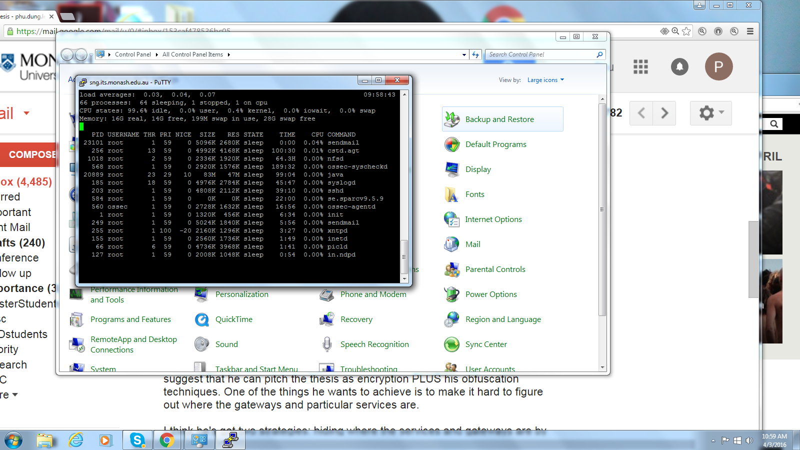
Unix top cammand

Slide 20
Memory Management – Paging
Paging: Programs/data (on disk) divided into logical sections called PAGES and main memory (RAM or Cache) divided into areas called page FRAMES. A Page-Table then translates the pages to their corresponding frames at run-time. We will mainly use term “page”.
When a program is running, its pages are brought into memory as required – ie. only a portion of the program (and/or its data) is in the main memory, the rest stays on the disk. That is only required pages are brought into the main memory.

Slide 21
Memory Management – Paging
Page size is typically in powers of 2 (e.g. 512Bytes, 1024Bytes, etc) to aide address translation.
Large page sizes will :
increase internal fragmentation, but can
reduce maintenance overhead of page tables since there are less pages to maintain
What if small page size is used? Will there be opposite effect?
So it's important to have the correct page size. But what is the correct page size?

Slide 22
Page Table
The O/S maintains a Page Table for each process. A Page table has one entry for each page of a process. If a page table is large, it may need to be paged as well.
A page table also contains other data, such as whether page is in memory or on disk, whether a page has been modified, etc.

Slide 23
Process Table
The O/S also maintains a Process Table for all the processes. A Process Table contains entries called Process Control Blocks (PCB). Each PCB represents one process.
A typical PCB entry contains data such as :
process state & process ID
program counter
memory address of the Page Table
resources needed
etc

Slide 24
Page Placement/Swapping
If a required page is not in memory then an interrupt called “Page Fault” occurs. This causes the required page to be loaded into the main memory, and the page table updated. Page table indicates whether page is in memory by a "valid/invalid" bit entry.
If a process’ memory is full, but a page for it is needed, then, MM will page swapping. Certainly page table gets updated.

Slide 25
Memory management - Paging
Program logical addresses are converted to the form:
page_number : page_offset
e.g. a 32-bit address may use 21 bits for page # and11 bits for offset (so total of 2²¹, or ~2.1million pages).
A Page # is used as an index into the Page Table, to find the corresponding Frame #.
Page Tables reside in memory. Each process has its own Page Table.

Slide 26
Paging with Cache
ie. Pages are found in the
cache 80% of the time
Hit ratio = percentage of times a page is found in the cache. Highly-dependent on the number of registers in the cache.
Eg. If we use a16-register cache with an 80% hit rate, 50 ns cache access time and 750 ns memory access time, the comparative access times roughly would be:
750 + 750 = 1500 ns for every access with no caching
OR,
0.8 * (50 + 750) + 0.2 * (50 + 750 + 750) => 950 ns for every access with caching
Hence in this case, the use of caching results in approx. 36.7% decrease in single memory access time
Assessing Page Table
Assessing physical Memory Frames
Assessing Cache memory
Assessing Page Table

Slide 27
Paging Algorithms
Some common Page replacement algorithms :
Least Recently Used (LRU) page swapped out - each access time stamped ➔ extra overhead.
Least Frequently Used (LFU) page swapped out - each access adds to count, but this causes problems with new pages that have just been brought in (which would naturally have a low frequency count!)
First In First Out (F.I.F.O) - oldest page swapped out first; simple but has the disadvantage that the most heavily used page may be replaced.
ie. O/S would need to keep track
of all memory accesses with a time-stamp

Slide 28
Paging Algorithm Variations
Some algorithms use a "reference" bit which is set when page is used, but periodically reset by system.
Not Used Recently (NUR) - modification of LRU, that also looks at whether page has been modified (in addition to being accessed).
Second Chance algorithms are modification of FIFO to allow second chance if reference bit is set. Page is time stamped again as though new.
Modern O/S'es often use a combination of different paging algorithms.
Notes:
NUR – not just used, but modified…

Slide 29
Page Replacement Policy
Local vs Global Page Replacement Policies
Whenever there is a need to replace pages in memory, what is the range of pages that the replacement policy is applied to?
local - replaces pages actually owned by the process
global - replaces pages from any process
Global replacement is generally more flexible, because there is a larger set of replacement pages to choose from;
disadvantage : can reduce the working set size (less memory) for unrelated processes.
Crucial pages (eg. the actual disk driver, video driver, etc) can be marked as “locked” so that they are never swapped out.

Slide 30
Some Useful Texts/Resources
Harvey M. Deitel, Paul J. Deitel and David R. Choffnes - Operating Systems (3rd Edition)
Lister A.M. & Eager R.D. - Fundamentals of Operating Systems, Macmillan
Andrew S. Tanenbaum and Albert S. Woodhull - Operating Systems Design and Implementation (3rd Edition)
free online resources : http://www.linfo.org/virtual_memory.html
http://www.faqs.org/docs/linux_admin/x1752.html
http://www.linuxjournal.com/article/8178
http://www.redhat.com/magazine/001nov04/features/vm/

