Slide 1


FIT9134 Computer architecture and operating systems
Note 6 Operating System Unix Shell basics

Slide 2
Outline
How to interact with the OS
Command interpreters or graphic user interfaces
Unix shells
OS programs and your interpreter
Shell examples (many)

Slide 3
Shell Commands & Shell Scripting
Important :
This lecture, plus the next 2 lectures, contain materials which will be required for the 4 Session Tasks on Shell Scripting in Weeks 9-12.
Make sure you attend all these 3 lectures, otherwise you will have great difficulties completing those coming Session Tasks.

Slide 4
What is a Unix “shell”?
a Unix “shell” is a command-line interpreter :
accepts & executes text commands from user
runs shell scripts (programs written in a shell scripting language) to perform tasks
provides the traditional user interface for a Unix operating system; each user is given a “default shell” when the user account is created. However, you can change your shell any time you want.

Slide 5
2 Major Unix Shells
Bourne shell
developed by Stephen Bourne at Bell Labs in the late 1970s
supports shell scripting
typically in /bin/sh
C shell
developed by Bill Joy at the University of California in the late 1970s
designed to be more interactive & user-friendly
scripting language resembles C language
typically in /bin/csh
Notes:
The differences are primarily in syntax – also in job control etc, typically Bourne shell scripts will not run in CSH variants and vice versa
Tcsh – was the default shell on early Mac OS X versions

Slide 6
Which shell versions?
major Bourne shell variants:
Korn shell (David Korn, Bell Labs)
bash (Bourne again shell – GNU – does include some csh features)
ash (Kenneth Almquist – another open source version of Bourne shell) – dash is Debian ash for the Debian Linux distribution
zsh (Z shell – Paul Falstad, Princeton student – close to ksh)
major C shell variant:
tcsh (Ken Greer – enhanced csh)
which shell to use is often a matter of personal choice, but remember that typically Bourne shell variant scripts do not run in C shell variants, and vice-versa. There may also be commands which are specific to each variant.
Notes:
The differences are primarily in syntax – also in job control etc, typically Bourne shell scripts will not run in CSH variants and vice versa
Tcsh – was the default shell on early Mac OS X versions

Slide 7
How to check/change login shells
Check :
echo $SHELL
ps
Examine to find which shell is your default shell /etc/passwd
Change : just type the name of the shell program. Eg;
chsh
Notes:
The differences are primarily in syntax – also in job control etc, typically Bourne shell scripts will not run in CSH variants and vice versa
Tcsh – was the default shell on early Mac OS X versions

Slide 8
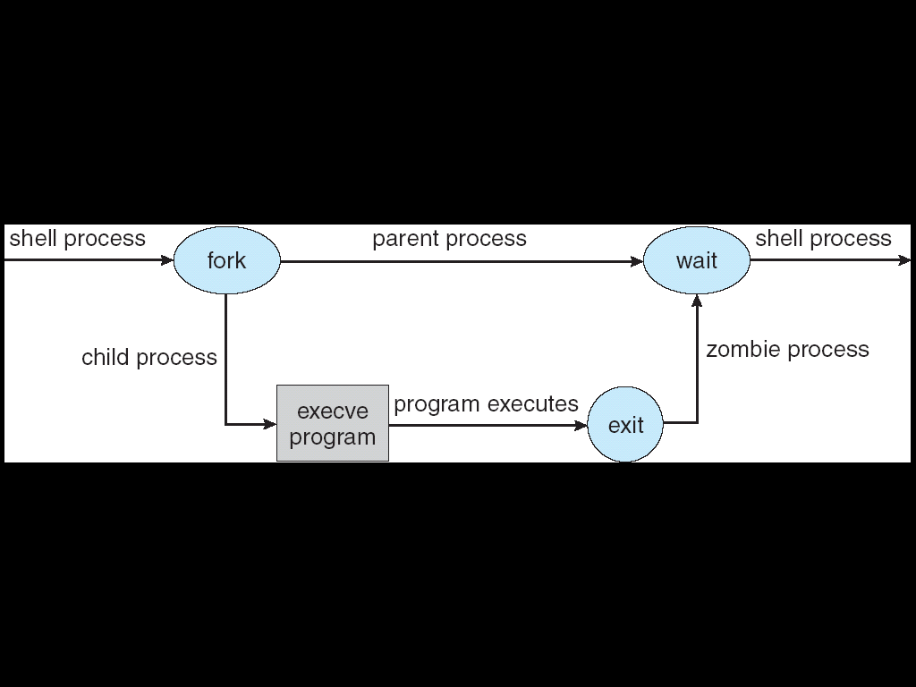
What happens when you type a command in the shell?
Technical explanation :
Plain-English explanation :
Shell process creates a copy of itself so there are now 2 running processes (the original “parent” shell and the new “child” copy of the shell).
The child copy of the shell is overlaid with the binary code representing the command (eg. ls –l) to be run, and this code is then executed.
While the command is executing, the parent shell goes to sleep and waits.
When the command terminates, the parent shell wakes up and resumes its execution (eg. if it is the shell process, it is ready to accept another command again)
Notes:
During the time between the termination of the child and the parent receiving the termination status (by calling the wait system call), the child is a zombie.

Slide 9
Standard Input, Output and Error
Remember, in Unix, everything is a file…
Every time a shell is started, 3 files are opened automatically : stdin, stdout, stderr (a program needs to read and write from a file) File Default Device File Descriptor stdin terminal input 0 stdout terminal output 1 stderr terminal output 2
Notes:
9
In Unix everything is a file, including the terminal and keyboard.
All commands requiring input take it by default from standard input;
ditto for standard output
Input and output can be redirected to usually other file

Slide 10
Output redirection (> symbol)
Unix commands generally send output to stdout
The output can be "redirected" to a file using the symbol >, eg :
$ ls -l /etc/passwd > tempfile
$ cat tempfile
-rw-r--r-- 1 root root 29757 Jul 23 9:05 /etc/passwd
While > overwrites the existing contents of the file, >> will append to the end of the file, eg :
$ ls -l /usr/bin/passwd >> tempfile
$ cat tempfile
-rw-r--r-- 1 root root 29757 Jul 23 9:05 /etc/passwd
-r-s--x--x 1 root root 13044 Jan 6 2001 /usr/bin/passwd
Notes:
10

Slide 11
Input redirection (< symbol)
The symbol < means “take the input for a program from a file instead of from the terminal” (stdout), eg :
$ wc –l (reads from number of lines typed at the
keyboard)
$ wc –l < mynotes (counts the number of lines in the
file “mynotes”)
Another example - display the list of logged-in users in sorted order :
$ who > temp (writes output to “temp”)
$ sort < temp (reads input from “temp”)
this could also be achieved with a single command, using a pipe :
$ who | sort (the 2 commands are connected by a pipe,
hence no temporary file is needed)
Notes:
11

Slide 12
Error Redirection ( 2> symbol)
Any command that produces error messages on stderr can have the messages redirected to another file. Some examples are :
$ cat y $ cat y > file1 This is y
$ cat x y $ cat x y > file2 cat: cannot open x cat: cannot open x This is y
$ cat x y 1> file1 2> file2 $ cat file1 This is y
$ cat file2 cat: cannot open x
What are the contents
of file1 & file2
after these commands?
In this example,
the file y contains “This is y”,
the file x does not exist
Abbreviations :
<0 is the same as <
1> is the same as >
Notes:
12

Slide 13
Be Careful with Output Redirection
Do not use the same file name as an argument to a command AND as the output file destination at the same time. You will not get the correct output file, and you may destroy the original file, eg :
cat f1 f2 > f1
(f1 may end up with the contents of just f2)
The safe way is :
cat f1 f2 > temp
mv temp f1
Result will be highly
unpredictable. Some
Shell may be smart
enough to reject such
a command.
Notes:
cat f1 f2 > f1
- if permitted, the system will open f1 for writing first, emptying its content, then f1 will end up with <empty>+<f2>

Slide 14
Unix Pipes ( | symbol )
Unix pipes allow you to use the output of one command directly as input of another command, ie.
cmd1 | cmd2 | cmd3 | ….. Example:
who | sort | less

Slide 15
Pattern matching (wildcards)
Special characters *, ? and [ ] can be used to abbreviate filenames. The shell then generates the complete filenames.
? matches any single character
* matches any group of characters (except a leading period)
[ ] surrounding a group of characters causes the shell to match filenames containing the individual characters

Slide 16
Pattern matching: Examples
ls amemo mem memo memo.0612 memoa memorandum memosally sallymemo user.memo
ls memo? memoa
ls memo* memo memo.0612 memoa memorandum memosally
ls memo[ar]* memoa memorandum
listing all files in current directory
"filtering" the results using wildcards
Notes:
Discuss echo - echos to standard output
the shell expands ambiguous file references before passing the parameters to echo.

Slide 17
Command Substitution
When a command is enclosed between two grave accent marks (or backquotes or backticks) ( ` ), the shell substitutes it with the output of the command. For instance, the following command :
$ echo there are `ls | wc -l` files in my directory
would output something like:
there are 52 files in my directory
the echo command simply prints its arguments on the terminal
substitutes
Do not confuse the backquote (`) with the single quote (')!

Slide 18
Command Sequences
We can execute several commands in sequence using the “;” operator:
date ; who ; ps -ael
(display today’s date; then displays who is on the system; then find what processes are running. The 3 commands
are not connected.) This is an example of unconditional sequencing.

Slide 19
Metacharacters
The shell has many metacharacters with special meanings – some we have already seen or used :
Metacharacter | Meaning
> | output redirection
< | input redirection
* | wild card : matches zero or more characters
? | wild card : matches any single character
[...] | wild card : matches any single character (from the set of characters within the brackets)
| | Pipe symbol
$ | access the value (ie. content) of a variable
\ | remove the special meaning of the character immediately following the back-slash character
`command` (backquotes) | Command Substitution; the backquotes will be replaced by the output from command (e.g: result=`who -l`)
' ' | remove the special meaning of all characters enclosed by the single quotes
'' '' | remove the special meaning of all characters enclosed by the double quotes, except the ‘$’ and ‘\’ characters

Slide 20
Shell Variables
There are two types of shell variables
local and environment
Some predefined environment variables :
$HOME the full pathname of your home directory
$PATH a list of directories to search for commands
$MAIL the full pathname of your mail box
$USER your user id
$SHELL the full pathname of your login shell
$TERM the type of your terminal
……..
To access the value of a variable, the variable name is preceded by the $ sign, eg :
$ echo Current username is $USER
Current username is andy

Slide 21
Shell Variables
Some shell variables are inherited from the environment; others are created by the shell when it starts up. To view those variables in the bash shell, use the set command:
$ set
HOME=/home/cwilson your home directory PATH=/usr/bin:/usr/sbin: command search path TERM=vt100 terminal type PS1="$ " prompt string 1 PS2="> " prompt string 2 MAIL=/var/mail/you file containing your mail CDPATH=$HOME directory search path
……
Depending of the shell used, some other related commands are :
printenv, setenv
Notes:
CDPATH affects the operation of the CD command. If CDPATH is not set, the CD command assumes the directory to change to is in the pwd. If CDPATH is set the list of directories is searched, and if the required one is on the list it becomes the pwd. usually starts with a colon so that pwd is searched first.

Slide 22
User-defined Variables
Users can define their own "local" variables.
A variable name starts with a letter and contains only alphanumeric characters.
The shell substitutes the value of a variable only when it is preceded by a $, unless there are other special characters
person=alex ← note : do NOT put spaces around the '=' sign
echo person person
echo $person $ echo "$person" alex alex
echo '$person' $ echo \$person $person $person

Slide 23
How does the Shell find commands?
When a command is entered, the shell
first checks whether it is a built-in command
else, checks if the command starts with a / (ie. an absolute path)
if an absolute path is given, shell executes the file as a command
else, searches the directories specified in the environment variable PATH, from left to right, for an executable file that matches the command name
to see the current command search path, type :
echo $PATH
.:/usr/ucb:/bin:/usr/bin (a typical search path)
Note : by default, the path typically does not include the current directory. This often creates slight confusions when the user tries to run a command in the current directory. How would you fix this?

Slide 24
More Sequencing
Conditional sequencing examples :
$ prog1 && prog2
execute prog2 only if prog1 was successful
$ prog1 || echo prog1 failed!!
execute echo only if prog1 returns error (ie. fails)
Every UNIX process terminates with an exit value :
0 means success
non-zero (usually 1) means failure
The variable that contains the last exit value is ?. Hence $? will contain the exit value of the last command executed.

Slide 25
Background Processing
Normally, when you give a command, the shell creates a process to execute that command, and sleeps until the command execution is finished (ie. the user does not get the command prompt back until then).
In many cases it is very useful to run commands in background and continue with other tasks, especially if those background tasks take a long time to complete.

Slide 26
Background Processing
If a command is followed by a &, the shell puts that command in the background, and returns immediately to accept the next command, eg :
find / -name ‘*.txt’ -print > alltxtfile &
(find all files with extension .txt, starting from the root directory and within all subdirectories, then save the output to alltxtfile – and doing all that in the background)

Slide 27
Job Control Examples
$ cc myNeverEndingProgram.c
^z (control-z) suspends the job (process)
$ bg puts the current suspended job in the background
$ date executes another command (now that we have control of the terminal back)
Sun Sep 14 20:32:56 EST 2014
$ fg brings the last background job (the lengthy compiler job)
back to the foreground
“cc” is the Unix C compiler
“bg” is the Unix “background” command
“fg” is the Unix “foreground” command

Slide 28
Job Control Examples
$ cc assign1.c & runs 3 compilation jobs in background
$ cc assign2.c &
$ cc assign3.c &
$ jobs lists all your jobs (the 3 compiler jobs above)
that were running in the background

Slide 29
Job Control Examples
$ jobs -l lists the jobs that belongs to the user
[1] 23456 cc assign1.c
[2] 13234 cc assign2.c
[3] 34533 cc assign3.c
$ fg %2 brings the second job (compiling assign2.c)
into the foreground. This means that this job will again run interactively on the
terminal.
Note that you can refer to the process by its process-id or by the job number. In the latter, prefix the job number with a % (like the example shown above).

Slide 30
Filters
A “filter” is typically a command that reads the output from one program (or standard input or a file) and produces some standard output
It filters (based on the program) the contents of its input stream
It sends its results to standard output, but never modifies the input stream or file
Output results may be further processed by another filter
Examples of some common filters:
sort - sort on specified fields
wc - count lines, words and characters
grep - search files for a pattern (see also lecture on regular expressions)
tr - translate specified characters

Slide 31
Examples
ls /etc | grep conf | wc –l list all the files in /etc, then search for the string conf, then count lines
ls –l /etc | grep ^d | sort –r > /tmp/directories list the files in /etc in long format, then search for strings beginning with d, then sort in reverse alphabetic order,
then saves the output to /tmp/directories

Slide 32
tee - Send output to a file and stdout
Syntax: tee [-a] file-list
who | tee unsortedusers | sort
who | tee unsortedusers | sort | tee sortedusers
tee is commonly used in 2 circumstances:
to collect intermediate output in pipeline
to send final output of a command to the screen and a file
Eg :
stdin ➔
➔ stdout
tee
➔
file

