Slide 1
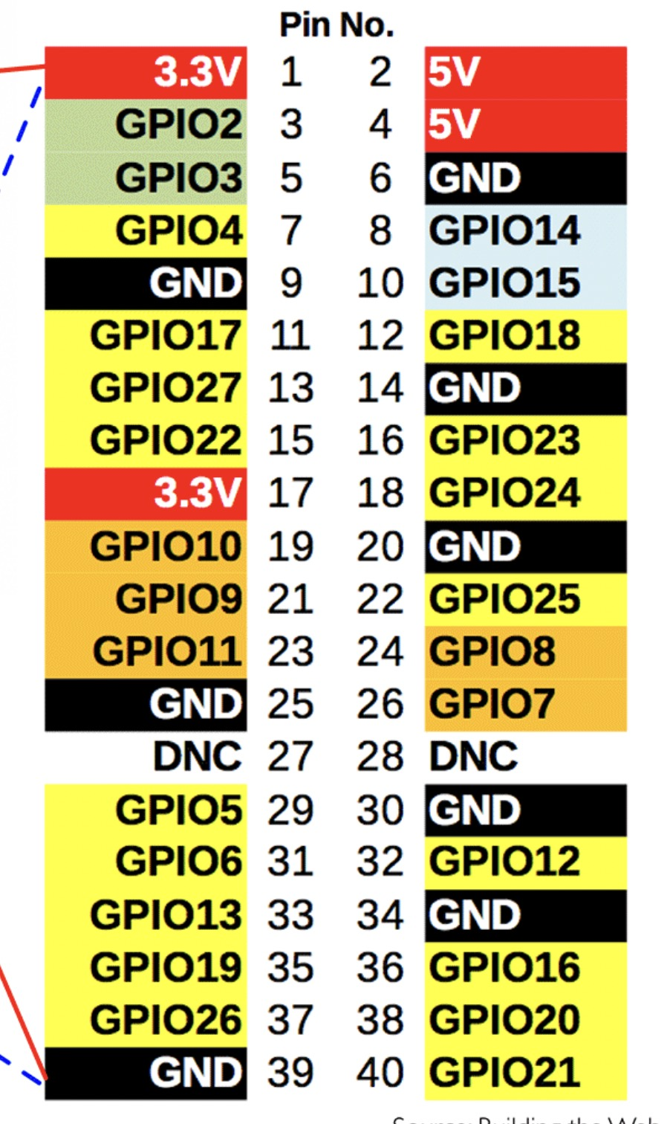
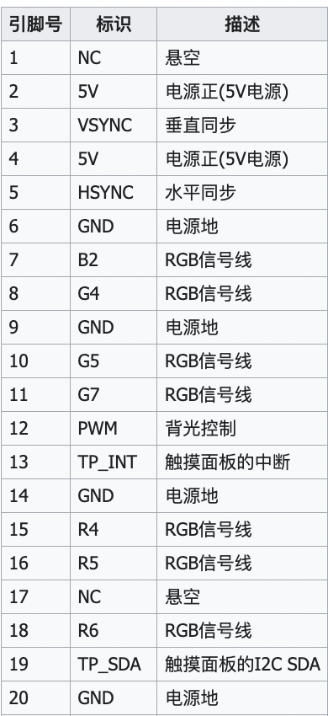
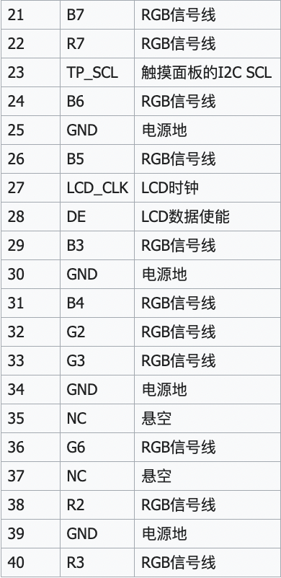
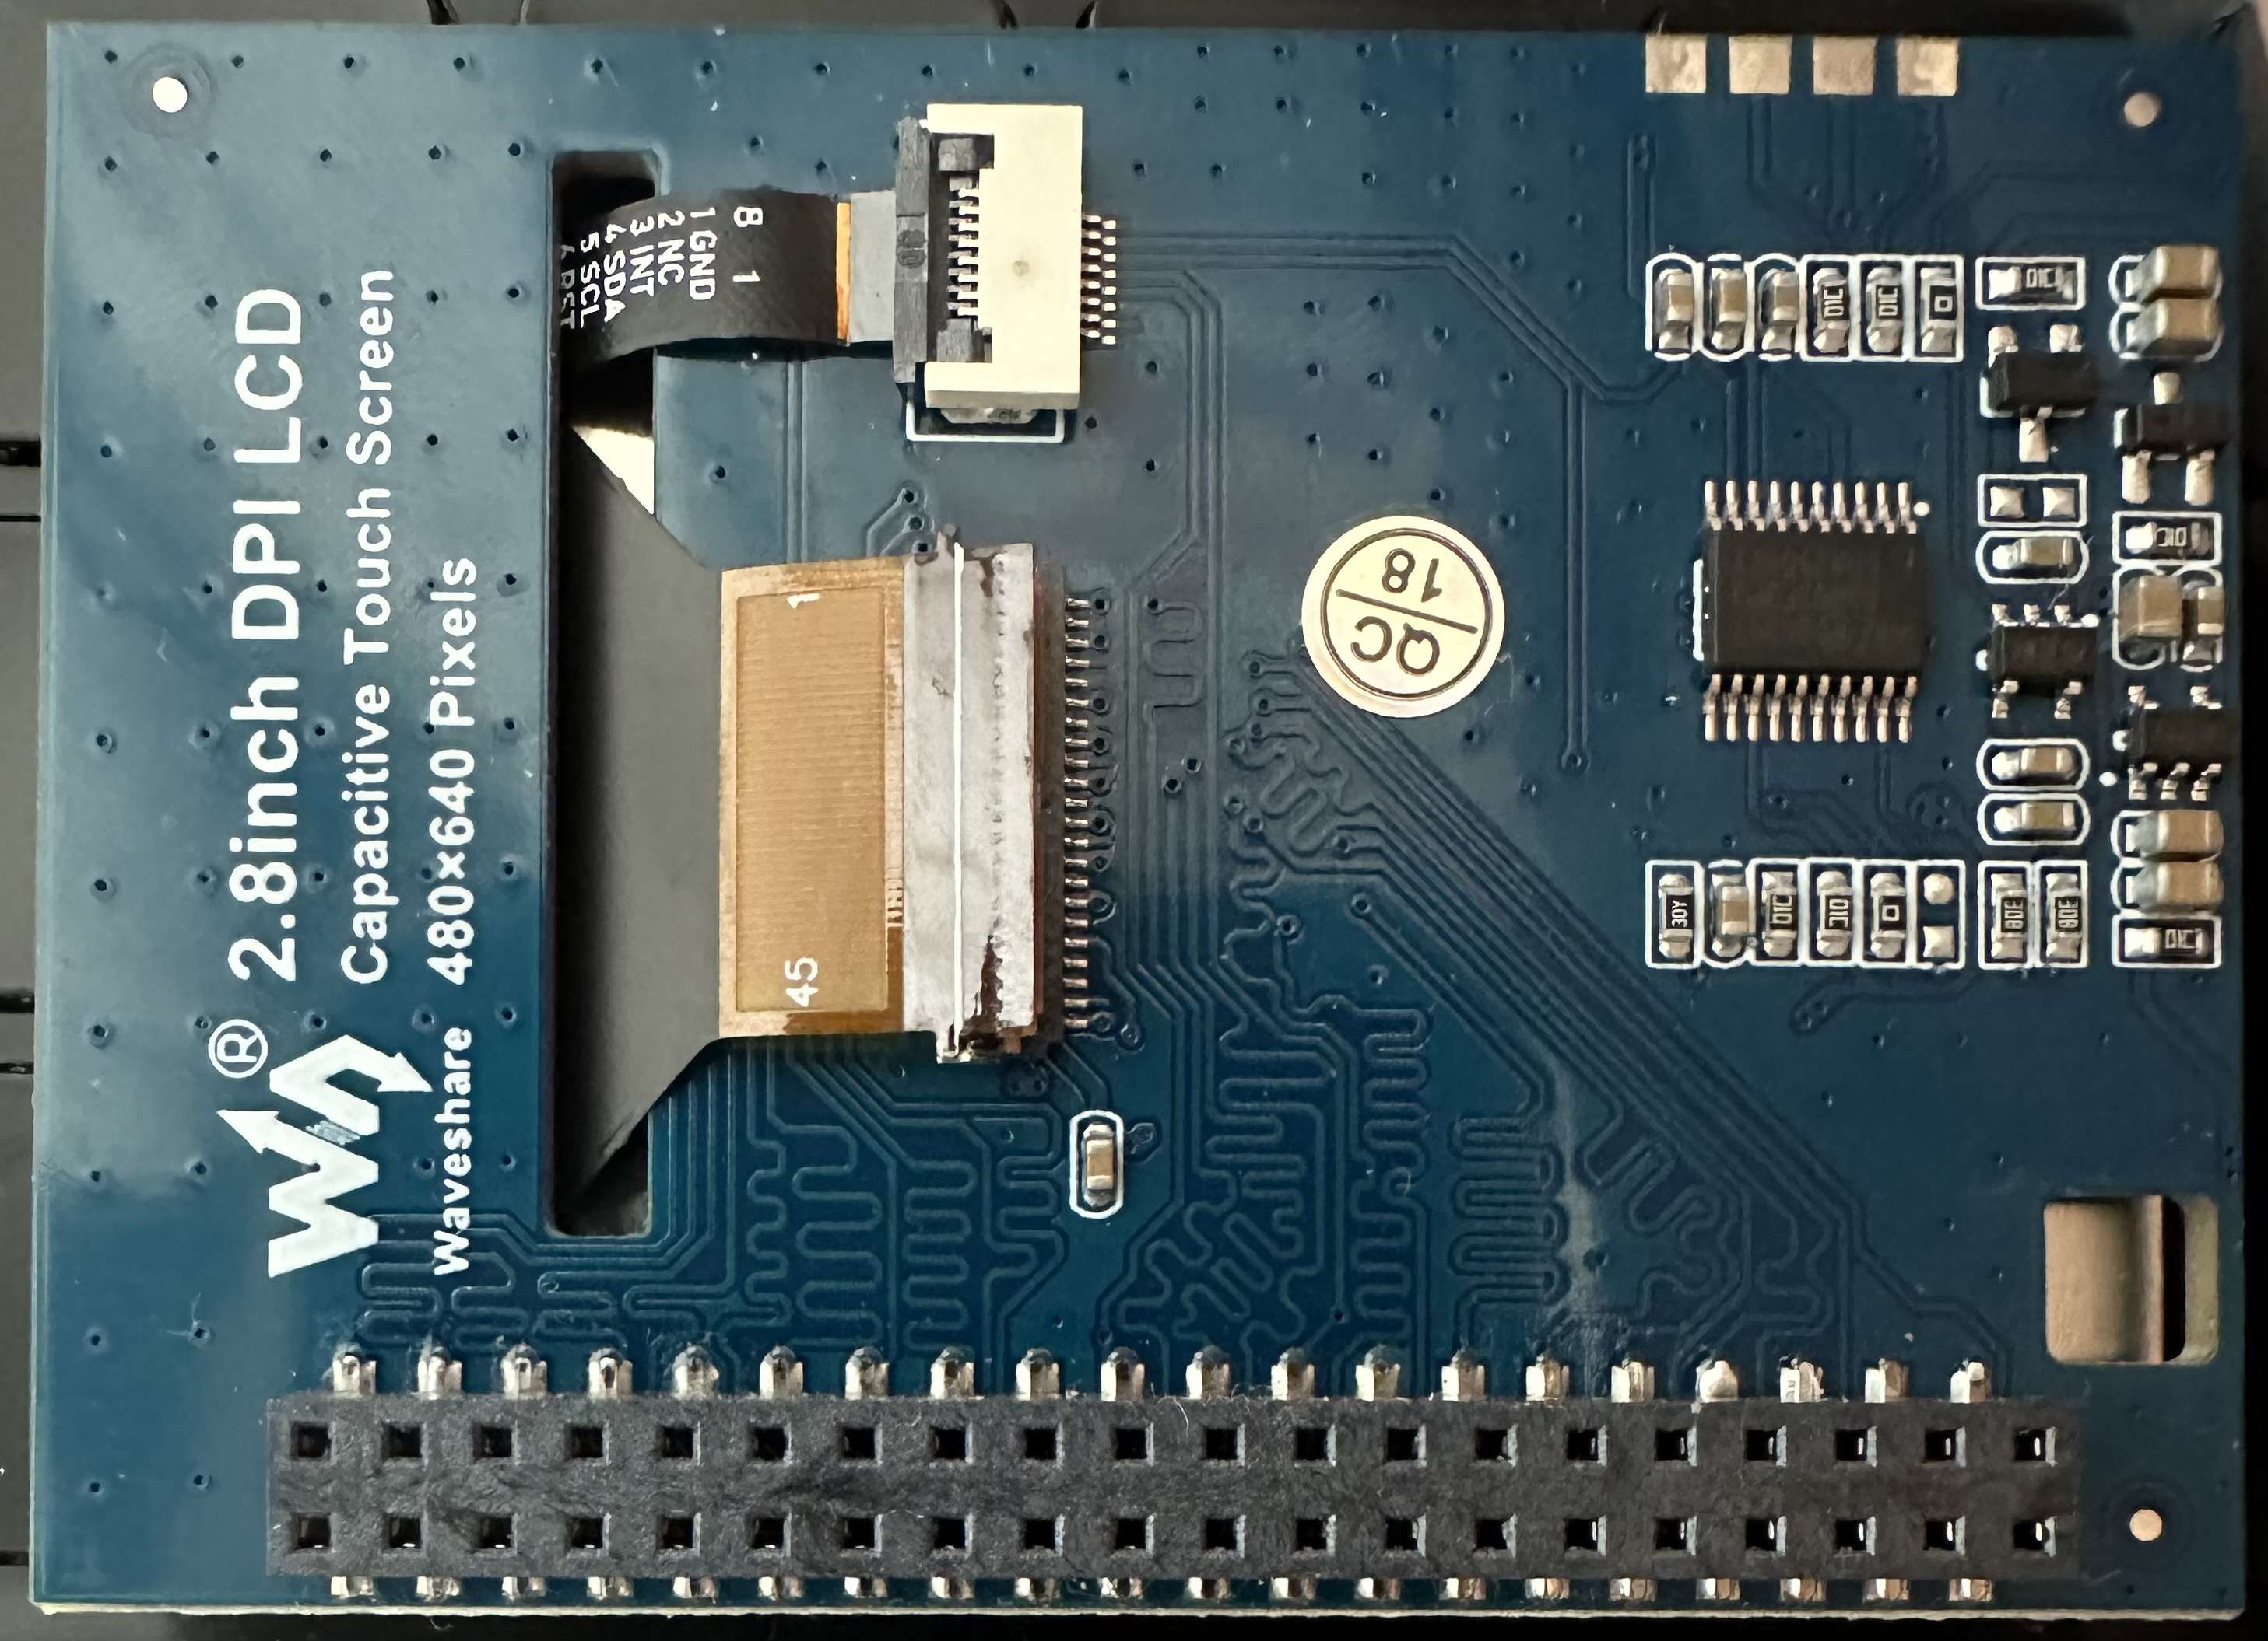
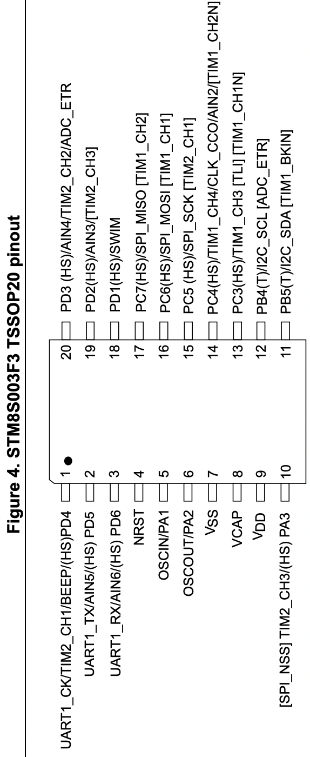
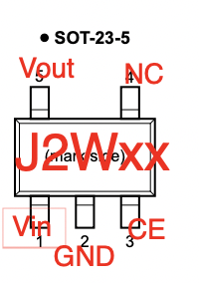
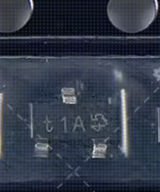
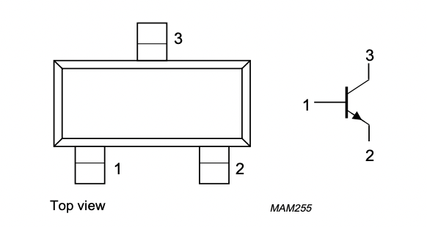
R3
R2
G6
G2
DE
B5
B6
R7
R6
R5
PWM
G5
G4
GND
5V
5V
G3
B4
B3
LCD_CLK
TP_SCL
B7
TP_SDA
R4
TP_INT
G7
B2
HSYNC
VSYNC
3V3/NC
44: GND+2R
42: NC
40: 3V3
38: 3V3
36: TP_RST?
34: HSYNC
32: LCD_PCLK
30: CS
28: GND+2R
26: B1?
24: B3
22: B5
20: B7
18: G0?
16: G2
14: G4
12: G6
10: GND
8: R1?
6: R3
4: R5
2: R7
45: LED
43: NC
41: NC
39: 3V3
37: 3V3
35: VSYNC
33: DE
31: SCLK
29: MOSI
27: B0?
25: B2
23: B4
21: B6
19: GND
17: G1?
15: G3
13: G5
11: G7
9: R0?
7: R2
5: R4
3: R6
1: GND
CE1
10K
5V
VSYNC
3V3
TP_RST
TP_RST
GND+2R
GND
5V
2K
2K
PD2
10K
10K
GND
2R
GND
5V
VSYNC
VSYNC
3V3
GND
CE1
G
5V
LED3.3
GND
GND
NC2
19: PD2
13: VSYNC
J2WK
LED3.3
NC2
18: SWIM
NC1?
3V3
NC1?
3V3
J2WK
STM8S003F3
GND
GND
VIN?
GND
绿色1 MOSI 静止后0V
黄色5 SCLK 静止后3.3V
紫色2 CS 静止后3.3V
10K
VIN?
GND
T1A 30
PMBT3904
NPN
1?
5V
2: CS
4:RST
1?
1: MOSI
5: SCLK
7: GND
9: 3V3
平时3.3
开机1.6
平时3.3
平时0
RST
3V3
3V3
GND
NC
INT
SDA
SCL
TP_RST
VCC
GND
5V
GND
2?
5V
PWM
PWM
3V3
5V
GND
2?
10K
5V
10K
10K
PWM
3V3
RST?
GND
GND
GND
3V3
SWIM
RST
GND

