Slide 1
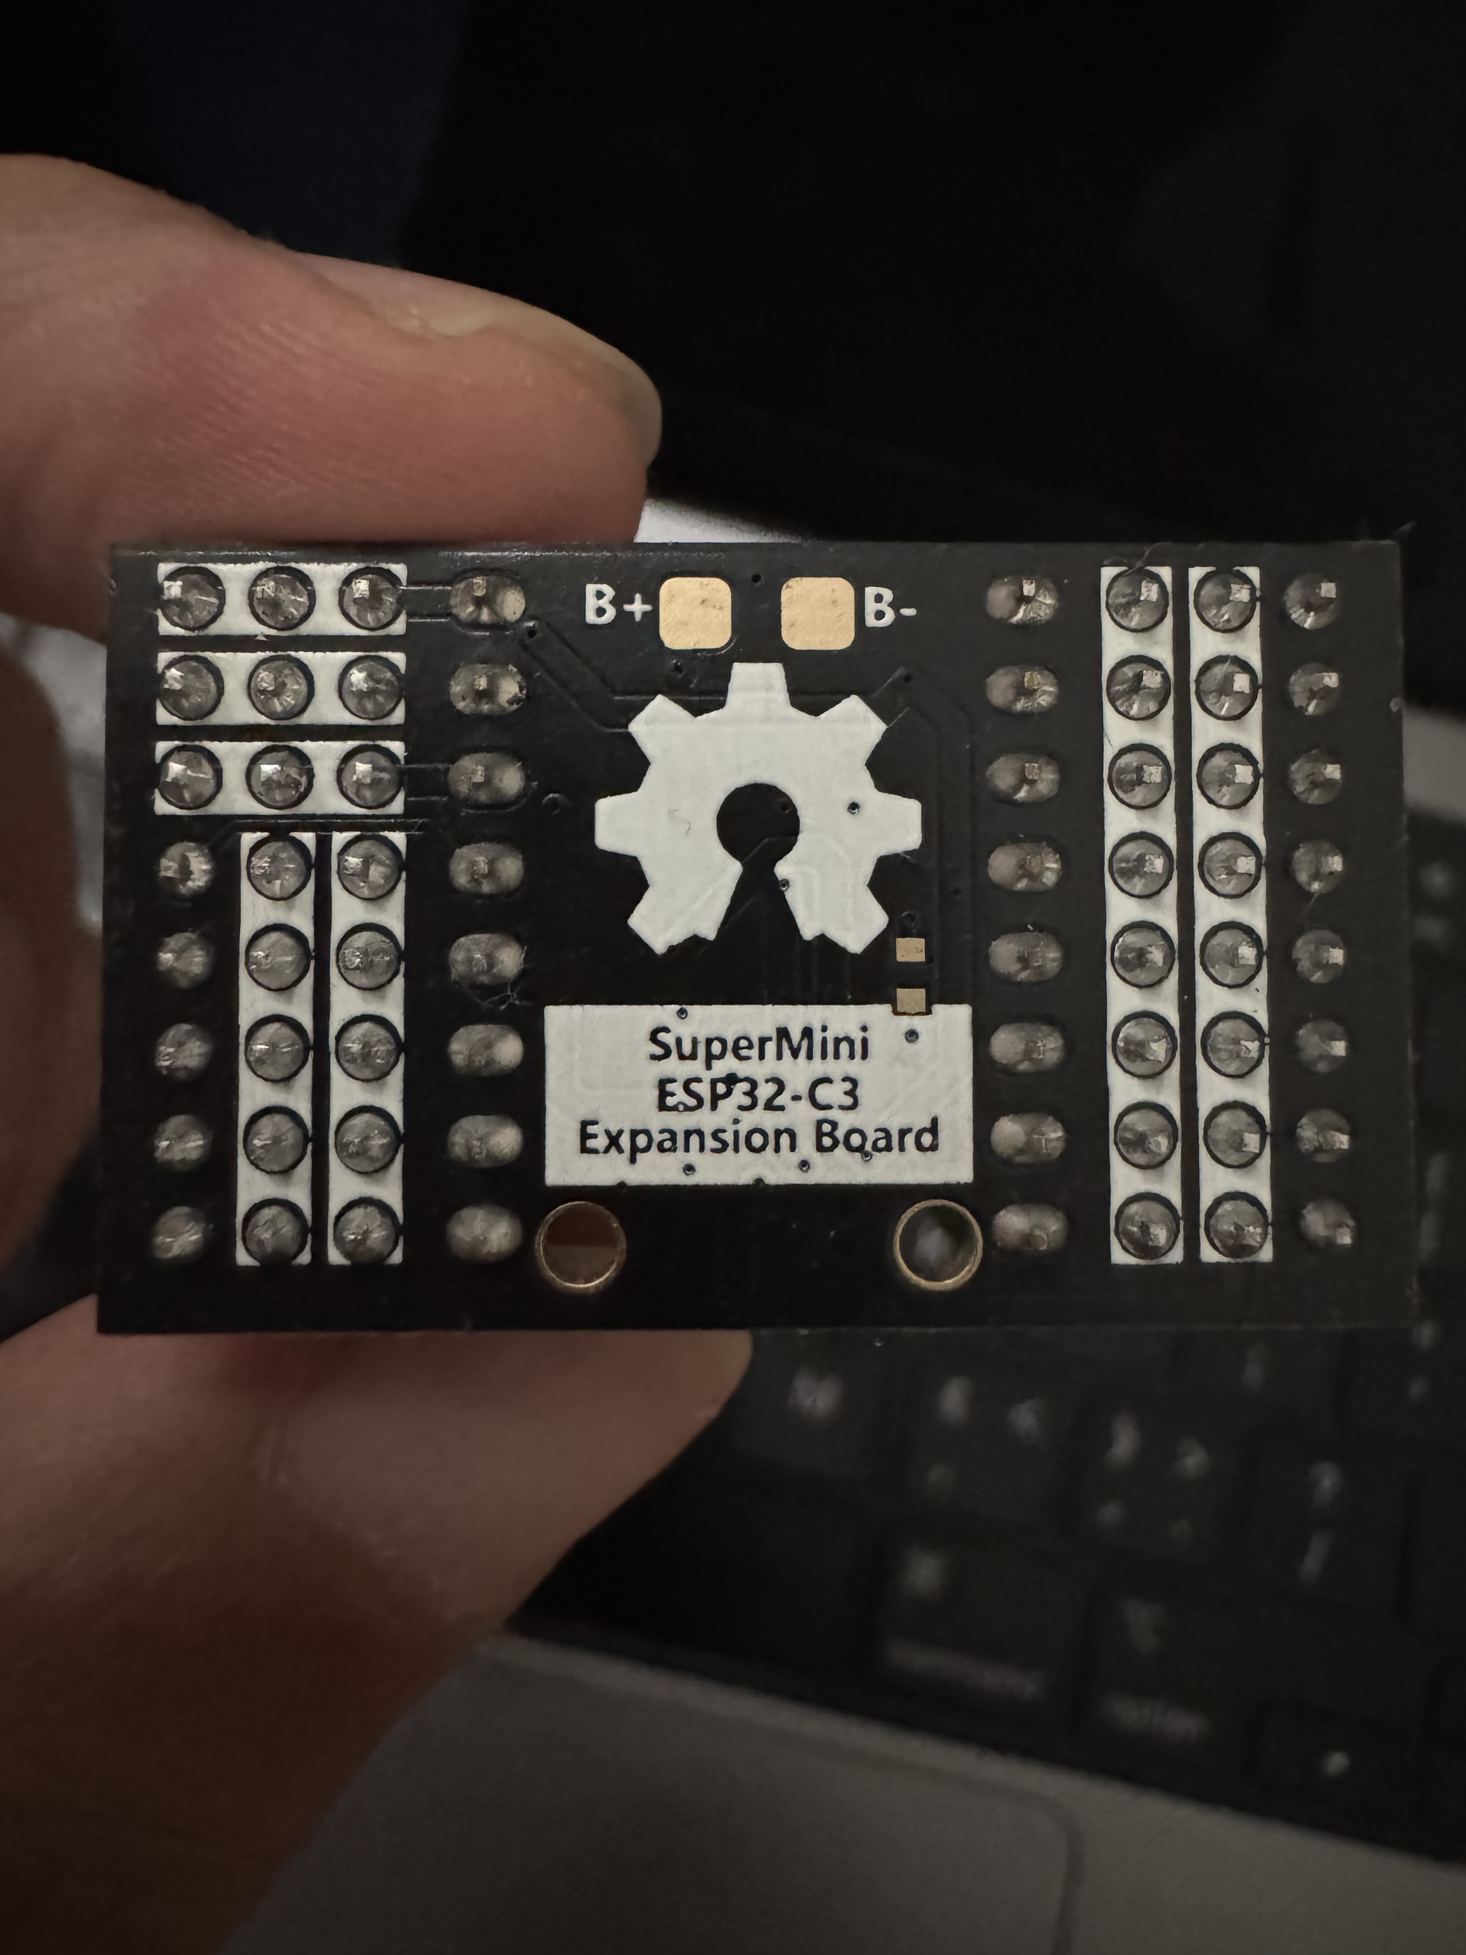
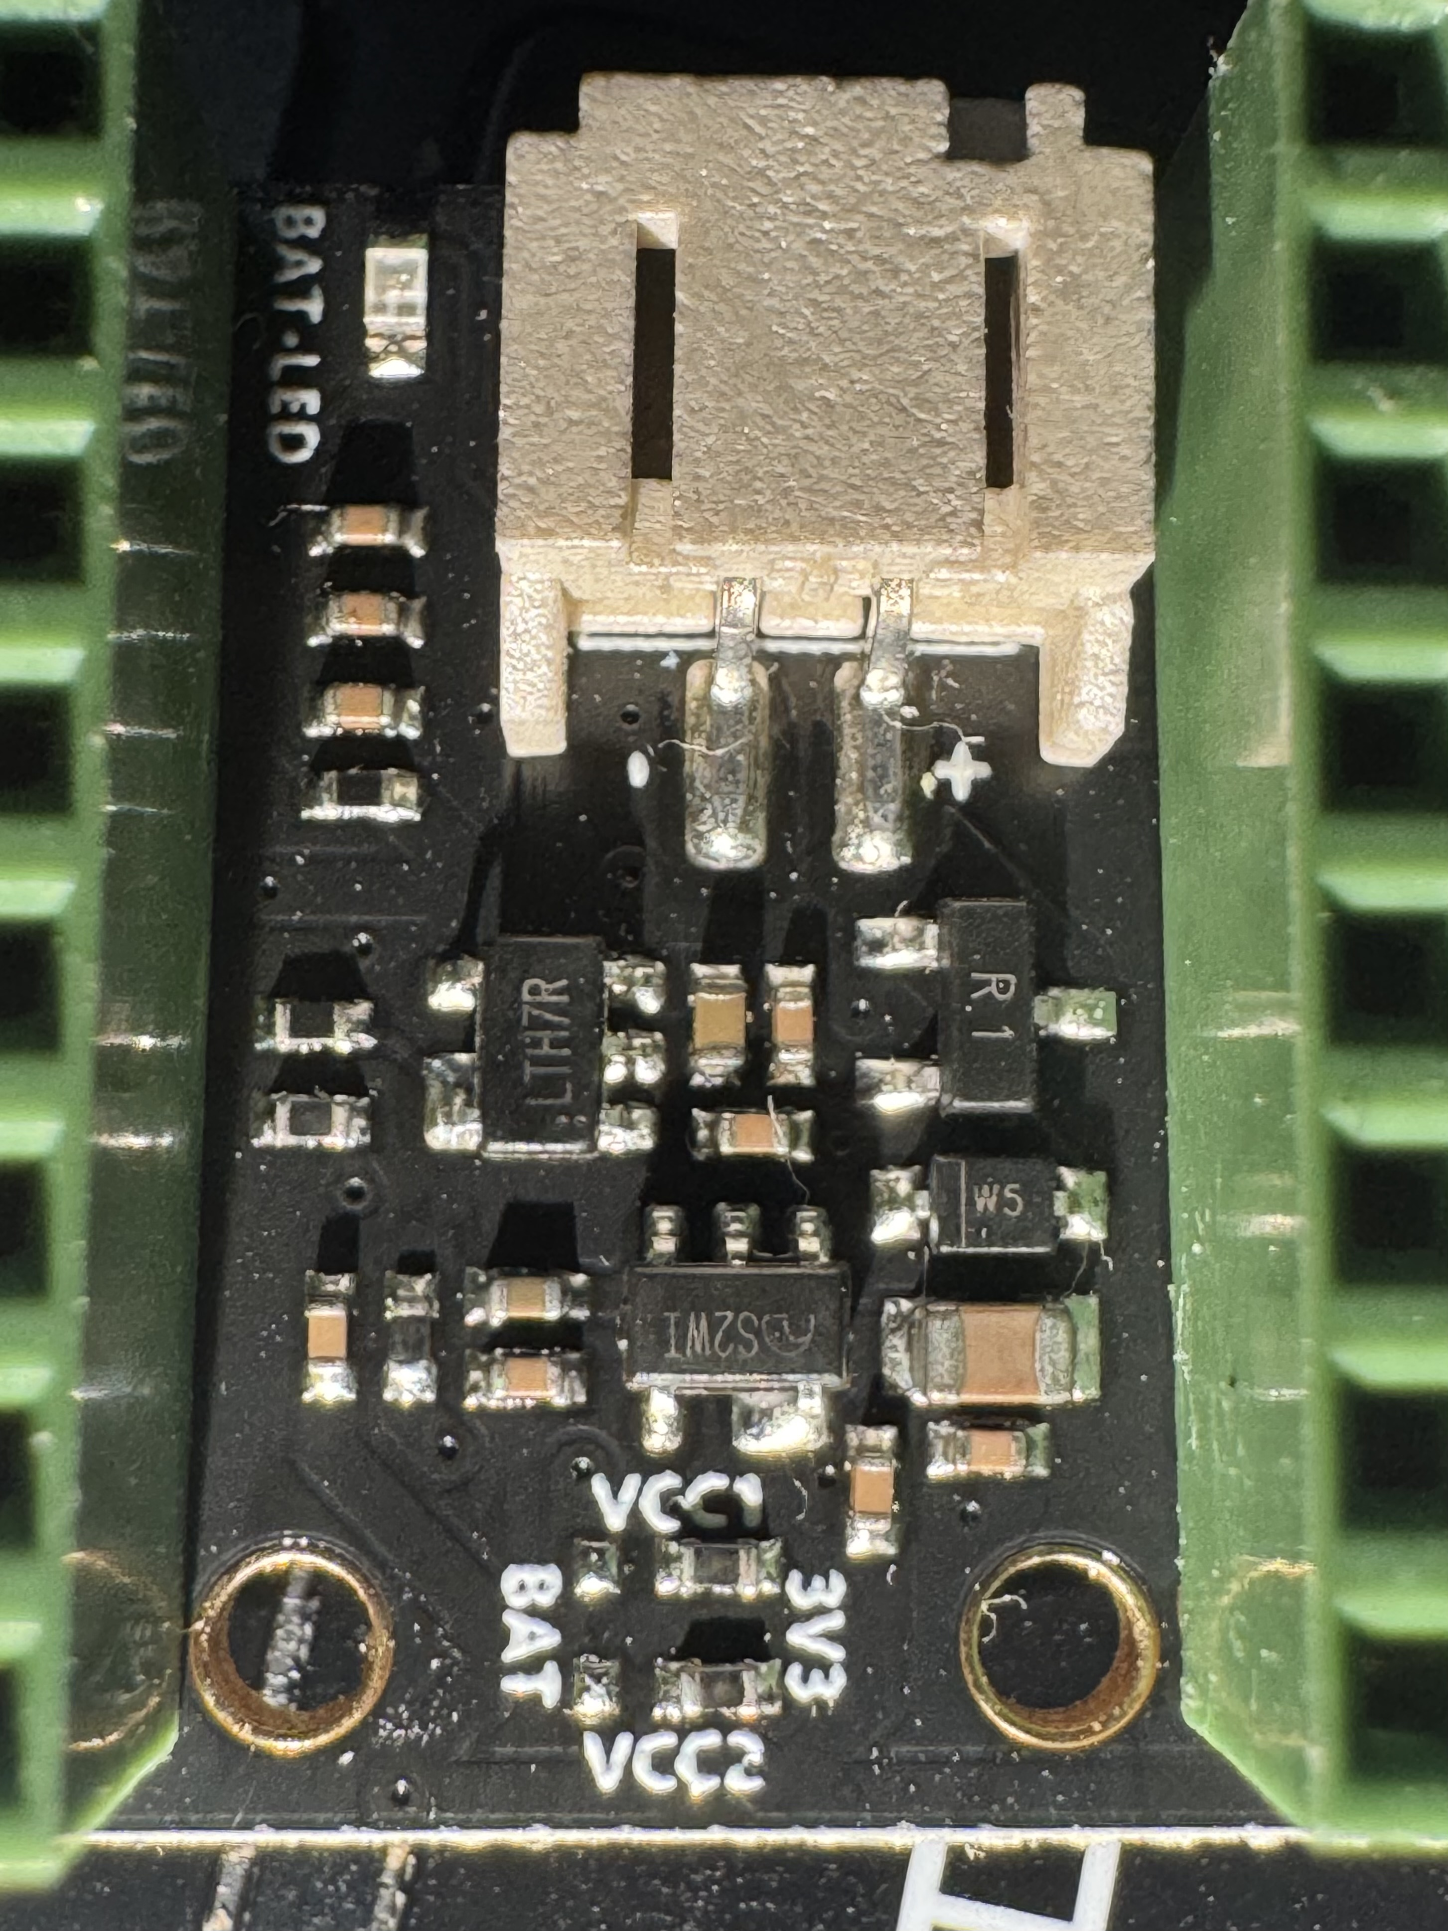
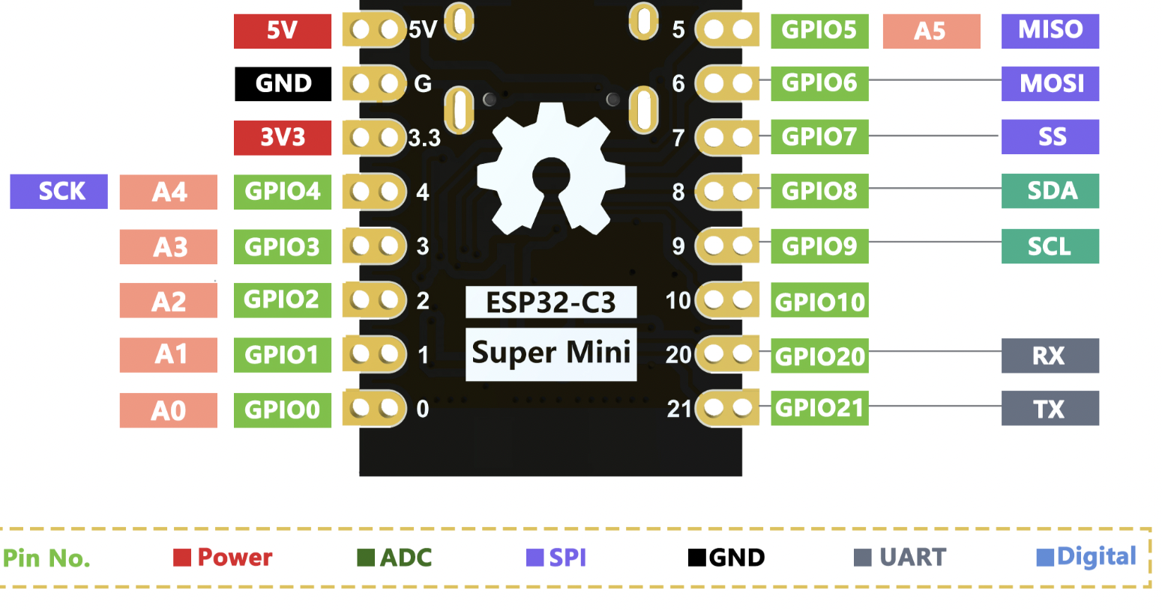
3V3
0Ω
3V3
VBAT
3V3
0Ω
3V3
VBAT
3V3
PROG
GND
3V3
GND
3V3
NC
PROG2
GND
3V3
VSYS
GND
5V
3V3
ME6211C33M5G
GND
10KΩ
VSYS
GND
GND
5V
VSYS
GND
VSYS/EN
VSYS
1.5KΩ
5V
GND
CHG
PROG
PROG2
GND
VSYS
GND
GND
GND
VBAT
PMOS
PROG
GND
VBAT
VBAT
VBAT
5V
10KΩ
5V
锂电池充电
充电电流100mA+，在PCB背面短接，可增加到500mA+
1KΩ
VBAT
GND
5V
LEDA
GND
5V
GND
5V
3V3
GND
5V
LEDA
GND
CHG
5V

Slide 2
