Slide 1
Adventure Science Center Project Update #1
Date: 7/11/22
Lana cartailler

Slide 2
Completed Goals
Created several drafts of choropleth maps using county data
Used population counts in one of the maps

Slide 3
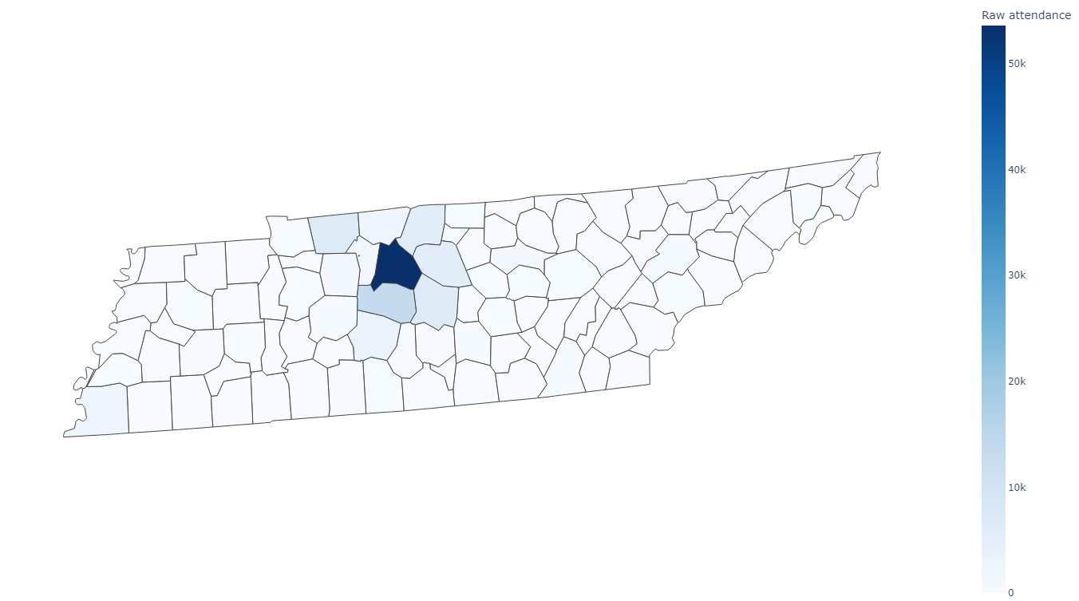
Attendance visualization #1
Map shows Adventure Science Center attendance numbers initially provided
It does not show much attendance from counties other than Davidson
We can adjust color scale if using the attendance numbers is preferred (make darker hues)
Notes:
Can change legend to include ranges (0, 0-1, 1-2, etc)
Doesn’t show much attendance from rural counties; wouldn’t be effective at convincing legislators from those counties to fund ASC

Slide 4
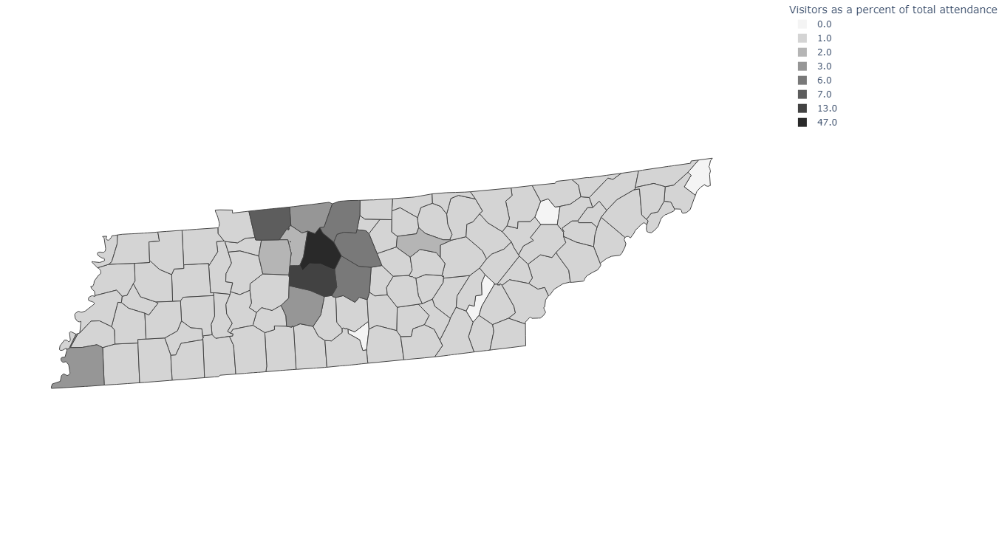
Attendance visualization #2
Map shows Adventure Science Center visitors from each county as a percent of the total attendance
Rounded up percent values to nearest whole number
By rounding up, most counties are now colored, and Davidson no longer appears to be the dominant county
Notes:
Can change legend to include ranges (0, 0-1, 1-2, etc)

Slide 5
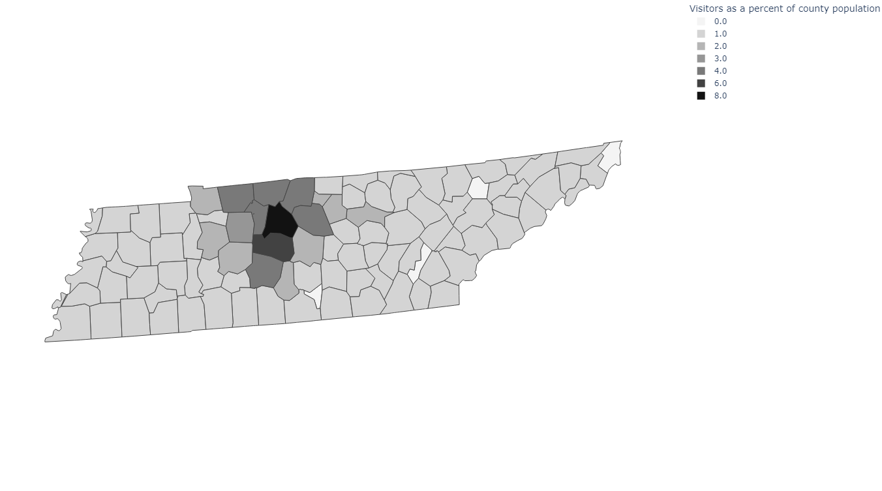
Attendance visualization #3
Map shows Adventure Science Center visitors from each county as a percent of that county’s population
This effectively normalizes the attendance such that it can be compared across counties
Also rounded up percent values to nearest whole number
Suggests that distance might be a factor in attendance
Notes:
Obtained county population from online source

Slide 6
Online Version
Notes:
Have online map w/ tool tips pulled up

Slide 7
Next Steps and Questions
Is it okay for the data to be publicly available online?
What colors are preferred? (A single-color gradient with white might be best according to data)
If #2 and #3 are preferred, would you prefer to keep the rounded whole numbers in the legend or have a range (e.g. 1.0 < x < 2.0 instead of 2.0)?
When will the final data set be available?
What date will final print-friendly plot be needed?

