Slide 1



Mutual_fund_dashboard
View in Power BI
Last data refresh:
12/22/2025 8:31:36 PM UTC
Downloaded at:
12/22/2025 8:33:37 PM UTC

Slide 2
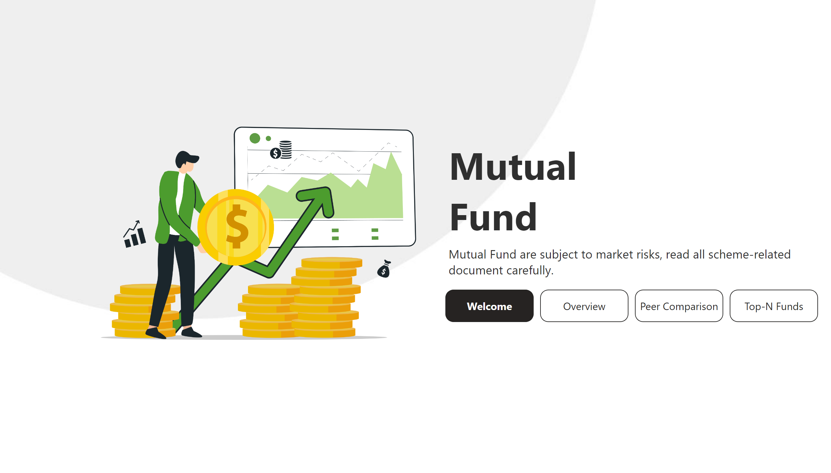
Welcome
Notes:
image
No alt text provided
textbox
No alt text provided
textbox
No alt text provided
pageNavigator
No alt text provided

Slide 3
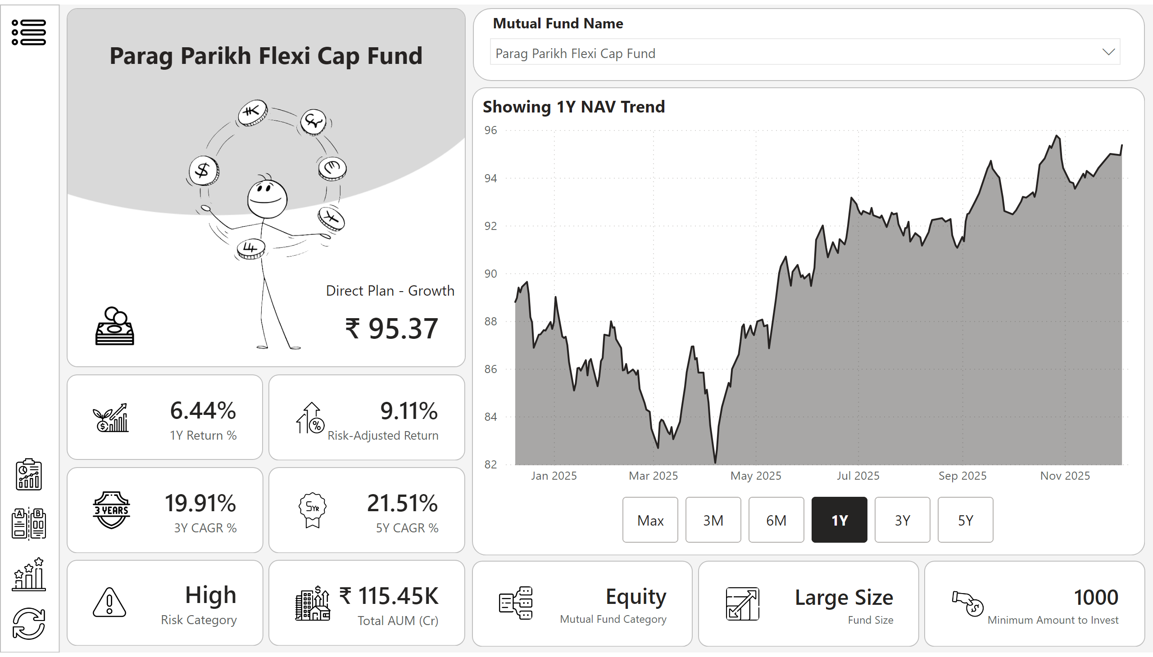
Overview
Notes:
cardVisual
No alt text provided
Showing 1Y NAV Trend
No alt text provided
advancedSlicerVisual
No alt text provided
shape
No alt text provided
image
No alt text provided
shape
No alt text provided
image
No alt text provided
shape
No alt text provided
cardVisual
No alt text provided
shape
No alt text provided
cardVisual
No alt text provided
slicer
No alt text provided
shape
No alt text provided
shape
No alt text provided
shape
No alt text provided
shape
No alt text provided
shape
No alt text provided
shape
No alt text provided
shape
No alt text provided
shape
No alt text provided
cardVisual
No alt text provided
cardVisual
No alt text provided
cardVisual
No alt text provided
cardVisual
No alt text provided
cardVisual
No alt text provided
shape
No alt text provided
shape
No alt text provided
cardVisual
No alt text provided
cardVisual
No alt text provided
image
No alt text provided
image
No alt text provided
image
No alt text provided
image
No alt text provided
image
No alt text provided

Slide 4
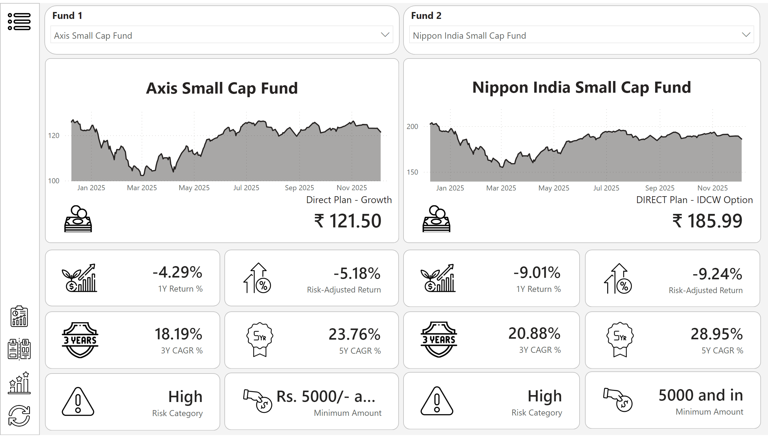
Peer Comparison
Notes:
cardVisual
No alt text provided
shape
No alt text provided
image
No alt text provided
shape
No alt text provided
image
No alt text provided
shape
No alt text provided
cardVisual
No alt text provided
slicer
No alt text provided
shape
No alt text provided
shape
No alt text provided
shape
No alt text provided
shape
No alt text provided
shape
No alt text provided
shape
No alt text provided
shape
No alt text provided
cardVisual
No alt text provided
cardVisual
No alt text provided
cardVisual
No alt text provided
cardVisual
No alt text provided
cardVisual
No alt text provided
shape
No alt text provided
slicer
No alt text provided
cardVisual
No alt text provided
shape
No alt text provided
shape
No alt text provided
cardVisual
No alt text provided
cardVisual
No alt text provided
cardVisual
No alt text provided
cardVisual
No alt text provided
cardVisual
No alt text provided
cardVisual
No alt text provided
Showing 1 Year NAV Trend
No alt text provided
Showing 1 Year NAV Trend
No alt text provided
shape
No alt text provided
shape
No alt text provided
shape
No alt text provided
shape
No alt text provided
shape
No alt text provided
shape
No alt text provided
shape
No alt text provided
shape
No alt text provided
image
No alt text provided
image
No alt text provided
image
No alt text provided

Slide 5
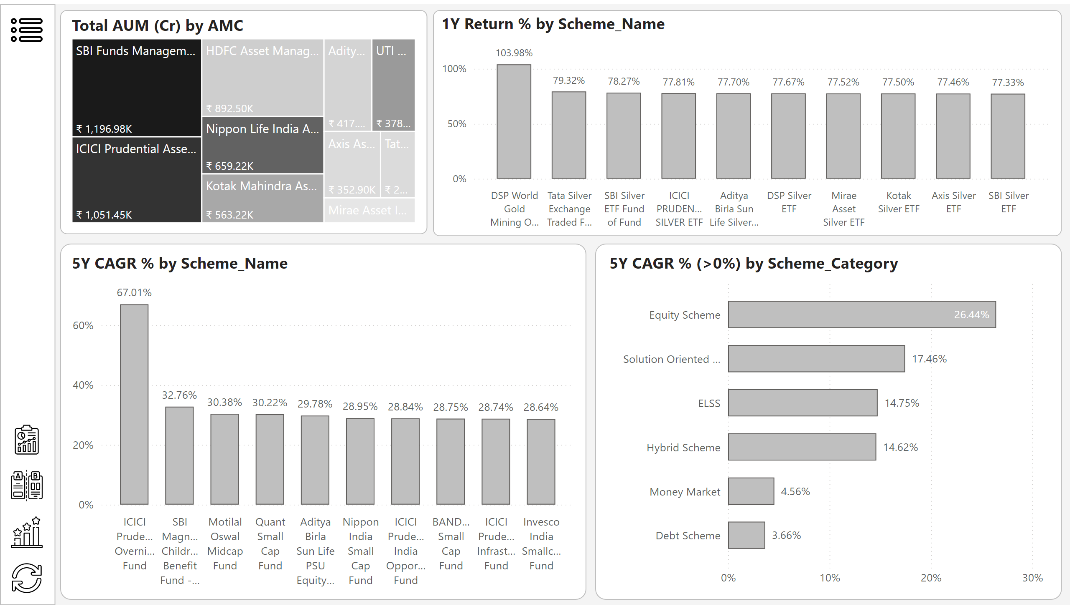
Top-N Funds
Notes:
shape
No alt text provided
image
No alt text provided
image
No alt text provided
shape
No alt text provided
columnChart
No alt text provided
columnChart
No alt text provided
shape
No alt text provided
shape
No alt text provided
5Y CAGR % (>0%) by Scheme_Category
No alt text provided
shape
No alt text provided
treemap
No alt text provided
image
No alt text provided
image
No alt text provided
image
No alt text provided

