Slide 1

Alliance : Cold War Conflict
Oral Status Report #1
By Bryce Wiedower

Slide 2


Work Analysis
Nailed Down Project Theme & Story board
Mapped out most of the UI
Got a graphics consultant!
Determined all graphics needed

Slide 3
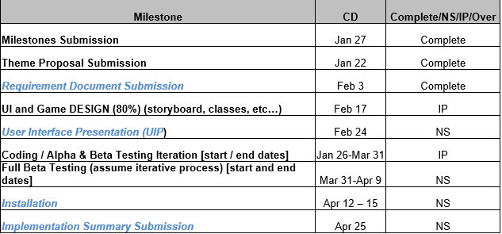
Milestones

Slide 4
Development highlights
Nailing down our theme
Completed game workflow
Game board design almost complete

Slide 5
Development lowlights
Unity learning curve is steep (ML agents & in general)
Development starting off slow as we learn the technologies
Delay in getting graphics started because of us getting a consultant late

Slide 6
Development statistics
File Type | File Count
.cs | 10
.prefab | 29
.png | 3
.docx | 10
Total | 52
Size | 1,941 KB

Slide 7
Progress report

Slide 8
Questions??

