Slide 1

Alliance : Cold War Conflict
Oral Status Report #2
By George Cook

Slide 2


Work Analysis
Got a music consultant
Set up training environment
Game Core mostly functional
Made our first install

Slide 3
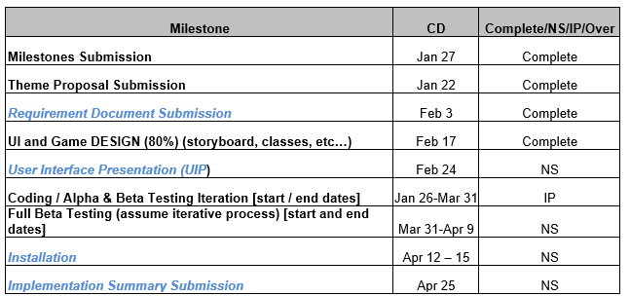
Milestones

Slide 4
Development highlights
Reached 80% milestone on time
Better group understanding of the whole project
Found a music consultant
ML environment set up for training

Slide 5
Development lowlights
Busy with seminar papers/presentations
AI and UI not integrated with the Game Core
Unsure how to configure the neural network

Slide 6
Development statistics
File Type | File Count
.cs | 19
.prefab | 103
.png | 11
.docx | 21
.jpeg | 2
.unity | 3
.yaml | 1
Total | 160
Size | 208,231 KB

Slide 7
Progress report

Slide 8
Questions??

