Slide 1

Alliance : Cold War Conflict
Oral Status Report #3
By Andrew Mock

Slide 2


Work Analysis
Integrated remainder of the rules in the game core
Can play a complete game against AI
Successfully installing multiple times a week

Slide 3
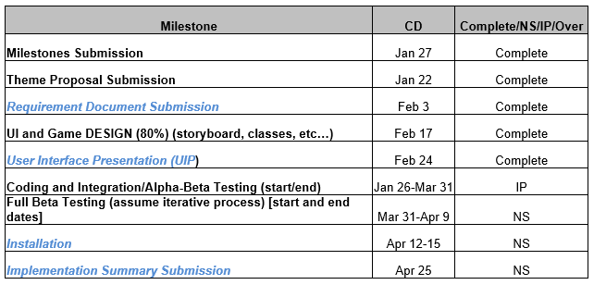
Milestones

Slide 4
Development highlights
Completed UIP
Can now play a complete game with AI
Received and integrated main music

Slide 5
Development lowlights
Busy with seminar papers/presentations
Didn’t have a completely playable game for UIP
Elusive bugs in game core that are hard to reproduce
Difficulty in training the AI

Slide 6
Development statistics
File Type | File Count
.cs | 17
.prefab | 103
.png | 13
.docx | 28
.jpeg | 2
.unity | 4
.yaml | 1
.mp3 | 3
Total | 163
Size | 214,634 KB

Slide 7
Progress report

Slide 8
Questions??

