Slide 1

Alliance : Cold War Conflict
Oral Status Report #4
By Andrew Mock

Slide 2
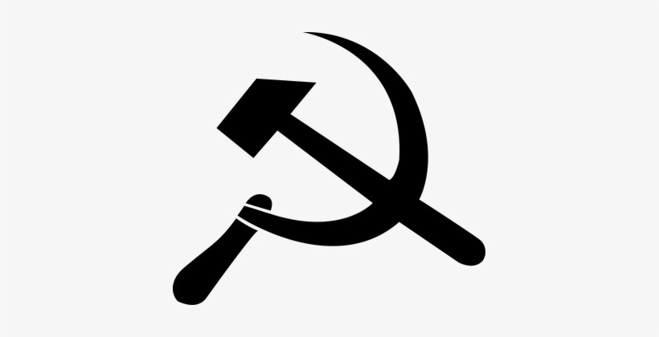

Work Analysis
Fine tuning of graphics and UI
Training of AI
Development of

Slide 3
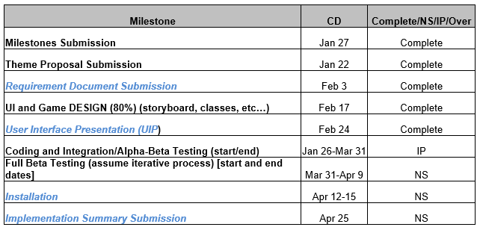
Milestones

Slide 4
Development highlights
Neural network is running and now being trained
All team members will be done with their seminars
Have the functionality for all the help features finished

Slide 5
Development lowlights
Unable to play a game over the network
Seminar taking time away from development over the last few weeks

Slide 6
Development statistics
File Type | File Count
.cs | 20
.prefab | 83
.png | 15
.docx | 34
.jpeg | 2
.unity | 4
.yaml | 1
.mp3 | 3
Total | 162
Size | 23089 KB

Slide 7
Progress report

Slide 8
Questions??

