Slide 1

Alliance : Cold War Conflict
Oral Status Report #5
By Mary Yukich

Slide 2
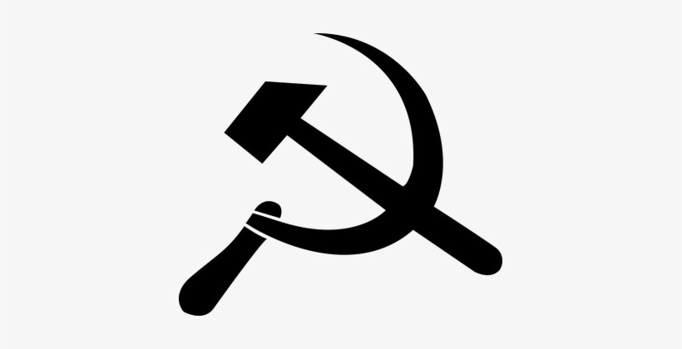

Work Analysis
Integrated Networking component
Added sound effects
Added Intro scene
Started Beta Testing
Refining UI

Slide 3
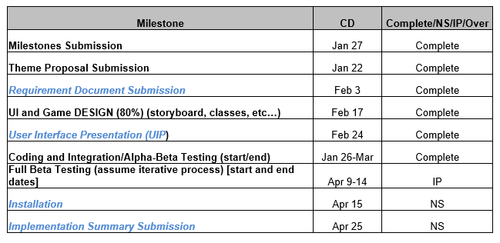
Milestones

Slide 4
Development highlights
Can play game to completion across the network
Receiving helpful feedback from Beta Testers

Slide 5
Development lowlights
Continued difficulty in training the AI
Delay in implementing final graphics and animations

Slide 6
Development statistics
File Type | File Count
.cs | 23
.prefab | 85
.png | 35
.docx | 34
.jpeg | 3
.unity | 4
.yaml | 1
.mp3 | 19
Total | 204
Size | 24,277 KB

Slide 7
Progress report

Slide 8
Questions??

