Slide 1
Python-String and Lists
Feb 10, 2012
Eman Ghobrial

Slide 2
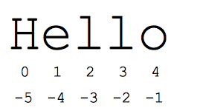
Slicing valid for both Strings and Lists
Indexes
Slices
S = ‘Hello’
First char => S[0]=‘H’
Last char => S[-1] = ‘o’
All but first =>S[1:]=‘ello’
First two S[:2]=‘He’
Last three S[-3:]=‘llo’
All but first and last char S[1:-1]=‘ell’

Slide 3
String Methods
Function Name | What it does?
s.lower(), s.upper() | returns the lowercase or uppercase version of the string
s.strip() | returns a string with whitespace removed from the start and end
s.isalpha()/s.isdigit()/s.isspace(). | tests if all the string chars are in the various character classes
s.startswith('other'), s.endswith('other') | tests if the string starts or ends with the given other string
s.find('other') | searches for the given other string (not a regular expression) within s, and returns the first index where it begins or -1 if not found
s.replace('old', 'new') | returns a string where all occurrences of 'old' have been replaced by 'new’
s.split('delim') | - returns a list of substrings separated by the given delimiter. The delimiter is not a regular expression, it's just text. 'aaa,bbb,ccc'.split(',') -> ['aaa', 'bbb', 'ccc']. As a convenient special case s.split() (with no arguments) splits on all whitespace chars.
-s.join(list) | opposite of split(), joins the elements in the given list together using the string as the delimiter. e.g. '---'.join(['aaa', 'bbb', 'ccc']) -> aaa---bbb---ccc

Slide 4
List Methods
Function Name | What it does?
list.append(elem) | adds a single element to the end of the list. Common error: does not return the new list, just modifies the original.
list.insert(index, elem) | inserts the element at the given index, shifting elements to the right.
list.extend(list2) | adds the elements in list2 to the end of the list. Using + or += on a list is similar to using extend().
list.index(elem) | searches for the given element from the start of the list and returns its index. Throws a ValueError if the element does not appear (use "in" to check without a ValueError).
list.remove(elem) | searches for the first instance of the given element and removes it (throws ValueError if not present)
list.sort() | sorts the list in place (does not return it). (The sorted() function shown below is preferred.)
list.reverse() | reverses the list in place (does not return it)
list.pop(index) | removes and returns the element at the given index. Returns the rightmost element if index is omitted (roughly the opposite of append()).

Slide 5
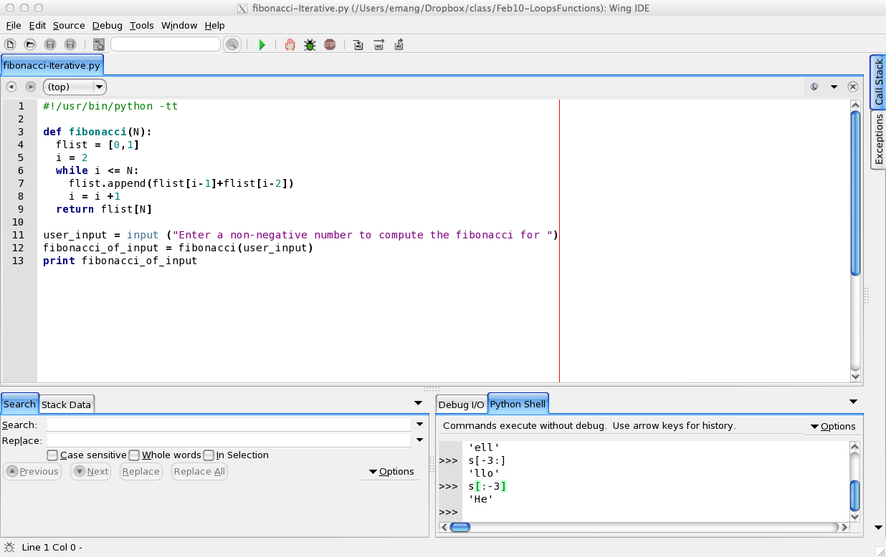
Iterative Fibonacci using Lists

Slide 6
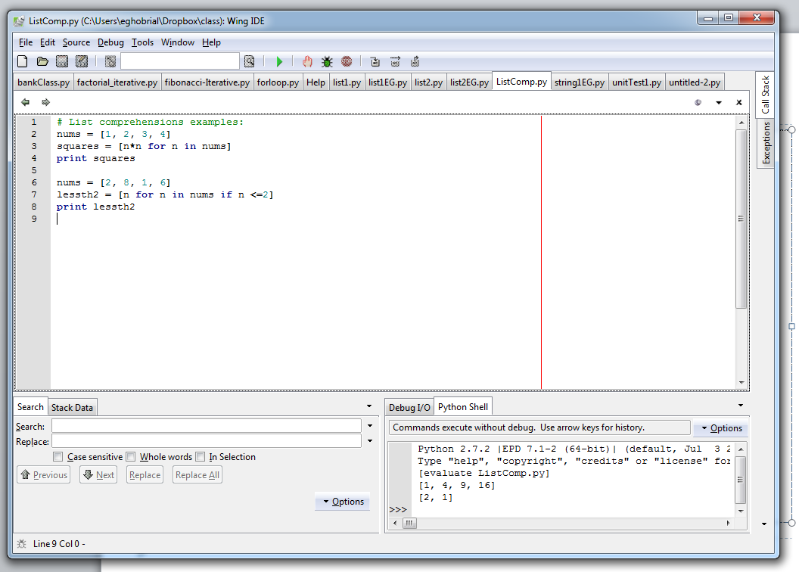
List Comprehensions
Compact way to write expression that expands to a whole list

