Slide 1
Python-Dictionary-Files
Feb 24, 2012
Eman Ghobrial

Slide 2
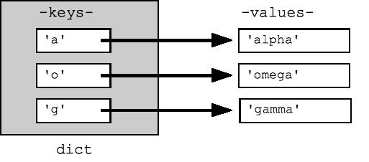
Dictionary
Dictionary
Methods
Dictionary functions
D={} # define a blank one
D[‘a’]=‘alpha’ # to add items to dict
D[‘x’] # gives an error does not exists
D.get(‘a’) # returns alpha, pop() removes
‘a’ in D # returns True
‘x’ in D # returns False
D.keys() # returns a list of keys
D.values() # returns a list of values
D.items() # returns tuples of D
for k in sorted(D.keys()): print k # Loop over the dict.

Slide 3
Files (text files)
The open() function => opens and returns file handle
Use the following codes along with the open()
‘w’ for write
‘r’ for read and ‘rU’ for read universal
Example:
f = open (‘sample.txt’,’rU)
for line in f: #iterates over the lines of the file
print line, #, makes print do not add an end=of-line char
f.close() # good practice
text = f.read() => reads the whole file into a text variable
lines = f.readlines() => reads the whole file into a list

Slide 4
To get the words on a separate list
text.split() # default to split and uses the space as the delimiter
f.write(string) # used to write to an open file

