Slide 1
Python-Binary-Files
March 2, 2012
Eman Ghobrial

Slide 2
Files (binary files)
The open() function => opens and returns file handle
Use the following codes along with the open()
‘wb’ for write
‘rb’ for read
‘r+b’ read and write
Ex:
f = open (filename, ‘rb’)
fdata=f.read()

Slide 3
C like struct
struct.pack(fmt, v1, v2, ...) Return a string containing the values v1, v2, ... packed according to the given format. The arguments must match the values required by the format exactly.
struct.unpack(fmt, string) Unpack the string (presumably packed by pack(fmt, ...)) according to the given format. The result is a tuple even if it contains exactly one item. The string must contain exactly the amount of data required by the format (len(string) must equal calcsize(fmt)).
struct.calcsize(fmt) Return the size of the struct (and hence of the string) corresponding to the given format.

Slide 4
Format Characters
Format | C Type | Python type | Standard size | Notes
x | pad byte | no value
c | char | string of length 1 | 1
b | signed char | integer | 1 | (3)
B | unsigned char | integer | 1 | (3)
? | _Bool | bool | 1 | (1)
h | short | integer | 2 | (3)
H | unsigned short | integer | 2 | (3)
i | int | integer | 4 | (3)
I | unsigned int | integer | 4 | (3)
l | long | integer | 4 | (3)
L | unsigned long | integer | 4 | (3)
q | long long | integer | 8 | (2), (3)
Q | unsigned long long | integer | 8 | (2), (3)
f | float | float | 4 | (4)
d | double | float | 8 | (4)
s | char[] | string
p | char[] | string
P | void * | integer |  | (5), (3)

Slide 5
Examples
A basic example of packing/unpacking three integers:
>>> from struct import *
>>> pack('hhl', 1, 2, 3)
'\x00\x01\x00\x02\x00\x00\x00\x03'
>>> unpack('hhl', '\x00\x01\x00\x02\x00\x00\x00\x03')
(1, 2, 3)
>>> calcsize('hhl')
8

Slide 6
Another Example
>>> record = 'raymond \x32\x12\x08\x01\x08'
>>> name, serialnum, school, gradelevel = unpack('<10sHHb', record)
>>> from collections import namedtuple
>>> Student = namedtuple('Student', 'name serialnum school gradelevel')
>>> Student._make(unpack('<10sHHb', record)) Student(name='raymond ', serialnum=4658, school=264, gradelevel=8)

Slide 7
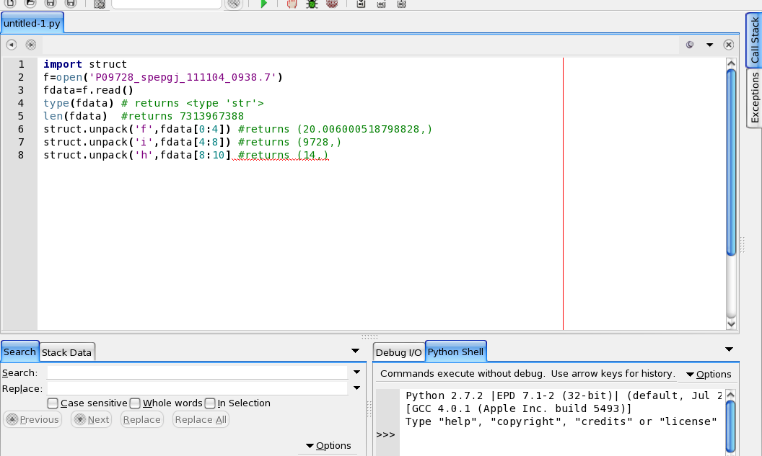
Read the Whole File in Memory

Slide 8
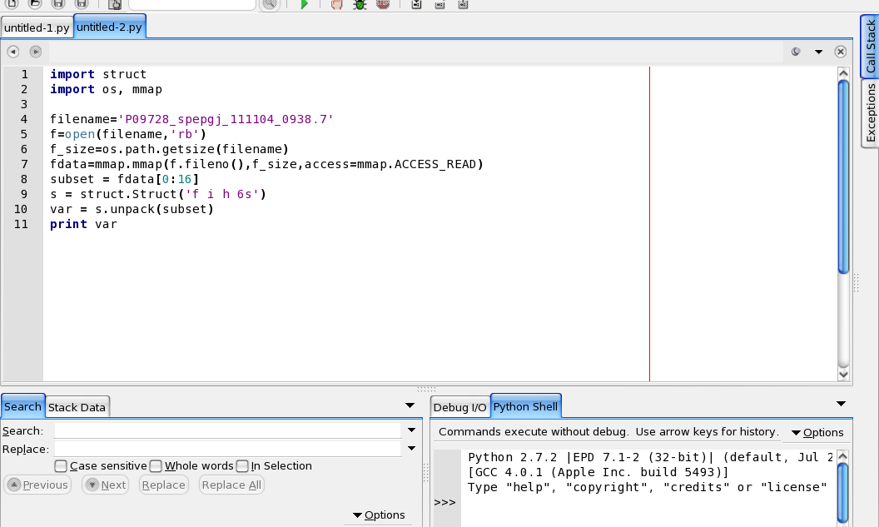
Using Memory Map

