Slide 1
Python-Object Oriented Programming
March 23 2012
Eman Ghobrial

Slide 2
Procedural Programming
Procedural Programming
Advantages:
Easy to learn
Requires minimal planning
Disadvantage:
No formal relations between data and functions
Every detail is exposed (no Encapsulation)

Slide 3
Why to use OOP?
We know it is more complex, and need more thinking ahead.
Some of OOP Advantages:
Reusability
Data and Functions are defined in one unit the class
No online changing or adding objects properties

Slide 4
OOP Main Concepts
What is ……
a class?
an object?
Encapsulation?
Inheritance?
Functions and operator Overloading?
Polymorphism?
Notes:
Class is an outline of an idea it combines properties (data) and Methods (actions)
An Object is an instance of a class, use isa function
Encapsulation (hide some data/method implementation from the user so it could not be changed). By default properties are public, this can be changed to protected, private, constant or dependent
Inheritance (notion of a super class and a sub class) reusability of classes and overloading methods
Function/operator overloading o allow the functions and operators to work on different types other than the original defined one.
Polymorphism: Is the ability to create a variable, a function, or an object that has more than one form.

Slide 5
Classes, Objects and Constructors
A class is a template
The constructor method is used to create an object (instance of the class).
Constructor method is defined as follows:
def __init__(self, attrib1, attrib2=default val, etc..)

Slide 6
The Self
All methods take self as first argument, but self is left out in method calls.
All data attributes and method calls must within the class be prefixed by self .
The self variable holds a reference to the current class instance.
The name self is just a convention. Any name will do, but others than self will most likely confuse readers of the code.

Slide 7
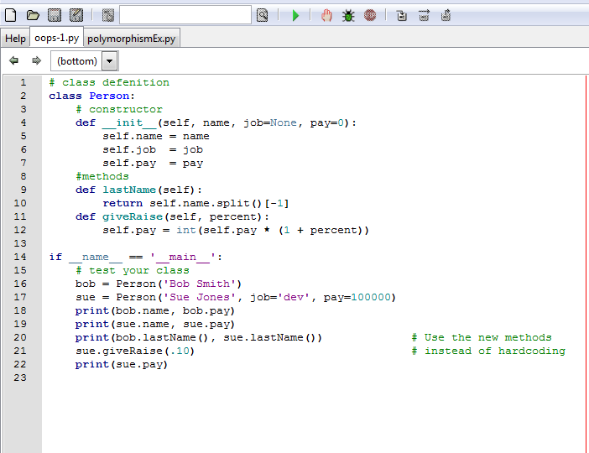
Example

Slide 8
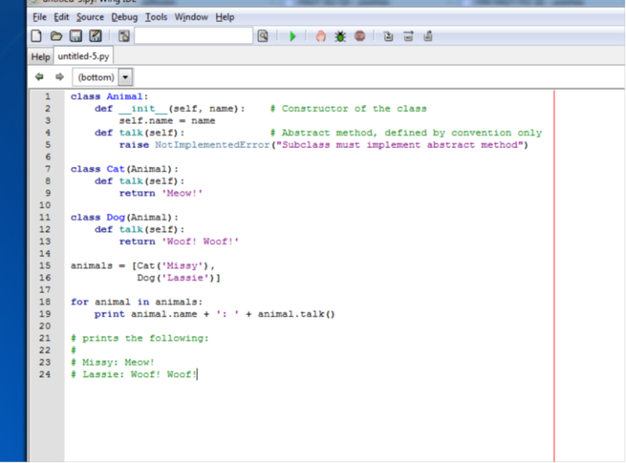
Inheritance/Polymorphism Example

