Slide 1
Python-XML
April 6,2012
Eman Ghobrial

Slide 2
Overview
XML Introduction
Parsing Using DOM in Python
XML Example
Tree Representation
Client Example
Rebuilding XML files

Slide 3
XML Introduction
The key power that XML provides us with is the ability to exchange information between machines and especially applications. Because the format of an XML document is standard ASCII text, we can easily process that information with a parser into a format that can be used within an application.
Two main types of parser exist: the event-driven parser, which processes each XML tag in sequence within a document and in turn triggers an event designed to handle that tag; and the tree-based parser, which converts the XML document into a complex tree structure. Examples of such parsers include the SAX system (event-driven) and DOM (tree-based), which we shall be using for our examples.

Slide 4
XML Example

Slide 5
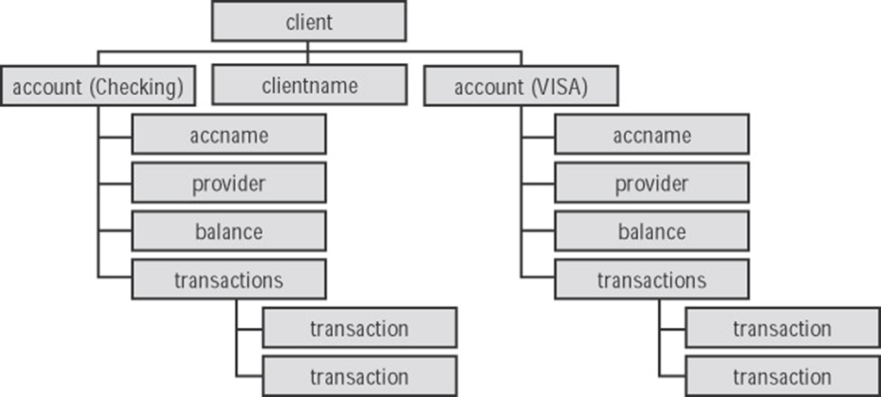
XML Tree for the Pervious Example

Slide 6
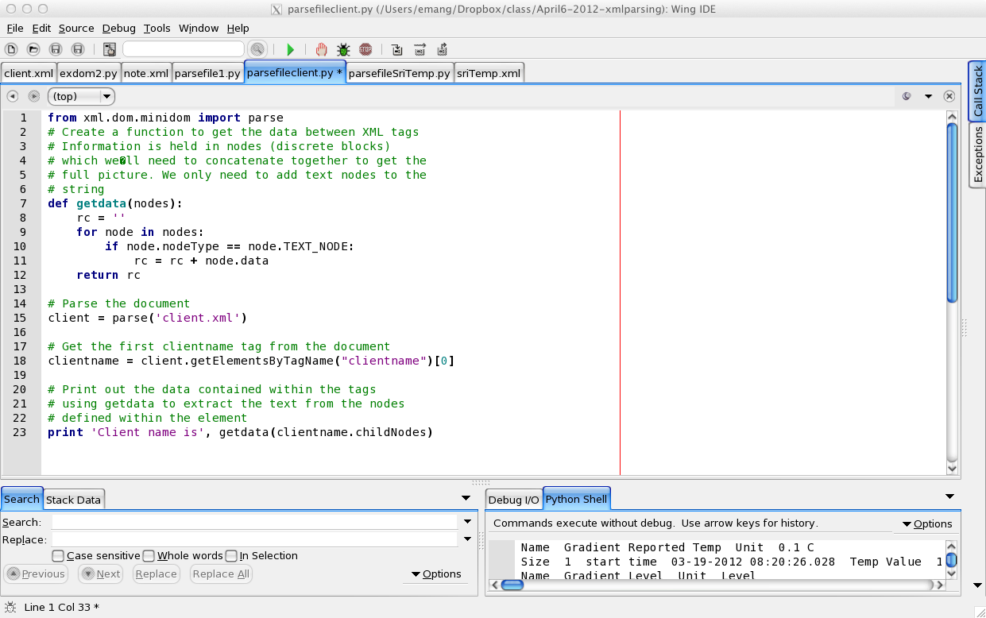
Parsing the file and read the values

Slide 7
getElementsByTagName
Returns an object (one tree branch)
getAttribute("name"), returns the attribute values
Demo the client example

Slide 8
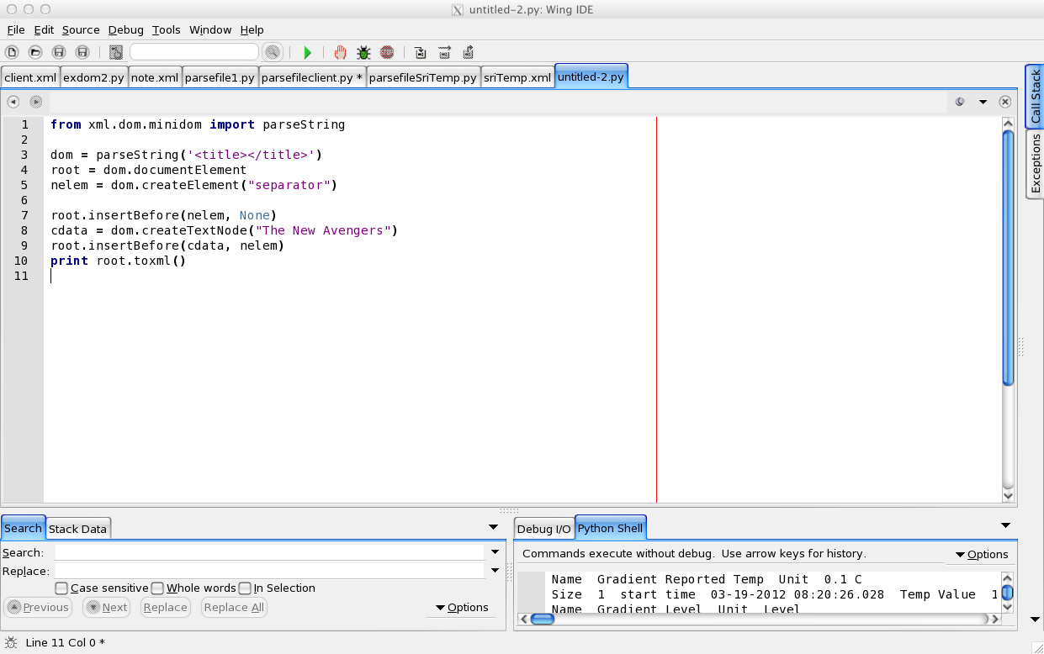
Rebuilding an XML File

