Slide 1
Python-matplotlib
April 20,2012
Eman Ghobrial

Slide 2
Overview
matplotlib Introduction
Pyplot
Line plot
plot()
axis() takes [xmin, xmax, ymin, ymax]
Multiple figures and axes
Adding text, mathematical expressions and saving your figure
Annotating

Slide 3
pylab
matplotlib is a collection of command style functions that make matplotlib work like MATLAB.
Functions make change to figures such as create a figure, plot lines, configure the plotting area, etc.

Slide 4
Line plot
plot(), takes an arbitrary number of arguments, example:
plot([1,2,3,4],[1,4,9,16]), plot x versus y
plot([1,2,3,4],[1,4,9,16],’ro’), ro to plot red circles
axis([0,6,0,20])
The axis command takes a list of [xmin,xmax,ymin,ymax]

Slide 5
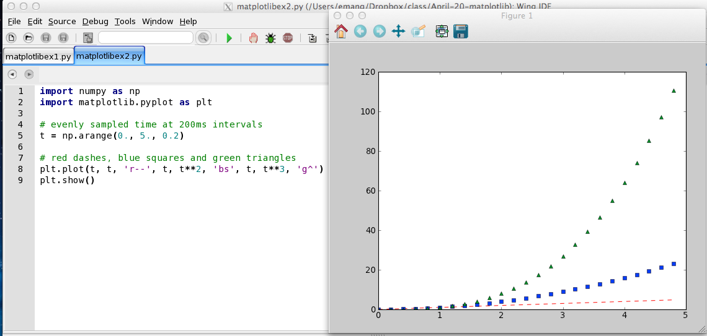
Line plot example-using the arange function

Slide 6
Multiple figures and axes

Slide 7
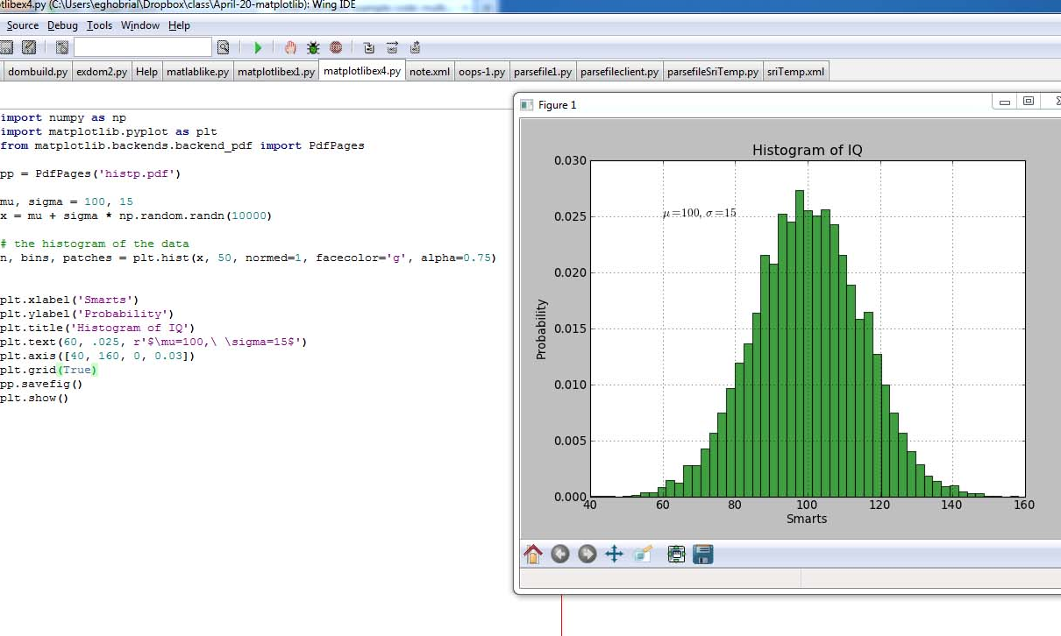
Adding text

Slide 8
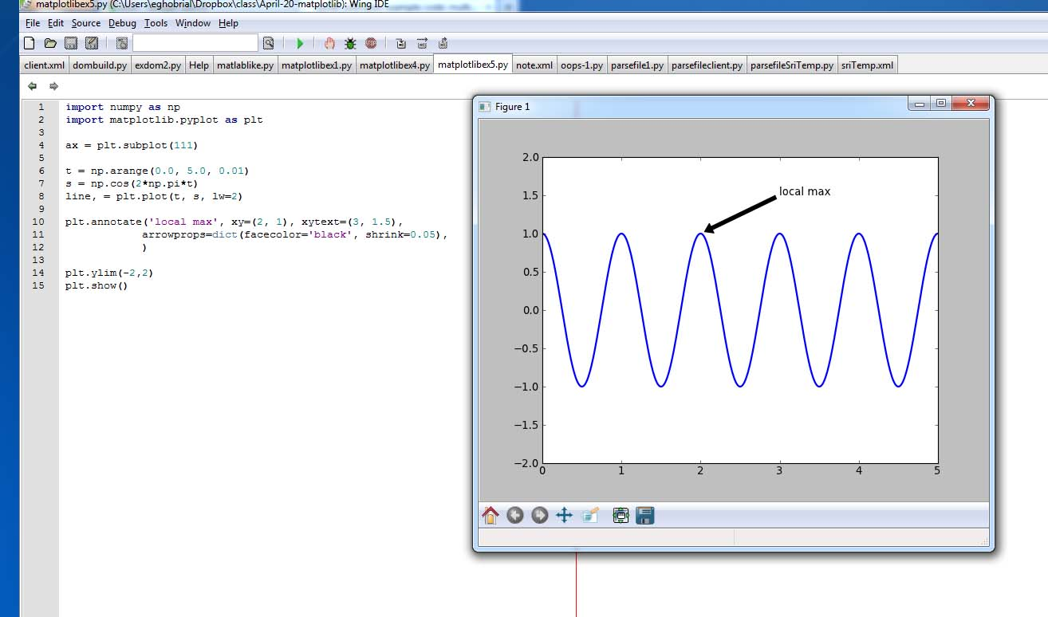
Annotating

