Slide 1



SIP SRONO
Tanggal Presentasi diisi Manual

Slide 2
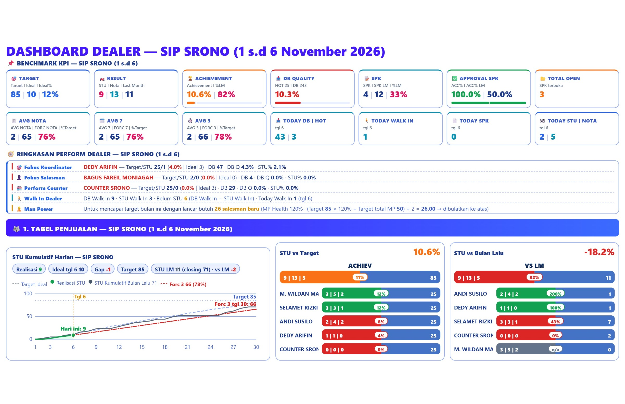
# DEALER CONDITION REVIEW

Slide 3
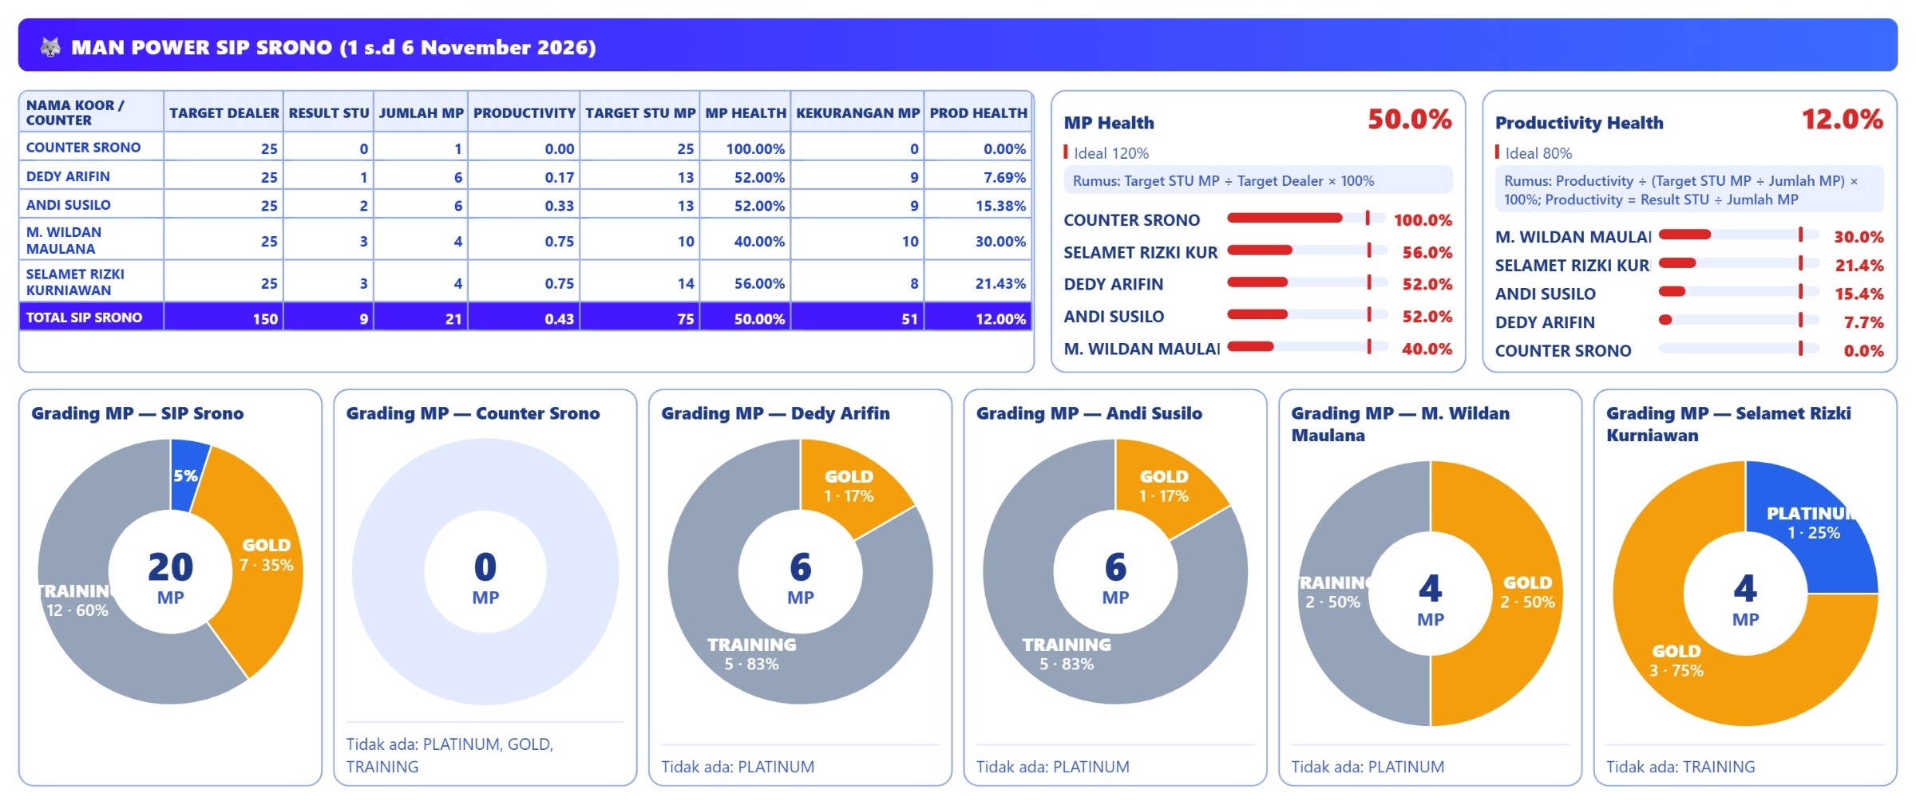
# MAN POWER DEALER REVIEW

Slide 4
DEALER RECRUITMENT
RECRUITMENT 4 HARI TERAKHIR
1. TOTAL POSTING LOKER :
2. TOTAL RESPONDEN :
3. JUMLAH SURAT LAMARAN MASUK :
4. JUMLAH INTERVIEW :
5. JUMLAH SALESMAN DITERIMA :
PERBAIKAN RECRUITMENT
1. Tambah 14 salesman baru
2.
3.
TARGET PERBAIKAN :

Slide 5
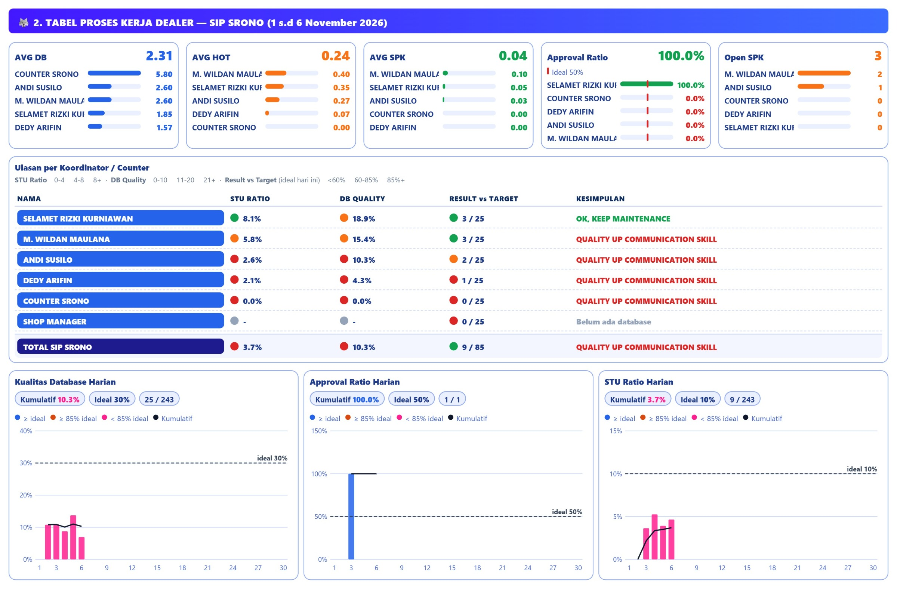
# DEALER PROCESS REVIEW

Slide 6
# DEALER DATABASE QUALITY REVIEW
CONDITION | PROBLEM | PERBAIKAN | TARGET PERBAIKAN | TIME LINE
DB QUALITY: DB 243 dengan HOT 25 → DB Q 10.3% (ideal 30%); STU 9 → STU% 3.7% (ideal 10%); input 2.3 DB/MP/hari oleh 21 MP.

Slide 7
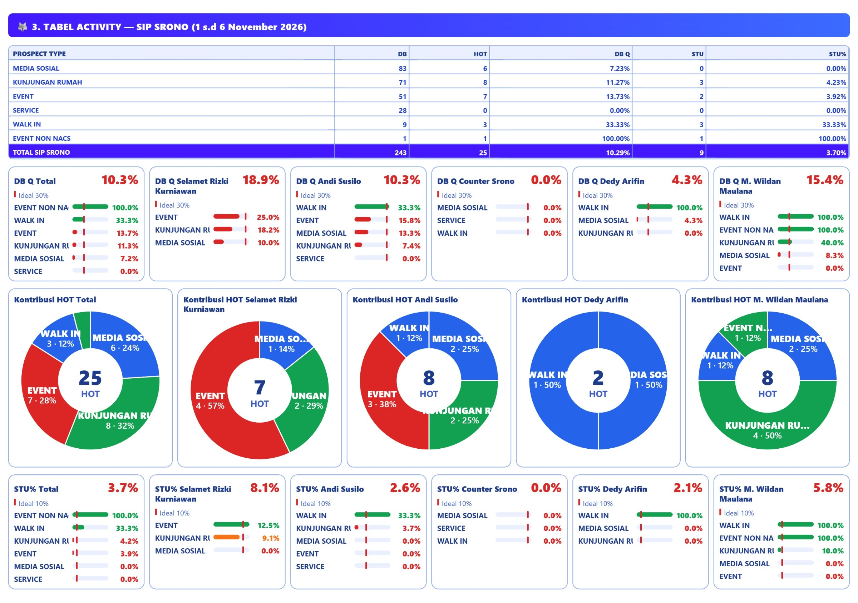
# DEALER ACTIVITY REVIEW

Slide 8
# DEALER ACTIVITY REVIEW
CONDITION | PROBLEM | PERBAIKAN | TARGET PERBAIKAN | TIME LINE
SUB PROSPECT 1: EVENT › EVENT LOCAL (POS TENDA YAMAHA MUNCAR)-MUNCAR: DB 19, HOT 3 (DB Q 15.8%), STU 0 (STU% 0.0%).
SUB PROSPECT 2: EVENT › EVENT LOCAL (POS TENDA YAMAHA SILIRAGUN-PESANGGARAN: DB 16, HOT 0 (DB Q 0.0%), STU 0 (STU% 0.0%).
SUB PROSPECT 3: EVENT › EVENT LOCAL (POS TENDA YAMAHA SAMSAT BE-CLURING: DB 16, HOT 4 (DB Q 25.0%), STU 2 (STU% 12.5%).
MEDIA SOSIAL: Media Sosial: target 21 STU, realisasi 0 (0.0%) DB 83, HOT 6 (DB Q 7.2%), STU 0 (STU% 0.0%).

Slide 9
DEDY ARIFIN
LOW PERFORM COORDINATOR

Slide 10
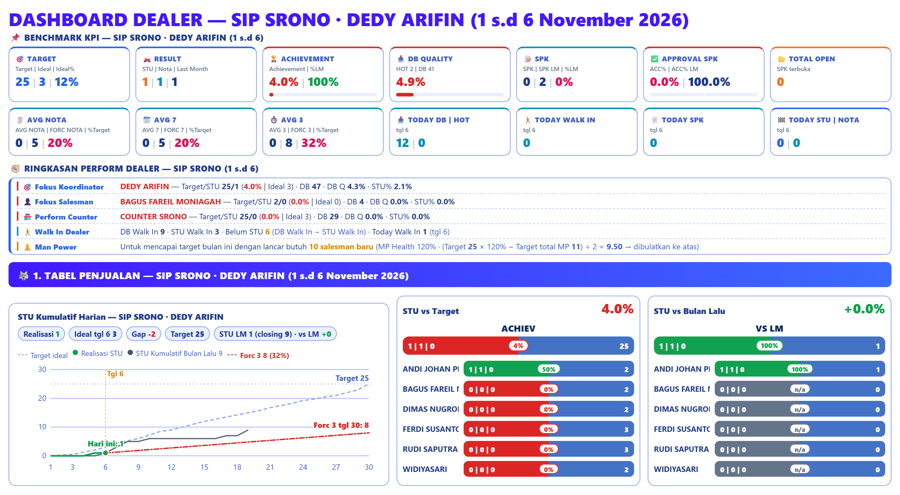
# COORDINATOR CONDITION REVIEW

Slide 11
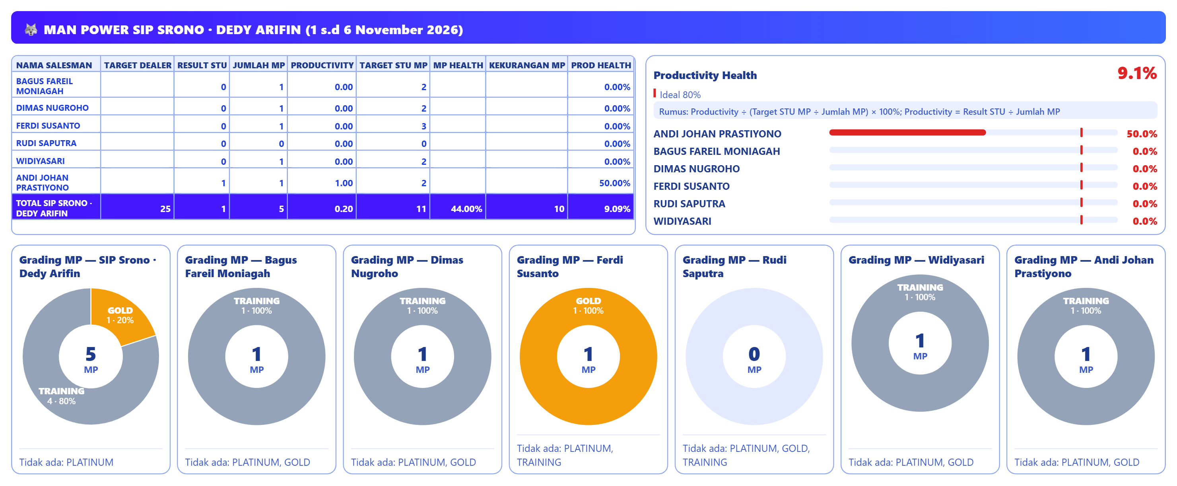
# MAN POWER COORDINATOR REVIEW

Slide 12
RECRUITMENT KOORDINATOR
RECRUITMENT 4 HARI TERAKHIR
1. TOTAL POSTING LOKER :
2. TOTAL RESPONDEN :
3. JUMLAH SURAT LAMARAN MASUK :
4. JUMLAH INTERVIEW :
5. JUMLAH SALESMAN DITERIMA :
PERBAIKAN RECRUITMENT
1. Tambah 9 salesman baru
2.
3.
TARGET PERBAIKAN :

Slide 13
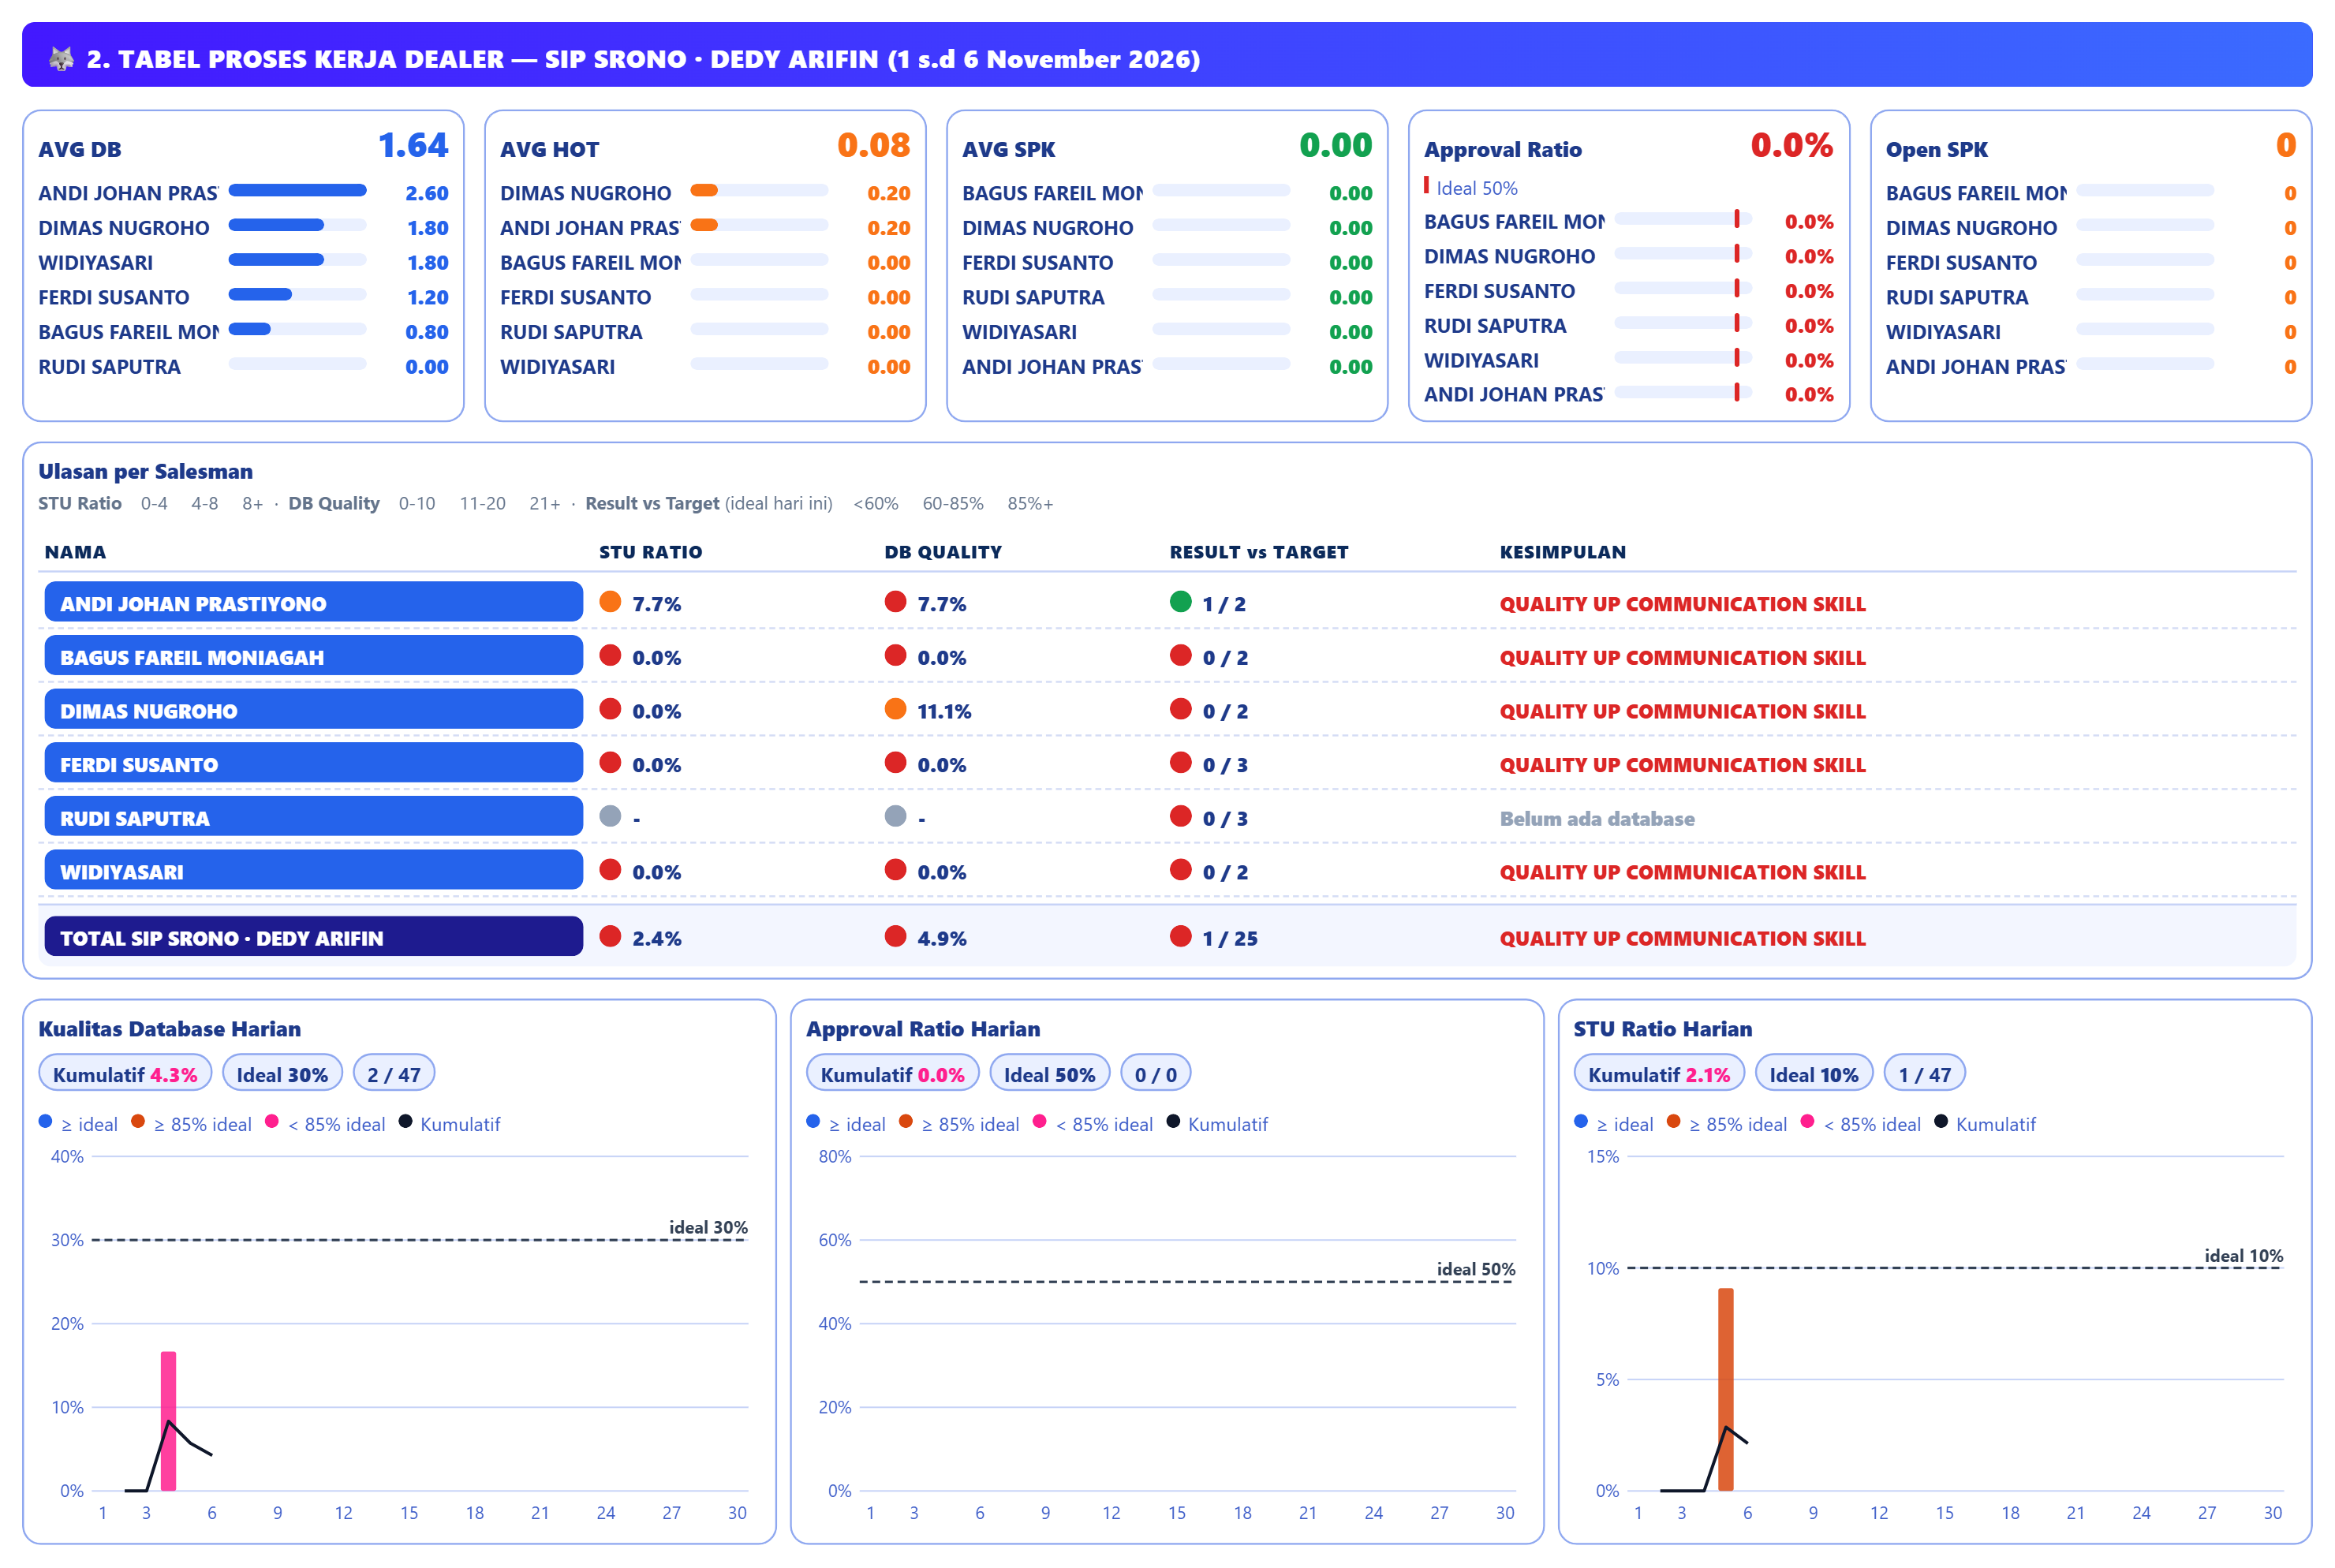
# COORDINATOR PROCESS REVIEW

Slide 14
# MAN POWER COORDINATOR REVIEW
CONDITION | PROBLEM | PERBAIKAN | TARGET PERBAIKAN | TIME LINE
SALESMAN TERBURUK 1: BAGUS FAREIL MONIAGAH: STU 0/2 (0.0%), DB 4, HOT 0 (DB Q 0.0%), SPK 0, ACC 0%, STU% 0.0%.
SALESMAN TERBURUK 2: FERDI SUSANTO: STU 0/3 (0.0%), DB 6, HOT 0 (DB Q 0.0%), SPK 0, ACC 0%, STU% 0.0%.
SALESMAN TERBURUK 3: MOHAMMAD MIFTA: STU 0/2 (0.0%), DB 6, HOT 0 (DB Q 0.0%), SPK 0, ACC 0%, STU% 0.0%.

Slide 15
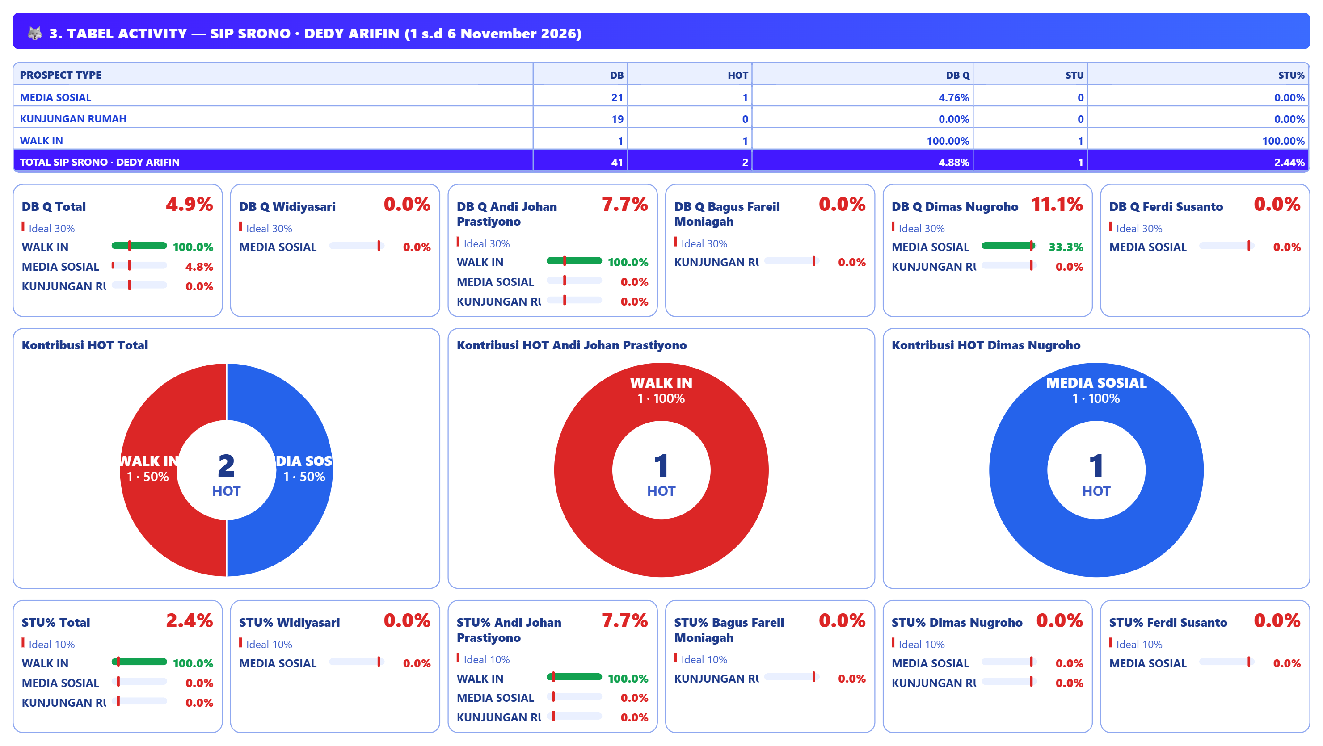

Slide 16
# COORDINATOR ACTIVITY REVIEW
CONDITION | PROBLEM | PERBAIKAN | TARGET PERBAIKAN | TIME LINE
SUB PROSPECT EVENT 1: KUNJUNGAN RUMAH › >5 TAHUN: DB 23, HOT 0 (DB Q 0.0%), STU 0 (STU% 0.0%).
SUB PROSPECT EVENT 2: Tidak ada data pada periode ini.
MEDIA SOSIAL KOORDINATOR: Media Sosial: target 6 STU, realisasi 0 (0.0%) DB 23, HOT 1 (DB Q 4.3%), STU 0 (STU% 0.0%).

Slide 17
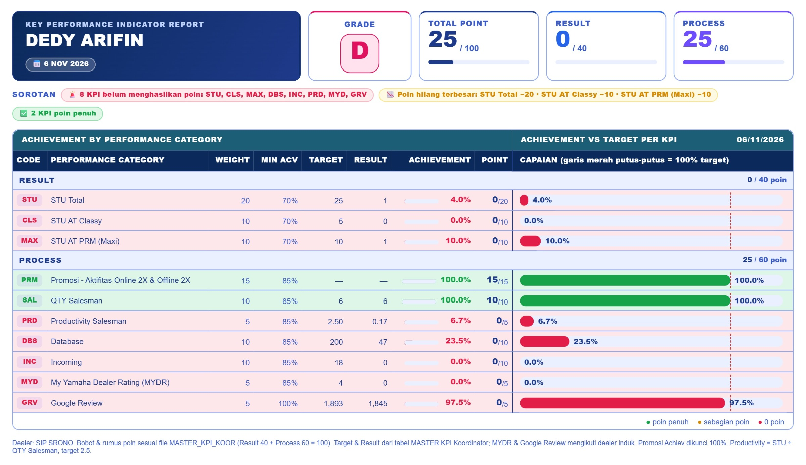
# COORDINATOR KPI REVIEW

Slide 18
COUNTER SRONO
COUNTER DEALER SIP SRONO

Slide 19
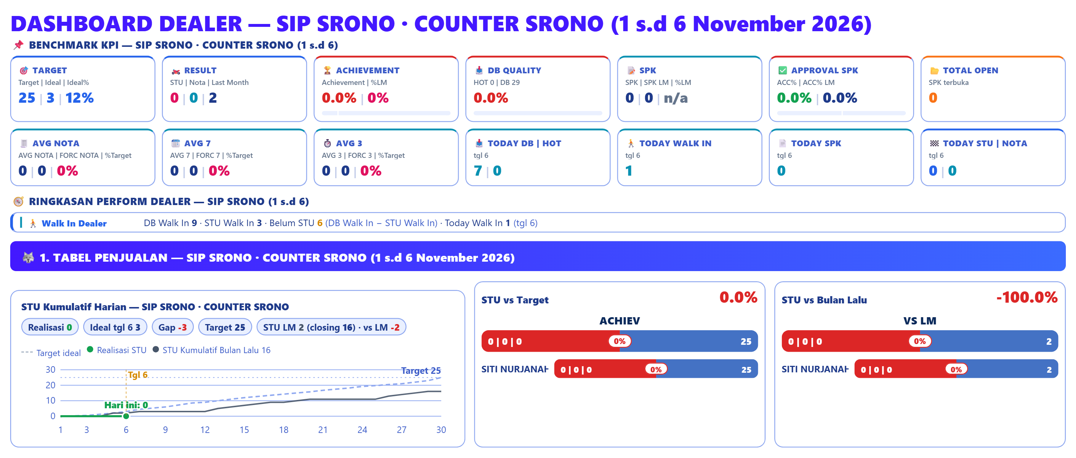
# COUNTER CONDITION REVIEW

Slide 20
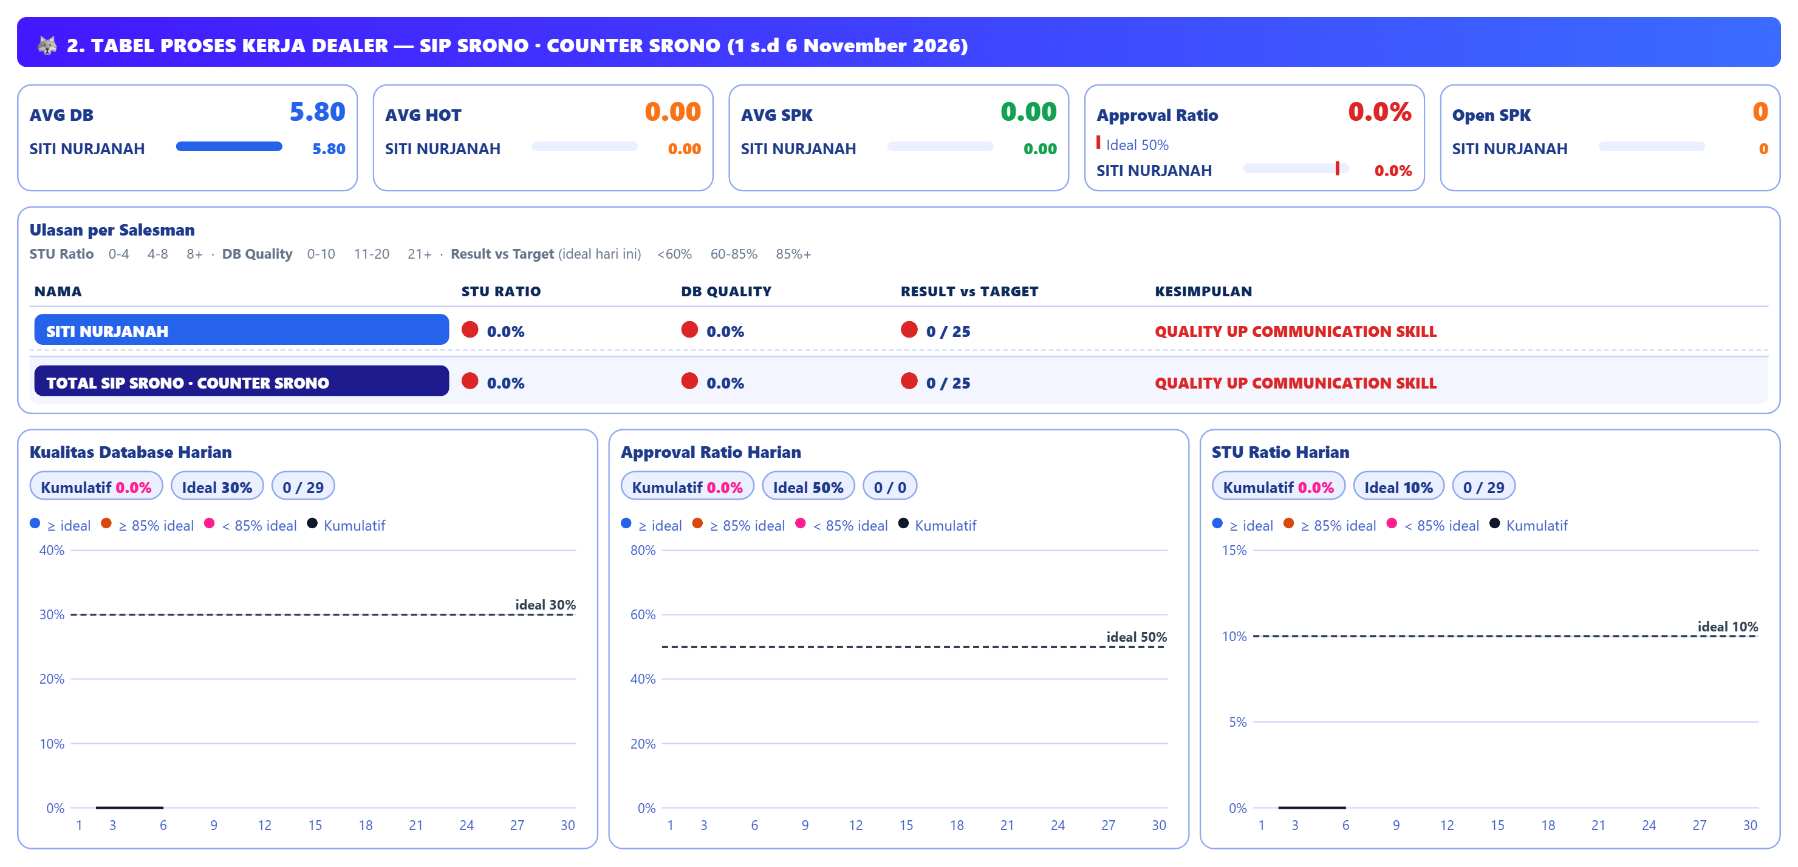
# COUNTER PROCESS REVIEW

Slide 21
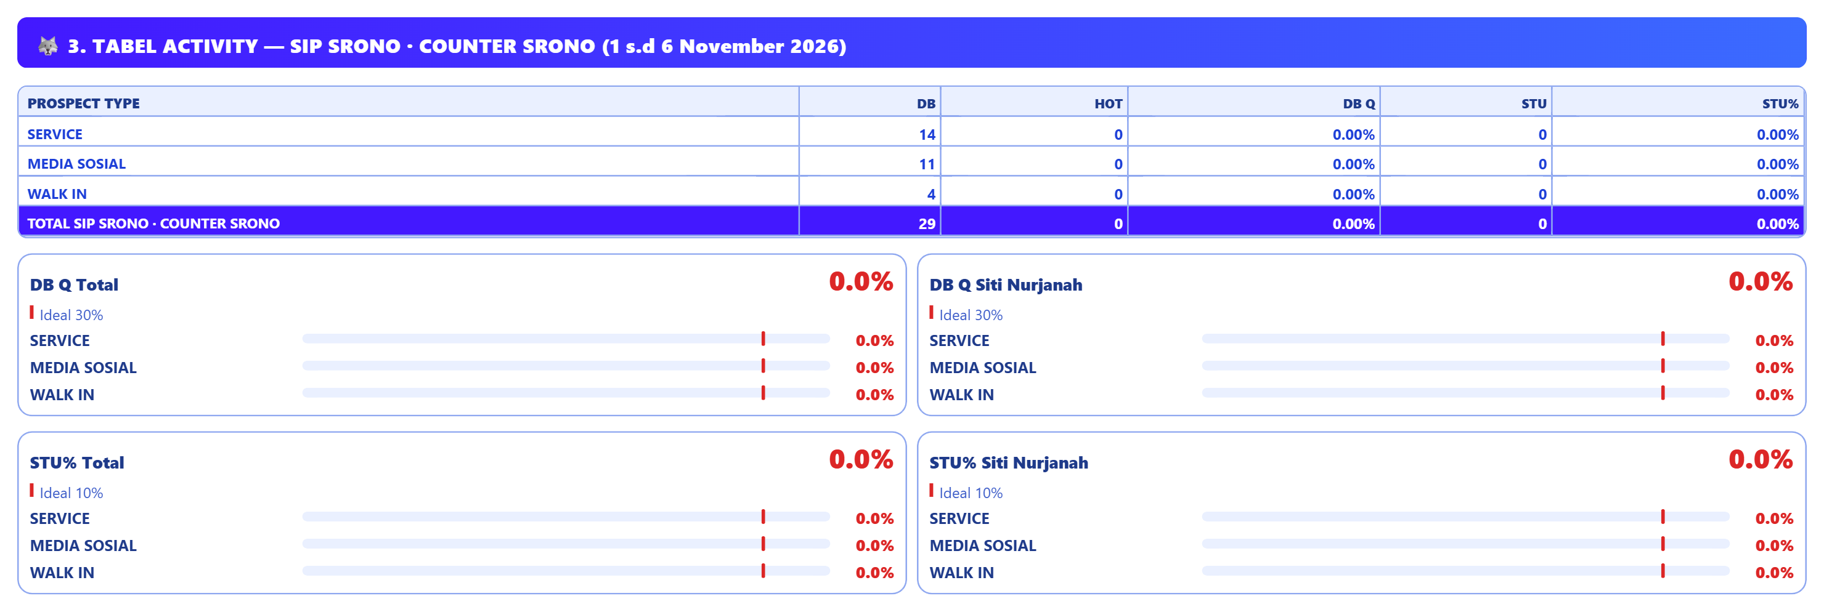
# COUNTER ACTIVITY REVIEW

Slide 22
# COUNTER REVIEW
CONDITION | PROBLEM | PERBAIKAN | TARGET PERBAIKAN | TIME LINE
DB QUALITY: DB 29 dengan HOT 0 → DB Q 0.0% (ideal 30%); STU 0 → STU% 0.0% (ideal 10%); input 5.8 DB/MP/hari oleh 1 MP.
WALK IN: target 15 STU, realisasi 0 (0%); DB 4, HOT 0 (DB Q 0.0%), STU 0 (STU% 0.0%).
MEDIA SOSIAL: target 8 STU, realisasi 0 (0%); DB 11, HOT 0 (DB Q 0.0%), STU 0 (STU% 0.0%).

Slide 23
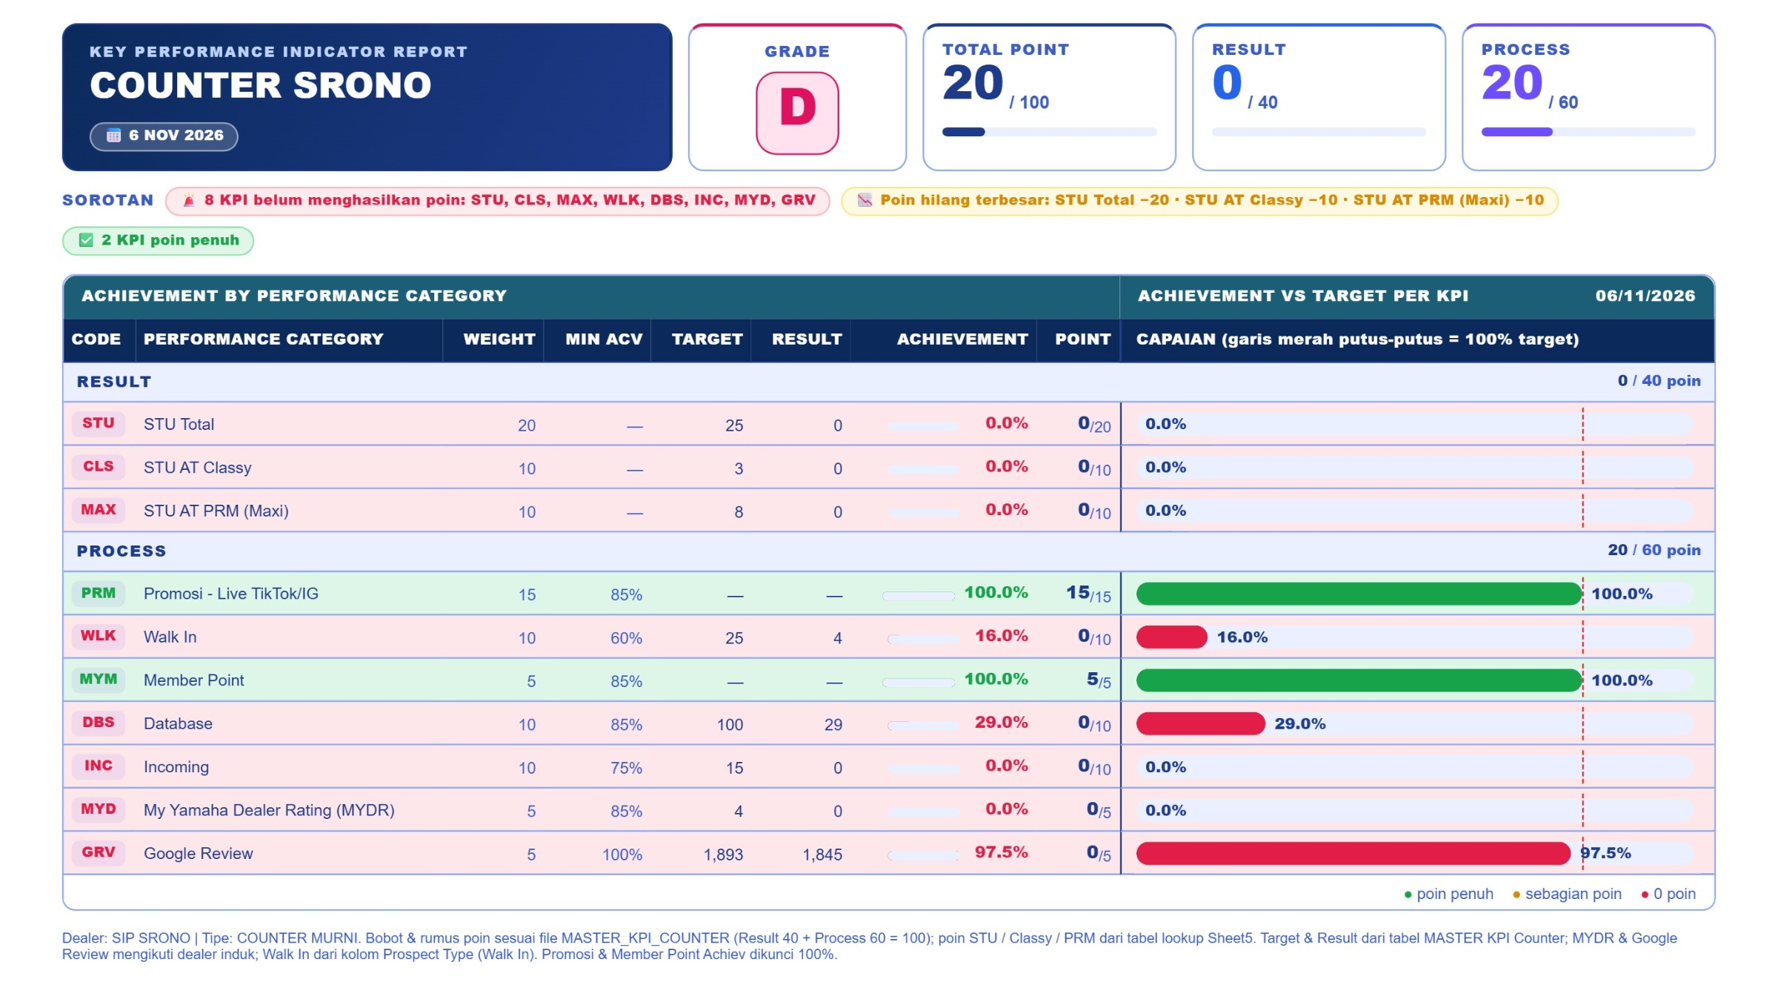
# COUNTER KPI REVIEW

Slide 24
SPK & LEASING
SIP SRONO

Slide 25
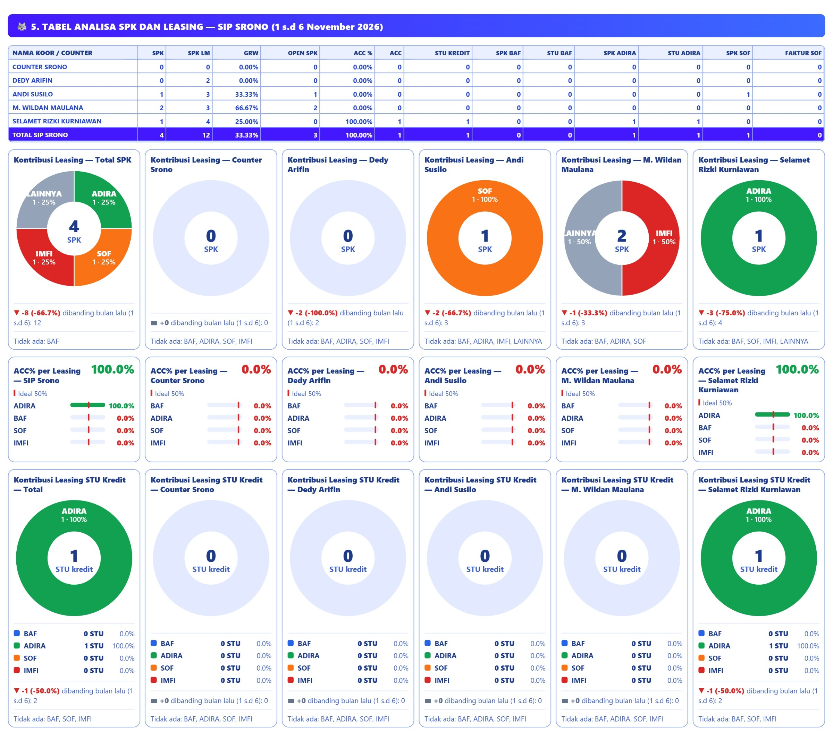
# SPK & LEASING REVIEW

Slide 26
# SPK & LEASING REVIEW
CONDITION | PROBLEM | PERBAIKAN | TARGET PERBAIKAN | TIME LINE
LEASING BAF: SPK 0, ACC% 0.0% (ideal 50%), STU kredit cair 0 unit (0% dari STU kredit); total SPK dealer 4 (LM 12), SPK terbuka 3.
LEASING ADIRA: SPK 1, ACC% 100.0% (ideal 50%), STU kredit cair 1 unit (100% dari STU kredit); total SPK dealer 4 (LM 12), SPK terbuka 3.
LEASING SOF: SPK 1, ACC% 0.0% (ideal 50%), STU kredit cair 0 unit (0% dari STU kredit); total SPK dealer 4 (LM 12), SPK terbuka 3.

Slide 27
STU by TYPE
SIP SRONO

Slide 28
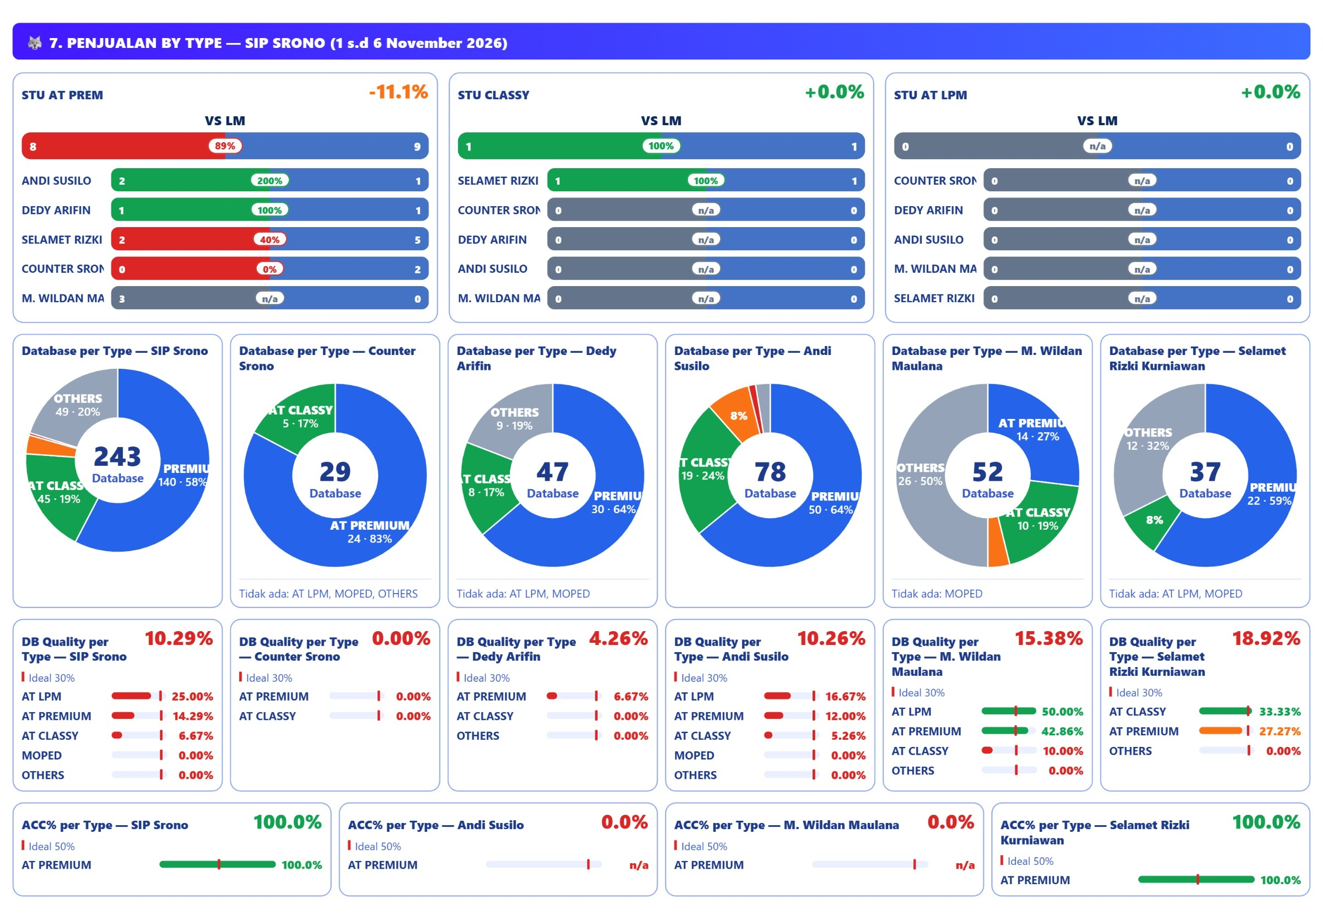
STU by TYPE REVIEW

Slide 29
# STU by TYPE REVIEW
CONDITION | PROBLEM | PERBAIKAN | TARGET PERBAIKAN | TIME LINE
AT PREMIUM: STU 8/51 (15.7%), LM 9 (growth 89%), DB 140, HOT 20 (DB Q 14.3%), SPK 4, ACC 100%.
AT CLASSY: STU 1/21 (4.8%), LM 1 (growth 100%), DB 45, HOT 3 (DB Q 6.7%), SPK 0, ACC 0%.
AT LPM: STU 0/8 (0.0%), LM 0 (growth 0%), DB 8, HOT 2 (DB Q 25.0%), SPK 0, ACC 0%.

Slide 30
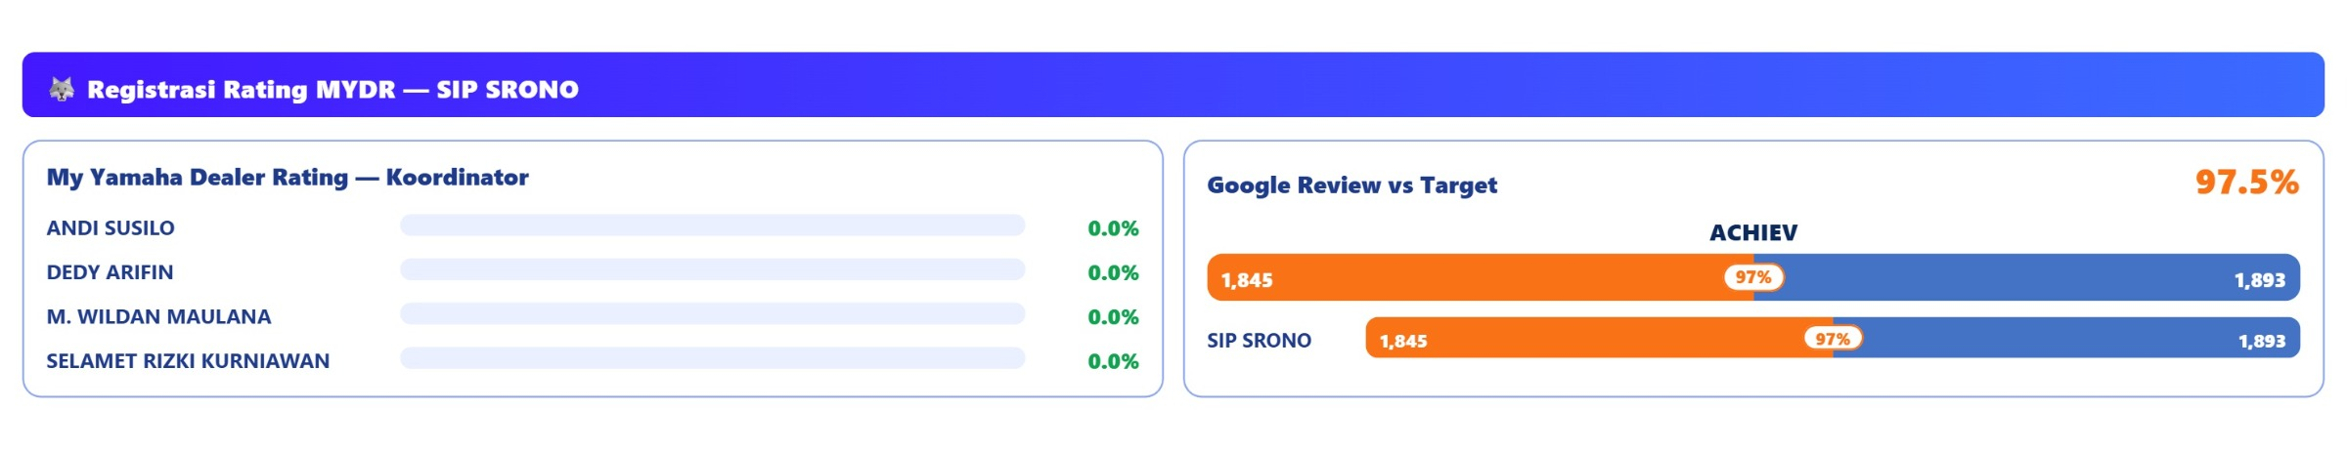
# My Yamaha Dealer Rating REVIEW

Slide 31
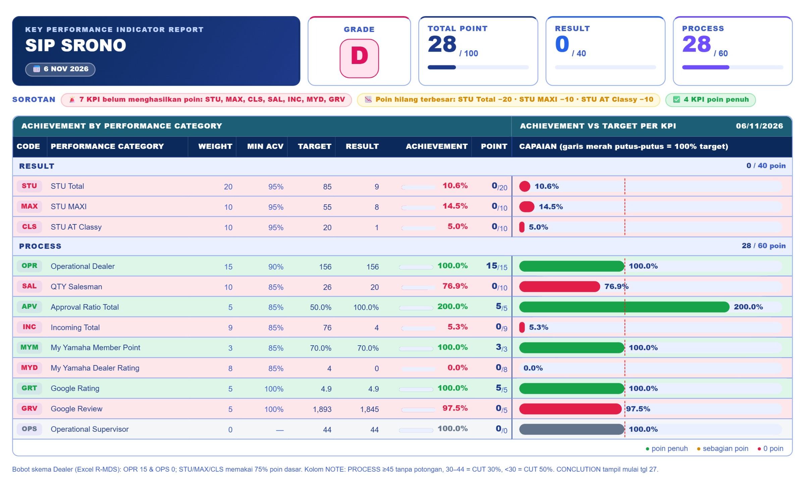
# DEALER KPI REVIEW

Slide 32
# DOCUMENTATION

Slide 33
Thank You!

