Slide 1



SIP A. YANI
Tanggal Presentasi diisi Manual

Slide 2
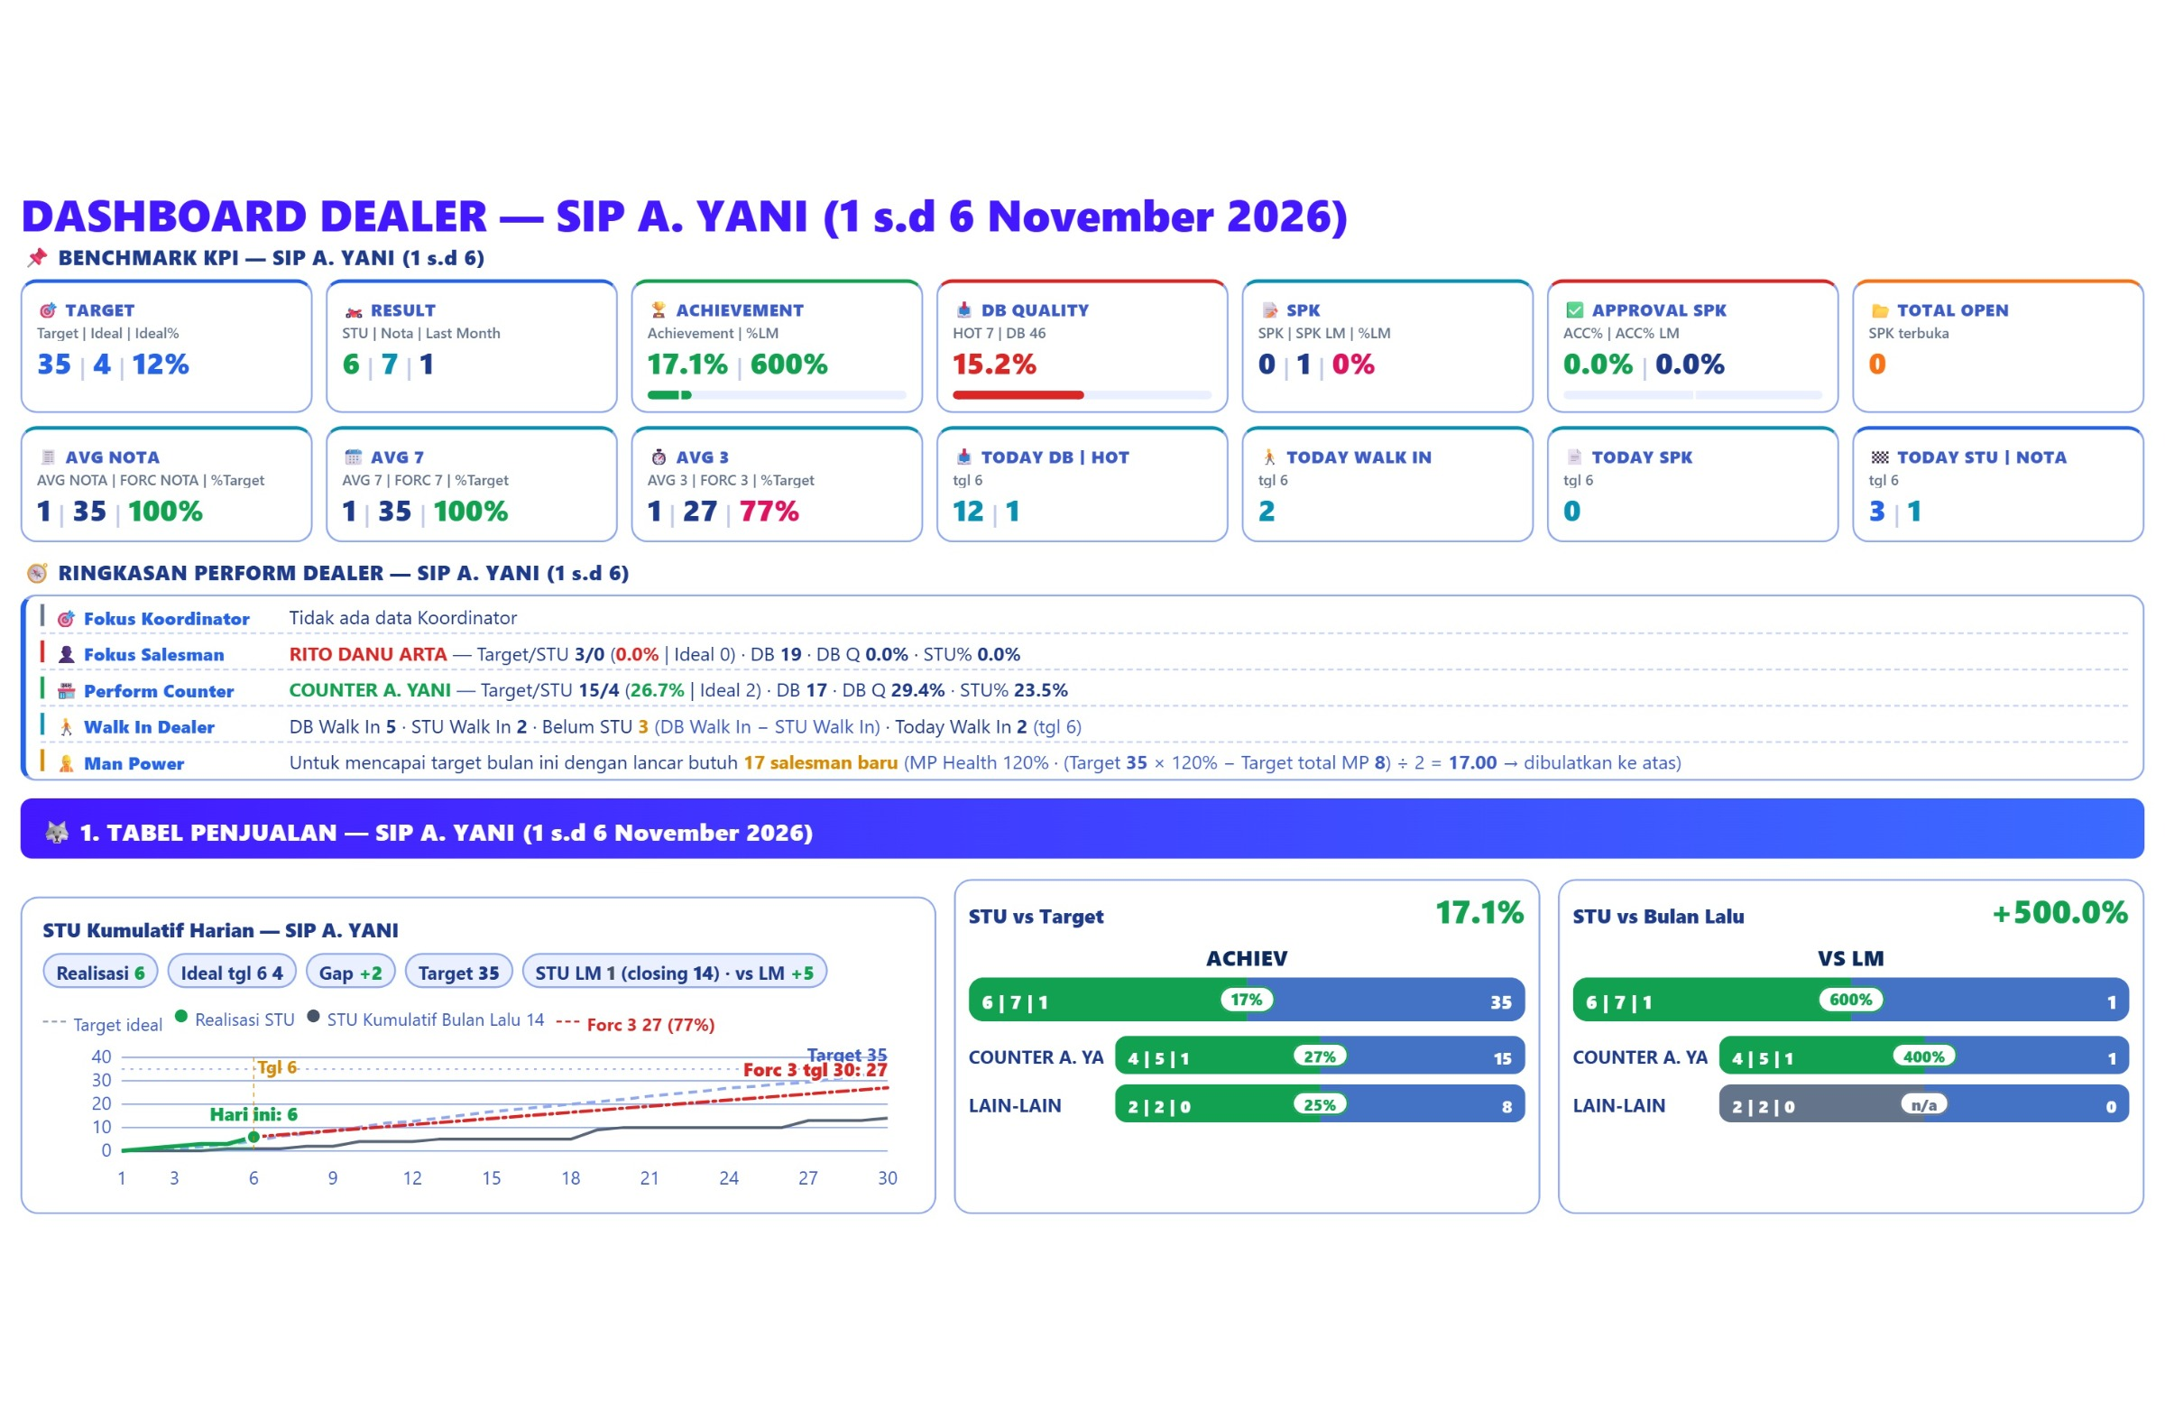
# DEALER CONDITION REVIEW

Slide 3
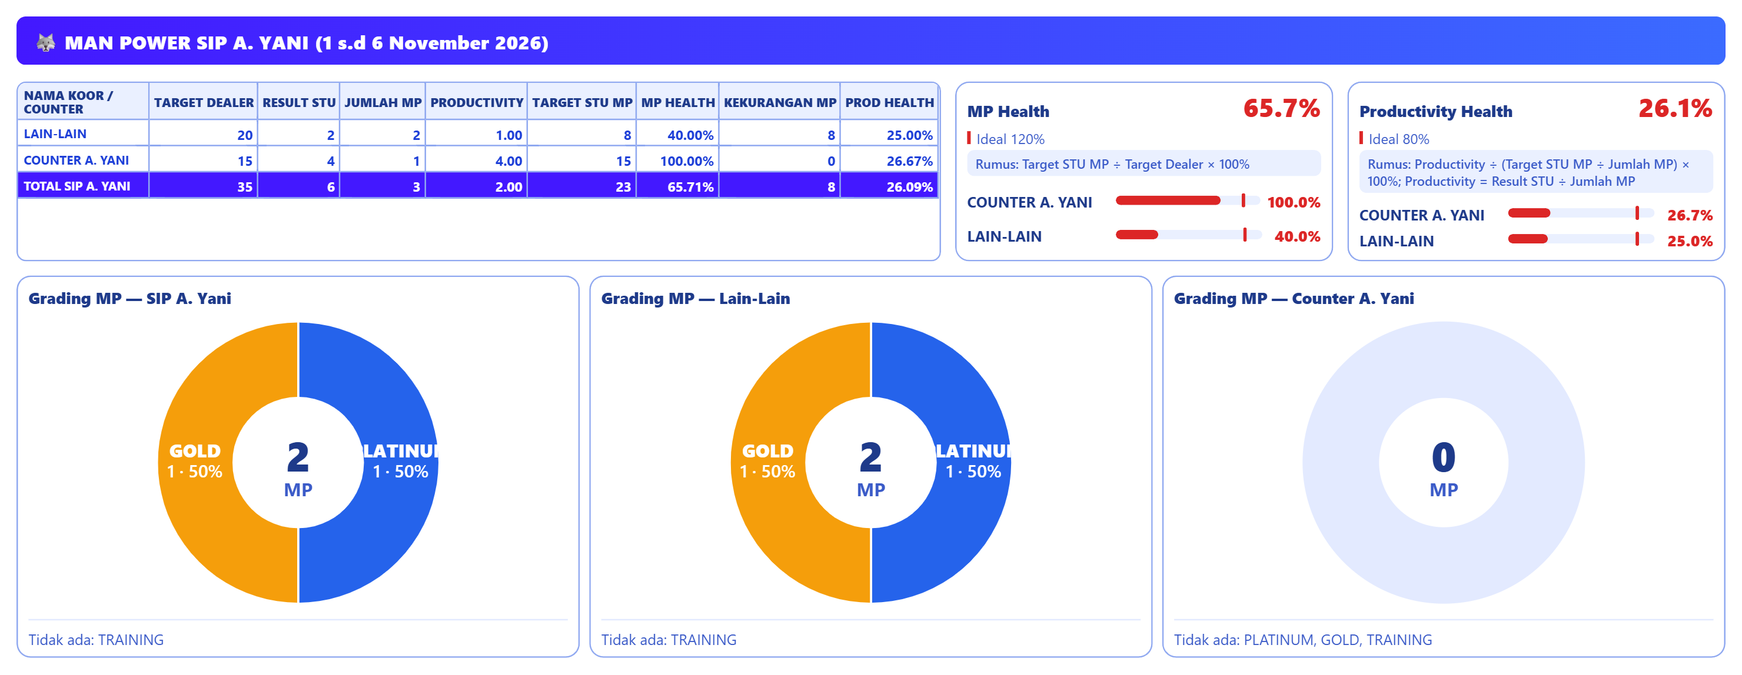
# MAN POWER DEALER REVIEW

Slide 4
DEALER RECRUITMENT
RECRUITMENT 4 HARI TERAKHIR
1. TOTAL POSTING LOKER :
2. TOTAL RESPONDEN :
3. JUMLAH SURAT LAMARAN MASUK :
4. JUMLAH INTERVIEW :
5. JUMLAH SALESMAN DITERIMA :
PERBAIKAN RECRUITMENT
1. Tambah 10 salesman baru
2.
3.
TARGET PERBAIKAN :

Slide 5
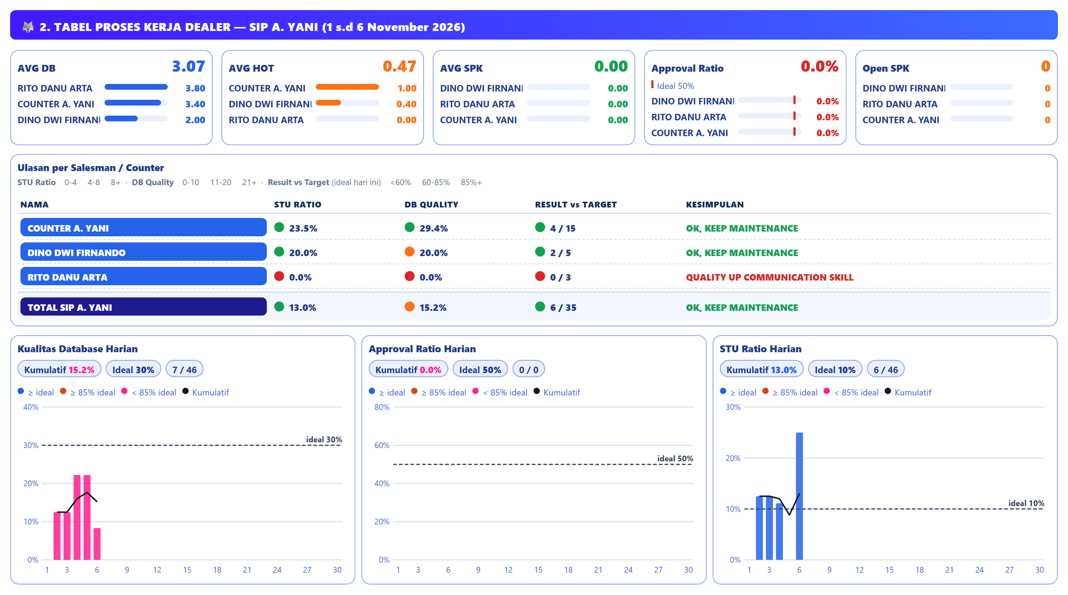
# DEALER PROCESS REVIEW

Slide 6
# DEALER DATABASE QUALITY REVIEW
CONDITION | PROBLEM | PERBAIKAN | TARGET PERBAIKAN | TIME LINE
DB QUALITY: DB 46 dengan HOT 7 → DB Q 15.2% (ideal 30%); STU 6 → STU% 13.0% (ideal 10%); input 3.1 DB/MP/hari oleh 3 MP.

Slide 7
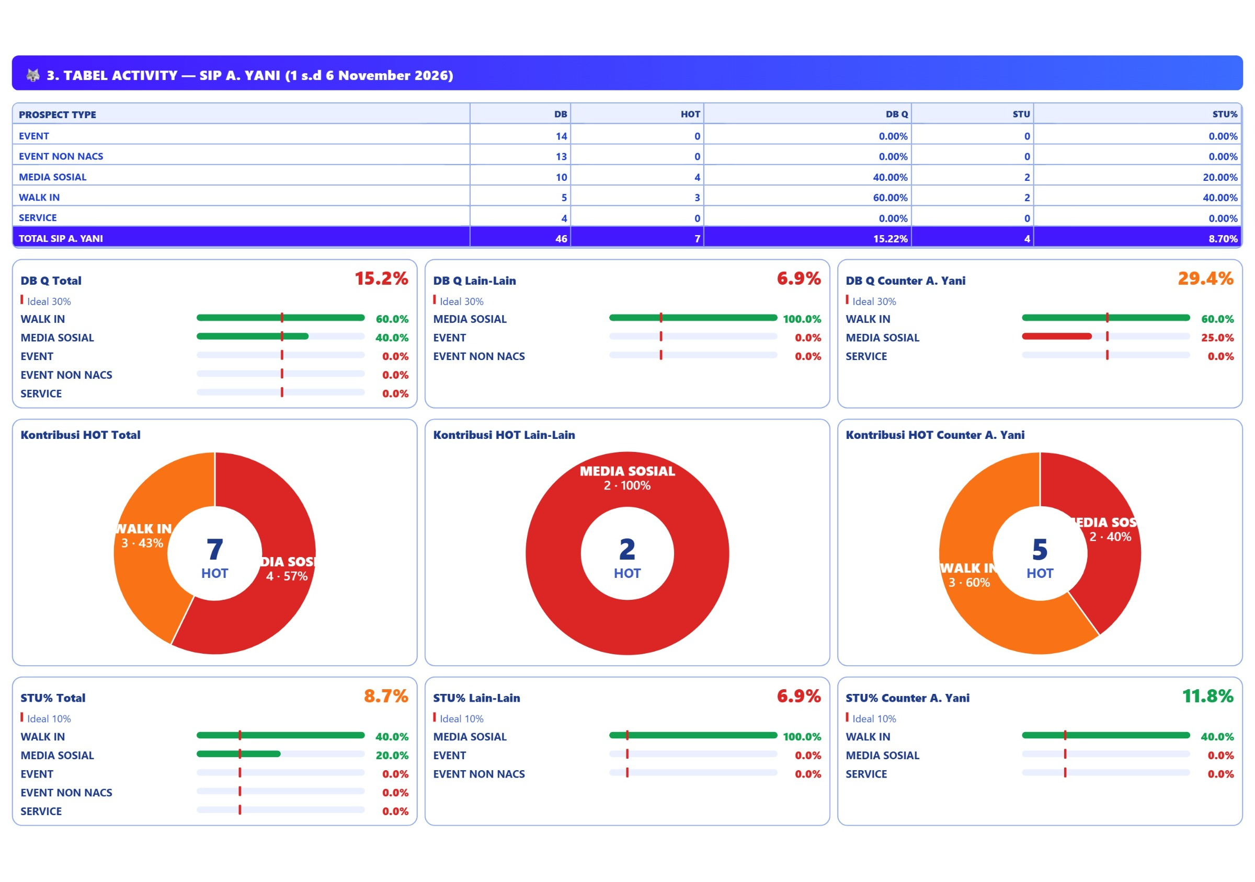
# DEALER ACTIVITY REVIEW

Slide 8
# DEALER ACTIVITY REVIEW
CONDITION | PROBLEM | PERBAIKAN | TARGET PERBAIKAN | TIME LINE
SUB PROSPECT 1: EVENT › EVENT LOCAL (POS TENDA YAMAHA SAMSAT BA-BANYUWANGI: DB 14, HOT 0 (DB Q 0.0%), STU 0 (STU% 0.0%).
SUB PROSPECT 2: Tidak ada data pada periode ini.
SUB PROSPECT 3: Tidak ada data pada periode ini.
MEDIA SOSIAL: Media Sosial: target 9 STU, realisasi 2 (22.2%) DB 10, HOT 4 (DB Q 40.0%), STU 2 (STU% 20.0%).

Slide 9
COUNTER A. YANI
COUNTER DEALER SIP A. YANI

Slide 10
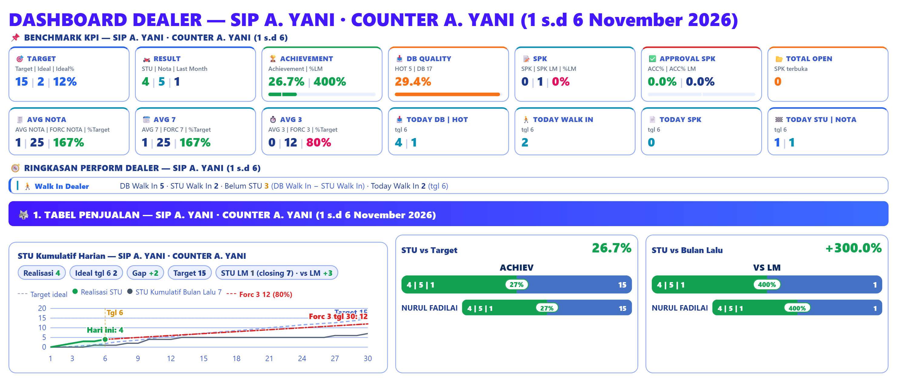
# COUNTER CONDITION REVIEW

Slide 11
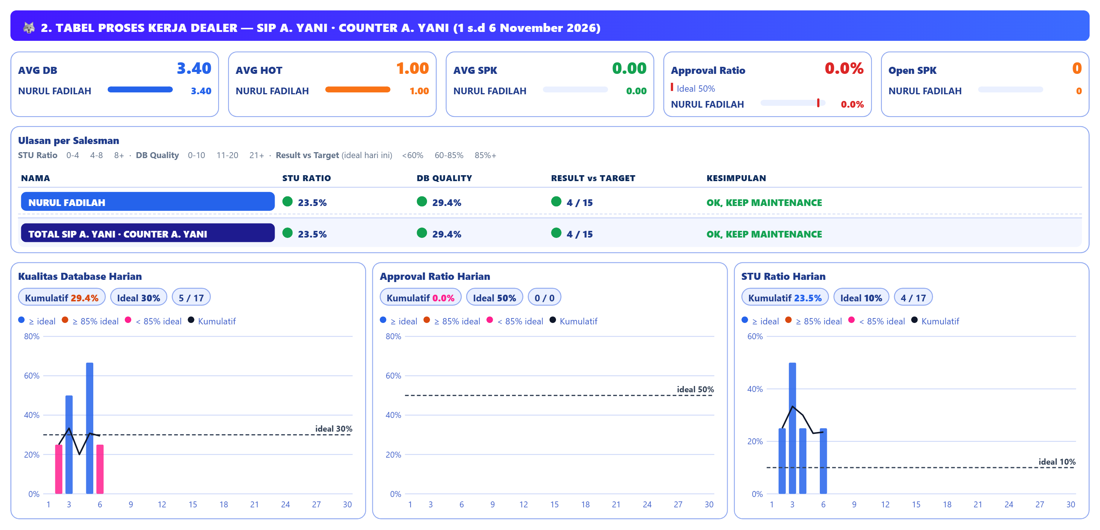
# COUNTER PROCESS REVIEW

Slide 12
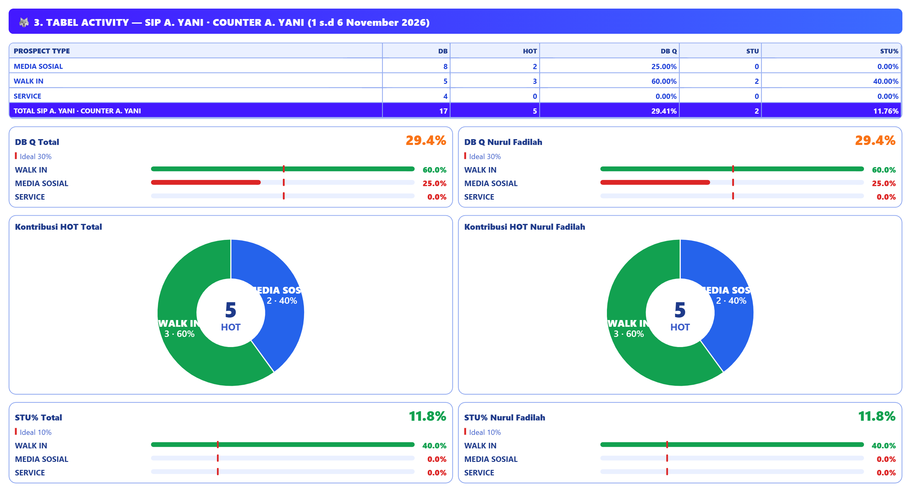
# COUNTER ACTIVITY REVIEW

Slide 13
# COUNTER REVIEW
CONDITION | PROBLEM | PERBAIKAN | TARGET PERBAIKAN | TIME LINE
DB QUALITY: DB 17 dengan HOT 5 → DB Q 29.4% (ideal 30%); STU 4 → STU% 23.5% (ideal 10%); input 3.4 DB/MP/hari oleh 1 MP.
WALK IN: target 9 STU, realisasi 2 (22%); DB 5, HOT 3 (DB Q 60.0%), STU 2 (STU% 40.0%).
MEDIA SOSIAL: target 4 STU, realisasi 0 (0%); DB 8, HOT 2 (DB Q 25.0%), STU 0 (STU% 0.0%).

Slide 14
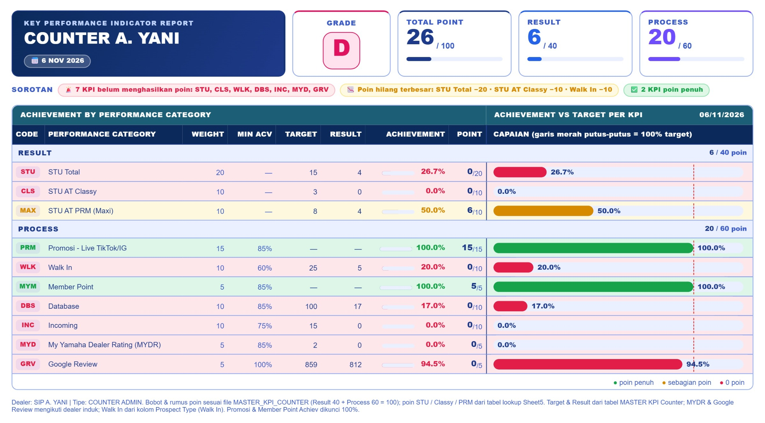
# COUNTER KPI REVIEW

Slide 15
SPK & LEASING
SIP A. YANI

Slide 16
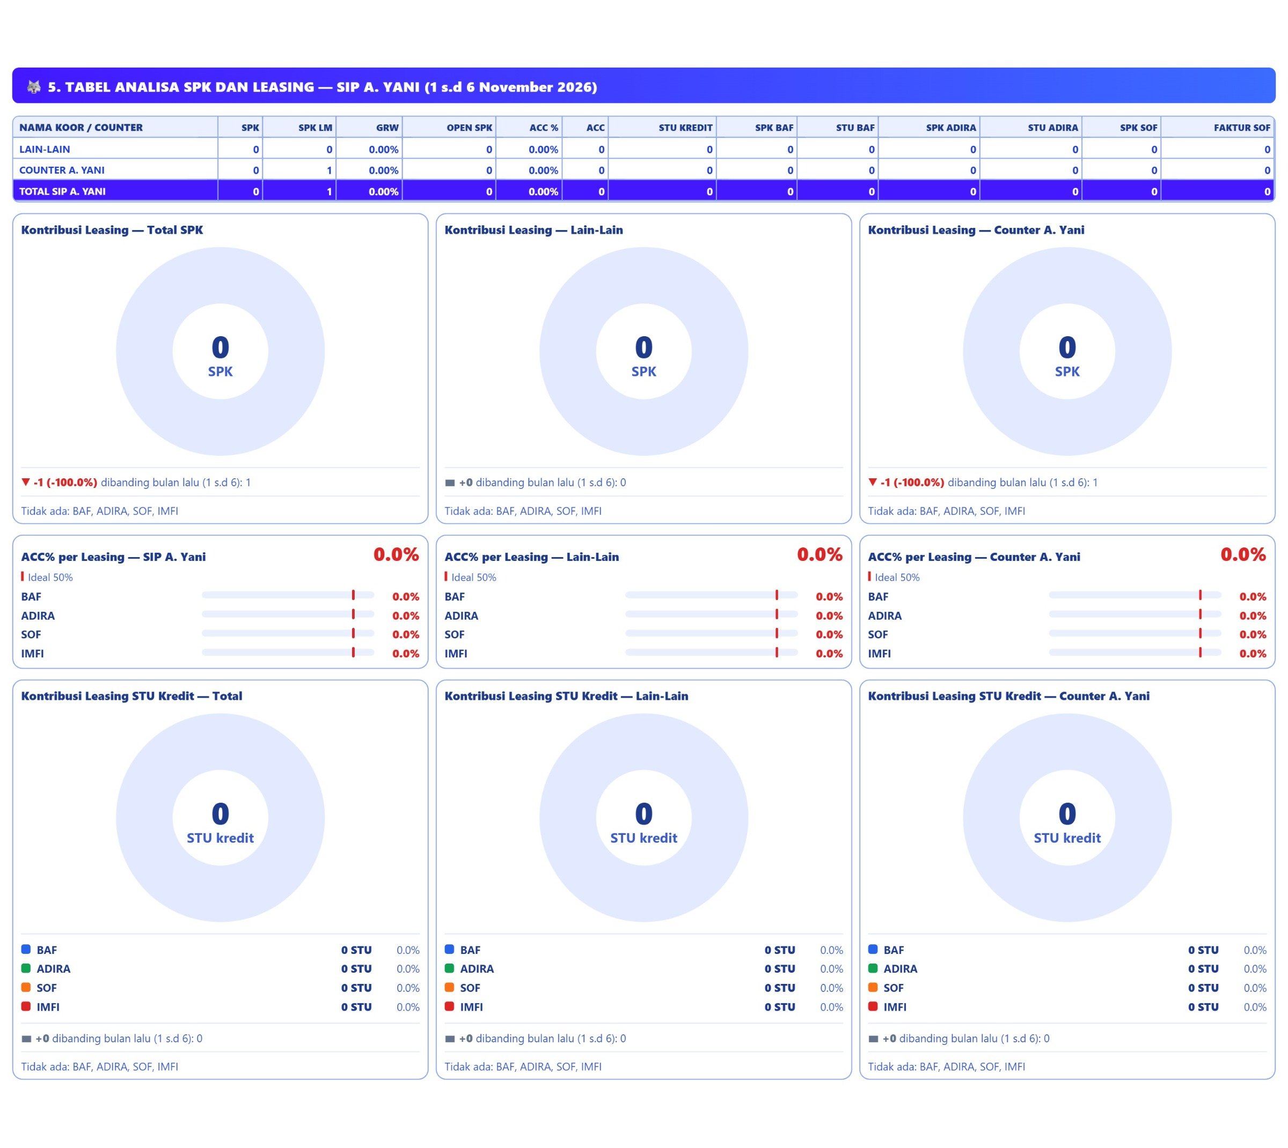
# SPK & LEASING REVIEW

Slide 17
# SPK & LEASING REVIEW
CONDITION | PROBLEM | PERBAIKAN | TARGET PERBAIKAN | TIME LINE
LEASING BAF: SPK 0, ACC% 0.0% (ideal 50%), STU kredit cair 0 unit (0% dari STU kredit); total SPK dealer 0 (LM 1), SPK terbuka 0.
LEASING ADIRA: SPK 0, ACC% 0.0% (ideal 50%), STU kredit cair 0 unit (0% dari STU kredit); total SPK dealer 0 (LM 1), SPK terbuka 0.
LEASING SOF: SPK 0, ACC% 0.0% (ideal 50%), STU kredit cair 0 unit (0% dari STU kredit); total SPK dealer 0 (LM 1), SPK terbuka 0.

Slide 18
STU by TYPE
SIP A. YANI

Slide 19
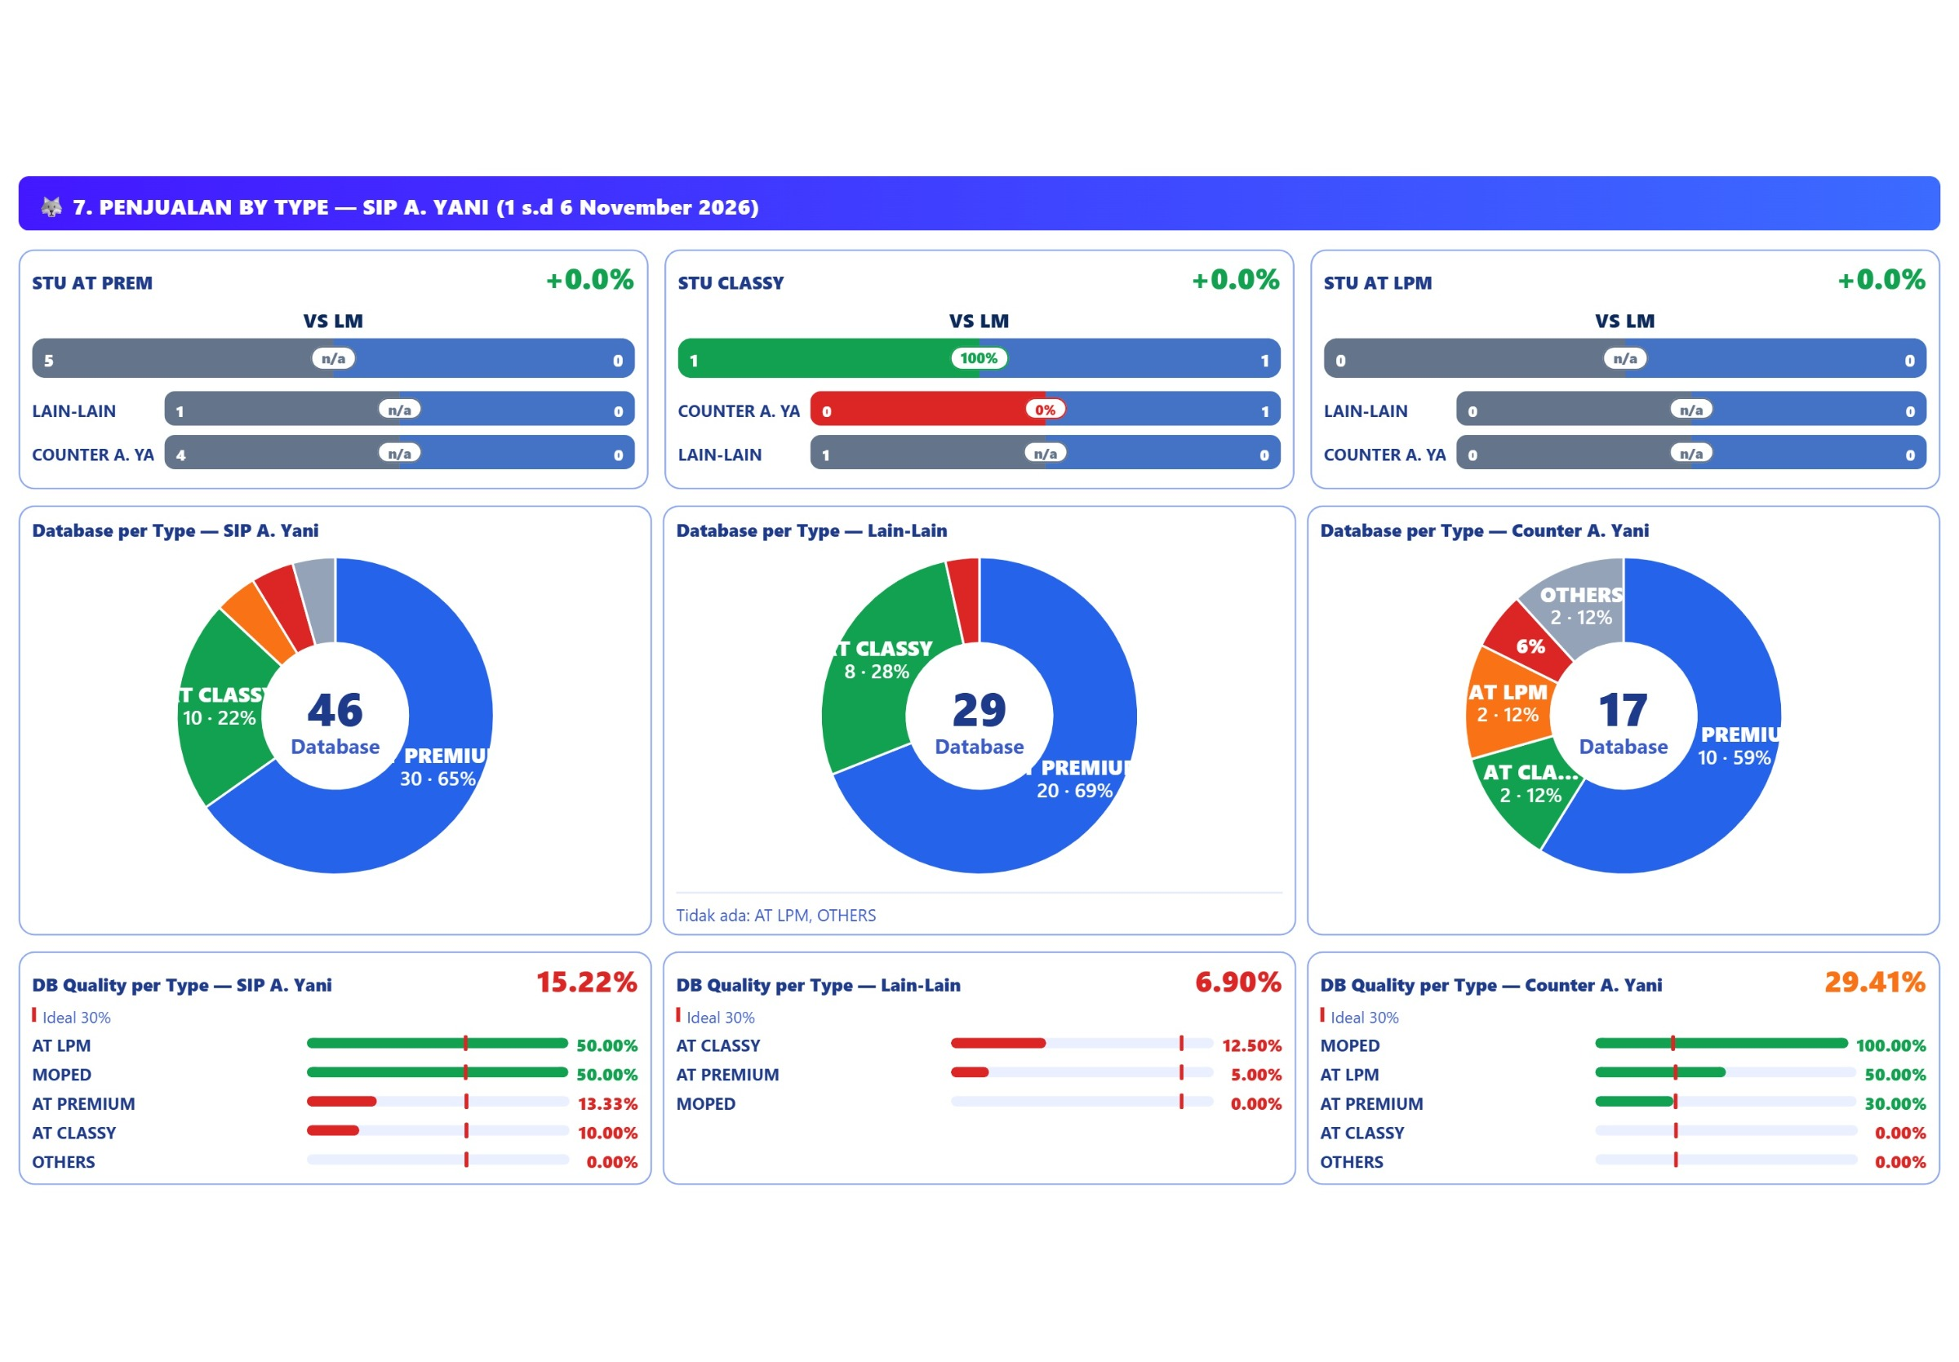
STU by TYPE REVIEW

Slide 20
# STU by TYPE REVIEW
CONDITION | PROBLEM | PERBAIKAN | TARGET PERBAIKAN | TIME LINE
AT PREMIUM: STU 5/21 (23.8%), LM 0 (growth 0%), DB 30, HOT 4 (DB Q 13.3%), SPK 0, ACC 0%.
AT CLASSY: STU 1/9 (11.1%), LM 1 (growth 100%), DB 10, HOT 1 (DB Q 10.0%), SPK 0, ACC 0%.
AT LPM: STU 0/4 (0.0%), LM 0 (growth 0%), DB 2, HOT 1 (DB Q 50.0%), SPK 0, ACC 0%.

Slide 21
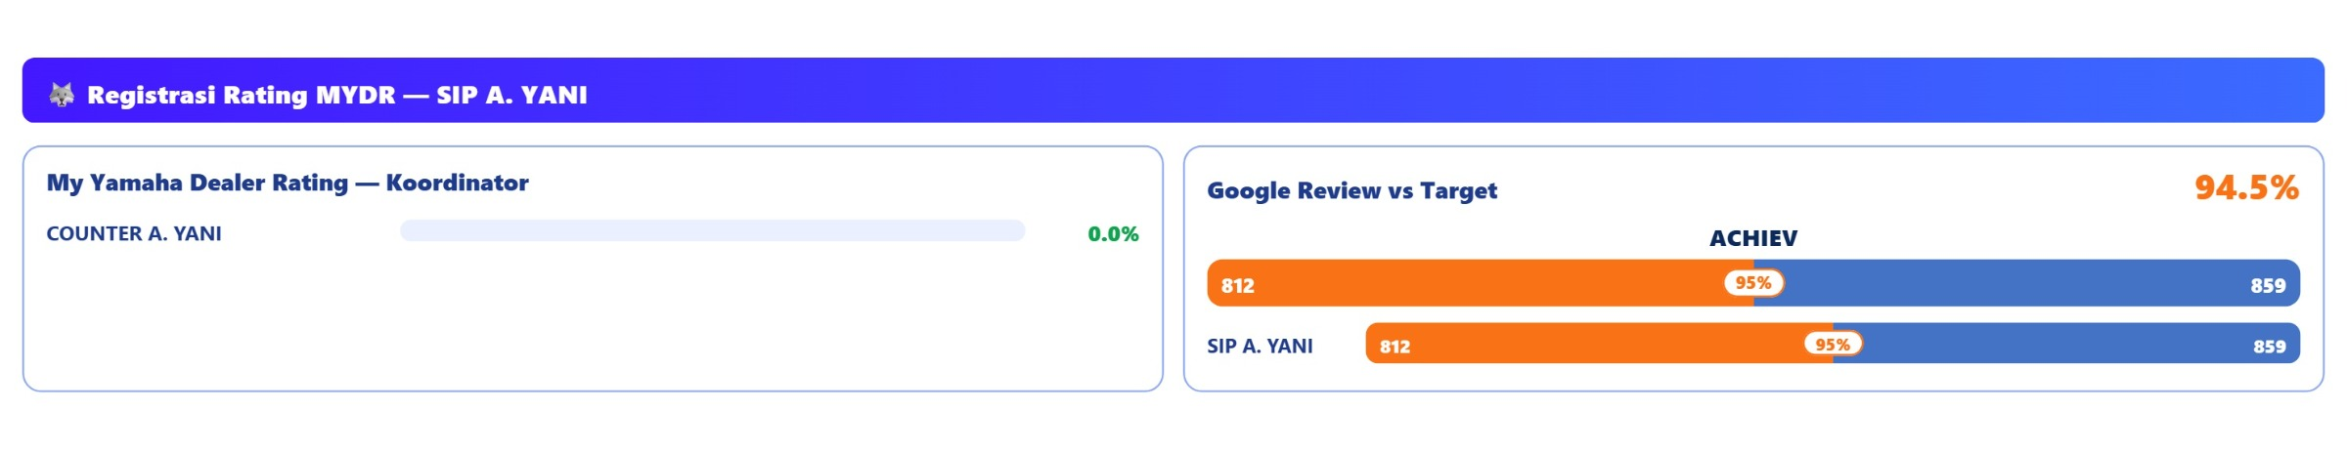
# My Yamaha Dealer Rating REVIEW

Slide 22
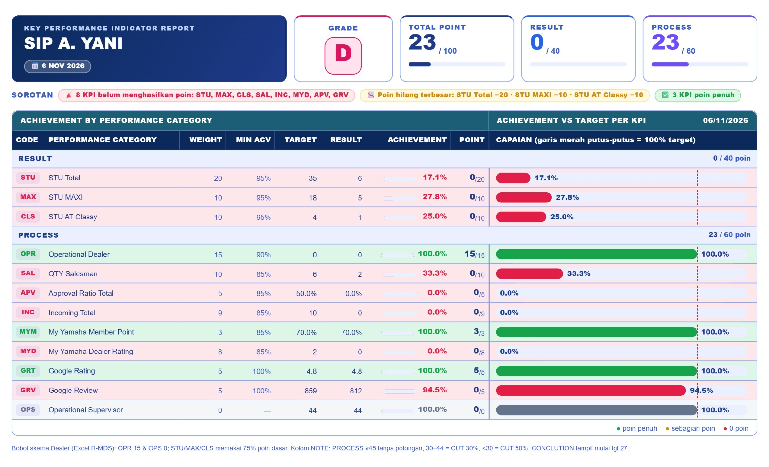
# DEALER KPI REVIEW

Slide 23
# DOCUMENTATION

Slide 24
Thank You!

