Slide 1
SIPTAPI
A TAPI service provider for SIP
klaus.darilion@ipcom.at

Slide 2
Introduction
SIPTAPI is a SIP based call-control client which can be used to initiate phone calls.
SIPTAPI is not a full SIP client, thus a dedicated SIP client – a SIP softphone or hardphone – is needed
SIPTAPI will instruct the SIP client to call a certain number

Slide 3

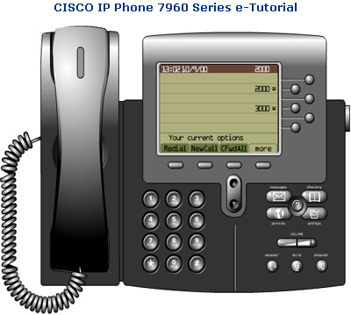
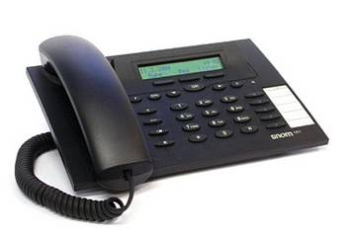
Usage
1.
➔ dial callee‘s numer in a TAPI application (e.g. Outlook, Phoner, dialer.exe)
2.
➔ caller‘s phone rings, pick up!
3.
➔ SIPTAPI tells the caller‘s phone to dial the callee‘s number (SIP REFER request)
4.
➔ callee‘s phone rings

Slide 4

Call Flow
1. INVITE caller’s phone
2. REFER caller’s phone to callee
5. BYE
3. INVITE callee
SIP Proxy
callee‘s phone
4. NOTIFY
SIPTAPI
caller‘s SIP phone

Slide 5
TAPI structure
Windows
TAPI Application
(e.g. Outlook)
TAPI
SIP TAPI TSP
processing thread
eXosip2
SIP Proxy

Slide 6
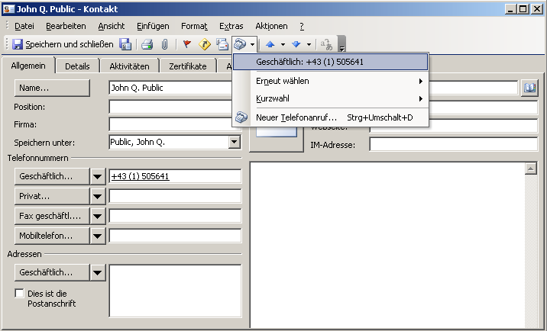
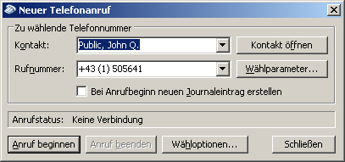
TAPI dialing
e.g. Outlook

Slide 7
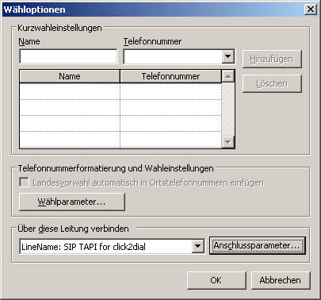
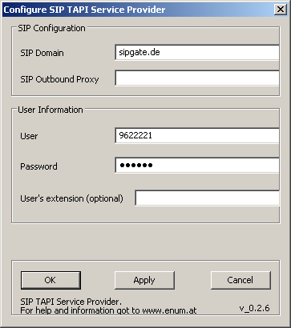
TAPI dialing
e.g. Outlook

Slide 8
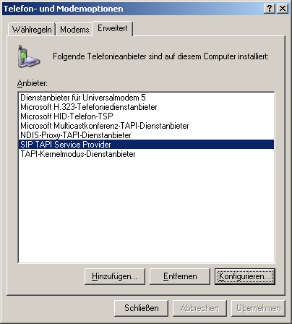
Configuration

Slide 9
Configuration
SIP Domain
  This is the SIP domain, either a fully qualified domain name or the IP address of the SIP server. Examples:
    sipgate.de
    1.2.3.4
SIP Outbound Proxy
  This field is optional and usually not needed. It should only be used if your SIP provider requires you to use an outbound proxy. In doubt leave this field empty. Examples:
    1.1.1.1
    2.2.2.2:6060
User
  The SIP username (SIP-ID) assigned to you by your SIP provider. This is just the userpart without the domain. Examples:
    klaus.darilion
    00431234567
Password
  The SIP password
User’s extension
  This field is optional and usually not needed. If a user’s extension is specified, the SIPTAPI will call this extension instead of its own extension. This is sometimes needed with Asterisk installations where you have a dedicated SIP account for the SIPTAPI and a dedicated SIP account for the SIP phone, or if the SIP username can not be used for dialing and an extension must be used.

Slide 10
Alternative Usage
Sometimes the SIP provider/PBX does not apply correct routing to REFER requests
If the following items are fulfilled, the alternative approach can be used
  the SIP phone has a static IP address and uses a static port
  there is direct IP connectivity between the SIPTAPI PC and the SIP phone

Slide 11
Alternative Call Flow
3. INVITE callee
SIP Proxy
callee‘s phone
1. INVITE caller’s phone
2. REFER caller’s phone to callee
5. BYE
SIPTAPI
caller‘s SIP phone
4. NOTIFY

Slide 12
Alternative Configuration
Example
  SIPTAPI is on PC with IP address 192.168.1.2
  SIP phone uses static IP address 192.168.1.3
  SIP phone uses static SIP port 8879
SIP Domain
  the SIP domain specified by your service provider
SIP Outbound Proxy
  192.168.1.3:8879
User
  the SIP user name specified by your service provider
Password
  the SIP password specified by your service provider
User’s extension
  leave this field empty

Slide 13
Technology
Microsoft TAPI
http://msdn.microsoft.com/library/default.asp?url=/library/en-us/dnanchor/html/tapitspimspi.asp
asttapi – TAPI provider for asterisk
http://sourceforge.net/projects/asttapi/
© Nick Knight
eXosip2/osip – SIP stack + high level API
http://www.gnu.org/software/osip/osip.html
http://savannah.nongnu.org/projects/exosip/
© Aymeric Moizard

Slide 14
Limitations
no STUN support ➔ NAT traversal requires SIP proxy with NAT traversal or outboundproxy (rport supported)
no SRV support, resolves only A records (no problem if the outboundproxy performs SRV)
some TAPI applications require strange phone number formats, e.g. Outlook: +43 (1) 505641
➔ +country code (local area code) number

Slide 15
how to get it
https://sourceforge.net/projects/siptapi/
Website: http://www.ipcom.at/index.php?id=561
License: GPL
Installation:
  copy siptapi.tsp into the windows\system32 directory
  ControlPanel → PhoneAndModemOptions → Advanced → Add → SIP TAPI Service Provider
  SIP TAPI Service Provider → Configure…
  configure your username, password, SIP domain and outboundproxy
debugging
  use Sysinternals DebugView to capture log messages: http://www.sysinternals.com/ntw2k/freeware/debugview.shtml
  use Wireshark to capture the SIP packets

