Slide 1
SIPTAPI
(scroll down for commercial SIPTAPI)
A TAPI service provider for SIP
klaus.darilion@ipcom.at

Slide 2
Note
If you can’t get SIPTAPI to work, feel free to contact me, but:
never ever contact me without reading all the READMEs, tutorials and other documentation included in the download package!!!!!
I do not have the time to tell people again and again all the things which is already written down in the docs
Thus, if you still have problems, then I will assist you, if your problem description contains at least:
  Operating System: XP, Vista…? 32/64 bit?
  TAPI application: dialer.exe, Outlook, CRM…? 32/64bit?
  The SIP phone you are using: SNOM, eyebeam, …?
  The SIP server you are using, e.g. Asterisk, sipX, Kamailio, or a hosted service (sipgate…)?

Slide 3
Table of Content
This README starts with the basic concept of TAPI and SIPTAPI. These principles are the same for the free and commercial SIPTAPI!
At the end of the document, the extensions of the commercial SIPTAPI and SIPTAPI-ACD are described

Slide 4
Introduction
SIPTAPI is a SIP based call-control client which can be used to initiate phone calls.
SIPTAPI is not a full SIP client, thus a dedicated SIP client – a SIP softphone or hardphone – is needed
SIPTAPI will instruct the SIP client to call a certain number
SIPTAPI can be used with SIP proxies (Kamailio) or PBXs (Asterisk)
If the SIP server is hosted by a service provider then SIPTAPI may not work → see alternative usage below

Slide 5

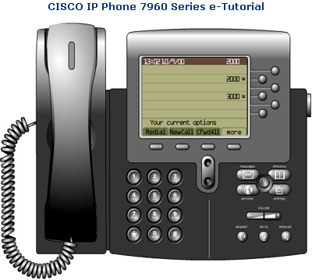
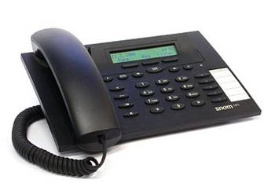
Usage
1.
➔ dial callee‘s numer in a TAPI application (e.g. Outlook, Phoner, dialer.exe)
2.
➔ caller‘s phone rings, pick up!
3.
➔ SIPTAPI tells the caller‘s phone to dial the callee‘s number (SIP REFER request)
4.
➔ callee‘s phone rings

Slide 6

Call Flow with a SIP Proxy
(Kamailio)
1. INVITE caller’s phone
2. REFER caller’s phone to callee
5. BYE
3. INVITE callee
SIP Proxy
callee‘s phone
4. NOTIFY
SIPTAPI
caller‘s SIP phone

Slide 7
Call Flow with Asterisk
1. INVITE caller’s phone
3. REFER caller’s phone to callee
4. BYE
4. INVITE callee
Asterisk
callee‘s phone
2. INVITE caller’s phone
SIPTAPI
caller‘s SIP phone

Slide 8
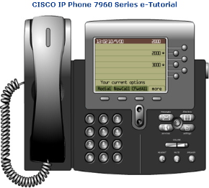
TAPI structure
Find more details how TAPI works at http://www.ipcom.at/en/telephony/siptapi/tapi/
Windows
TAPI Application
(e.g. Outlook)
user‘s SIP phone
TAPI
SIP TAPI TSP
processing thread
PSTN
eXosip2
SIP Proxy/PBX

Slide 9
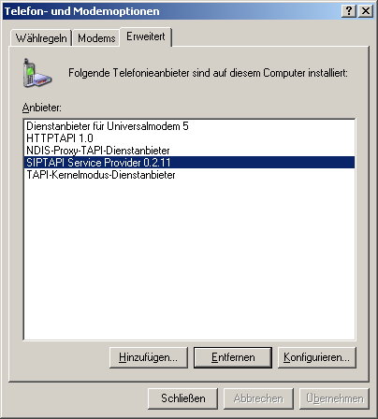
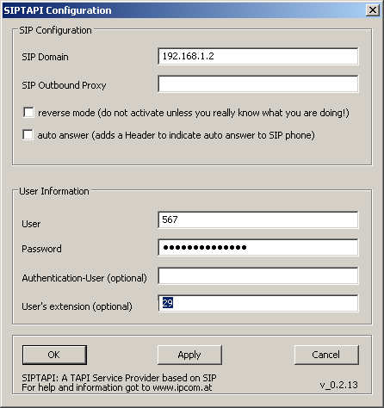
Configuration
  Note: On Windows Vista and Windows 7 you must configure SIPTAPI via the control panel and need administrator privileges!!!

Slide 10
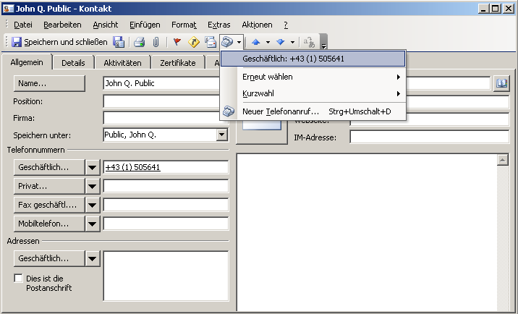
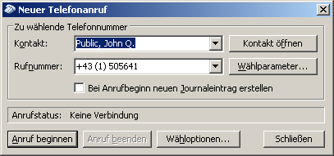
TAPI dialing
e.g. Outlook

Slide 11
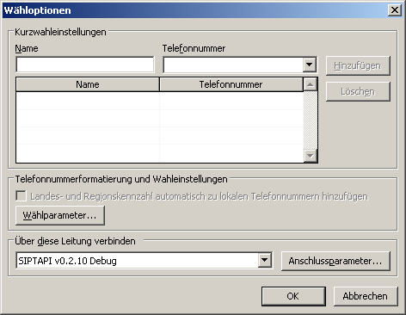
TAPI dialing
e.g. Outlook
choose SIPTAPI as TAPI line
make the phone call
2.
1.

Slide 12
Configuration
SIP Domain
  This is the SIP domain, either a fully qualified domain name or the IP address of the SIP server. Examples:
    sipgate.de
    1.2.3.4
SIP Outbound Proxy
  This field is optional and usually not needed. It should only be used if your SIP provider requires you to use an outbound proxy. In doubt leave this field empty. Examples:
    1.1.1.1
    2.2.2.2:6060
User
  The SIP username (SIP-ID) assigned to you by your SIP provider. This is just the userpart without the domain. Examples:
    klaus.darilion
    00431234567
Password
  The SIP password
Authentication User
  Some systems use a dedicated username for authentication, which is not identical to the SIP username. Usually you can leave this field empty.
User’s extension
  This field is optional and usually not needed. If a user’s extension is specified, the SIPTAPI will call this extension instead of its own extension. This is sometimes needed with Asterisk installations where you have a dedicated SIP account for the SIPTAPI and a dedicated SIP account for the SIP phone, or if the SIP username can not be used for dialing and an extension or phone-number must be used to dial to the SIP phone.
reverse mode
  In this mode SIPTAPI will first call the dialed number, and only if the target answers the call, the call will be transferred to the user's SIP phone. Use with caution - you can not hear any in-band messages or ringback tones in this mode!
auto answer
  In this mode SIPTAPI will add certain headers to the INVITE request to instruct the phone to answer the phone call automatically. This feature usually only works in the "alternative mode" or if the SIP server is a proxy. When using B2BUAs like Asterisk it won't work. It should work with Grandstream, Polycom and SNOM phones, but needs to be turned on in the web interface of the phone, e.g.: "Allow Auto Answer by Call-Info: Yes" for Grandstream phones.

Slide 13
Alternative Usage
Sometimes the SIP provider/PBX does not apply correct routing to REFER requests, or just denies them
If the following items are fulfilled, the alternative approach can be used
  the SIP phone has a static IP address and uses a static port
  there is direct IP connectivity between the SIPTAPI PC and the SIP phone

Slide 14
Alternative Call Flow
3. INVITE callee
SIP Proxy
callee‘s phone
1. INVITE caller’s phone
2. REFER caller’s phone to callee
5. BYE
SIPTAPI
caller‘s SIP phone
4. NOTIFY

Slide 15
Alternative Configuration
Example
  SIPTAPI is on PC with IP address 192.168.1.2
  SIP phone uses static IP address 192.168.1.3
  SIP phone uses static SIP port 8899
SIP Domain
  the SIP domain specified by your service provider
SIP Outbound Proxy
  192.168.1.3:8899
User
  the SIP user name specified by your service provider
Password
  the SIP password specified by your service provider
User’s extension
  leave this field empty

Slide 16
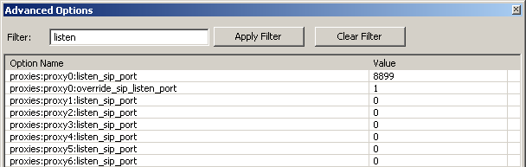
Alternative Configuration for
Xlite 3 and Eyebeam
Xlite per default uses a dynamic SIP port ☹
How to get Xlite a static IP address?
  Xlite uses the IP address of the PC. Thus make sure the PC has a static IP address
How to get Xlite a static SIP port?
  Start Xlite
  Dial ***7469 → a pop window with advanced options appears. Filter for "listen":

Slide 17
Alternative Configuration for
Xlite 3 and Eyebeam
change listen SIP port for the respective SIP account to a certain SIP port, e.g.: 8899
set override_sip_listen_port to 1
restart Xlite
configure in SIPTAPI outbound proxy: 127.0.0.1:8899
Configure “user extension” with the Sip clients username and 127.0.0.1:port as hostpart, e.g:
klaus.darilion@127.0.0.1:8899

Slide 18
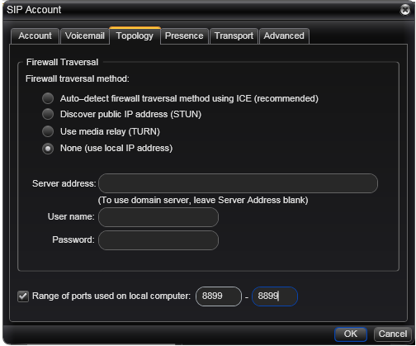
Alternative Configuration for
Bria and Xlite 4
How to get Xlite a static IP address?
  Xlite4/Bria uses the IP address of the PC. Thus make sure the PC has a static IP address
How to get a static
SIP port?
  limit the port range
  to a single port:

Slide 19
Alternative Configuration for
Bria and Xlite 4
Softphone → Account Settgins → choose the respective account → Topology → Range of ports … → limit to one port, e.g: 8899-8899
restart Xlite4/Bria
configure in SIPTAPI outbound proxy: 127.0.0.1:8899
Configure “user extension” with the SIP clients’ username and 127.0.0.1:port as hostpart, e.g:
klaus.darilion@127.0.0.1:8899

Slide 20
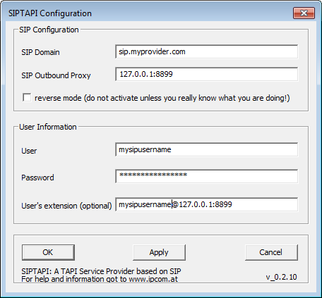
Alternative Configuration for Bria/Xlite/Eyebeam
SIPTAPI screenshot (e.g. client is fixed to port 8899)
Note: this requires at least version 0.2.10!!!

Slide 21
Reverse Mode
Normally SIPTAPI calls the user's phone and then refers it to the real target
In reverse mode SIPTAPI will call directly the target, and once the target answers, it gets refered to the user's phone.
Note: In reverse mode you wont get any audible call progress indication (e.g. ringback, busy tone ...)
Note: “reverse mode” does not work with the “alternative configuration”
1. INVITE callee’s phone
3. REFER callee’s phone to caller’s phone
5. BYE
2. INVITE callee’s phone
Asterisk
callee‘s phone
4. INVITE caller’s phone and bridge to callee’s phone
caller‘s SIP phone
SIPTAPI

Slide 22
Technology
Microsoft TAPI
http://msdn.microsoft.com/library/default.asp?url=/library/en-us/dnanchor/html/tapitspimspi.asp
asttapi – TAPI provider for asterisk
http://sourceforge.net/projects/asttapi/
© Nick Knight
eXosip2/osip – SIP stack + high level API
http://www.gnu.org/software/osip/osip.html
http://savannah.nongnu.org/projects/exosip/
© Aymeric Moizard

Slide 23
Limitations
no STUN support ➔ NAT traversal requires SIP proxy with NAT traversal or outboundproxy (rport supported)
some TAPI applications require strange phone number formats, e.g. Outlook: +43 (1) 505641
➔ +country code (local area code) number

Slide 24
how to get it
https://sourceforge.net/projects/siptapi/
Website: http://www.ipcom.at/en/telephony/siptapi/
License: GPL
Installation:
  copy siptapi.tsp into the windows\system32 directory
  ControlPanel → PhoneAndModemOptions → Advanced → Add → SIP TAPI Service Provider
  SIP TAPI Service Provider → Configure…
  configure your username, password, SIP domain and outboundproxy

Slide 25
Debugging
use Sysinternals DebugView to capture log messages (run as Administrator on Vista and above): http://www.sysinternals.com/ntw2k/freeware/debugview.shtml
use Wireshark to capture the SIP packets
Log files
  Free version: c:\siptapi_0.2.log
  Commercial version: c:\siptapi.log and c:\siptapi_osip.log

Slide 26
Commercial SIPTAPI
Note: The following slides do only apply to the commercial SIPTAPI

Slide 27
Commercial SIPTAPI
The commercial SIPTAPI additionally supports
  multiple lines → can be used in terminal server (e.g. Citrix) environments
  incoming call indication
  ACD mode: to be used by ACD dialer applications

Slide 28
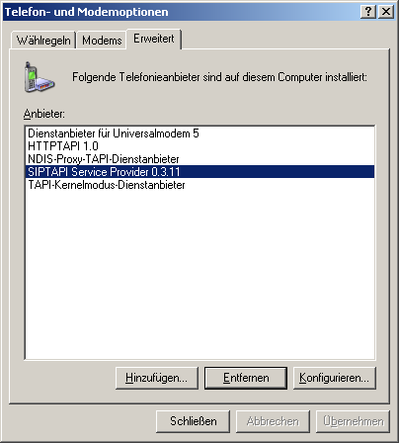
Commercial SIPTAPI Configuration
Control Panel → Phone
and Modem Options
  Note: On Windows Vista and Windows 7 you must configure SIPTAPI via the control panel and need administrator privileges!!!

Slide 29
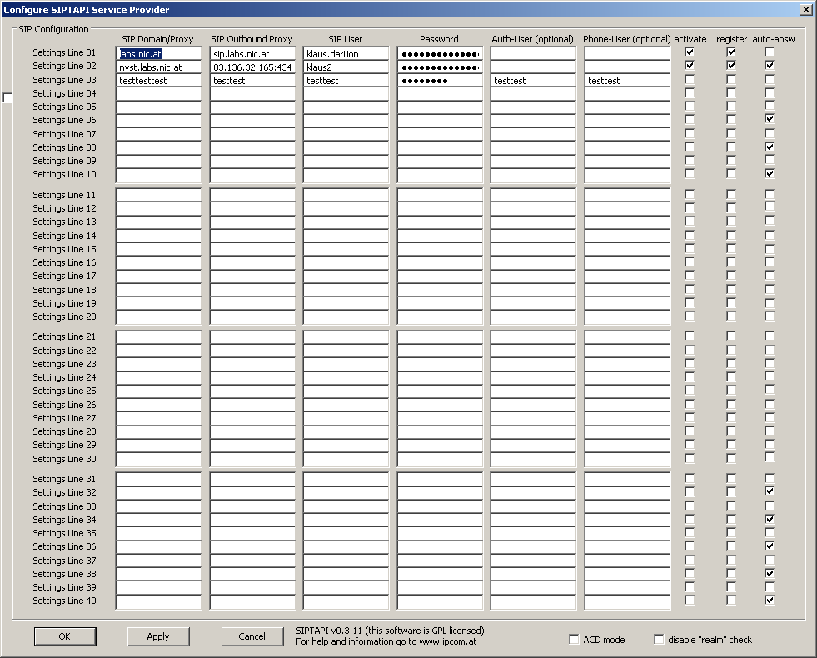
Commercial SIPTAPI Configuration
supports up to 40 totally independent lines

Slide 30
Commercial SIPTAPI Configuration
indicate to the phone
that it should auto-answer
the call
REGISTER to the SIP server
(needed for incoming call
indication)
enable/disable a line

Slide 31
Commercial SIPTAPI Configuration
Activate ACD mode (to be used by
ACD dialer software for outbound
call campaigns)
Many SIP server use an authentication
realm which does not match the SIP
domain. In this case you have to disable
the "realm" check.

Slide 32
Commercial SIPTAPI Operation Modes
Standard Mode
  call local user, automatically transfer the local user to the to-be-dialed number
ACD Mode (Dialer Mode)
  call the to-be-dialed number, wait until TAPI application transfers the call to a local agent/user

Slide 33
Commercial SIPTAPI Configuration
SIP Domain/Proxy:
  This is the SIP domain, either a fully qualified domain name or the IP address of the SIP server. Examples:
    sipgate.de
    1.2.3.4
SIP Outbound Proxy
  This field is optional and usually not needed. It should only be used if your SIP provider requires you to use an outbound proxy. In doubt leave this field empty. Examples:
    1.1.1.1
    2.2.2.2:6060
SIP User
  The SIP username (SIP-ID) assigned to you by your SIP provider. This is just the userpart without the domain. Examples:
    klaus.darilion
    00431234567
Password
  The SIP password
Auth-user
  if the SIP authentication username is different to the SIP username you can specify it here. Otherwise it should be empty. If you are unsure just leave it empty.
Phone-user
  This field is optional and usually not needed. If a user’s extension is specified, the SIPTAPI will call this extension instead of its own extension. This is sometimes needed with Asterisk installations where you have a dedicated SIP account for the SIPTAPI and a dedicated SIP account for the SIP phone, or if the SIP username can not be used for dialing and an extension must be used.

Slide 34
Commercial SIPTAPI Configuration
Activate
  Here you can disable lines without loosing the configuration settings.
Register
  when checked, this line REGISTERs to the SIP proxy/PBX. This is necessary to receive incoming call indication
Auto-answer
  In this mode SIPTAPI will add certain headers to the INVITE request to instruct the phone to answer the phone call automatically. This feature usually only works in the "alternative mode" or if the SIP server is a proxy. When using B2BUAs like Asterisk it won't work. It should work with Grandstream, Polycom and SNOM phones, but needs to be turned on in the web interface of the phone, e.g.: "Allow Auto Answer by Call-Info: Yes" for Grandstream phones.
Enable "realm" checking
  If this option is checked, then the SIP authentication also verifies the authentication realm provided by the SIP server. Usually it is not disabled, as may providers do not set the authentication realm properly. Checking this feature is necessary if you use the same user under multiple domains (e.g. sip:john.doe@example.com and sip:john.doe@mydomain.com)

Slide 35
Commercial SIPTAPI Configuration
Normal mode
  In normal mode, SIPTAPI calls first the local phone. On answer, the local phone gets transferred to the actual target.
Reverse mode
  In reverse mode, SIPTAPI calls first the actual target. On answer, the actual target gets transferred to the local phone. Note, in this mode you can not detect errors with in-band signaling (early media announcements)
ACD mode
  This mode is intended for outgoing ACD dialer applications. In this mode, SIPTAPI calls first the to-be-dialed target, and then waits for a blindTransfer request to transfer the call to the local agent. To be used with ACD-TAPI-Dialers, e.g. Overdialer from Grutzeck. Note, in this mode you can not detect errors with in-band signaling (early media announcements)

Slide 36
Alternative Usage
same technique as in free SIPTAPI version
  does not work in ACD mode
  not compatible with incoming call indication

Slide 37
ACD Mode
1.
➔ the ACD dialer TAPI application dials a new target number (e.g. Grutzeck‘s Overdialer)
2.
➔ target‘s phone rings, pick up!
3.
➔ the ACD dialer application requests a blind transfer to the agent → SIPTAPI instructs the PBX to transfer the target to a local agent (a certain extensions or a calling queue)
4.
➔ agent‘s phone rings

Slide 38
ACD Mode - Signaling
2. call target
1. INVITE target
3. REFER target to
agent
6. BYE
SIP
PBX
callee‘s phone
4. INVITE agent
5. NOTIFY
SIPTAPI
agent‘s SIP phone

Slide 39
ACD Mode - Configuration
Fixed: 40 lines
Every line needs a dedicated SIP Account at the SIP PBX (e.g. Asterisk)
disabled lines are still reported to TAPI as lines, but using them triggers LINERR_UNAVAIL error

Slide 40

ACD Mode with SIPTAPI
SIPTAPI
Asterisk
e.g. 4x ISDN PRI 120 lines
PSTN
line 1: account 1
account 1
line 2: account 2
account 2
line 3: account 3
account 3
…
…
…
line 40: account 40
account 40
agent 1
account agent 1
agent 2
account agent 2
agent 3
account agent 3
…
…
agent 20
account agent 20

Slide 41
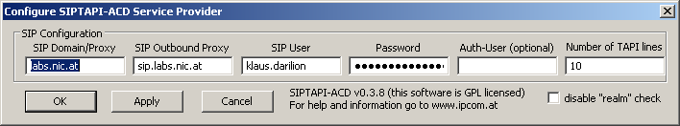
SIPTAPI-ACD
Based on SIPTAPI, but optimized for ACD Dialers
Number of TAPI lines configureable: 1 - 999
  changing the numbers requires reinitializing of the TSP)
Uses a single SIP account for all lines
  Asterisk: call-limit = 999
No support for incoming call indication!!!

Slide 42
SIPTAPI-ACD
SIPTAPI-ACD
a single SIP account can handle multiple concurrent calls
Asterisk
e.g. 4x ISDN PRI 120 lines
PSTN
line 1: account 1
account 1
line 2: account 1
line 3: account 1
…
…
line X: account 1
agent 1
account agent 1
agent 2
account agent 2
agent 3
account agent 3
…
…
agent 20
account agent 20

