Slide 1
SIP TAPI
A click2dial application, based on
asttapi and eXosip2
Klaus.Darilion@enum.at

Slide 2

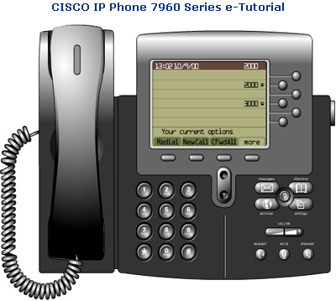
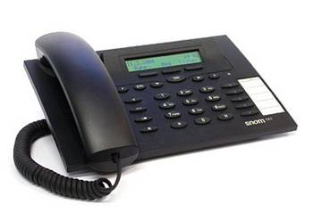
Scenario
1.
➔ dial callee‘s numer in TAPI application (e.g. Outlook)
2.
➔ caller‘s phone rings, pick up!
3.
➔ caller‘s phone INVITEs callee
4.
➔ callee‘s phone rings

Slide 3

Call Flow
1. INVITE myphone
2. REFER to callee
5. BYE myphone
3. INVITE callee
SIP Proxy
callee‘s phone
4. NOTIFY
TAPI Application
my SIP phone

Slide 4
TAPI structure
Windows
TAPI Application
(e.g. Outlook)
TAPI
SIP TAPI TSP
processing thread
eXosip2
SIP Proxy

Slide 5
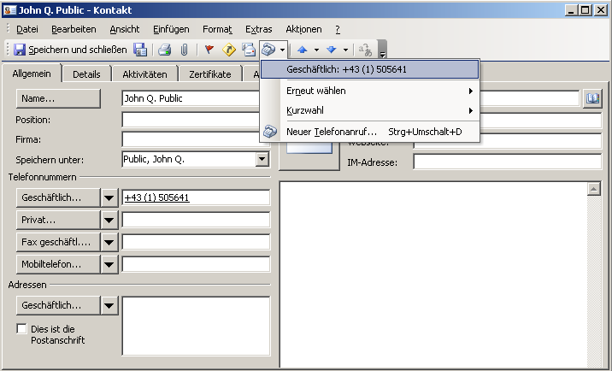
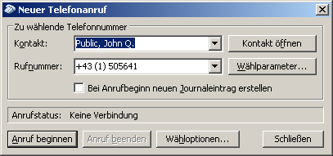
TAPI dialing
e.g. Outlook

Slide 6
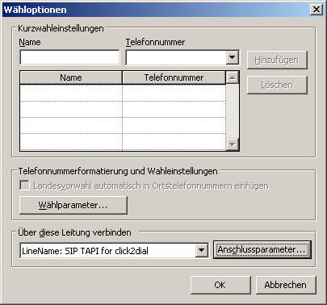
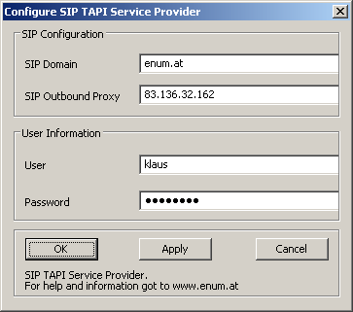
TAPI dialing
e.g. Outlook

Slide 7
Technology
Microsoft TAPI
http://msdn.microsoft.com/library/default.asp?url=/library/en-us/dnanchor/html/tapitspimspi.asp
asttapi – TAPI provider for asterisk
http://sourceforge.net/projects/asttapi/
© Nick Knight
eXosip2/osip – SIP stack + high level API
http://www.gnu.org/software/osip/osip.html
http://savannah.nongnu.org/projects/exosip/
© Aymeric Moizard

Slide 8
Limitations
no STUN support ➔ NAT traversal requires SIP proxy with NAT traversal or outboundproxy (rport supported)
no SRV support, resolves only A records (no problem if the outboundproxy performs SRV)
probably buggy TAPI implementation
some TAPI applications require strange phone number formats, e.g. Outlook: +43 (1) 505641
➔ +country code (local area code) number

Slide 9
ToDo
STUN
SRV
ENUM
check sipfrag response code in NOTIFY
allow regexp applied to phone number

Slide 10
how to get it
www.enum.at ➔ Using ENUM ➔ siptapi
License: GPL
Installation:
  copy siptapi.tsp into the windows\system32 directory
  ControlPanel → PhoneAndModemOptions → Advanced → Add → SIP TAPI Service Provider
  SIP TAPI Service Provider → Configure…
  configure your username, password, SIP domain and outboundproxy
  debug using Sysinternals DebugView: http://www.sysinternals.com/ntw2k/freeware/debugview.shtml

Slide 11
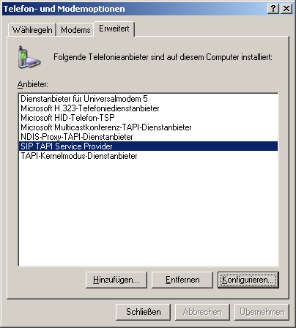
Configuration

