Slide 1
SIPTAPI
A TAPI service provider for SIP
klaus.darilion@ipcom.at

Slide 2
Note
If you can’t get SIPTAPI to work, feel free to contact me, but:
never ever contact me without reading all the READMEs, tutorials and other documentation included in the download package!!!!!
I do not have the time to tell people again and again all the things which is already written down in the docs
Thus, if you still have problems, then I will assist you, if your problem description contains at least:
  Operating System: XP, Vista…? 32/64 bit?
  TAPI application: dialer.exe, Outlook, CRM…? 32/64bit?
  The SIP phone you are using: SNOM, eyebeam, …?
  The SIP server you are using, e.g. Asterisk, sipX, Kamailio, or a hosted service (sipgate…)?

Slide 3
Introduction
SIPTAPI is a SIP based call-control client which can be used to initiate phone calls.
SIPTAPI is not a full SIP client, thus a dedicated SIP client – a SIP softphone or hardphone – is needed
SIPTAPI will instruct the SIP client to call a certain number
SIPTAPI can be used with SIP proxies (Kamailio) or PBXs (Asterisk)
If the SIP server is hosted by a service provider then SIPTAPI may not work → see alternative usage below

Slide 4

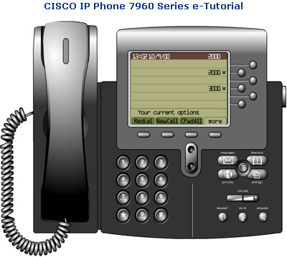
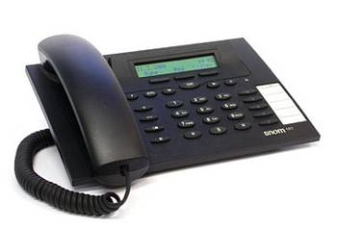
Usage
1.
➔ dial callee‘s numer in a TAPI application (e.g. Outlook, Phoner, dialer.exe)
2.
➔ caller‘s phone rings, pick up!
3.
➔ SIPTAPI tells the caller‘s phone to dial the callee‘s number (SIP REFER request)
4.
➔ callee‘s phone rings

Slide 5

Call Flow with a SIP Proxy
(Kamailio)
1. INVITE caller’s phone
2. REFER caller’s phone to callee
5. BYE
3. INVITE callee
SIP Proxy
callee‘s phone
4. NOTIFY
SIPTAPI
caller‘s SIP phone

Slide 6
Call Flow with Asterisk
1. INVITE caller’s phone
3. REFER caller’s phone to callee
4. BYE
4. INVITE callee
Asterisk
callee‘s phone
2. INVITE caller’s phone
SIPTAPI
caller‘s SIP phone

Slide 7
TAPI structure
Windows
TAPI Application
(e.g. Outlook)
TAPI
SIP TAPI TSP
processing thread
eXosip2
SIP Server

Slide 8
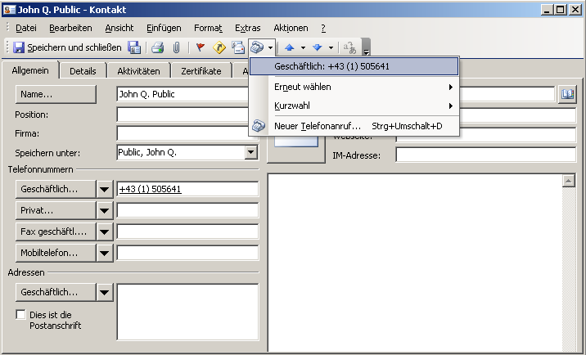
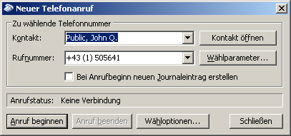
TAPI dialing
e.g. Outlook

Slide 9
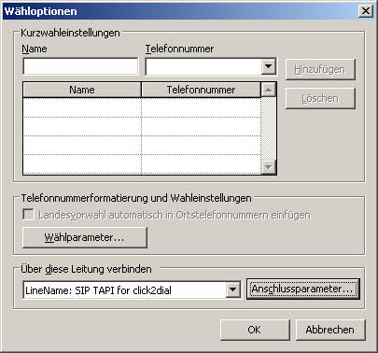
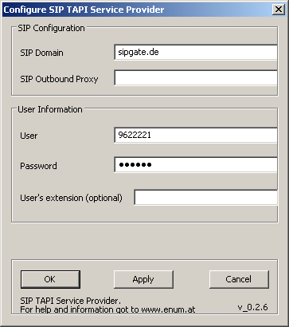
TAPI dialing
e.g. Outlook

Slide 10
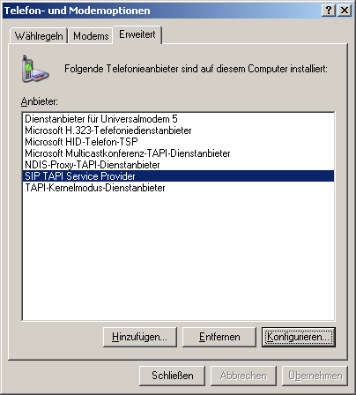
Configuration

Slide 11
Configuration
SIP Domain
  This is the SIP domain, either a fully qualified domain name or the IP address of the SIP server. Examples:
    sipgate.de
    1.2.3.4
SIP Outbound Proxy
  This field is optional and usually not needed. It should only be used if your SIP provider requires you to use an outbound proxy. In doubt leave this field empty. Examples:
    1.1.1.1
    2.2.2.2:6060
User
  The SIP username (SIP-ID) assigned to you by your SIP provider. This is just the userpart without the domain. Examples:
    klaus.darilion
    00431234567
Password
  The SIP password
User’s extension
  This field is optional and usually not needed. If a user’s extension is specified, the SIPTAPI will call this extension instead of its own extension. This is sometimes needed with Asterisk installations where you have a dedicated SIP account for the SIPTAPI and a dedicated SIP account for the SIP phone, or if the SIP username can not be used for dialing and an extension must be used.

Slide 12
Alternative Usage
Sometimes the SIP provider/PBX does not apply correct routing to REFER requests, or just denies them
If the following items are fulfilled, the alternative approach can be used
  the SIP phone has a static IP address and uses a static port
  there is direct IP connectivity between the SIPTAPI PC and the SIP phone

Slide 13
Alternative Call Flow
3. INVITE callee
SIP Proxy
callee‘s phone
1. INVITE caller’s phone
2. REFER caller’s phone to callee
5. BYE
SIPTAPI
caller‘s SIP phone
4. NOTIFY

Slide 14
Alternative Configuration
Example
  SIPTAPI is on PC with IP address 192.168.1.2
  SIP phone uses static IP address 192.168.1.3
  SIP phone uses static SIP port 8899
SIP Domain
  the SIP domain specified by your service provider
SIP Outbound Proxy
  192.168.1.3:8899
User
  the SIP user name specified by your service provider
Password
  the SIP password specified by your service provider
User’s extension
  leave this field empty

Slide 15
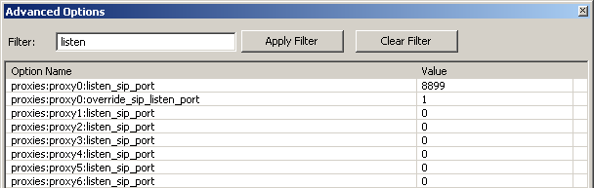
Alternative Configuration for
Xlite/Eyebeam
Xlite per default uses a dynamic SIP port ☹
How to get Xlite a static IP address?
  Xlite uses the IP address of the PC. Thus make sure the PC has a static IP address
How to get Xlite a static SIP port?
  Start Xlite
  Dial ***7469 → a pop window with advanced options appears. Filter for "listen":

Slide 16
Alternative Configuration for
Xlite/Eyebeam
change listen SIP port for the respective SIP account to a certain SIP port, e.g.: 8899
set override_sip_listen_port to 1
restart Xlite
(in Bria, search in the account settings/options for a port range and limit to one single port)
configure in SIPTAPI outbound proxy: 127.0.0.1:8899
Configure “user extension” with the Sip clients username and 127.0.0.1:port as hostpart, e.g:
klaus.darilion@127.0.0.1:8899

Slide 17
Reverse Mode
Normally SIPTAPI calls the user's phone and then refers it to the real target
In reverse mode SIPTAPI will call directly the target, and once the target answers, it gets refered to the user's phone.
Note: In reverse mode you wont get any audible call progress indication (e.g. ringback, busy tone ...)
Note: “reverse mode” does not work with the “alternative configuration”
1. INVITE callee’s phone
3. REFER callee’s phone to caller’s phone
5. BYE
2. INVITE callee’s phone
Asterisk
callee‘s phone
4. INVITE caller’s phone and bridge to callee’s phone
caller‘s SIP phone
SIPTAPI

Slide 18
Technology
Microsoft TAPI
http://msdn.microsoft.com/library/default.asp?url=/library/en-us/dnanchor/html/tapitspimspi.asp
asttapi – TAPI provider for asterisk
http://sourceforge.net/projects/asttapi/
© Nick Knight
eXosip2/osip – SIP stack + high level API
http://www.gnu.org/software/osip/osip.html
http://savannah.nongnu.org/projects/exosip/
© Aymeric Moizard

Slide 19
Limitations
no STUN support ➔ NAT traversal requires SIP proxy with NAT traversal or outboundproxy (rport supported)
some TAPI applications require strange phone number formats, e.g. Outlook: +43 (1) 505641
➔ +country code (local area code) number

Slide 20
how to get it
https://sourceforge.net/projects/siptapi/
Website: http://www.ipcom.at/en/telephony/siptapi/
License: GPL
Installation:
  copy siptapi.tsp into the windows\system32 directory
  ControlPanel → PhoneAndModemOptions → Advanced → Add → SIP TAPI Service Provider
  SIP TAPI Service Provider → Configure…
  configure your username, password, SIP domain and outboundproxy

Slide 21
Debugging
use Sysinternals DebugView to capture log messages (run as Administrator on Vista and above): http://www.sysinternals.com/ntw2k/freeware/debugview.shtml
use Wireshark to capture the SIP packets
Log files
  Free version: c:\siptapi_0.2.log
  Commercial version: c:\siptapi.log and c:\siptapi_osip.log

