Slide 1
PerfectHome
Rod Hammond . Elijah Ginter . Kristen Edwards . Toland Gooch
4 November 2016
Skill Distilery, SD6

Slide 2
Scope and Purpose
Home relocation assistance
Keep track of appointments
Jot down thoughts related to each home/property
Personal photo repository
Quick reference rating system

Slide 3
Demo
Kristen Edwards

Slide 4

Technology
Elijah Ginter

Slide 5
Technologies
Back-End:
mySQL Database
JPA/Hibernate Project
Spring MVC Dynamic Web Projec
Front-End
Angular
jQuery
HTML
CSS/Bootstrap
API
REST API
Google API
Zillow API
Cloudinary

Slide 6
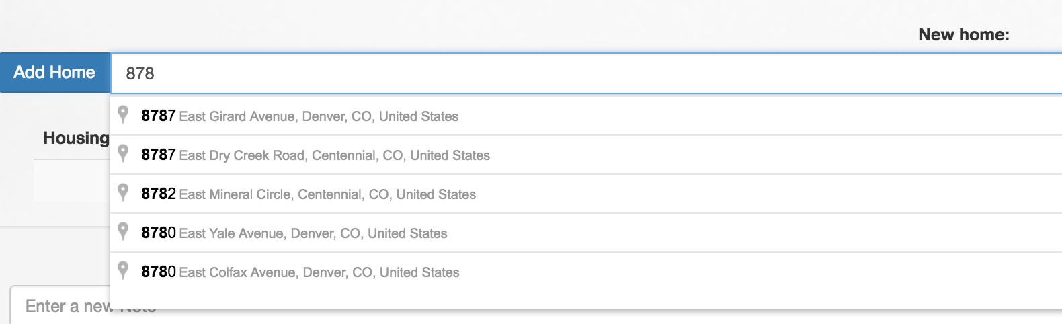
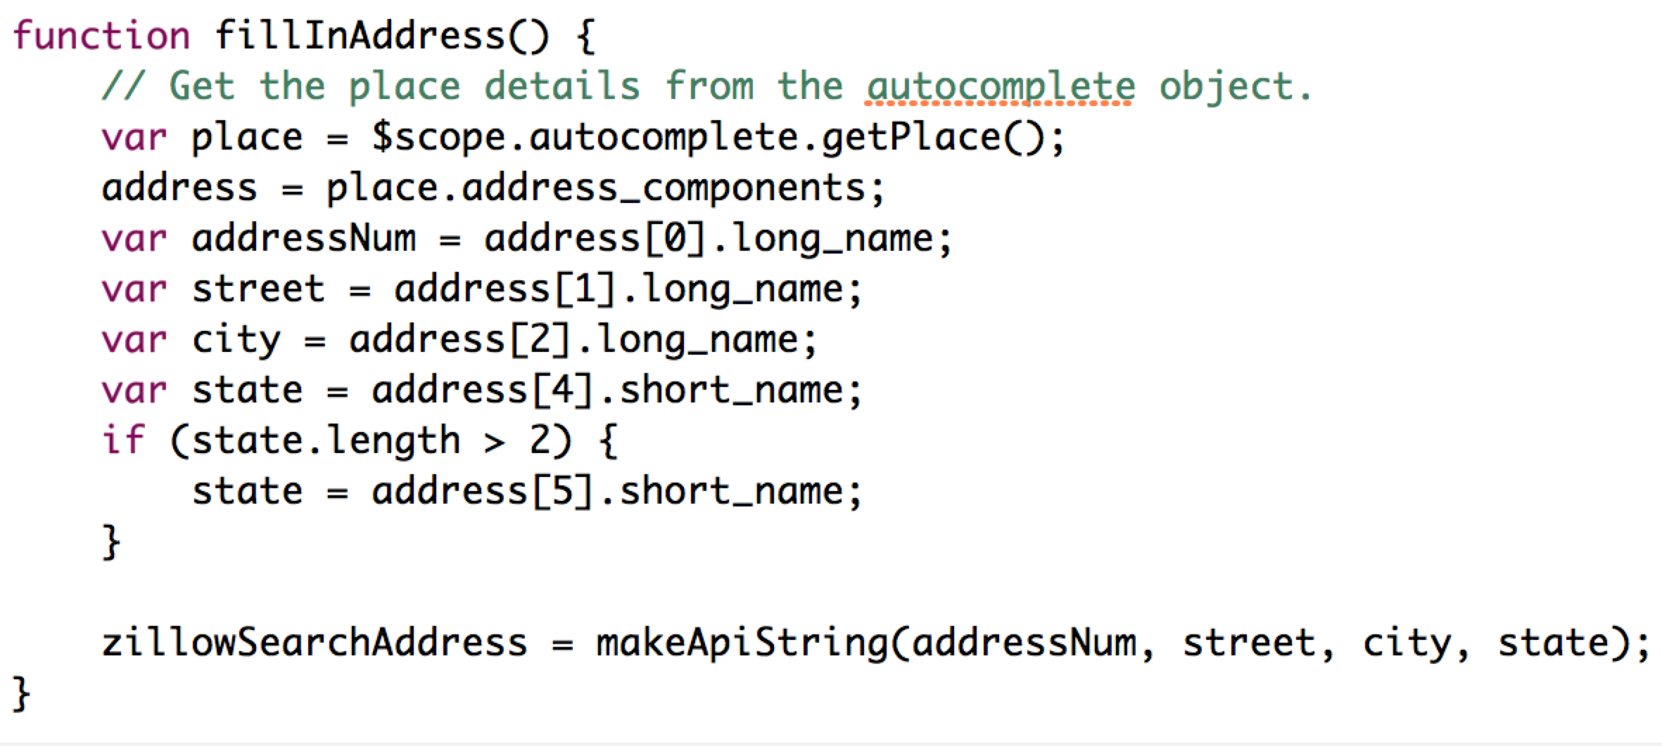
Code Snippets
Google API

Slide 7
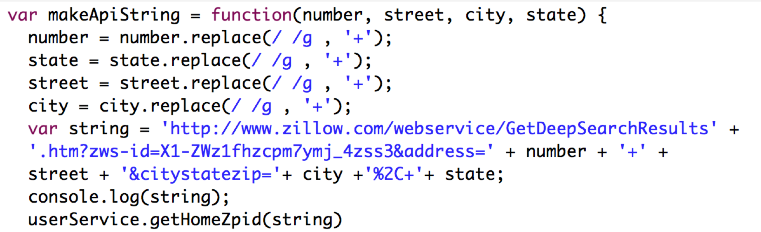
Code Snippets
Zillow API(1 of 6)

Slide 8
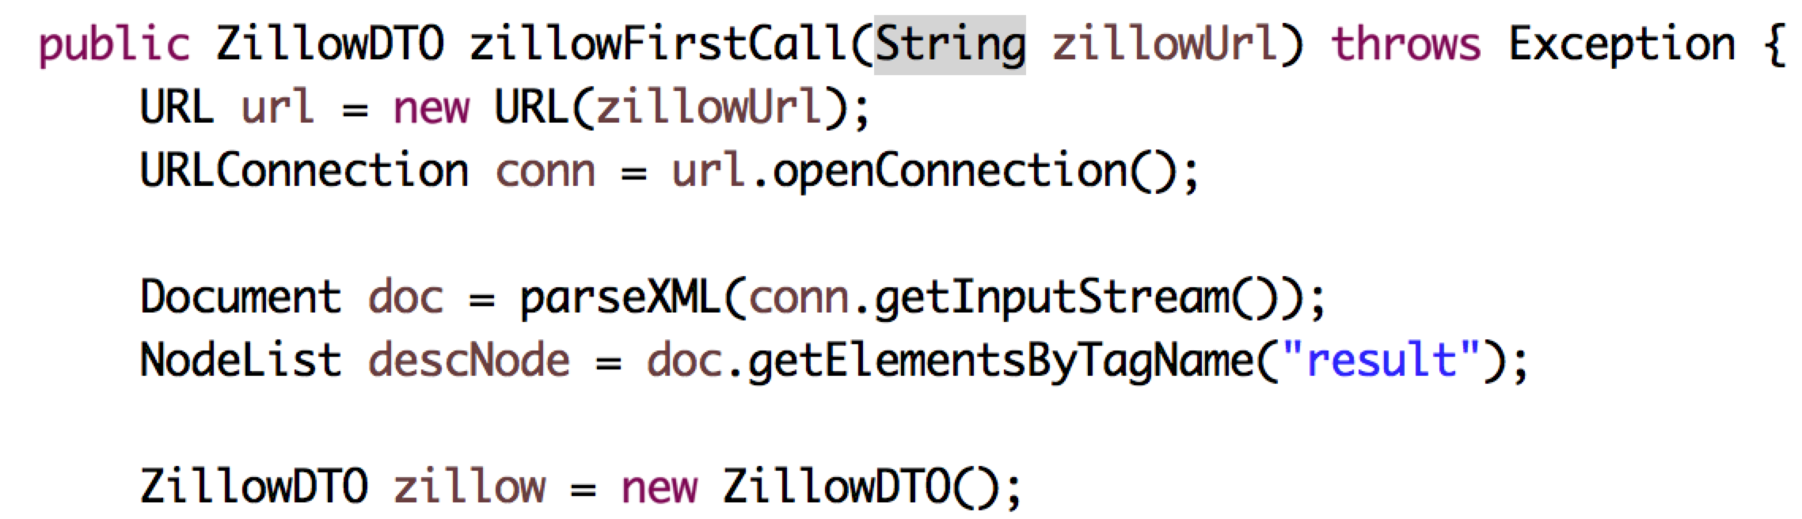
Code Snippets
Zillow API(2 of 6)

Slide 9
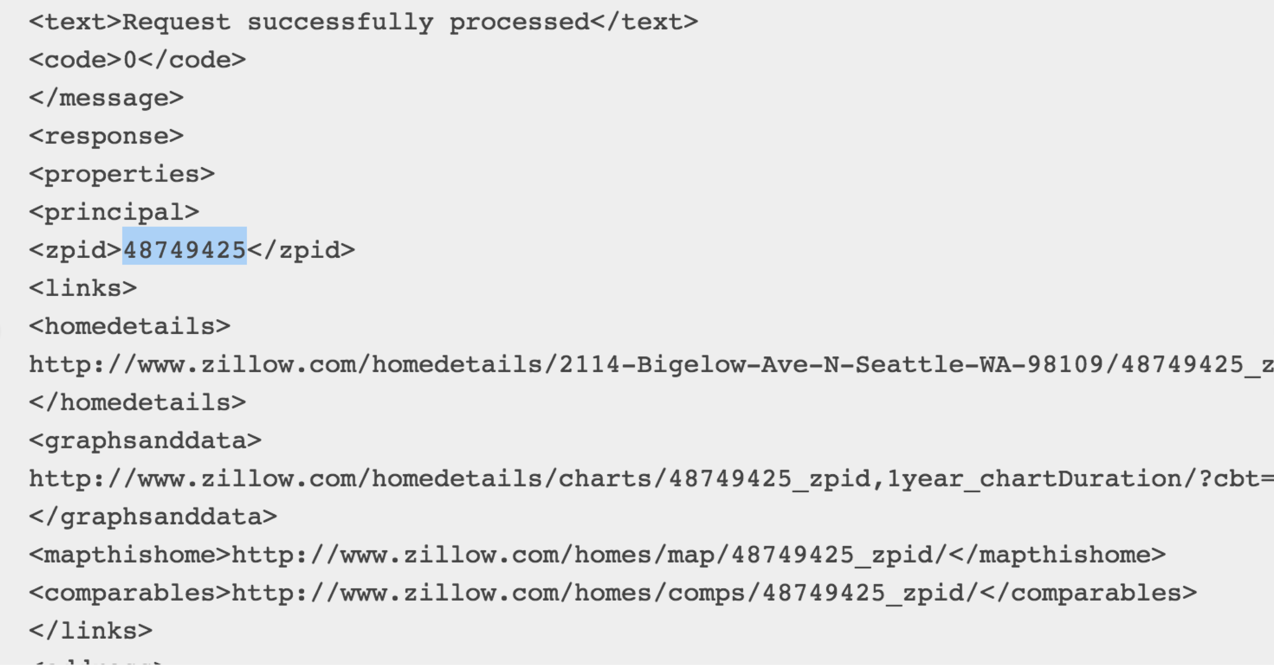
Code Snippets
Zillow API(3 of 6)

Slide 10
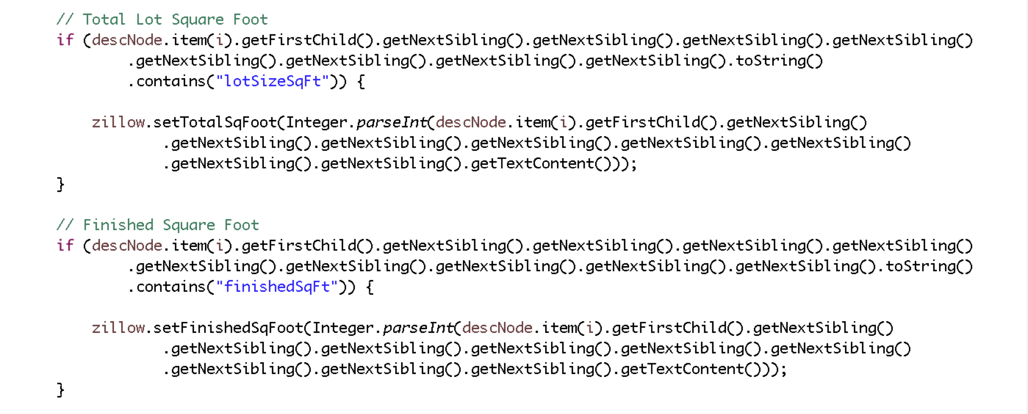
Code Snippets
Zillow API(4 of 6)

Slide 11
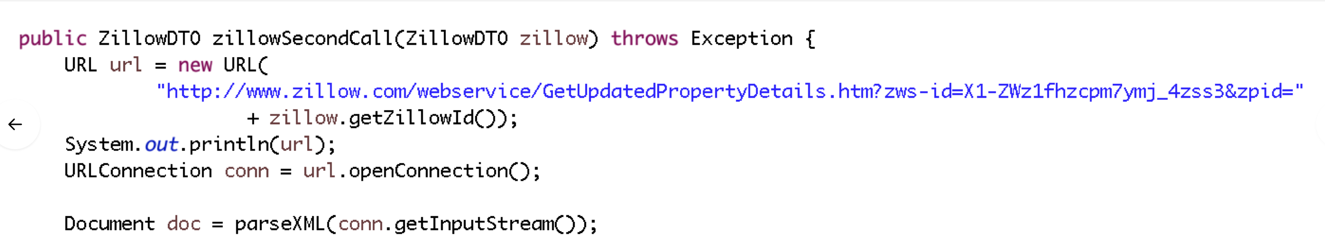
Code Snippets
Zillow API(5 of 6)

Slide 12
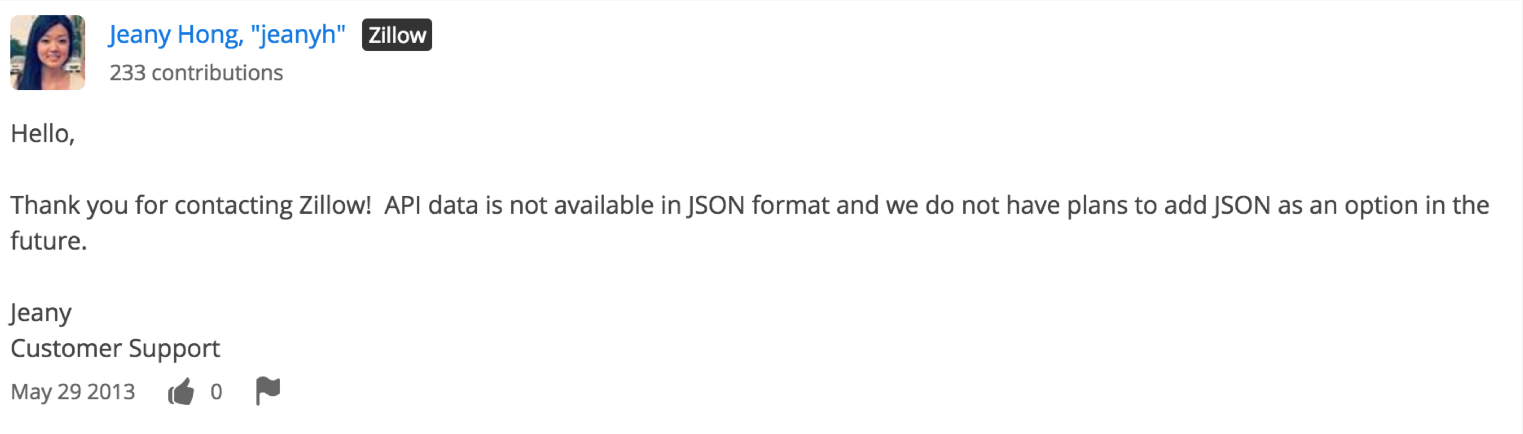
Code Snippets
Zillow API(6 of 6)

Slide 13
Front-end Styling
Toland Gooch

Slide 14
Closing
PerfectHome 2.o
Reduce API dependency
Todo suspense user notifications
More frequent GitHub pushes
Feature management control from start to finish
Develop UML before starting code
Functionality 1st then group transition to UI development

