Slide 1
Lecture 4:
Dispatch Rules &
Simplified Shifting Bottleneck
H. Abouee Mehrizi 2016

Slide 2
Outline
From Project Planning to Scheduling
A Scheduling Problem
What are Heuristic Methods?
What is a Dispatching Rule?
Simplified Shifting Bottleneck Heuristic
  Example 5.4.2
H. Abouee Mehrizi 2016

Slide 3

Readings
P Ch 5.2, 5.4, C.2
Some slides taken from University of Toronto
  See Pinedo CD
H. Abouee Mehrizi 2016

Slide 4
Overview
Critical Path
Method (CPM)
Program Evaluation
and Review Technique
(PERT)
Time/Cost Trade-off Heuristic
No resource
Constraints
Project
Scheduling
Resource
Constraints
Heuristics
Integer Programming
Formulations
H. Abouee Mehrizi 2016

Slide 5
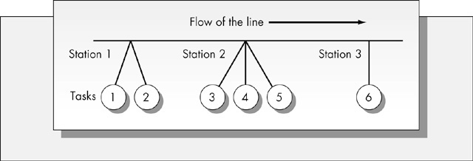

Flow Shop Scheduling
Routes of all jobs are identical (all jobs visit the same machines in the same sequence)
H. Abouee Mehrizi 2016

Slide 6
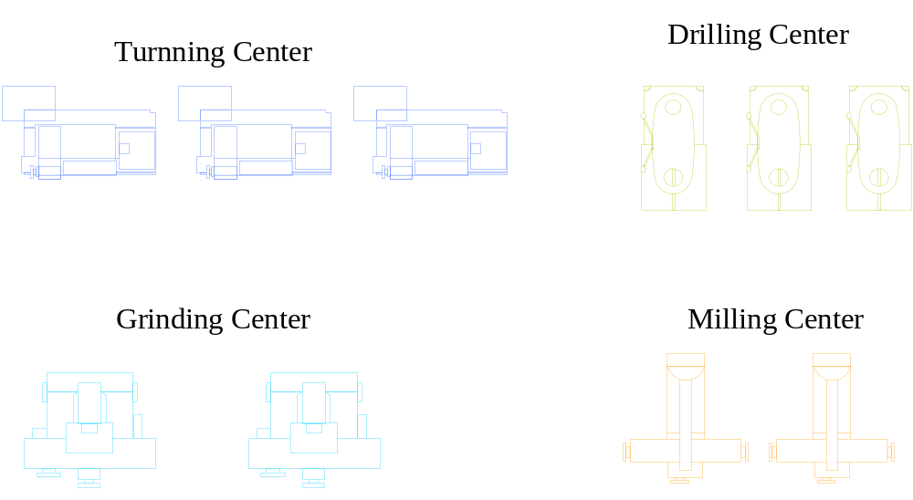
Job Shop Scheduling (JSP)
A job shop is organized by machines which are grouped according to their functions
Job 1
Job 2
H. Abouee Mehrizi 2016

Slide 7
Job Shop Scheduling (JSP)
Operation/Task/
Activity
Each operation
requires one unit
of one resource
Each resource
has a capacity
of 1
Job
Precedence Constraint
H. Abouee Mehrizi 2016

Slide 8
Job Shop Scheduling (JSP)
J0
Need to decide
the order of each
operation on
each resource
J1
J2
H. Abouee Mehrizi 2016

Slide 9



Job Shop Scheduling (JSP)
J0
J1
J2
makespan
H. Abouee Mehrizi 2016

Slide 10
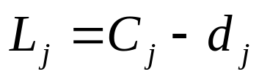

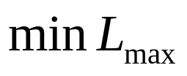


Beyond the JSP #3
Optimize something other than makespan
Lateness
Maximum lateness
Minimize maximum lateness
Due date for job j
Completion time of job j
Lateness
H. Abouee Mehrizi 2016

Slide 11
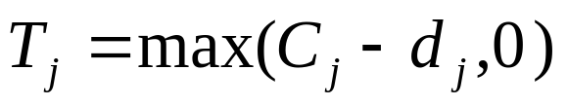
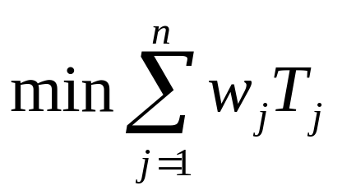

Beyond the JSP #3
Optimize something other than makespan
Tardiness
Minimize the total weighted tardiness
Due date for job j
Completion time of job j
Tardiness
Weight for job j
H. Abouee Mehrizi 2016

Slide 12
Heuristic Methods
Fast algorithms that result in a schedule
Usually no quality guarantee
  except in very restricted cases
    e.g., 1-machine
  sometimes good quality, but can be arbitrarily bad depending on the data for the specific problem
H. Abouee Mehrizi 2016

Slide 13
Dispatching Rules
J0
J0
J2
J1
J1
J2
t
H. Abouee Mehrizi 2016

Slide 14
Dispatching Rules
Create a queue of operations for each resource
  include all operations that can execute at the current time
Whenever a machine becomes free:
  update queues
  rank operations (based on a [simple] rule)
  schedule highest priority activity
H. Abouee Mehrizi 2016

Slide 15
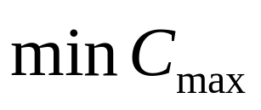
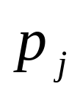
Longest Processing Time (LPT)
Objective: minimize the makespan
Always choose the to execute the activity in the queue with the longest processing time
Makespan of the problem
H. Abouee Mehrizi 2016

Slide 16
Longest Processing Time (LPT)
J0
J0
J2
J1
J1
J2
t
H. Abouee Mehrizi 2016

Slide 17
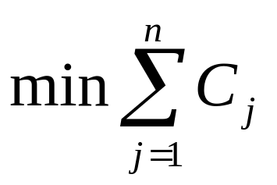
Shortest Processing Time (SPT)
Objective: minimize the total completion time
Always choose the to execute the activity in the queue with the shortest processing time
Completion time of job j
H. Abouee Mehrizi 2016

Slide 18
Dispatching Rules: SPT
J0
J0
J2
J1
J1
J2
t
H. Abouee Mehrizi 2016

Slide 19
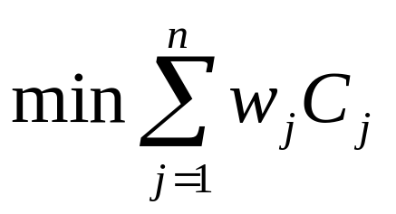
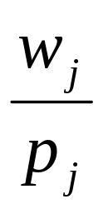
Weighted Shortest
Processing Time (WSPT)
Objective: minimize the total weighted completion time
Always choose the to execute the activity in the queue with the greatest ratio of weight to processing time
Weight for job j
Completion time of job j
Completion time of job j
H. Abouee Mehrizi 2016

Slide 20
Dispatching Rules: WSPT
W0=1
J0
J0
J2
J1
W1=2
J1
4
W2=3
J2
1
t
H. Abouee Mehrizi 2016

Slide 21

Earliest Due Date First (EDD)
Objective: minimize maximum lateness
Always choose to execute the activity in the queue with the earliest due date
H. Abouee Mehrizi 2016

Slide 22
Dispatching Rules: EDD
d0=9
J0
J0
J2
J1
d1=8
J1
d2=10
J2
t
H. Abouee Mehrizi 2016

Slide 23
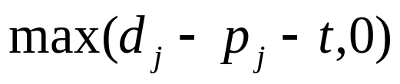
Minimize Slack First (MS)
Dynamic priority rule
Objective: minimize maximum lateness
When a machine becomes available, the job with the least slack is chosen
Time that the machine becomes available
H. Abouee Mehrizi 2016

Slide 24
Dispatching Rules: MS
d0=9
J0
J0
J2
J1
d1=8
J1
4
d2=9
J2
1
t=2
H. Abouee Mehrizi 2016

Slide 25
Dispatching Rules
Except in special cases, dispatch rules are not guaranteed to find the optimal solution
Often used for very hard (or large) problems were a good solution is “good enough”
H. Abouee Mehrizi 2016

Slide 26

Another Scheduling
Problem
Jobs | Processing times | Weights
0 | J0R0[15] → J0R1[50] → J0R2[60] | w₀ = 2
1 | J1R1[50] → J1R0[50] → J1R2[15] | w₁ = 3
2 | J2R0[30] → J2R1[15] → J2R2[20] | w₂ = 5
Find a schedule that minimizes the total weighted completion time
  w₀C₀ + w₁C₁ + w₂C₂
Use WSPT
C_{i} is the end
time of job i
H. Abouee Mehrizi 2016

Slide 27

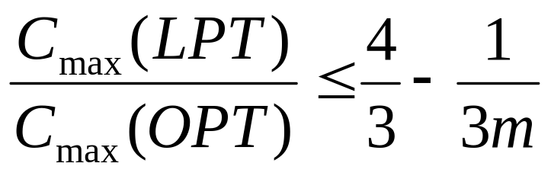
Dispatching Rules: Challenge Yourself!
Prove that the weighted shortest processing time rule is optimal for a single resource problem with the objective function of minimizing the total weighted completion time
Prove that maximum gap between the optimal solution and the longest processing time rule for a problem with m resources and objective function of minimizing the makespan is
H. Abouee Mehrizi 2016

Slide 28

Shifting Bottleneck
Heuristic Method for JSP
  makespan minimization
Bottleneck resource: the most used resource
  the one in which the activities are “latest” in some sort of relaxation of the problem
Idea:
  solve a series of 1-machine problems from the most to least loaded resource
H. Abouee Mehrizi 2016

Slide 29

Simplified Shifting
Bottleneck (SSBH)
Find optimal 1-machine schedule for each unscheduled machine
  subject to any already scheduled resources
Identify bottleneck resource
Keep optimal 1-machine sequence for bottleneck resource
H. Abouee Mehrizi 2016

Slide 30
Simplified Shifting Bottleneck Heuristic (SSBH)
M = set of all machines
M0 = set of “already scheduled” machines
  Initially M0 is empty
  “already scheduled” means all activities on that resource have been sequenced
H. Abouee Mehrizi 2016

Slide 31
SSBH Overview
Step 1: Find C_{max}, release, and due dates
  CPM
Step 2: Find min L_{max} 1-machine schedules
Step 3: Add max L_{max} machine to M0
Step 4: (SKIPPED)
Step 5: If M = M0, done. Else goto 1
H. Abouee Mehrizi 2016

Slide 32

Example 5.4.2
JSP, min C_{max}
Jobs | Machines | Processing times
1 | 1,2,3 | p₁₁=10, p₂₁=8, p₃₁=4
2 | 2,1,4,3 | p₂₂=8, p₁₂=3, p₄₂=5 , p₃₂=6
3 | 1,2,4 | p₁₃=4, p₂₃=7, p₄₃=3
M1
J1
10
8
4
M2
M3
J2
8
3
5
6
M4
H. Abouee Mehrizi 2016
J3
4
7
3

Slide 33
SSBH Step 1
Find release date and due date of each operation
Use CPM to find CP and min. start time, max. end time for each activity
H. Abouee Mehrizi 2016

Slide 34
SSBH Step 1: Find C_{max}
10
8
4
8
3
5
6
4
7
3
H. Abouee Mehrizi 2016

Slide 35
SSBH Step 1: Find C_{max}
[0
[10
[10
[18
[18
[22
10
8
4
[0
[8
[8
[11
[11
[16
[16
[22
8
3
5
6
[0
[4
[4
[11
[11
[14
4
7
3
H. Abouee Mehrizi 2016

Slide 36
SSBH Step 1: Find C_{max}
[0 0]
[10 10]
[10 10]
[18 18]
[18 18]
[22 22]
10
8
4
[0 0]
[8 8]
[8 8]
[11 11]
[11 11]
[16 16]
[16 16]
[22 22]
8
3
5
6
[0 8]
[4 12]
[4 12]
[11 19]
[11 19]
[14 22]
4
7
3
r_{j} = min start
d_{j} = max end
H. Abouee Mehrizi 2016

Slide 37
SSBH Step 1: Find Release & Due Dates (CPM)
Questions?
J1
10
8
4
release date
[0 10]
[10 18]
[18 22]
due date
J2
8
3
5
6
[0 8]
[8 11]
[11 16]
[16 22]
J3
4
7
3
[0 12]
[4 19]
[11 22]
H. Abouee Mehrizi 2016

Slide 38

SSBH Step 2: Find Min
L_{max} 1-Machine Schedules
Using release and due dates, min. L_{max}
10
3
4
10
3
4
L_{max}(1) = 5
M1
[0 10]
[8 11]
[0 12]
0
10
13
M2
J1
8
J2
8
J3
7
J2
J3
J1
8
7
8
L_{max}(2) = 5
[10 18]
[0 8]
[4 19]
0
8
15
M3
4
6
L_{max}(3) = 4
6
4
[18 22]
[16 22]
16
22
M4
5
3
L_{j} = C_{j} – d_{j}
L_{max} = max(L_{j})
5
3
L_{max}(4) = 0
[11 16]
[11 22]
H. Abouee Mehrizi 2016
11
16

Slide 39
SSBH Step 3:
Add Machine to M0
Pick machine with highest L_{max}
Use sequence found in Step 2
  L_{max}(1) = L_{max}(2) = 5
  Arbitrarily choose to add machine 1
H. Abouee Mehrizi 2016

Slide 40
SSBH Step 4: (SKIPPED)
Step 4 from SBH is skipped in the Simplified SBH
H. Abouee Mehrizi 2016

Slide 41
SSBH Step 5: Termination
M0 ≠ M so goto Step 1
H. Abouee Mehrizi 2016

Slide 42
SSBH Overview
Step 1: Find C_{max}, release, and due dates
  CPM
Step 2: Find min L_{max} 1-machine schedules
Step 3: Add max L_{max} machine to M0
Step 4: (SKIPPED)
Step 5: If M = M0, done. Else goto 1
H. Abouee Mehrizi 2016

Slide 43
SSBH Step 1 (Iteration 2): Find C_{max}
10
8
4
8
3
5
6
4
7
3
H. Abouee Mehrizi 2016

Slide 44
SSBH Step 1 (Iteration 2): Find C_{max}
10
8
4
8
3
5
6
4
7
3
H. Abouee Mehrizi 2016

Slide 45
SSBH Step 1 (Iteration 2): Find C_{max}
[0
[10
[10
[18
[18
[22
10
8
4
[0
[8
[10
[13
[13
[18
[18
[24
8
3
5
6
[13
[17
[17
[24
[24
[27
4
7
3
H. Abouee Mehrizi 2016

Slide 46
SSBH Step 1 (Iteration 2): Find C_{max}
[0 0]
[10 10]
[10 15]
[18 23]
[18 23]
[22 27]
10
8
4
[0 2]
[8 10]
[10 10]
[13 13]
[13 16]
[18 21]
[18 21]
[24 27]
8
3
5
6
[13 13]
[17 17]
[17 17]
[24 24]
[24 24]
[27 27]
4
7
3
H. Abouee Mehrizi 2016

Slide 47
SSBH Step 1 (Iteration 2)
M0 = {M1}
Find C_{max,} release & due dates
M2
J1
8
J2
8
J3
7
[10 23]
[0 10]
[17 24]
M3
4
6
[18 27]
[18 27]
M4
5
3
[13 21]
[24 27]
H. Abouee Mehrizi 2016

Slide 48
SSBH Step 2 (Iteration 2): Find Min L_{max} 1-M Schedules
Using release and due dates, min. L_{max}
M2
J1
8
J2
8
J3
7
J2
8
J1
8
J3
7
L_{max}(2) = 1
[10 23]
[0 10]
[17 24]
0
8
10
18
M3
4
6
either schedule OK
6
4
L_{max}(3) = 1
[18 27]
[18 27]
18
24
M4
5
3
5
3
L_{max}(4) = 0
[13 21]
[24 27]
13
24
H. Abouee Mehrizi 2016

Slide 49
SSBH Step 3 (Iteration 2): Add Machine to M0
Pick machine with highest L_{max}
Use sequence found in Step 2
  L_{max}(2) = L_{max}(3) = 1
  Arbitrarily choose to add machine 2
H. Abouee Mehrizi 2016

Slide 50
SSBH Step 4 (Iteration 2): (SKIPPED)
Step 4 from SHB is skipped in the Simplified SSHB
H. Abouee Mehrizi 2016

Slide 51
SSBH Step 5: Termination
M0 ≠ M so goto Step 1
H. Abouee Mehrizi 2016

Slide 52
SSBH Step 1 (Iteration 3): Find C_{max}
10
8
4
8
3
5
6
4
7
3
H. Abouee Mehrizi 2016

Slide 53
SSBH Step 1 (Iteration 3): Find C_{max}
[0
[10
[10
[18
[18
[22
10
8
4
[0
[8
[10
[13
[13
[18
[18
[24
8
3
5
6
[13
[17
[18
[25
[25
[28
4
7
3
H. Abouee Mehrizi 2016

Slide 54
SSBH Step 1 (Iteration 3): Find C_{max}
[0 0]
[10 10]
[10 10]
[18 18]
[18 24]
[22 28]
10
8
4
[0 2]
[8 10]
[10 11]
[13 14]
[13 17]
[18 22]
[18 22]
[24 28]
8
3
5
6
[13 14]
[17 18]
[18 18]
[25 25]
[25 25]
[28 28]
4
7
3
H. Abouee Mehrizi 2016

Slide 55
SSHB Step 1 (Iteration 3)
M0 = {M1, M2}
Find C_{max}= 28, find release & due dates
M3
4
6
[18 28]
[18 28]
M4
5
3
[13 22]
[25 28]
H. Abouee Mehrizi 2016

Slide 56

SSBH Step 2 (Iteration 3): Find Min L_{max} 1-M Schedules
Using release and due dates, min. L_{max}
M3
4
6
6
4
L_{max}(3) = 0
[18 28]
[18 28]
18
24
M4
5
3
5
3
L_{max}(4) = 0
[13 22]
[25 28]
13
25
H. Abouee Mehrizi 2016

Slide 57
SSBH Step 3 (Iteration 3): Add Machine to M0
L_{max}(3) = L_{max}(4) = 0
So you actually have a final schedule by adding sequences from Step 2
M1
10
3
4
M2
J2
8
J1
8
J3
7
M3
6
4
M4
5
3
H. Abouee Mehrizi 2016

Slide 58
SSHB Step 4 (Iteration 3): (SKIPPED)
Step 4 from SHB is skipped in the Simplified SHB
H. Abouee Mehrizi 2016

Slide 59
SSHB Step 5: Termination
M0 = M so STOP
H. Abouee Mehrizi 2016

Slide 60
SSBH Overview
Step 1: Find C_{max}, release, and due dates
  CPM
Step 2: Find min L_{max} 1-machine schedules
Step 3: Add max L_{max} machine to M0
Step 4: (SKIPPED)
Step 5: If M = M0, done. Else goto 1
H. Abouee Mehrizi 2016

Slide 61

SSBH Example JSP
Apply SSBH to the following JSP
Jobs | Processing times
0 | J0R0[15] → J0R1[50] → J0R2[60]
1 | J1R1[50] → J1R0[50] → J1R2[15]
2 | J2R0[30] → J2R1[15] → J2R2[20]
H. Abouee Mehrizi 2016

Slide 62
Shifting Bottleneck
Heuristics (SBH)
Pick most loaded resource
Find optimal 1-machine schedule
Pick next most loaded resource
Find optimal 1-machine schedule consistent with previous 1-machine schedules
Re-compute previous 1-machine schedules - can they be improved?
H. Abouee Mehrizi 2016

Slide 63
SBH Overview
Step 1: Find C_{max}, r_{j}’s, and d_{j}’s
Step 2: Find min L_{max} 1-machine schedules
Step 3: Add max L_{max} machine (call it h) to M0
Step 4: Re-sequence machines in
M0 \ {h}
Step 5: If M = M0, done. Else goto 1
H. Abouee Mehrizi 2016

Slide 64
Example 5.4.2, p. 91
JSP, min C_{max}
Jobs | Machines | Processing times
1 | 1,2,3 | p₁₁=10, p₂₁=8, p₃₁=4
2 | 2,1,4,3 | p₂₂=8, p₁₂=3, p₄₂=5 , p₃₂=6
3 | 1,2,4 | p₁₃=4, p₂₃=7, p₄₃=3
M1
J1
10
8
4
M2
M3
J2
8
3
5
6
M4
H. Abouee Mehrizi 2016
J3
4
7
3

Slide 65
SBH Step 1
Find release date and due date of each operation
Use CPM to find CP and min. start time, max. end time for each activity
H. Abouee Mehrizi 2016

Slide 66
SBH Step 1: Find C_{max}
10
8
4
8
3
5
6
4
7
3
H. Abouee Mehrizi 2016

Slide 67
SBH Step 1: Find C_{max}
[0
[10
[10
[18
[18
[22
10
8
4
[0
[8
[8
[11
[11
[16
[16
[22
8
3
5
6
[0
[4
[4
[11
[11
[14
4
7
3
H. Abouee Mehrizi 2016

Slide 68
SBH Step 1: Find C_{max}
[0 0]
[10 10]
[10 10]
[18 18]
[18 18]
[22 22]
10
8
4
[0 0]
[8 8]
[8 8]
[11 11]
[11 11]
[16 16]
[16 16]
[22 22]
8
3
5
6
[0 8]
[4 12]
[4 12]
[11 19]
[11 19]
[14 22]
4
7
3
r_{j} = min start
d_{j} = max end
H. Abouee Mehrizi 2016

Slide 69
SBH Step 1: Find Release & Due Dates (CPM)
J1
10
8
4
release date
[0 10]
[10 18]
[18 22]
due date
J2
8
3
5
6
[0 8]
[8 11]
[11 16]
[16 22]
J3
4
7
3
[0 12]
[4 19]
[11 22]
H. Abouee Mehrizi 2016

Slide 70
SBH Step 2: Find Min
L_{max} 1-Machine Schedules
Using release and due dates, min. L_{max}
10
3
4
10
3
4
L_{max}(1) = 5
M1
[0 10]
[8 11]
[0 12]
0
10
13
M2
J1
8
J2
8
J3
7
J2
J3
J1
8
7
8
L_{max}(2) = 5
[10 18]
[0 8]
[4 19]
0
8
15
M3
4
6
L_{max}(3) = 4
6
4
[18 22]
[16 22]
16
22
M4
5
3
L_{j} = C_{j} – d_{j}
L_{max} = max(L_{j})
5
3
L_{max}(4) = 0
[11 16]
[11 22]
H. Abouee Mehrizi 2016
11
16

Slide 71
SBH Step 3:
Add Machine h to M0
Pick machine with highest L_{max}
Use sequence found in Step 2
  L_{max}(1) = L_{max}(2) = 5
  Arbitrarily choose to add machine 1
  So h = M1
H. Abouee Mehrizi 2016

Slide 72
SBH Step 4:
Resequence M0 \ {h}
h = M1
M0 = {M1}
M0 \ {M1} = {}
So there is nothing to do
Questions?
H. Abouee Mehrizi 2016

Slide 73
SBH Step 5: Termination
M0 ≠ M so goto Step 1
H. Abouee Mehrizi 2016

Slide 74
SBH Overview
Step 1: Find C_{max}, r_{j}’s, and d_{j}’s
Step 2: Find min L_{max} 1-machine schedules
Step 3: Add max L_{max} machine (call it h) to M0
Step 4: Re-sequence machines in
M0 \ {h}
Step 5: If M = M0, done. Else goto 1
H. Abouee Mehrizi 2016

Slide 75
SBH Step 1 (Iteration 2):
Find C_{max}
10
8
4
8
3
5
6
4
7
3
H. Abouee Mehrizi 2016

Slide 76
SBH Step 1 (Iteration 2):
Find C_{max}
[0
[10
[10
[18
[18
[22
10
8
4
[0
[8
[10
[13
[13
[18
[18
[24
8
3
5
6
[13
[17
[17
[24
[24
[27
4
7
3
H. Abouee Mehrizi 2016

Slide 77
SBH Step 1 (Iteration 2):
Find C_{max}
[0 0]
[10 10]
[10 15]
[18 23]
[18 23]
[22 27]
10
8
4
[0 2]
[8 10]
[10 10]
[13 13]
[13 16]
[18 21]
[18 21]
[24 27]
8
3
5
6
[13 13]
[17 17]
[17 17]
[24 24]
[24 24]
[27 27]
4
7
3
H. Abouee Mehrizi 2016

Slide 78
SBH Step 1 (Iteration 2)
M0 = {M1}
Find C_{max,} release & due dates
M2
J1
8
J2
8
J3
7
[10 23]
[0 10]
[17 24]
M3
4
6
[18 27]
[18 27]
M4
5
3
[13 21]
[24 27]
H. Abouee Mehrizi 2016

Slide 79
SBH Step 2 (Iteration 2): Find Min L_{max} 1-M Schedules
Using release and due dates, min. L_{max}
M2
J1
8
J2
8
J3
7
J2
8
J1
8
J3
7
L_{max}(2) = 1
[10 23]
[0 10]
[17 24]
0
8
10
18
M3
4
6
either schedule OK
6
4
L_{max}(3) = 1
[18 27]
[18 27]
18
24
M4
5
3
5
3
L_{max}(4) = 0
[13 21]
[24 27]
13
24
H. Abouee Mehrizi 2016

Slide 80
SBH Step 3 (Iteration 2): Add Machine to M0
Pick machine with highest L_{max}
Use sequence found in Step 2
  L_{max}(2) = L_{max}(3) = 1
  Arbitrarily choose h = machine 2
H. Abouee Mehrizi 2016

Slide 81
SBH Step 4 (Iteration 2):
Find C_{max}
10
8
4
8
3
5
6
4
7
3
H. Abouee Mehrizi 2016

Slide 82
SBH Step 4: (Iteration 2) Resequence M0 \ {h}
h = M2
M0 = {M1, M2}
M0 \ {M2} = {M1}
So we want to resequence M1 subject to the constraints on M2!!!!
H. Abouee Mehrizi 2016

Slide 83
SBH Step 4 (Iteration 2):
Find C_{max}
10
8
4
8
3
5
6
4
7
3
H. Abouee Mehrizi 2016

Slide 84
SBH Step 4 (Iteration 2):
Find C_{max}
10
8
4
8
3
5
6
4
7
3
H. Abouee Mehrizi 2016

Slide 85
SBH Step 4 (Iteration 2):
Find C_{max}
[0 0]
[10 10]
[10 10]
[18 18]
[18 24]
[22 28]
10
8
4
[0 2]
[8 10]
[8 11]
[11 14]
[11 17]
[16 22]
[16 22]
[22 28]
8
3
5
6
[0 14]
[4 18]
[18 18]
[25 25]
[25 25]
[28 28]
4
7
3
H. Abouee Mehrizi 2016

Slide 86
SBH Step 4: Find Min
L_{max} 1-Machine Schedule
Questions?
Using release and due dates, min. L_{max}
10
3
4
10
3
4
L_{max}(1) = 0
M1
[0 10]
[8 14]
[0 18]
0
10
13
Same as current sequence, so don’t change anything
  If min L_{max} schedule was different, we would change the M1 sequence
H. Abouee Mehrizi 2016

Slide 87
SBH Step 5: Termination
M0 ≠ M so goto Step 1
H. Abouee Mehrizi 2016

Slide 88
SBH Step 1 (Iteration 3):
Find C_{max}
10
8
4
8
3
5
6
4
7
3
H. Abouee Mehrizi 2016

Slide 89
SBH Step 1 (Iteration 3):
Find C_{max}
[0
[10
[10
[18
[18
[22
10
8
4
[0
[8
[10
[13
[13
[18
[18
[24
8
3
5
6
[13
[17
[18
[25
[25
[28
4
7
3
H. Abouee Mehrizi 2016

Slide 90
SBH Step 1 (Iteration 3):
Find C_{max}
[0 0]
[10 10]
[10 10]
[18 18]
[18 24]
[22 28]
10
8
4
[0 2]
[8 10]
[10 11]
[13 14]
[13 17]
[18 22]
[18 22]
[24 28]
8
3
5
6
[13 14]
[17 18]
[18 18]
[25 25]
[25 25]
[28 28]
4
7
3
H. Abouee Mehrizi 2016

Slide 91
SHB Step 1 (Iteration 3)
M0 = {M1, M2}
Find C_{max}= 28, find release & due dates
M3
4
6
[18 28]
[18 28]
M4
5
3
[13 22]
[25 28]
H. Abouee Mehrizi 2016

Slide 92
SSBH Step 2 (Iteration 3): Find Min L_{max} 1-M Schedules
Using release and due dates, min. L_{max}
M3
4
6
6
4
L_{max}(3) = 0
[18 28]
[18 28]
18
24
M4
5
3
5
3
L_{max}(4) = 0
[13 22]
[25 27]
13
24
H. Abouee Mehrizi 2016

Slide 93
SBH Step 3 (Iteration 3):
Add Machine to M0
L_{max}(3) = L_{max}(4) = 0
So you actually have a final schedule by adding sequences from Step 2
M1
10
3
4
M2
J2
8
J1
8
J3
7
M3
6
4
M4
5
3
H. Abouee Mehrizi 2016

Slide 94
SBH Step 3 (Iteration 3):
Add Machine to M0
But let’s assume you choose h = M3
M0 = {M1, M2, M3}
H. Abouee Mehrizi 2016

Slide 95
SBH Step 4: (Iteration 3) Resequence M0 \ {h}
h = M3
M0 = {M1, M2, M3}
M0 \ {M3} = {M1, M2}
So we want to
  resequence M1 subject to the constraints on M2 and M3
  resequence M2 subject to the constraints on M1 and M3
H. Abouee Mehrizi 2016

Slide 96

SBH Step 4 (Iteration 3):
Resequence M1 s.t. {M2,M3}
10
8
4
8
3
5
6
4
7
3
H. Abouee Mehrizi 2016

Slide 97
SBH Step 4 (Iteration 3):
Resequence M2 s.t. {M1,M3}
10
8
4
8
3
5
6
4
7
3
H. Abouee Mehrizi 2016

Slide 98
SHB Step 5: Termination
M0 ≠ M so goto Step 1
H. Abouee Mehrizi 2016

Slide 99
SHB Iteration 4
Sequence M4 (L_{max}(4) = 0)
Resequence:
  M1 s.t. {M2,M3,M4}
  M2 s.t. {M1,M3,M4}
  M3 s.t. {M1,M2,M4}
M0 = M so STOP
H. Abouee Mehrizi 2016

Slide 100
SBH Overview
Step 1: Find C_{max}, r_{j}’s, and d_{j}’s
Step 2: Find min L_{max} 1-machine schedules
Step 3: Add max L_{max} machine (call it h) to M0
Step 4: Re-sequence machines in
M0 \ {h}
Step 5: If M = M0, done. Else goto 1
H. Abouee Mehrizi 2016

Slide 101
Next Session
Tree search
Mixed integer programming (MIP) solving
H. Abouee Mehrizi 2016

Slide 102
Remarks
Tutorial 1: tomorrow
H. Abouee Mehrizi 2016

