Slide 1

Producer: Garrett Huxtable
Technical Lead: Eric Gleiser
Designers: Jason Clark & travis Moore

Slide 2
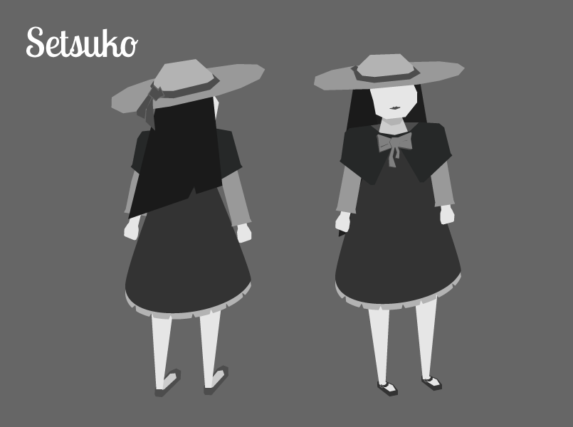
High Concept
Setsuko
A Japanese inspired top-down action-adventure about tragedy and dealing with the five stages of grief.

Slide 3
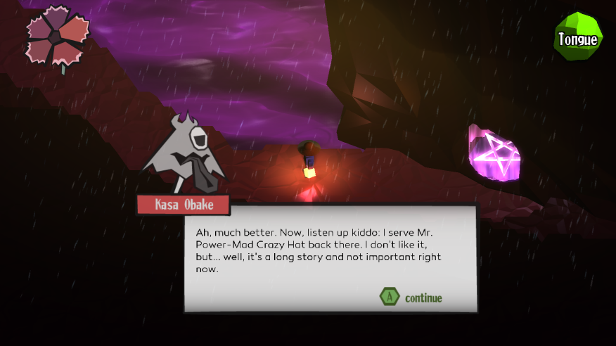
Last milestone

Slide 4
Demo
It’s demo time, yeah!

Slide 5
New animations

Slide 6
Risk 1: Scope
Problem:
Accomplishing everything we’ve planned for our game.
Mitigations
Flexibility in game length.
We’d like to complete a total of 3 dungeons, but will settle for 2 if we cannot do so.
Events in game are component based.
These events are often data driven.
Remove multiple endings.
The intro will be revised to only allow one way to complete the game.

Slide 7
Risk 2: Communication
Problem:
Our team still has problems with communication.
Mitigations
Schedule our second team-on-one.
We are hoping to be confirmed for next weekend.
Place a higher emphasis on using communication tools like Trello.
This would help us know what each other is doing for when we cannot all meet in the same place.
Use our new Google Doc weekly form.
This will help our producer in completing his producer logs

Slide 8
Risk 3: FBX Limitations
Problem:
Our models and animations are not functioning properly.
Mitigations
Bring up these problems with the Zero team.
We hope that they will implement a fix once they see the problems we are having.
Re-rig and re-animate our models.
While not ideal, we can work around some of the animation problems.
Limit the use of vertex shaders.
Also not ideal, but we can make due with only a few vertex shaders.

Slide 9
Schedule
Team Member | Milestone 2
Jason Clark | Dialog reduction (as per testing results) Design third dungeon Playtest club
Eric Gleiser | Finalizing the first dungeon Finalize the game ending Boss fights!
Garrett Huxtable | Producing Revise the intro level 3D modeling & animation
Travis Moore | Design the second dungeon Art direction Playtest club

Slide 10
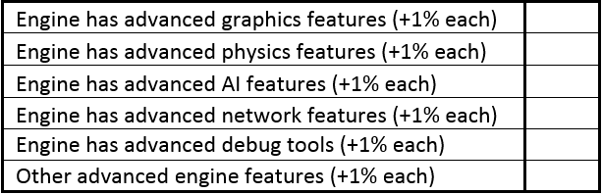
Rubric: Engine
+3%
+2%
+0%
+0%
+1%
+3%

Slide 11
Rubric: Content Editor
+2%

Slide 12

Rubric: Game Play
+2%
+1%

Slide 13
Rubric: testing

Slide 14
Rubric: team & presentation
-8%

Slide 15
Thank You

