Slide 1

Producer: Garrett Huxtable
Lead Designer: Jason Clark
Technical Lead: Eric Gleiser
Art Lead: Travis Moore

Slide 2
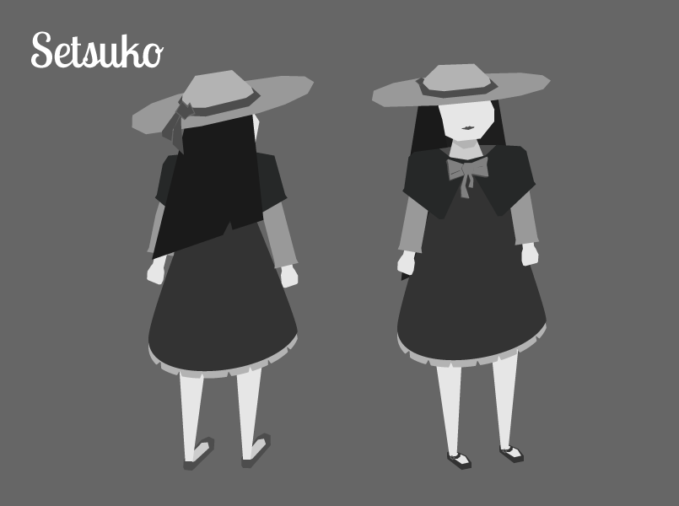
High Concept
Setsuko
A Japanese inspired top-down poetic action-adventure about tragedy and dealing with the inevitable.

Slide 3
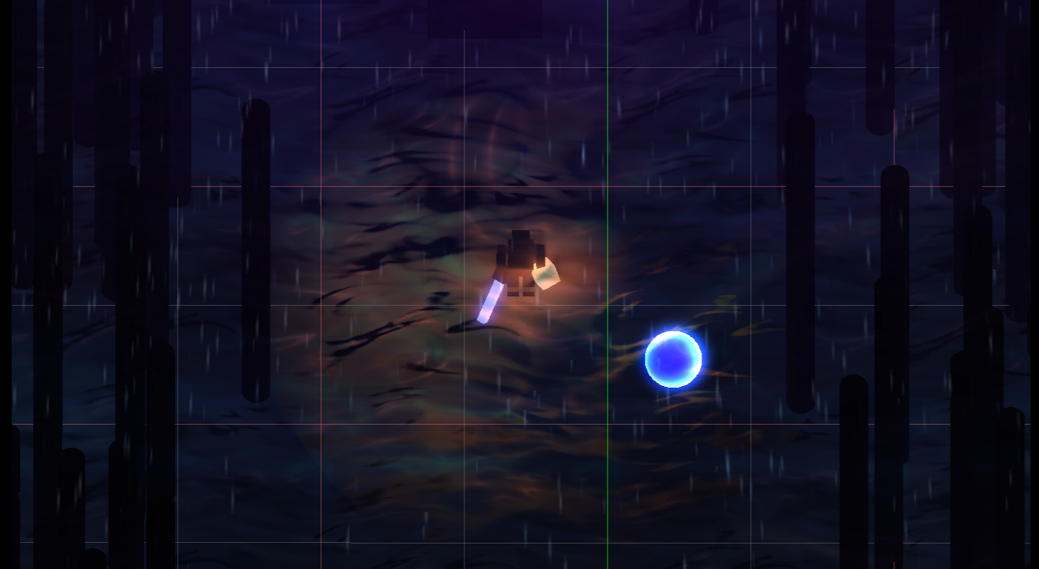
Last milestone

Slide 4
Demo

Slide 5
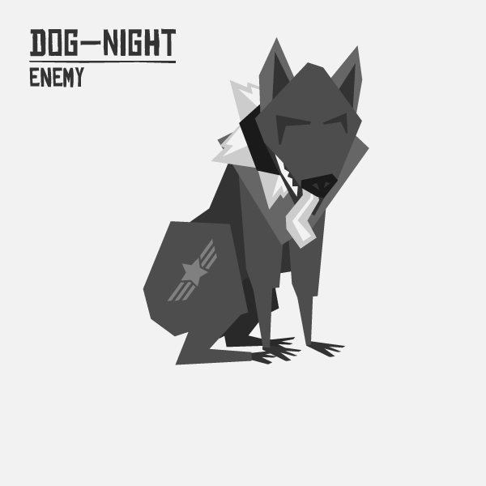
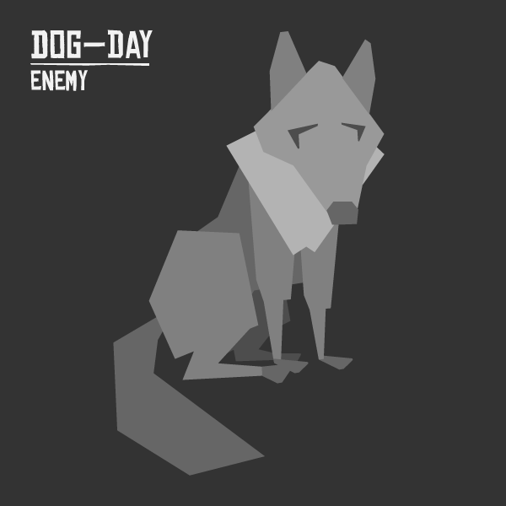
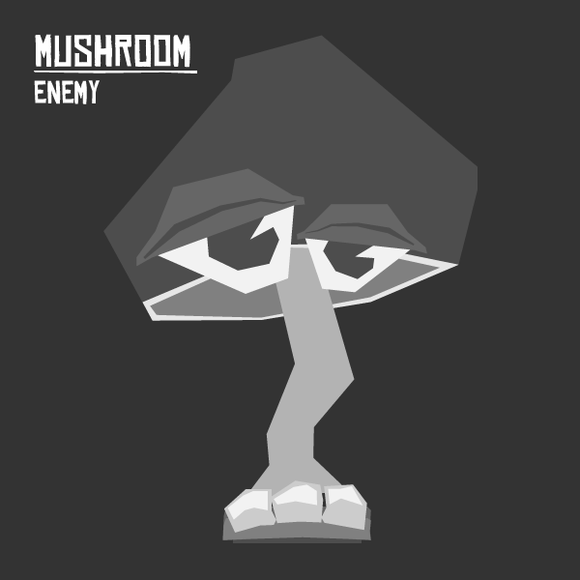
Concept Art

Slide 6
Risk 1: Scope
Mitigations
Flexibility in game length (game occurs over single day).
Events in game are component based and often data driven.
Remove multiple endings.
A team of self starters.

Slide 7
Risk 2: Communication
Mitigations
More structured team time where we all meet up.
Emphasis on reporting successes and failures to the rest of team.
Google form for weekly logs.

Slide 8
Risk 3: loss of Artists
Mitigations
Switch to a style that incorporates more 2D elements, rather than full 3D assets.
Eric and Garrett can do 3D art assets in Maya (as seen in this presentation).
Make use of the 2D art assets we already have.
Continue to look for capable 3D artists.

Slide 9
Schedule
Team Member | Week 9 | Week 10 | Week 11
Jason Clark | Enemy AI | Dialog | Puzzle Design
Eric Gleiser | Boss Fights! / 3D Models | Music / 3D Models | SFX / 3D Models
Garrett Huxtable | Level Design / 3D Models | Level Design / 3D Models | Level Design / 3D Models
Travis Moore | Enemy AI / 2D Art Assets | User Interface / 2D Art Assests | Pause Menu / 2D Art Assests

Slide 10
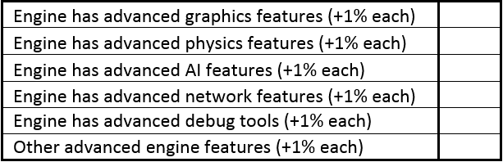
Rubric: Engine
+eric%
+eric%
+eric%
+eric%
+eric%
+eric%

Slide 11
Rubric: Content Editor
+eric%

Slide 12

Rubric: Game Play
+2%
+1%

Slide 13
Rubric: testing

Slide 14
Rubric: team & presentation
-8%

Slide 15
Thank You

