Slide 1

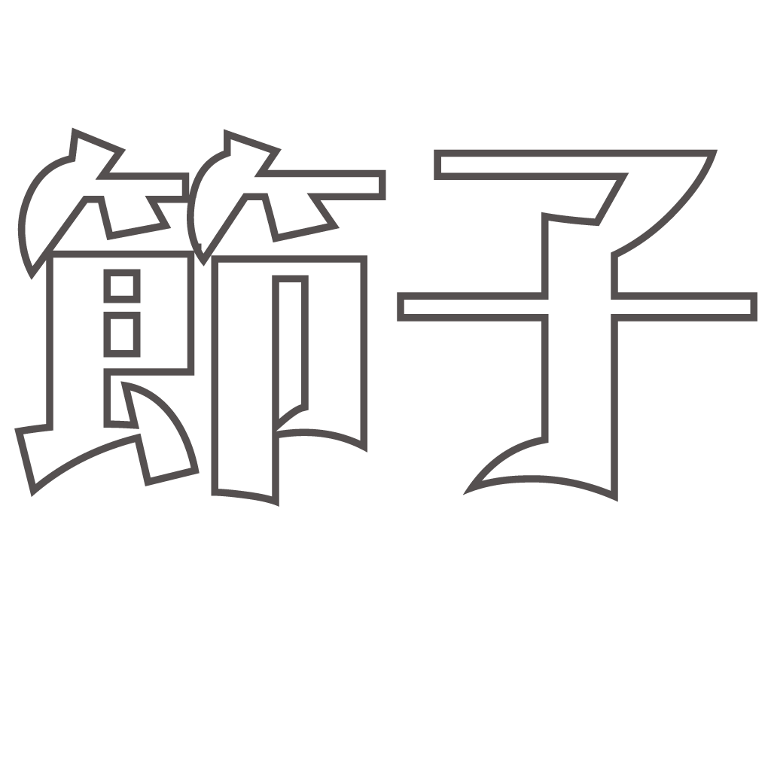
Presents
Producer: Garrett Huxtable
Technical Lead: Eric Gleiser
Narrative Designer: Jason Clark
Art Director: Travis Moore

Slide 2
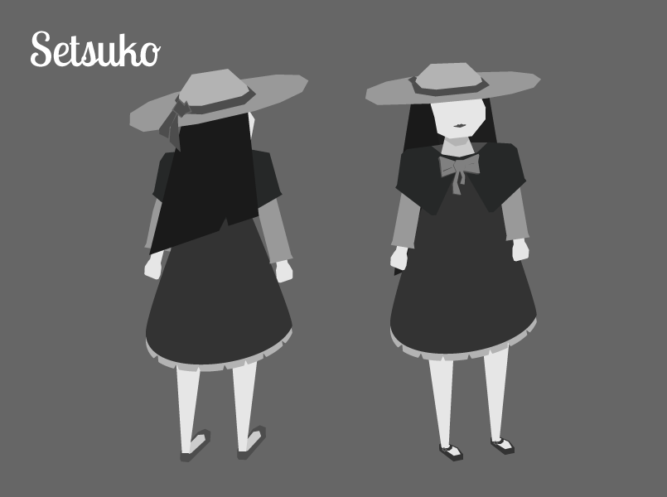
High Concept
Setsuko
A Japanese inspired top-down action-adventure about tragedy and dealing with the five stages of grief.

Slide 3
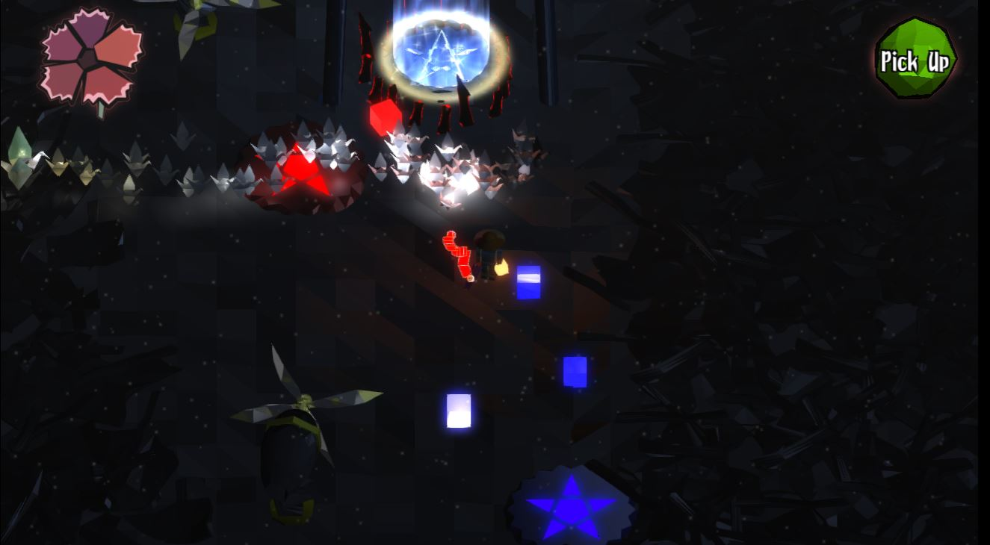
Last milestone

Slide 4
Demo
Narrative & Burnt City Dungeon Demo

Slide 5
Risk 1: Scope
Problem:
Accomplishing everything we’ve planned for our game.
Mitigations
Flexibility in game length.
We’d like to complete a total of 3 dungeons, but will settle for 2 if we cannot do so.
Events in game are component based.
These events are often data driven.
Remove multiple endings.
The intro will be revised to only allow one way to complete the game.

Slide 6
Risk 2: Voice Over Narration
Problem:
Voice narration could require more work then we think it might.
Mitigations
We have text based storytelling.
Our current dialog system can be used to do what we’d like to do with the voice narration.
Reduce quantity of narration.
This would create less to record and code into our game.
Cut voice narration.
If the voice narration is not complete by April 4, we can cut it.

Slide 7
Risk 3: Course Workload
Problem:
The semester is ending and this means more projects are due.
Mitigations
Pre-grade our project.
This will allow us to properly assess what needs to be done.
Stay on top of our work.
Try our best to decrease future stress by getting things done earlier.

Slide 8
Schedule
Team Member | Milestone 3
Jason Clark | Narrative Recording Finalizing Written Dialog Level Design
Eric Gleiser | Boss Fights Environment Modeling Enemy AI
Garrett Huxtable | Character Modeling Character Animation Environment Modeling
Travis Moore | Level Design UI Redesign Texture Characters

Slide 9
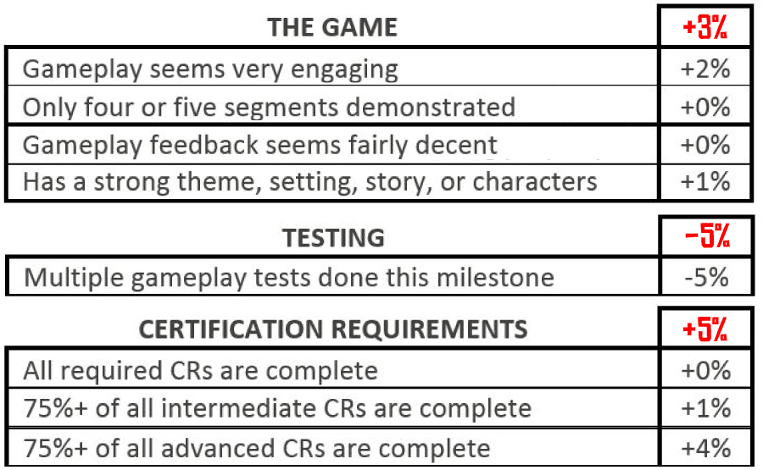
Rubric: the game + Testing + Certification

Slide 10
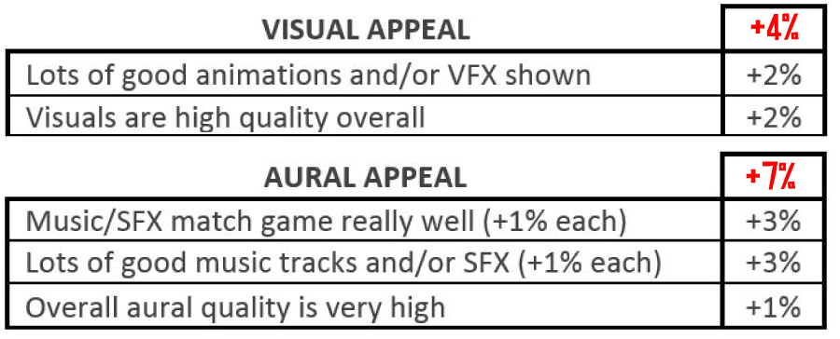

Rubric: visual & audio Appeal
+2%
+1%

Slide 11
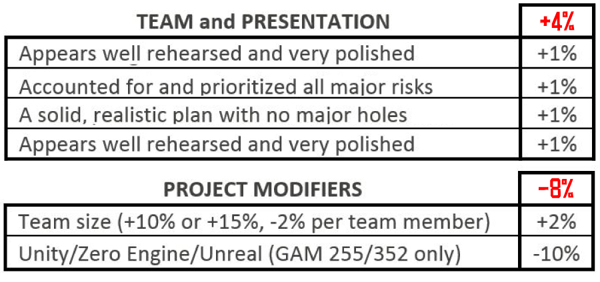
Rubric: Team Presentation & Modifiers
v

Slide 12
Thank You

