Slide 1
COMP541
Datapaths II &
Control I
Montek Singh
Mar 22, 2010

Slide 2
Topics
Single cycle MIPS
  Reading: Chapter 7
  Verilog code for MIPS at the end (!)
If you don’t feel comfortable with assembly language, pls review Ch. 6

Slide 3
First, Top Level of CPU
module top(input clk, reset,
output [31:0] writedata, dataadr,
output memwrite);
wire [31:0] pc, instr, readdata;
// instantiate processor and memories
mips mips(clk, reset, pc, instr, memwrite, dataadr,
writedata, readdata);
imem imem(pc[7:2], instr);
dmem dmem(clk, memwrite, dataadr, writedata,
readdata);
endmodule

Slide 4
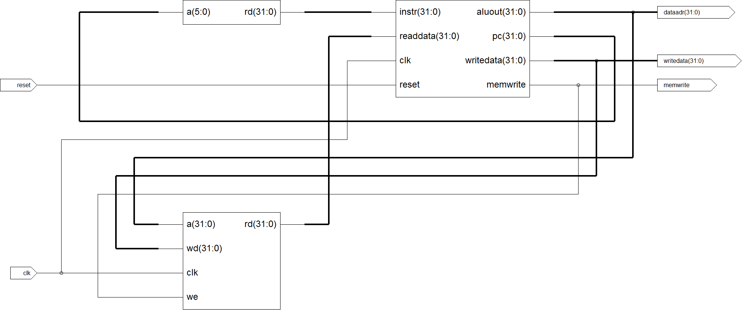
Top Level Schematic (ISE)
imem
MIPS
dmem

Slide 5
Top Level of MIPS
module mips(input clk, reset,
output [31:0] pc,
input [31:0] instr,
output memwrite,
output [31:0] aluout, writedata,
input [31:0] readdata);
wire memtoreg, branch,
pcsrc, zero,
alusrc, regdst, regwrite, jump;
wire [2:0] alucontrol;
controller c(instr[31:26], instr[5:0], zero,
memtoreg, memwrite, pcsrc,
alusrc, regdst, regwrite, jump,
alucontrol);
datapath dp(clk, reset, memtoreg, pcsrc,
alusrc, regdst, regwrite, jump,
alucontrol,
zero, pc, instr,
aluout, writedata, readdata);
endmodule

Slide 6
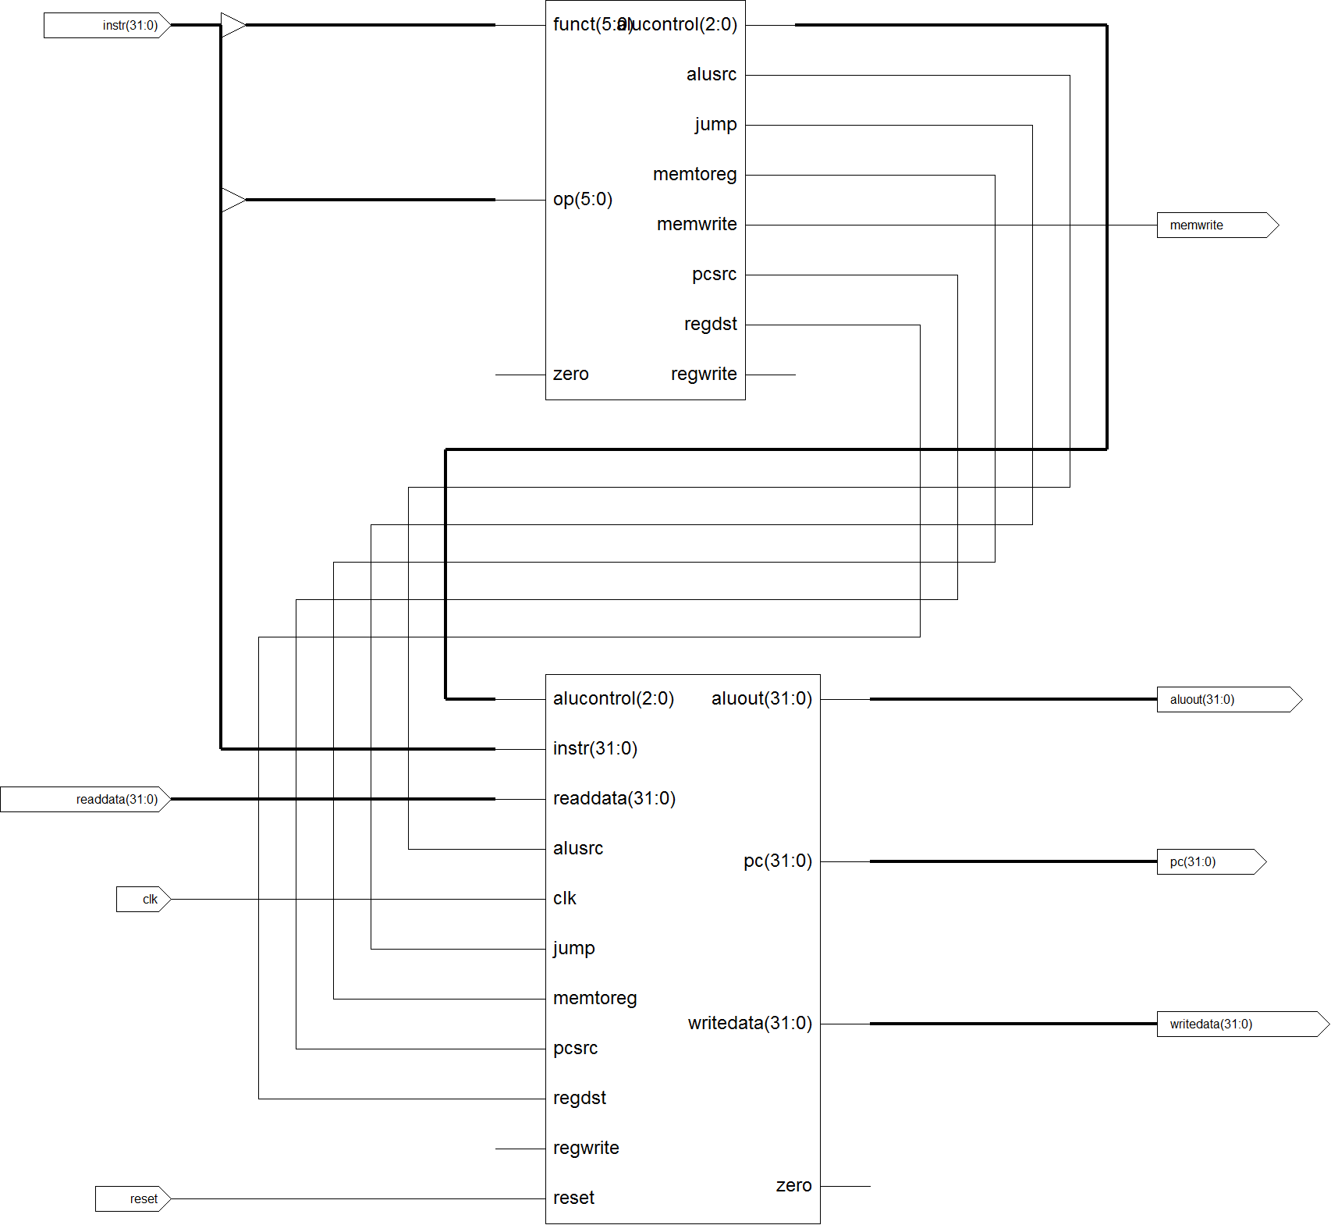
MIPS Schematic

Slide 7
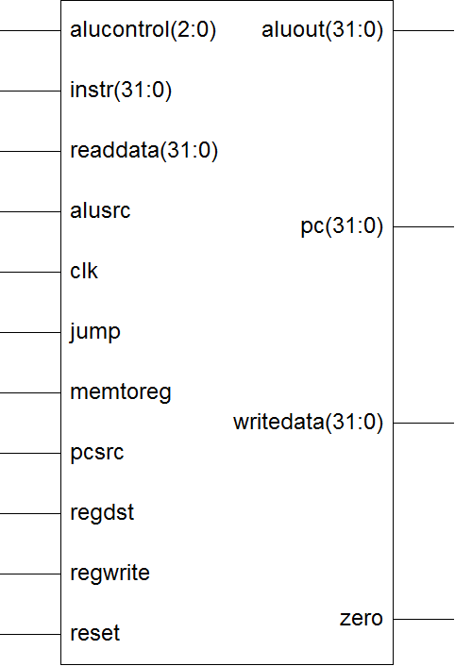
Datapath

Slide 8
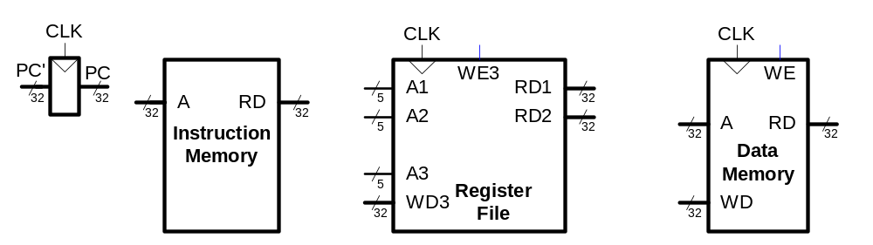
MIPS State Elements
We’ll fill out the datapath and control logic for basic single cycle MIPS
  First the datapath
  then the control logic

Slide 9
Let’s Design lw
What does it do?

Slide 10
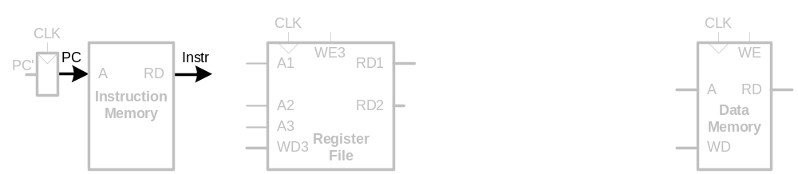
Single-Cycle Datapath: lw fetch
First consider executing lw
  How does lw work?
STEP 1: Fetch instruction

Slide 11
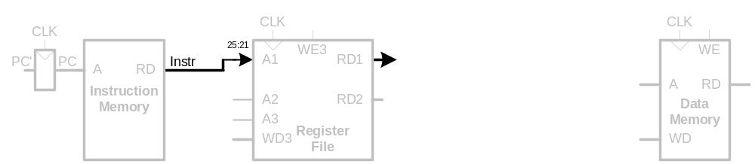
Single-Cycle Datapath: lw register read
STEP 2: Read source operands from register file

Slide 12
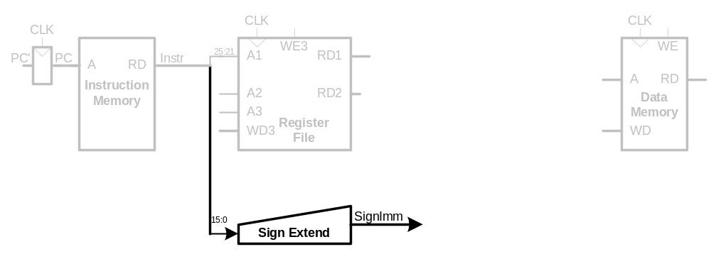
Single-Cycle Datapath: lw immediate
STEP 3: Sign-extend the immediate

Slide 13
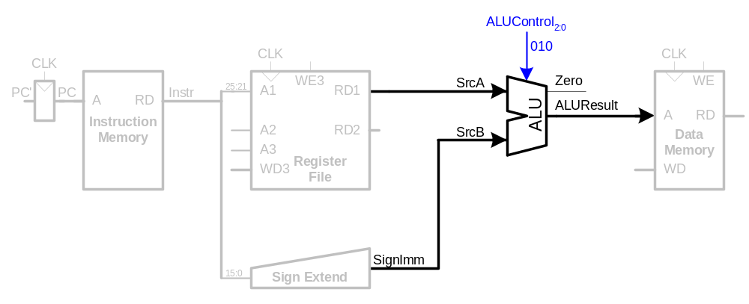
Single-Cycle Datapath: lw address
STEP 4: Compute the memory address
Note Control

Slide 14
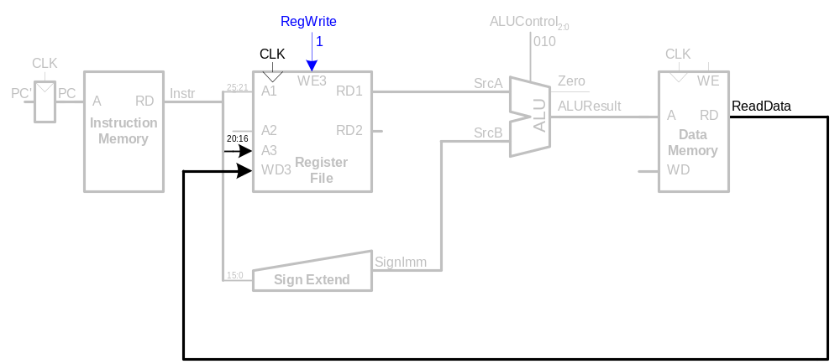
Single-Cycle Datapath: lw memory read
STEP 5: Read data from memory and write it back to register file

Slide 15
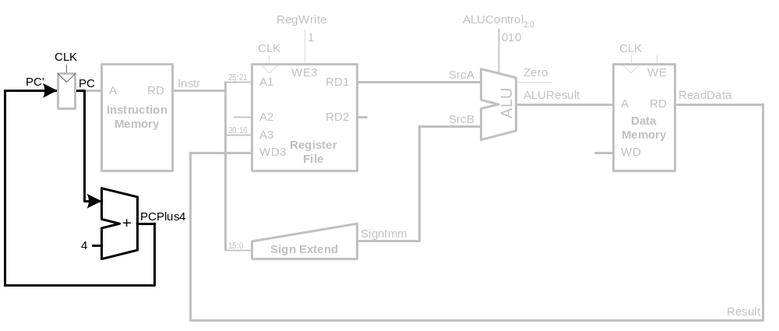
Single-Cycle Datapath: lw PC increment
STEP 6: Determine the address of the next instruction

Slide 16
Let’s be Clear
Although the slides said “STEP” …
  … all that stuff executed in one cycle!!!
Let’s look at sw
and then R-type

Slide 17
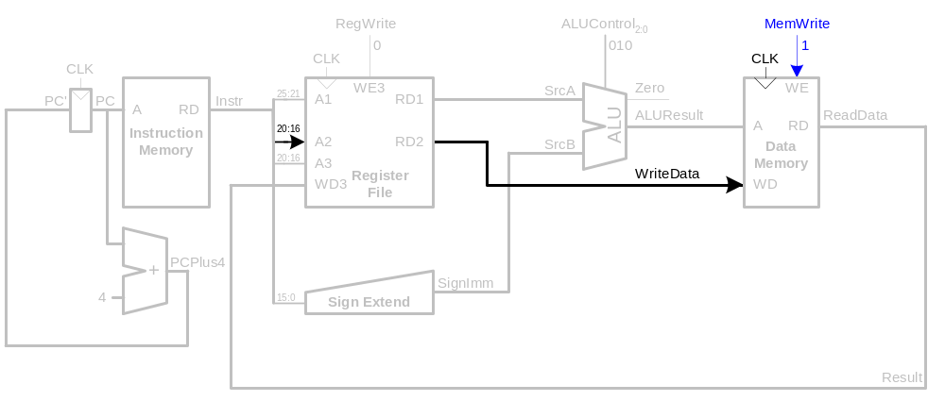
Single-Cycle Datapath: sw, write back
Write data in rt to memory

Slide 18
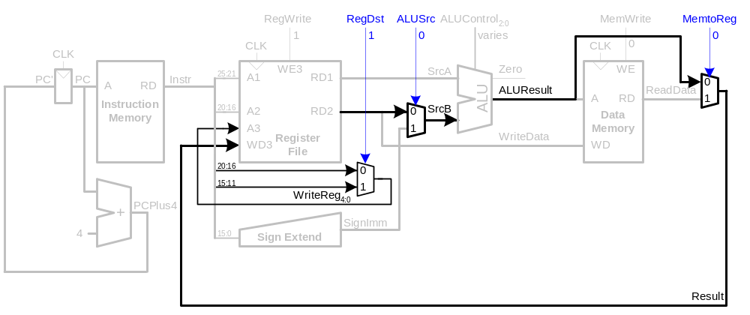
Single-Cycle Datapath: R-type instr
Read from rs and rt
Write ALUResult to register file
Write to rd (instead of rt)

Slide 19
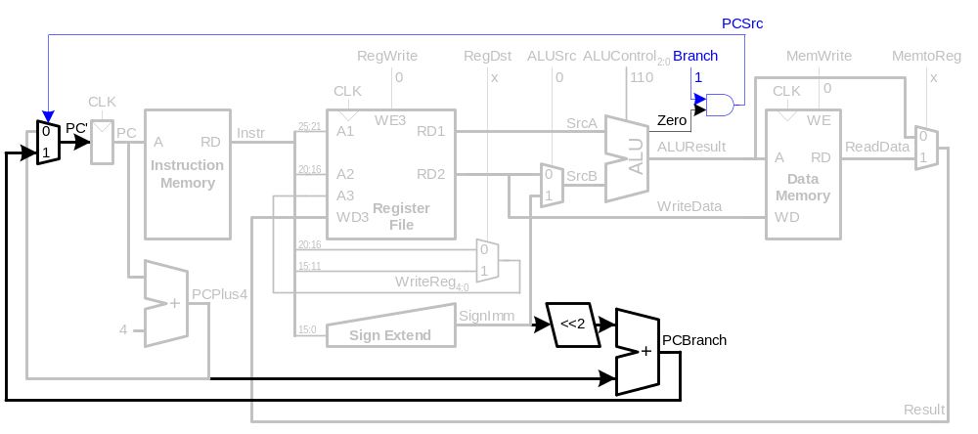
Single-Cycle Datapath: beq
Determine whether values in rs and rt are equal
Calculate branch target address:
BTA = (sign-extended immediate << 2) + (PC+4)

Slide 20
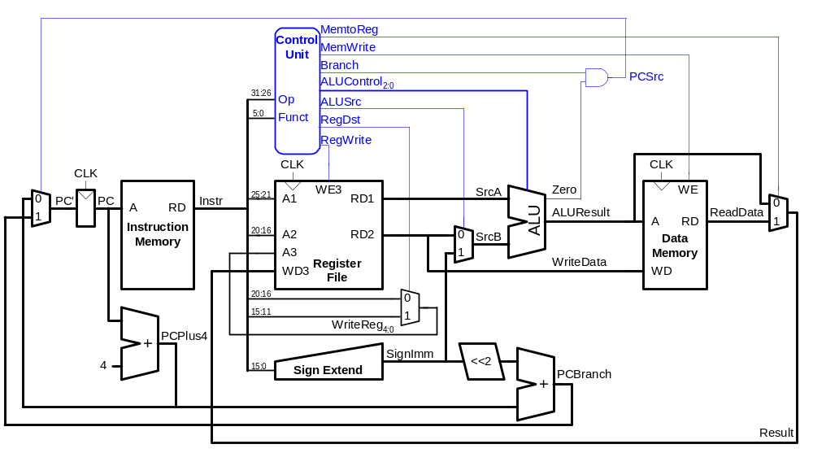
Complete Single-Cycle Processor (w/control)

Slide 21
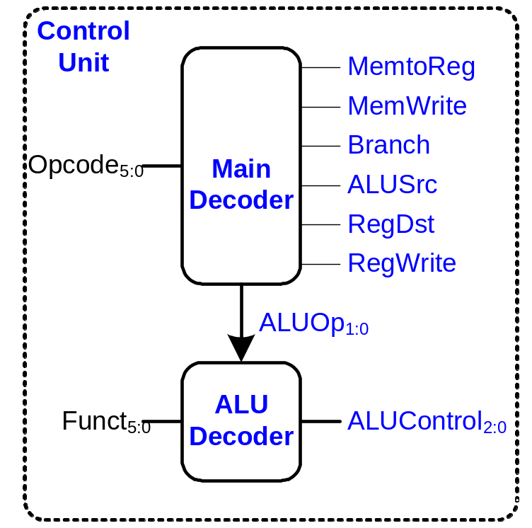
Control Unit

Slide 22
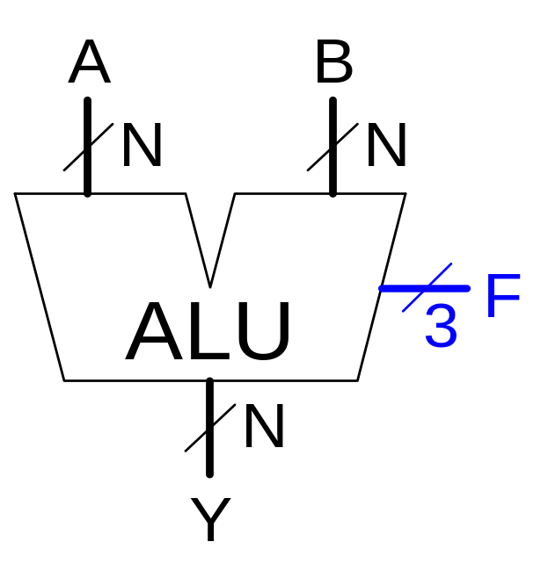
Review: ALU
F_{2:0} | Function
000 | A & B
001 | A | B
010 | A + B
011 | not used
100 | A & ~B
101 | A | ~B
110 | A - B
111 | SLT

Slide 23
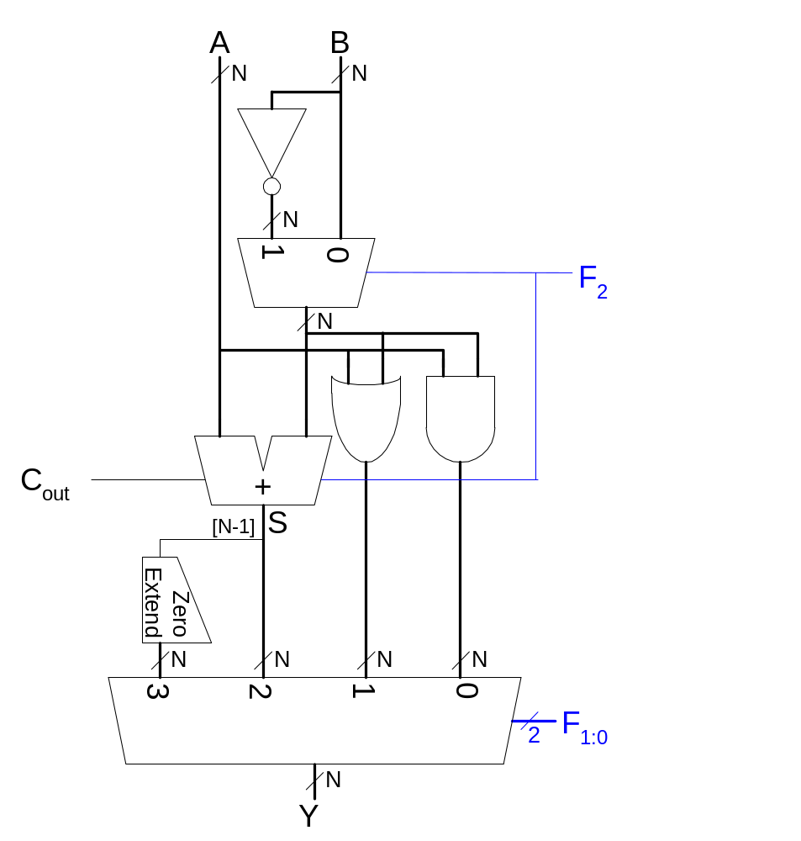
Review: ALU Design
F_{2:0} | Function
000 | A & B
001 | A | B
010 | A + B
011 | not used
100 | A & ~B
101 | A | ~B
110 | A - B
111 | SLT

Slide 24
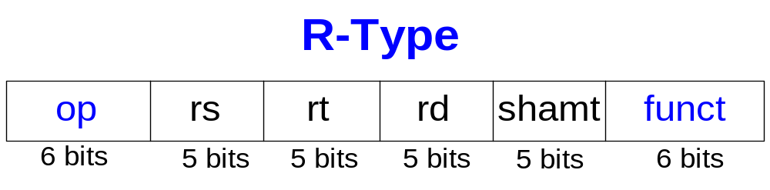
Review: R-Type
Fields:
  op: the operation code or opcode (0 for R-type instructions)
  funct: the function
  together, the opcode and function tell the computer
  what operation to perform

Slide 25
Controller (2 modules)
module controller(input [5:0] op, funct,
input zero,
output memtoreg, memwrite,
output pcsrc, alusrc,
output regdst, regwrite,
output jump,
output [2:0] alucontrol);
wire [1:0] aluop;
wire branch;
maindec md(op, memtoreg, memwrite, branch,
alusrc, regdst, regwrite, jump,
aluop);
aludec ad(funct, aluop, alucontrol);
assign pcsrc = branch & zero;
endmodule

Slide 26
Main Decoder
module maindec(input [5:0] op,
output memtoreg, memwrite, branch, alusrc,
output regdst, regwrite, jump,
output [1:0] aluop);
reg [8:0] controls;
assign {regwrite, regdst, alusrc,
branch, memwrite,
memtoreg, jump, aluop} = controls;
always @(*)
case(op)
6'b000000: controls <= 9'b110000010; //Rtype
6'b100011: controls <= 9'b101001000; //LW
6'b101011: controls <= 9'b001010000; //SW
6'b000100: controls <= 9'b000100001; //BEQ
6'b001000: controls <= 9'b101000000; //ADDI
6'b000010: controls <= 9'b000000100; //J
default: controls <= 9'bxxxxxxxxx; //???
endcase
endmodule
Why do this?

Slide 27
ALU Decoder
module aludec(input [5:0] funct,
input [1:0] aluop,
output reg [2:0] alucontrol);
always @(*)
case(aluop)
2'b00: alucontrol <= 3'b010; // add
2'b01: alucontrol <= 3'b110; // sub
default: case(funct) // RTYPE
6'b100000: alucontrol <= 3'b010; // ADD
6'b100010: alucontrol <= 3'b110; // SUB
6'b100100: alucontrol <= 3'b000; // AND
6'b100101: alucontrol <= 3'b001; // OR
6'b101010: alucontrol <= 3'b111; // SLT
default: alucontrol <= 3'bxxx; // ???
endcase
endcase
endmodule

Slide 28
Control Unit: ALU Decoder
ALUOp_{1:0} | Meaning
00 | Add
01 | Subtract
10 | Look at Funct
11 | Not Used
ALUOp_{1:0} | Funct | ALUControl_{2:0}
00 | X | 010 (Add)
X1 | X | 110 (Subtract)
1X | 100000 (add) | 010 (Add)
1X | 100010 (sub) | 110 (Subtract)
1X | 100100 (and) | 000 (And)
1X | 100101 (or) | 001 (Or)
1X | 101010 (slt) | 111 (SLT)

Slide 29
Control Unit: Main Decoder
Instruction | Op_{5:0} | RegWrite | RegDst | AluSrc | Branch | MemWrite | MemtoReg | ALUOp_{1:0}
R-type | 000000 | 1 | 1 | 0 | 0 | 0 | 0 | 10
lw | 100011 | 1 | 0 | 1 | 0 | 0 | 0 | 00
sw | 101011 | 0 | X | 1 | 0 | 1 | X | 00
beq | 000100 | 0 | X | 0 | 1 | 0 | X | 01

Slide 30
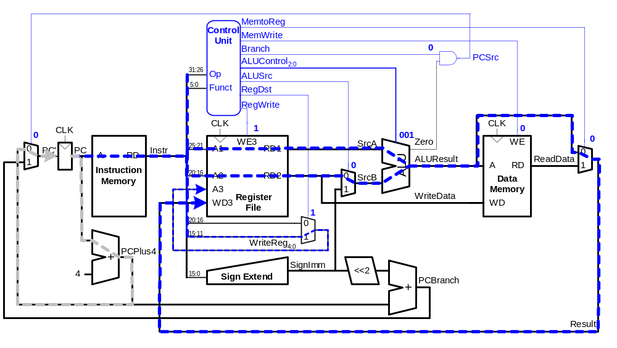
Single-Cycle Datapath Example: or

Slide 31
Extended Functionality: addi
No change to datapath

Slide 32
Control Unit: addi
Instruction | Op_{5:0} | RegWrite | RegDst | AluSrc | Branch | MemWrite | MemtoReg | ALUOp_{1:0}
R-type | 000000 | 1 | 1 | 0 | 0 | 0 | 0 | 10
lw | 100011 | 1 | 0 | 1 | 0 | 0 | 0 | 00
sw | 101011 | 0 | X | 1 | 0 | 1 | X | 00
beq | 000100 | 0 | X | 0 | 1 | 0 | X | 01
addi | 001000 | 1 | 0 | 1 | 0 | 0 | 0 | 00

Slide 33
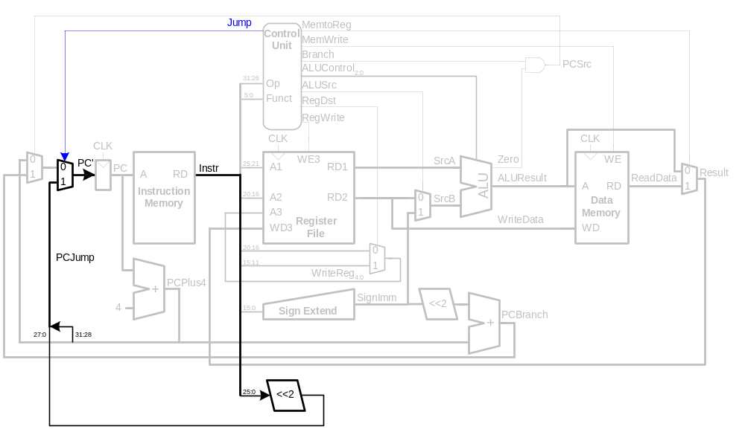
Extended Functionality: j

Slide 34
Control Unit: Main Decoder
Instruction | Op_{5:0} | RegWrite | RegDst | AluSrc | Branch | MemWrite | MemtoReg | ALUOp_{1:0} | Jump
R-type | 000000 | 1 | 1 | 0 | 0 | 0 | 0 | 10
lw | 100011 | 1 | 0 | 1 | 0 | 0 | 0 | 00
sw | 101011 | 0 | X | 1 | 0 | 1 | X | 00
beq | 000100 | 0 | X | 0 | 1 | 0 | X | 01
j | 000100 | 0 | X | X | X | 0 | X | XX | 1

Slide 35
Review: Processor Performance
Program Execution Time =
(# instructions)(cycles/instruction)(seconds/cycle)
= # instructions x CPI x TC

Slide 36
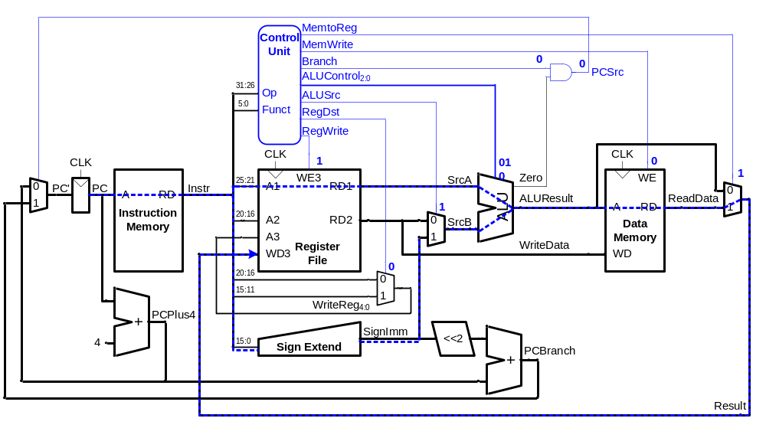
Single-Cycle Performance
T_{C} is limited by the critical path (lw)

Slide 37
Single-Cycle Performance
Single-cycle critical path:
T_{c} = t_{pcq_PC} + t_{mem} + max(t_{RFread}, t_{sext} + t_{mux}) + t_{ALU} + t_{mem} + t_{mux} + t_{RFsetup}
In most implementations, limiting paths are:
  memory, ALU, register file.
  T_{c} = t_{pcq_PC} + 2t_{mem} + t_{RFread} + t_{ALU} + t_{RFsetup} + t_{mux}

Slide 38
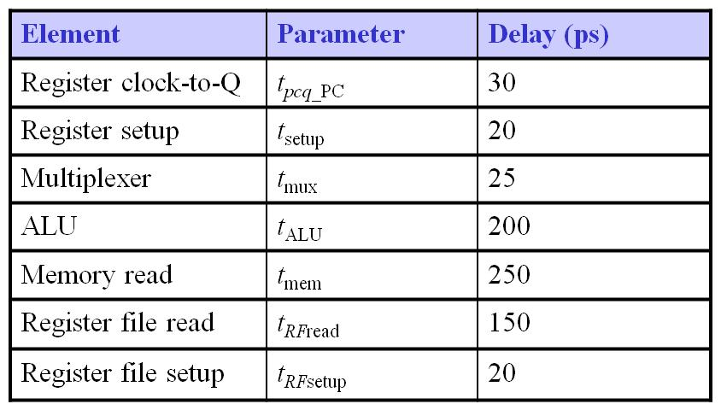
Single-Cycle Performance Example
T_{c} = t_{pcq_PC} + 2t_{mem} + t_{RFread} + t_{mux} + t_{ALU} + t_{RFsetup}
= [30 + 2(250) + 150 + 25 + 200 + 20] ps
= 925 ps

Slide 39
Single-Cycle Performance Example
For a program with 100 billion instructions executing on a single-cycle MIPS processor,
Execution Time = # instructions x CPI x T_{C}
= (100 × 10⁹)(1)(925 × 10⁻¹² s)
= 92.5 seconds

Slide 40
Any potentials problems?
How do our Block RAMs differ from the RAM illustrated here?
Do we want a Harvard architecture?
  instruction memory and data memory are separate

Slide 41
Next Time
We’ll look at multi-cycle MIPS
Adding functionality to our design

