Slide 1
PCA based 3D point cloud classification report for the course Nuages de Points et Modélisation 3D (NPM)
Leman FENG
Mars 2018

Slide 2
Introduction
Article Summary
Criticism
New ideas
Aspects:
Neighborhood selection
Feature design
Classification
Dataset Result

Slide 3
Article Summary
[1] Martin Weinmann, Boris Jutzi, Stefan Hinz, and Clement Mallet. Semantic point cloud interpretation based on optimal neighborhoods, relevant features and efficient classifiers,2015
[2] Timo Hackel, Jan D Wegner, and Konrad Schindler. Fast semantic segmentation of 3d point clouds with strongly varying density,2016

Slide 4
Article Summary Neighborhood selection
Timo
Multiscale k-NN, k=10
Pyramids of grid subsampling, 9 scales from 0.025m to 6.4m, with a factor of 2.
Martin
Single scale k-NN
Try k from 10 to 100, choose best k such that eigen-entropy is maximized

Slide 5
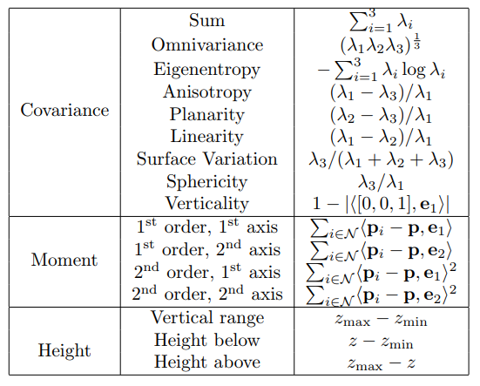
Article Summary Feature design
Timo
Martin
Similar Covariance features, plus other 2d/3d features

Slide 6
Article Summary Classification
Timo
Random forest with optimal depth and size
Martin
Random forest and other classifiers such as MLP, etc.
Random forest gives best performance at most of time

Slide 7
Article Summary Dataset & result
Timo
Paris rue Madame database
Paris rue Casette database
97% overall precision
Martin
Oakland 3D Point Cloud Dataset (92% overall precision)
Paris rue Madame database(63%~95% precision)
Randomly select 1000 points per class for training,
rest points for testing

Slide 8
Criticism Neighborhood selection
Timo
Multiscale k-NN, k=10
Pyramids of grid subsampling, 9 scales from 0.025m to 6.4m
Martin
Single scale k-NN
Try k from 10 to 100, choose best k such that eigen-entropy is maximized
Dilemma:
Scale too small:
Small details are captures, but too local
Scale too large:
Large coverage, but PCA of one single large ball is too abstract
One single scale is not enough
Most point cloud is to scale. The unit of length is know. Features with fixed scale maybe capture more precisely.

Slide 9
Criticism Feature design
Timo
Martin
Similar Covariance features, plus other 2d/3d features
Made up 8 features from 3 eigenvalues
Eigenvalue is not a probability, even if it’s normalized
Given 1st order moments and eigenvalues, 2nd order moments can be deduced. Since eigenvalue are in fact variance
You have no right to use height information. What about a car on a bridge? Without height info, precision drop “5%”, according to author

Slide 10
Criticism Classification
Timo
Random forest with optimal depth and size
Martin
Random forest and other classifiers such as MLP, etc.
Random forest gives best performance at most of time
I guess Random forest can’t create complicated features out of raw features, that’s why we need to invent a lot of hand-crafted features to feed it.

Slide 11
Criticism Dataset & result
Timo
Paris rue Madame database
Paris rue Casette database
97% overall precision
Martin
Oakland 3D Point Cloud Dataset (92% overall precision)
Paris rue Madame database(63%~95% precision)
Randomly select 1000 points per class for training,
rest points for testing
You shall not mix your testing data with your training data.
For many testing points, they have neighbors that were included in 1000 training points.
They will have similar features due to the same location in the same point cloud.

Slide 12
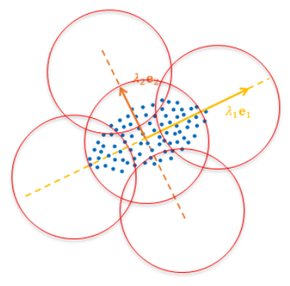
New ideas Neighborhood selection
Neighborhood’s Neighborhood
Not only pick one ball centered at queried points, but also take 6 other balls surrounding the center ball, use eigenvector of center ball as a natural frame
Use the Pyramids grid subsampling idea from Timo, but use radius neighborhood instead of k-NN.
Use 4 scales in total, from 0.1m to 2.7m with a factor of 3

Slide 14
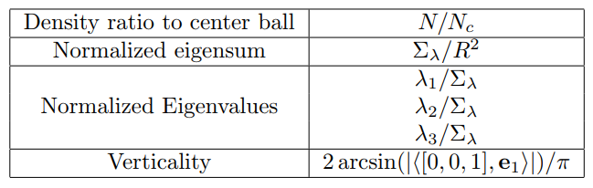
New ideas Feature design
No more hand-crafted features
Raw normalized eigenvalues
Plus density ratio to center ball

Slide 15
New ideas Classification
Random forest
MLP
Convolutional network
Same convolutional kernel for each ball. Because one useful kernel for one ball should also be useful for other ball
Same convolutional kernel for each scale.

Slide 16
INPUT
L1
L2
L3
OUTPUT
n2
n_ball
n_feature
m1
n2
reshape
by scale
n1
Full connection
n_scale
Conv m1 @ 1 x n2 x n_ball
n_scale x n_ball

Slide 17
New ideas Dataset
Training and testing data shall not come from the same part of point cloud
But they should also be similar
Solution: cut existing dataset into two parts

Slide 18
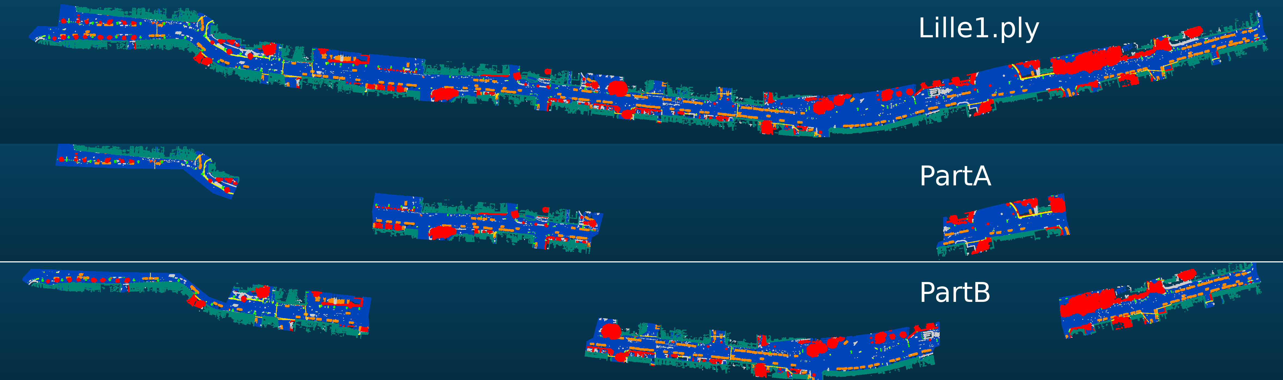
Paris-Lille-3D dataset^{[1]}
[1] X. Roynard, J.-E. Deschaud, and F. Goulette. Paris-lille-3d: a large and high-quality ground truth urban point cloud dataset for automatic segmentation and classification. ArXiv e-prints, November 2017.

Slide 19
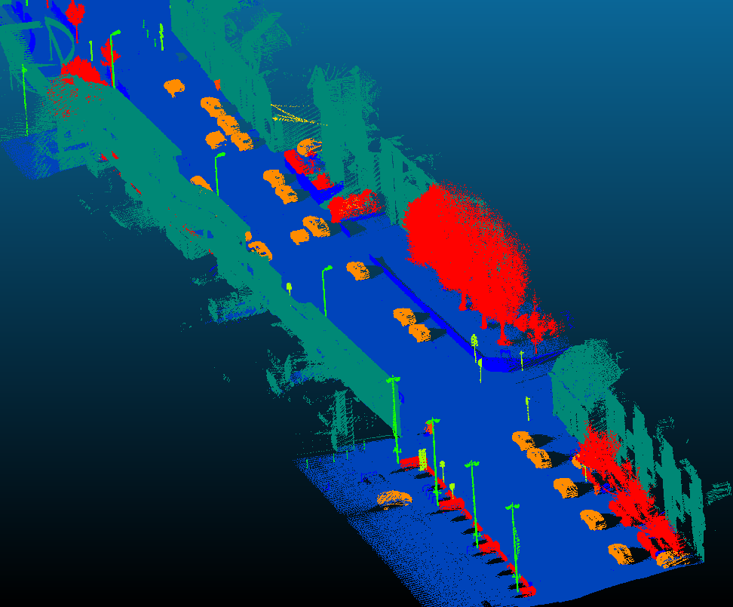
Paris-Lille-3D dataset

Slide 20
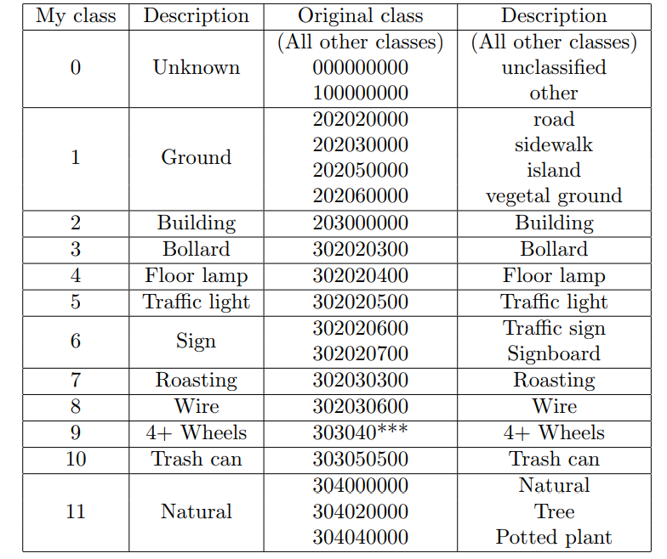
New ideas Dataset
Remapping of class labels

Slide 21
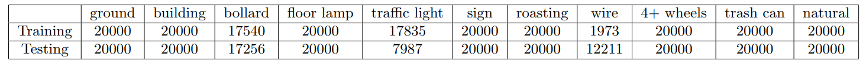
New ideas Dataset
Training and testing data number, from resp. part A and part B

Slide 22
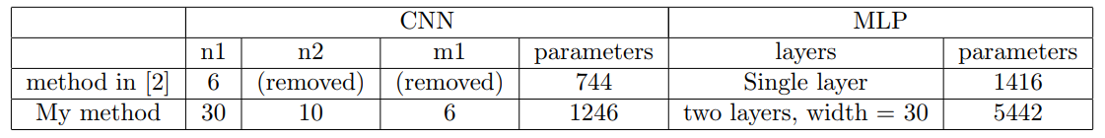
New ideas Result
Test Timo’s feature and my neighborhood’s neighborhood features.
Use three classifier, Random forest, MLP and CNN. Structure of MLP and CNN are adaptive to dataset. CNN have less parameters than MLP.

Slide 23
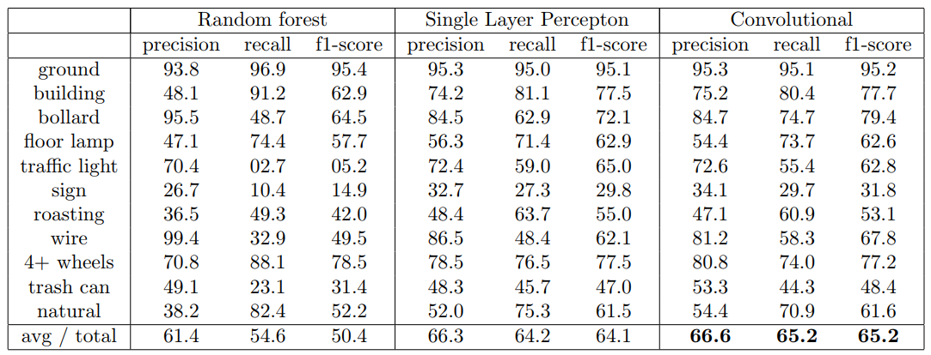
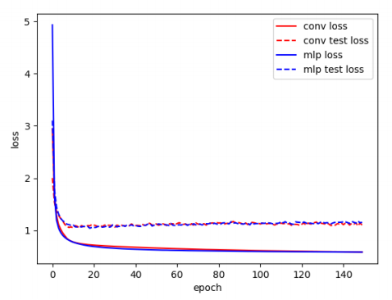
New ideas Result
Timo’s feature
(without height features)

Slide 24
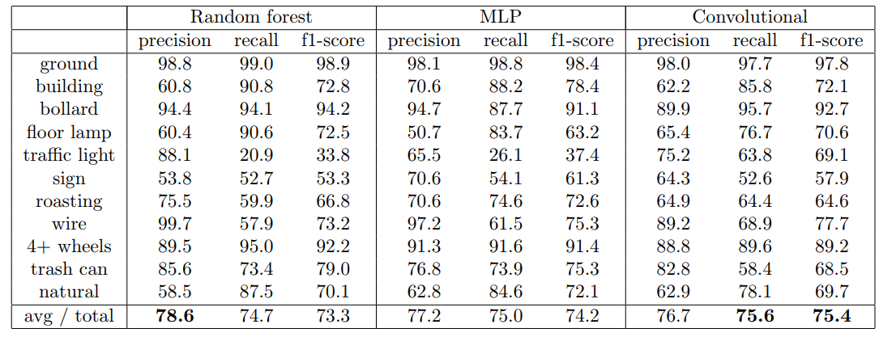
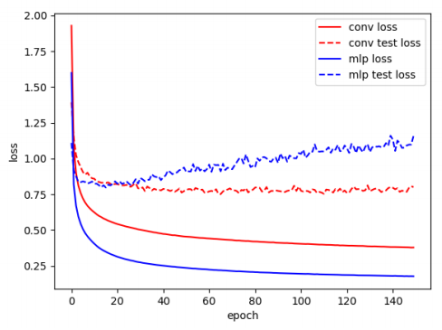
New ideas Result
My neighborhood’s neighborhood

Slide 25
Conclusion
The way the two papers choose training & testing samples from same point cloud do have problem. It will give fake high precision which is actually overfitting
The “97% overall precision using 1000 training samples per class and rest points for testing” can be reproduced in the Lille street dataset. And a drop of 5% precision without height features is also confirmed by the same test. Precision table is shown in the next page.
The new “Neighborhood’s neighborhood” feature gives better result than previous PCA-based method in my new test.
CNN gives better result than MLP and Random forest on Timo’s feature, but on my “Neighborhood’s neighborhood” feature, their performances are basically the same. Maybe it’s because Timo’s features only have balls, more suitable for CNN.
CNN+raw features might be a interesting direction for future research.

Slide 26

Conclusion
Test Timo’s methods without height features, while mixing training and testing samples as two papers.
92% overall precision, same as the 97%-5% result according to Timo’s paper.

