Slide 1
Global Aquaculture Production and Ocean Acidification
Initial Findings and Exploratory Data Analysis
Emma Mavis

Slide 2
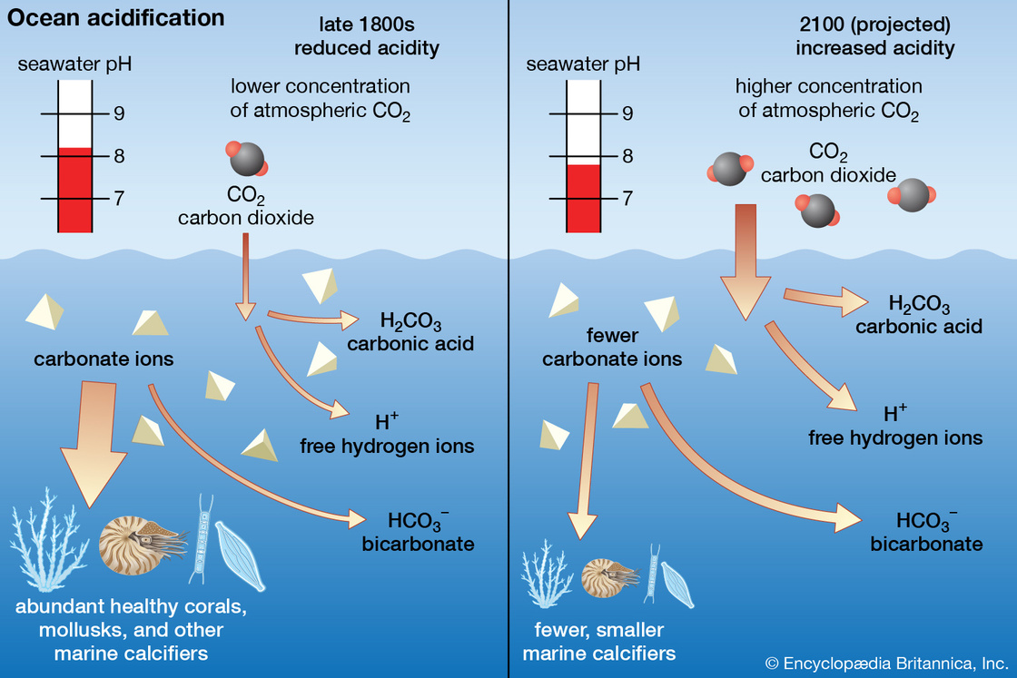
What is Ocean Acidification?
Increase in emissions means ocean absorbs greater amount of CO2
Why is this so bad?
Shells and skeletons dissolve –> alters structure of coral reefs –> alters marine food chains –> negatively effects human food supply
Reduction of seawater pH, carbonate ion concentration, saturation states of important calcium carbonate minerals

Slide 3
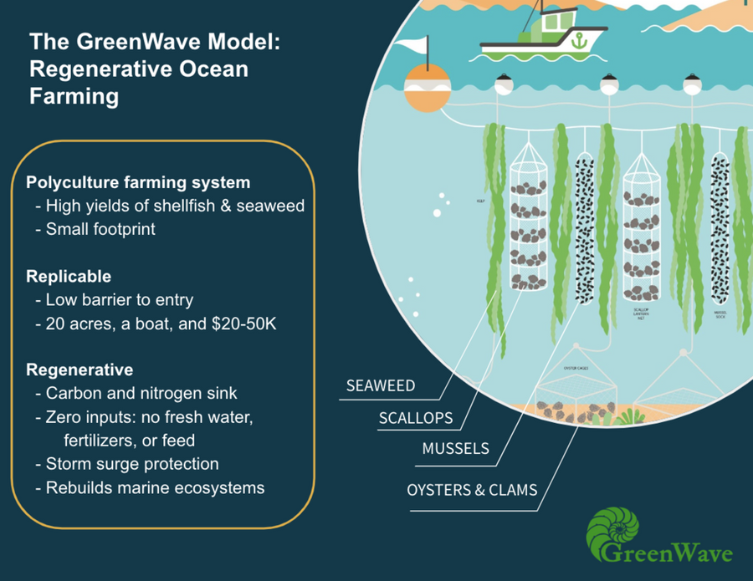
What is Aquaculture*?
Regenerative ocean farming
Applies to all fish, shellfish, seaweed, etc
Subset on shellfish and seaweed production – where we see most benefit
Effects on CO2 sequestration –> ocean acidification
* Sustainable aquaculture

Slide 4

First Looks at Aquaculture Data

Slide 5
Data collected from fishStatJ portal of the Food and Agriculture Organization of the United Nations
1950 – 2019
After subset, 494 observations
Many production values are 0, but this makes sense
Only small number of countries have data earlier than 1970s
Most 0’s occur from 1950-1980s
Found that countries with 0 production after 2010 have no coastal access nor great capital
Interesting further investigation…

Slide 6
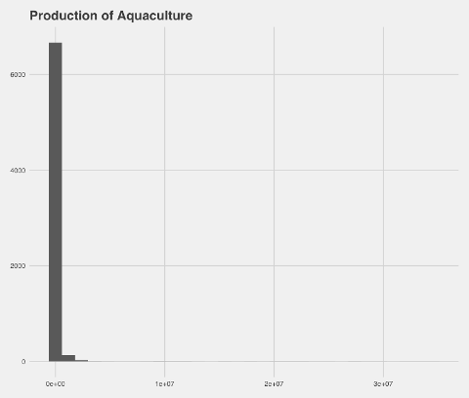
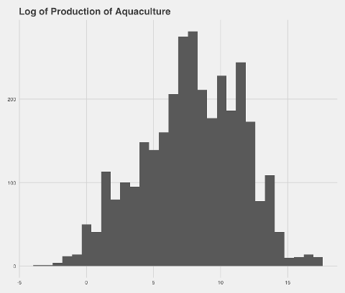
A look at Response Variable: Production

Slide 7
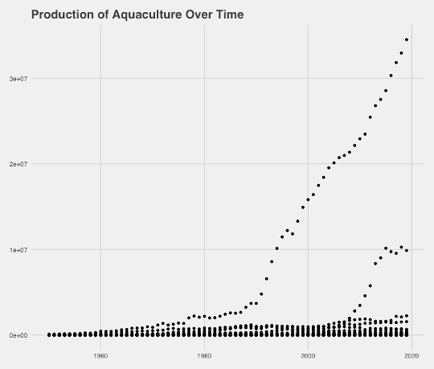
Production Over the Years
Starting in 90s many countries see drastic increase
Another increase after 2010

Slide 8
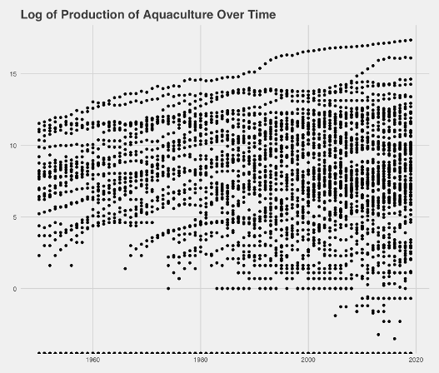
Production Over the Years
Interesting spread here
Thoughts of categorizing the countries

Slide 9
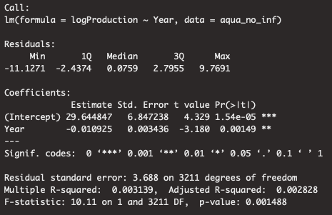
First Linear Model
Log(Production) ~ Year
Strong coefficient, terrible R-squared

Slide 10

First Looks at Ocean Acidification Data

Slide 11

Metric for ocean acidification is partial pressure of CO2 in seawater
Data collected from National Centers for Environmental Information
Mostly in Arctic and Antarctic regions
1957-2019
1,048,575 observations

Slide 12
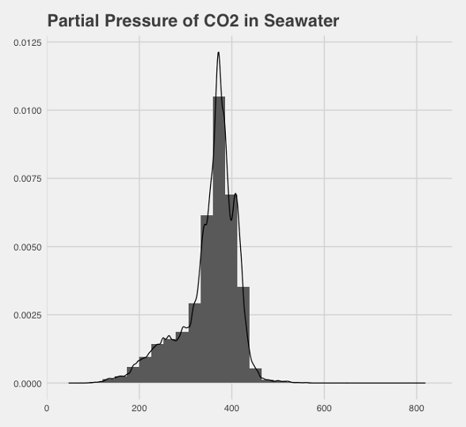
Not very normal distribution
Log transform, square root transform
Note: measured in micro-atm

Slide 13
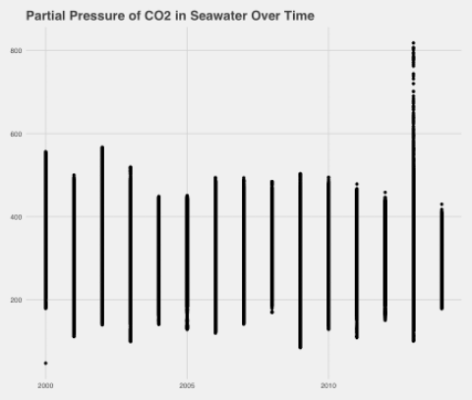
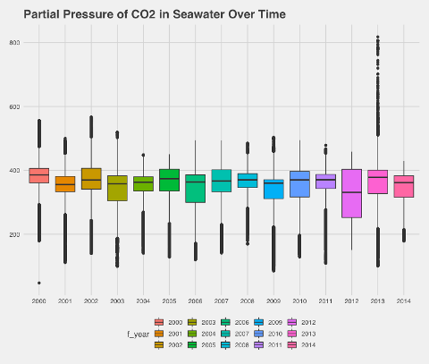
What happened in 2013?

Slide 14
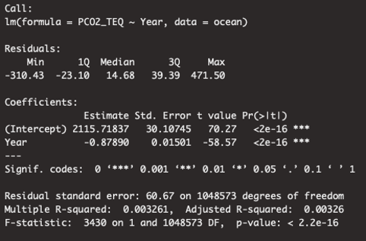
First Linear Model
Similar to aquaculture results
Good p-values probably due to large n

Slide 15

Going Forward
Figure out data drama with National Oceanic and Atmospheric Administration
Log transform aquaculture variable with a +1 so I can still include the 0-valued countries
Time series models
Merge data
Data only goes to 2014
Find data sets for non-polar regions

