Slide 1
Guide
When you complete to write this doc, please delete this page.
All green and Italic font(e.g., like this) are for guidance. When you write your own contents, please delete the guide comments.
All required item should be filled. If not, the app testing will be rejected.
If your app has “Quiz” part, please provide ‘answer sheet’. Your app will be tested much easier and faster.

Slide 2
Fusion Stream Player Description
Fusion Streaming

Slide 3
Revision History
Version | Date | Description | Author
1.0 | 2025.06.27 | Initial release - App Description document First version for Samsung certification | Fusion Streaming

Slide 4
Contents
UI Structure
Usage Scenario
Menu & function description
Key policy
How to change languages

Slide 5
UI Structure
Whole UI Structure
Main Screen (URL Input) → Playback Screen → Back → Main Screen
The app has 2 screens: URL input and full-screen player.
Depth: Main (URL input + Play button) > Player (full-screen video + controls)

Slide 6
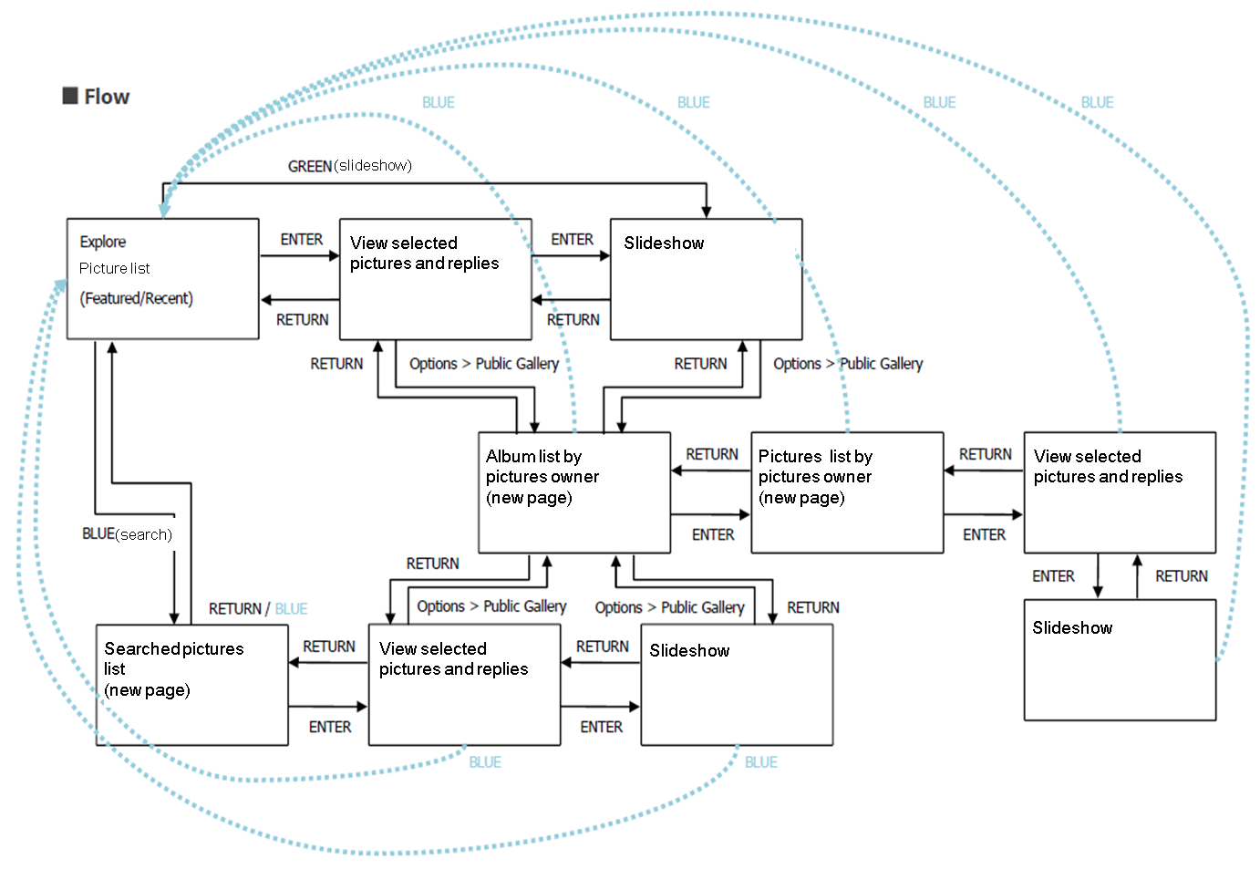
UI structure – sample1(flow graph)

Slide 7
UI Structure – sample2(depth navi.)
1st depth
2nd depth
3rd depth
4th depth
5th depth
Picture list
View selected pictures and replies
Slideshow
Album list by pictures owner
Picture list by pictures owner
View selected pictures and replies
Slideshow
Searched pictures list
View selected pictures and replies
Slideshow

Slide 8
Usage Scenario
Step 1: Launch the app. The main screen displays a URL input field.
Step 2: Enter a test URL. HLS: https://test-streams.mux.dev/x36xhzz/x36xhzz.m3u8 | MP4: https://www.w3schools.com/html/mov_bbb.mp4 Press BACK to return.

Slide 9
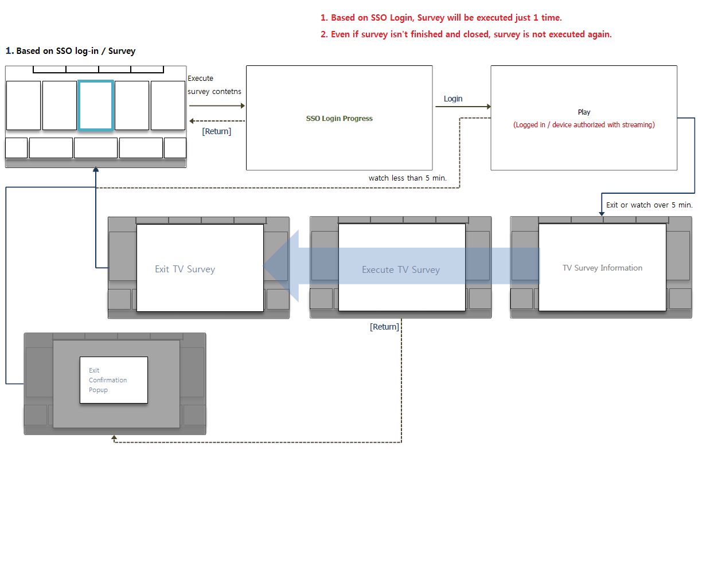
Usage Scenario – sample
It’s a sample of log-in function. Make your usage scenario refer to below sample.(It’s only example)

Slide 10
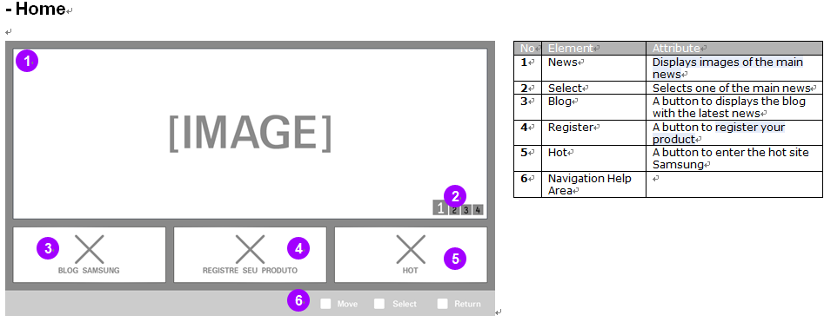
Menu & function description
Main Screen: URL input field + Play button | Player Screen: full-screen video + remote controls

Slide 11
Key Policy - sample
BACK: Return to URL input screen | OK/Enter: Play | Directional: Navigate/Seek | Play/Pause: Toggle playback
Button | Action | Remarks
ENTER | Change window screen to full screen or full screen to window screen.
Ch. Up/Down | N/R
UP/DOWN | N/R
LEFT/RIGHT | Move highlight to left or right
YELLOW | View information
RETURN | Move to previous page | Samsung Mandatory
EXIT | Close the app and show broadcasting channel | Samsung Mandatory
RETURN/EXIT | In case of Game App, if game is terminated, the exit popup should be displayed. | Samsung Mandatory

Slide 12
How to change languages
Items | Contents
How to change languages | If multi languages are supported, describe how to check multi languages on the App. If not, ignore this box. N/A - single language application.

