Slide 1
Classification
MER – making feelings objective

Slide 2
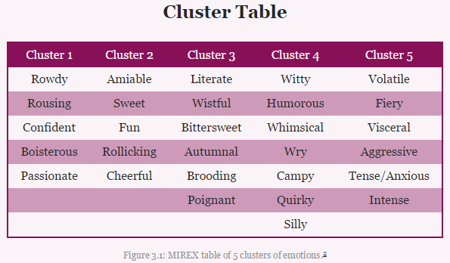
But what does it mean?
good question!
split data into predetermined categories
(Below MIREX table of 5 clusters of emotions)

Slide 3
Can you tell me more...
Well, since you asked
Binary
Single-label
Multi-class
Multi-label
Fuzzy Label

Slide 4
I know what you're thinking...
"I can classify music emotion with my eyes closed ..."
"Why do we need ML?"
- rules more accurate
- hard to describe what comes naturally
- still needs supervising

Slide 5
Classification
ML models

Slide 6
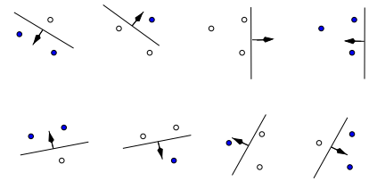
Support Vector Machines (SVM)
Training data
{(feature vector, ground truth)}
Data shattering

Slide 7
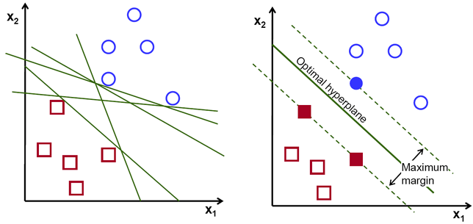
Support Vector Machines (SVM)
Maximum margin hyper-plane

Slide 8
Support Vector Machines (SVM)
Huh, what is it good for?
Primarily Binary Classification
Single-label
Multi-class
Multi-label

Slide 9
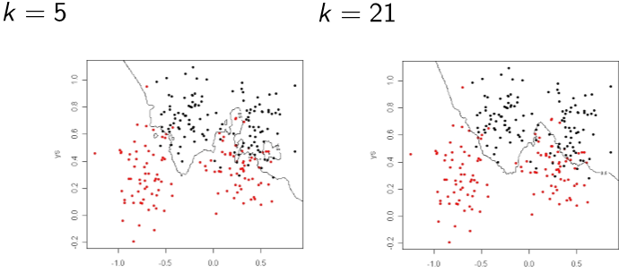
Fuzzy k-Nearest Neighbour (FKNN)
In use, data point is compared with all training data
k nearest neighbours found

Slide 10
Fuzzy k-Nearest Neighbour (FKNN)
The ML part
Values of training set are fuzzy vectors
Components of vectors: mean feature value a class
Error is calculated for each test data point
Weakest features are removed

Slide 11
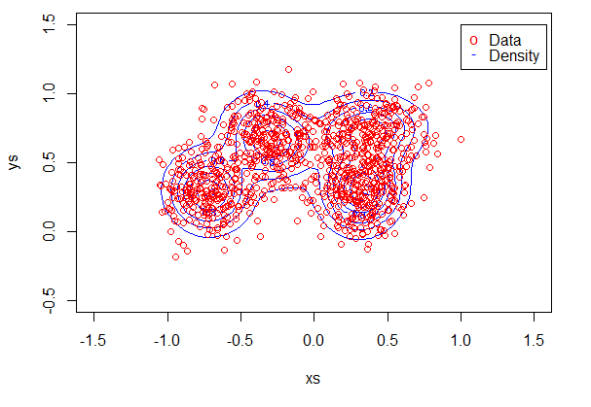
Gaussian Mixture Model (GMM)
Clusters data to form normal distributions

Slide 12
Classification
Conclusion

Slide 13
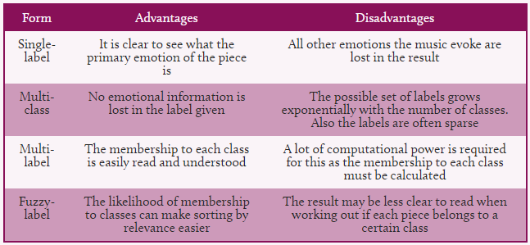
Conclusion
Greater efficiency than human labelling
Predicted emotion is clear

