Slide 1
Regression

Slide 2
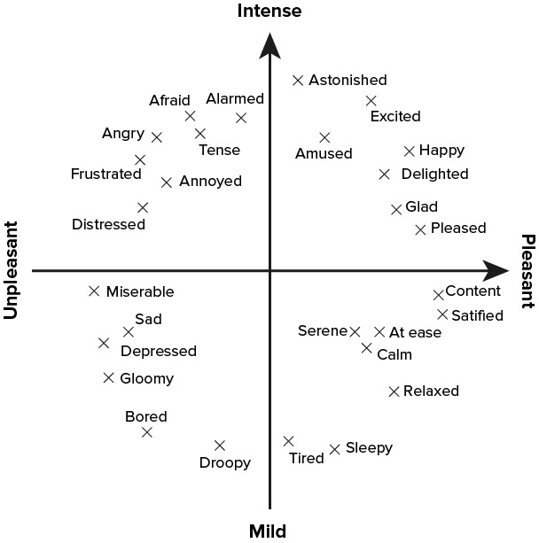
How is regression used in MER?
Thayer’s Arousal-valence plane of emotion
Different musical pieces are mapped onto this plane of emotion by a machine.
The quadrant they lie in will determine the emotion they express
Regression deals with a continuous plane to resolve ambiguity problems that can arise when dealing with emotions of music

Slide 3

Can a machine learn everything?
Our brains usually associates events that occur in our lives to the music we were listening to at the time.
In cases where a machine is trying to perceive the emotion of an individual, depending on a certain music sample, memories could complicate the process
Machines also struggle with ambiguity when it comes to selecting a songs mood.
Notes:
DISCUSS AMBIGUITY OF PEOPLES EMOTIONS Make sure to say this only applies to certain situations
Finish up by stating problems machine may face in the psychological field

Slide 4
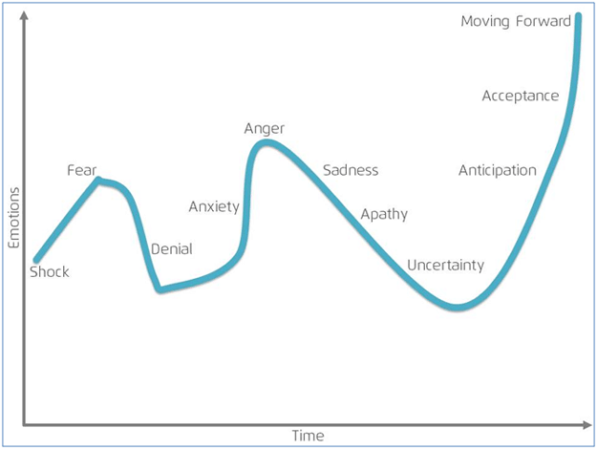
Time intervals
MER machines can analyse the emotion of music at different time intervals.
The overall emotion of a song can be calculated by finding an average between each segments emotion
Notes:
Ensure the graph is seen as a joke

Slide 5
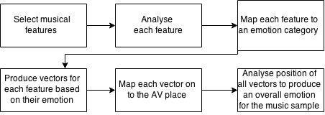
Support Vector Regression

Slide 6
Linear regression
Deals with mapping musical features on to the Arousal-Valence emotion plane
An LR machine is usually trained using Acoustic Emotion Gaussians (AEG)
Once the features are mapped from a musical features set to another set of AV values, an overall emotion is determined
Notes:
DISCUSS LINEAR REGRESSION
his approach creates a set of acoustic features that, in MER, would map on to a set of AV values with the same number of elements using AEG. The AV values from the second set are used to plot points on the Arousal-Valence plane which is then used to determine an overall emotion.

Slide 7
Active Machine Learning
Machine learning algorithms can be incorporated into MER machines
To allow better prediction accuracy.
Machines store results of their emotion evaluations in
a memory bank.
In future evaluations, the machine can reference the
memory bank to make more accurate predictions.
This can increase the speed of a techniques process if
It has to analyse large amounts of data e.g. musical features
Notes:
Reference techniques such a LR and SVR can use this

Slide 8
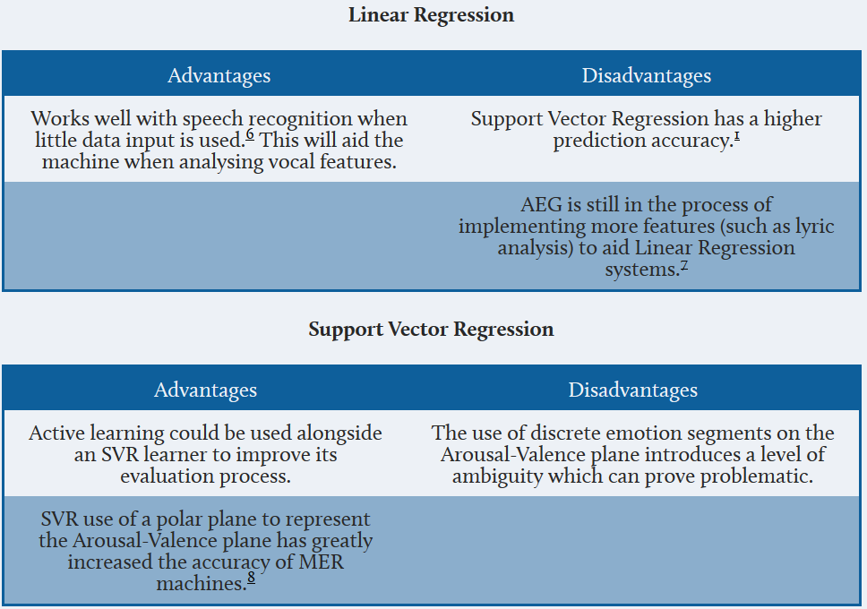
Comparisons

Slide 9
References
Russell, J. A. (1980). A circumplex model of affect. Journal of Personality and Social Psychology, 39, 1161–1178.
Yang , Y., Lin , Y., Su , Y. & Chen , H. (2008) A Regression Approach to Music Emotion Recognition. IEEE Transactions on Audio, Speech, and Language Processing. 16 (2), 1-1-10.
http://science-junkie.tumblr.com/post/70415569239/sagansense-why-do-the-songs-from-your-past#.VRCxMOGoNhZ
http://www.octopus-hr.co.uk/hrmoz/article/the-neuroscience-of-change.aspx
Tong , S. (2001) Active Learning: Theory and Applications. Philosophy. Stanford university.
SVR reference to my regression page
Wang, J., Yang, Y., Wang, H. & Jeng, S. (2012) The acoustic emotion Gaussians model for emotion-based music annotation and retrieval. Department of Electrical Engineering. National Taiwan University.

