Slide 1
Classification
MER – making feelings objective

Slide 2
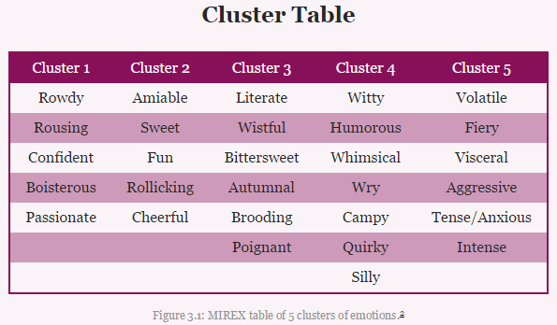
But what does it mean?
split data into predetermined categories

Slide 3
Can you tell me more...
Binary
Multi-class
Fuzzy Label
Single-label
Multi-label

Slide 4
I know what you're thinking "I can classify music emotion with my eyes closed ..."
Why do we need ML?
- rules more accurate
- hard to describe what comes naturally
- still needs supervising

Slide 5
Classification models
SVM
- Binary classifier
GMM
- More purpose ready for multi-label

Slide 6
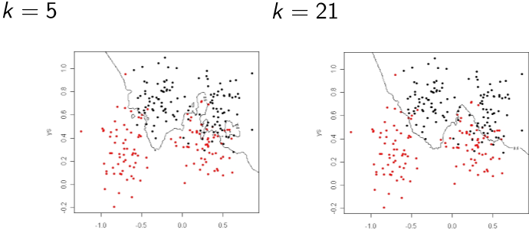
Fuzzy k-Nearest Neighbour (FKNN)
In use, data point is compared with all training data
k nearest neighbours found

Slide 7
Fuzzy k-Nearest Neighbour (FKNN)
The ML part
Values of training set are fuzzy vectors
Components of vectors: mean feature value a class
Error is calculated for each test data point
Weakest features are removed

Slide 8
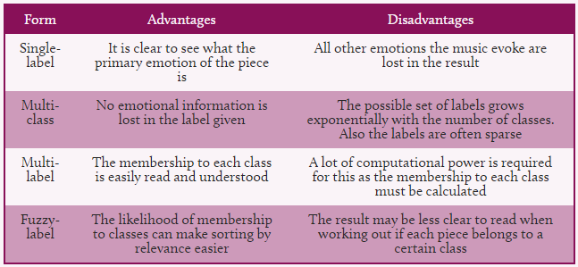
Conclusion
Greater efficiency than human labelling
Predicted emotion is clear

