Slide 1
Churn Prediction Project
POC – Customer Analytics
January 3th, 2018
Richard Vogg

Slide 2

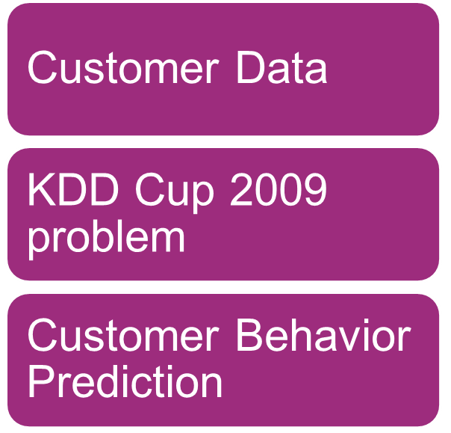

The Context

Slide 3
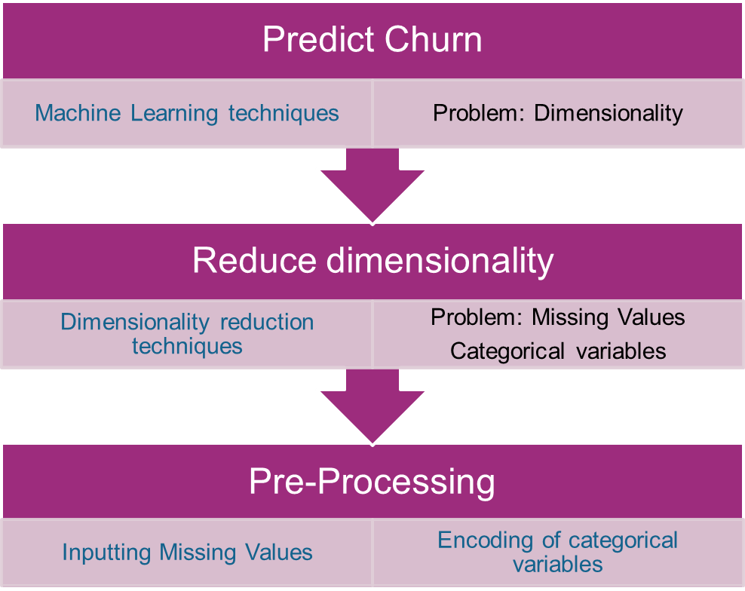
Challenges and Solutions
Variables | Large | Small
Numerical | 14740 | 190
Categorical | 260 | 40

Slide 4
The Workflow
Preprocessing
Dimensionality Reduction
Classification
Gradient Boosting Trees
One-Hot-Encoding
Missing Value Filter
Principal Component Analysis
Random Forest
Data
Binary Encoding
High Correlation Filter
Logistic Regression
Feature Importance Ranking
Neural Networks
Missing Values Imputation
Low Variance Filter
Support Vector Machine
<number> / evalueserve.com
©2018 Evalueserve. All rights reserved.

Slide 5

The Data
Variables | Large | Small
Numerical | 14740 | 190
Categorical | 260 | 40
We have a dimensionality
problem
Notes:
garbage-in-garbage-out

Slide 6
Missing Values Imputation
-NAs allowed by: Naïve Bayes, Decision Tree
-Nas not allowed by: Random Forest, Boosted Trees, Support Vector Machines
Approaches
-No imputation:
-Basic Imputation: Mean for numericals, “Other” for categoricals.
-MICE (Based on Case of Study)
Preprocessing:
-Correlation
-No Variance filtering
Technical Considerations
-Theory
-Time
Performance:
-No imputation
-Basic Imputation
-MICE

Slide 7
Column Filters
Purpose:
-Dimensionality Reduction
-Efficacy: Comparison vs Benchmark performance
-Efficiency: Time Management
Filters:
-Missing Values: 0 – 5 – 10 -25 – 50 %
-Low Variance: TBD
-High Correlation: 50 – 75 – 90 -100
Performance:
<3 tables, 1 per each filter outcome >

Slide 8
Thank you!
Although the information contained in this publication has been obtained from sources believed to be reliable, the author and Evalueserve disclaim all warranties as to the accuracy, completeness or adequacy of such information. Evalueserve shall have no liability for errors, omissions or inadequacies in the information contained herein or for interpretations thereof.

Slide 9

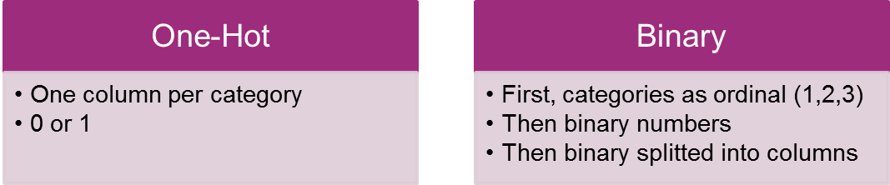
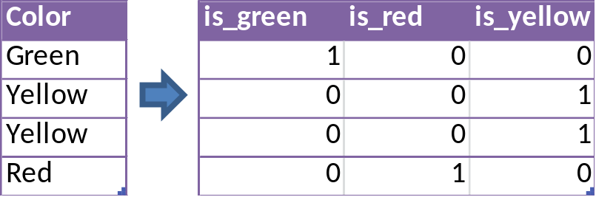
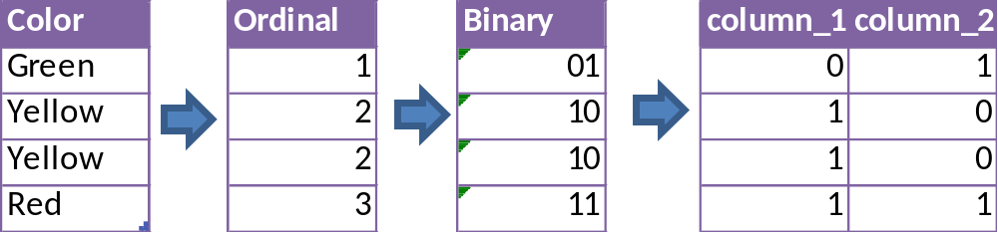
Encoding Categories
<number> / evalueserve.com

