Slide 1
Machine Learning A-Z™: Hands-On Python & R In Data Science
Linear Regression: Simple and Multiple
June 07, 2019
Ariel Capetillo
Juan Carlos Urrutia

Slide 2
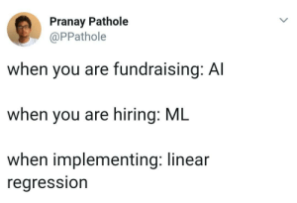
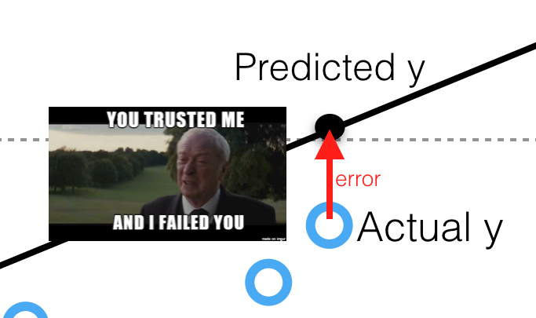
Contents
01 |  | Introduction to SLR
02 |  | SLR in Python
03 |  | SLR in R
04 |  | SLR Quiz
05 |  | Introduction to MLR and key concepts
06 |  | How to build a model
07 |  | MLR in Python
08 |  | MLR in R
09 |  | MLR Quiz

Slide 3


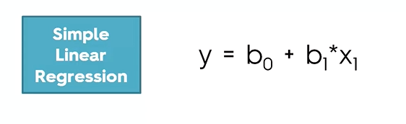
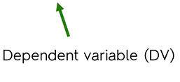
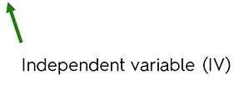
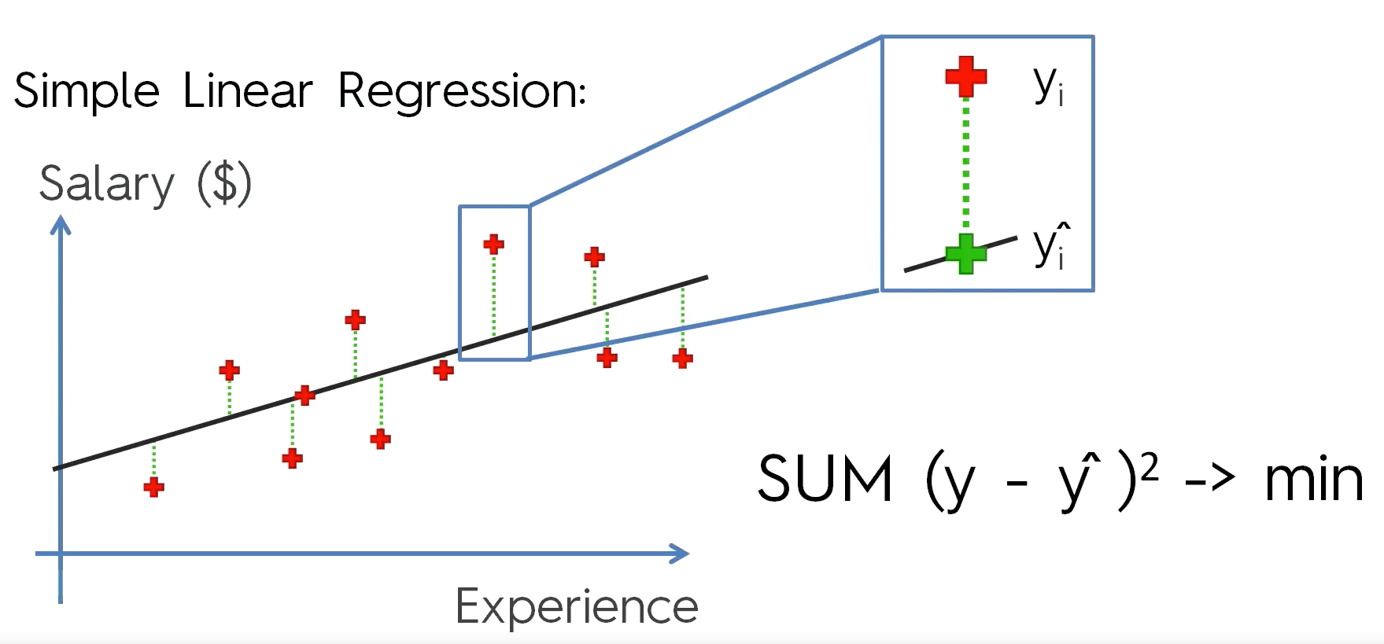
Simple Linear Regression
+ Error

Slide 4


Simple Linear Regression in Python
1
Python libraries for pre-processing:
Numpy: Mathematics library. Useful for making calculations.
Pyplot: Sub-library of matplotlib. Useful for plotting nice charts in Python
Pandas: Most famous library for importing and managing datasets.
2
We import the csv file. Then, we standardize it at our convenience (in this case, as arrays for the dependent and independent variables).
”pd” is the pandas library
iloc is used for specifying an index

Slide 5



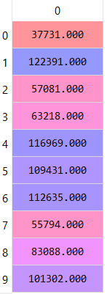
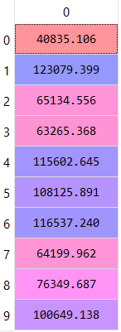
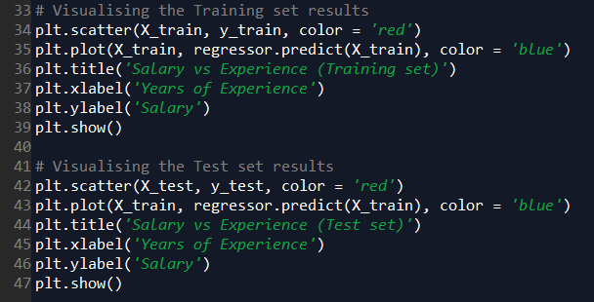
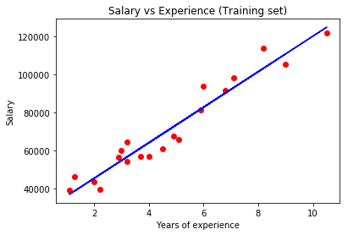
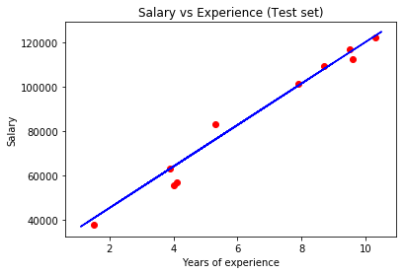
Simple Linear Regression in Python
3
4
Let’s talk a little bit about the parameters:
-fit_intercept: When shall we use it?
-normalize: What does this mean?
-n_jobs: This could optimize the process. Why?
5
y
y'
6

Slide 6

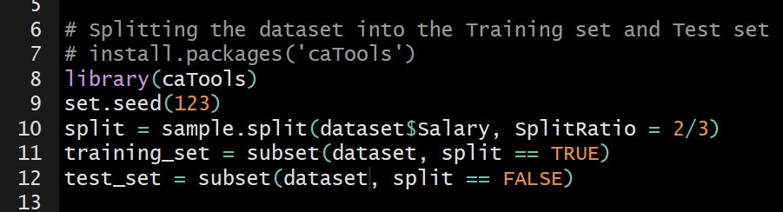
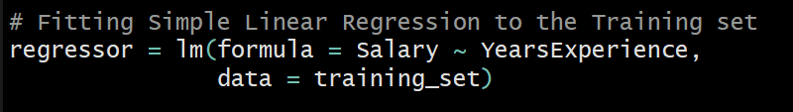
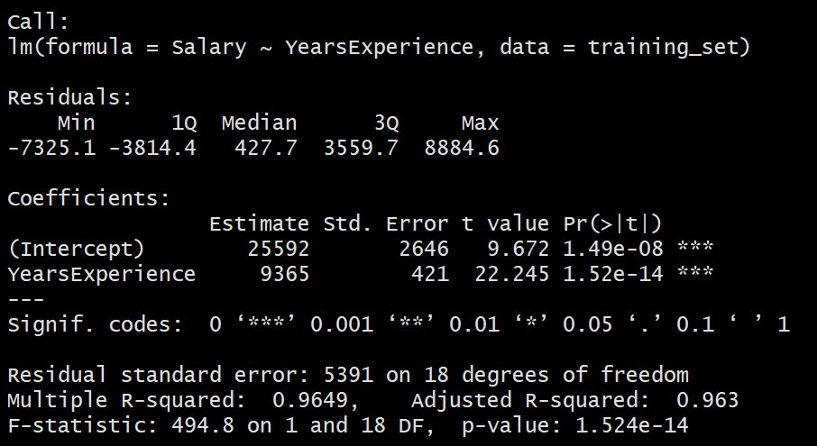
Simple Linear Regression in R
1
Which is the library we need for read.csv?
2
Remember, the library caTools is required for splitting the dataset
3
Let’s talk about:
-Residuals -Coefficients
-Estimates -Std. Error
-t value -Significance codes
-Degrees of freedom -R-squared
-Adjusted R-Squared -F-statistic
-p-value*

Slide 7

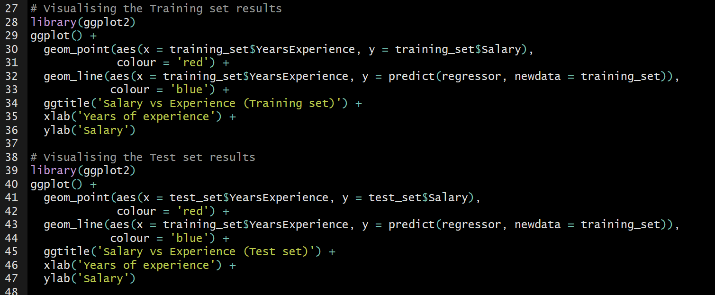
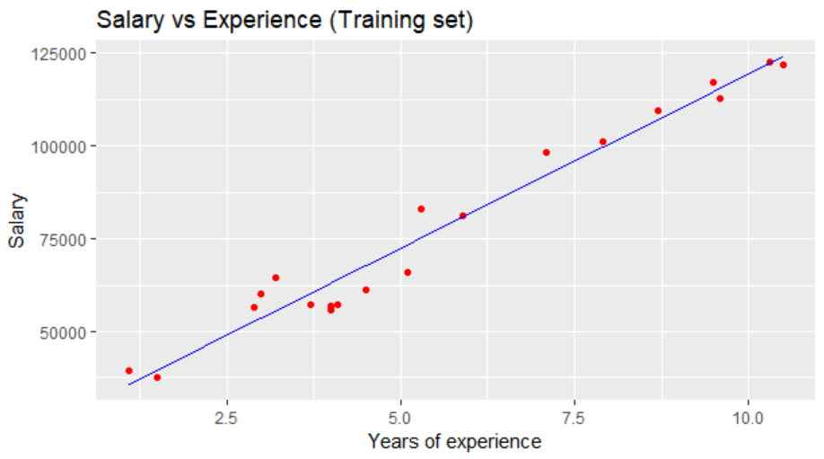
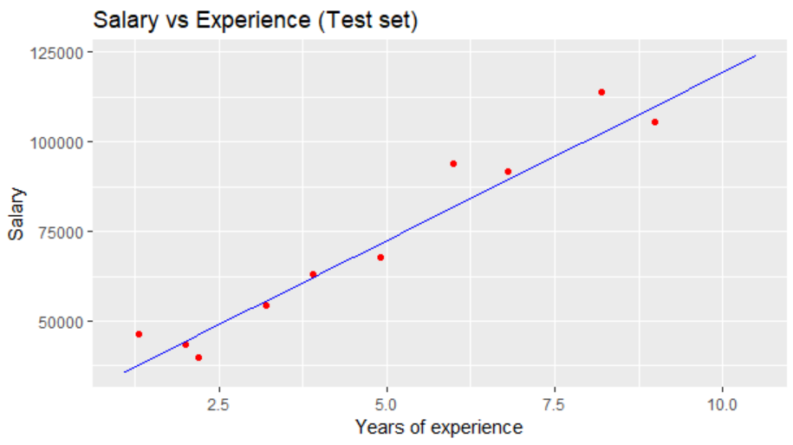
Simple Linear Regression in R
4
5

Slide 8
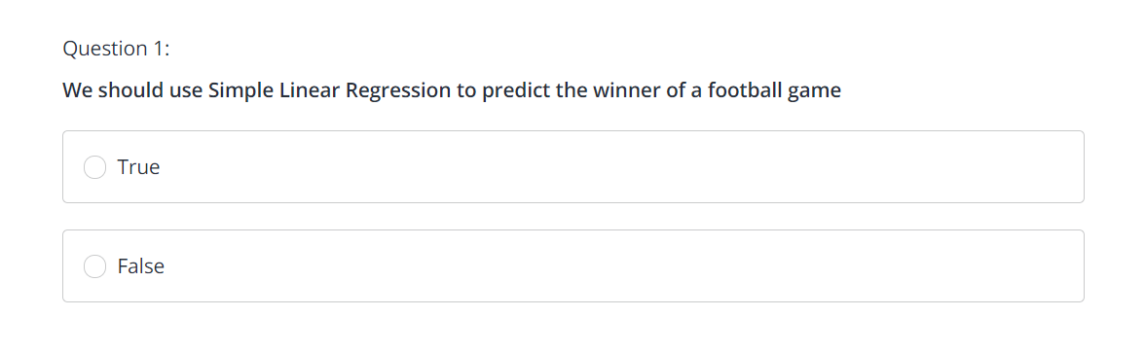
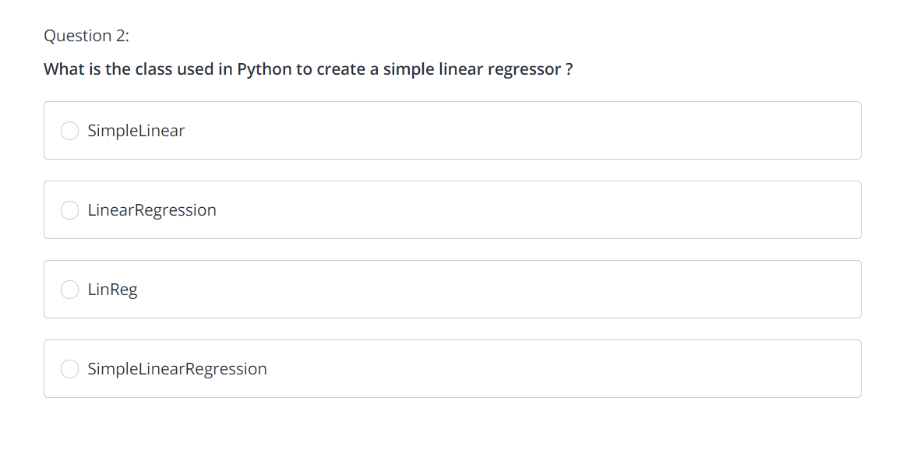
Simple Linear Regression Quiz

Slide 9
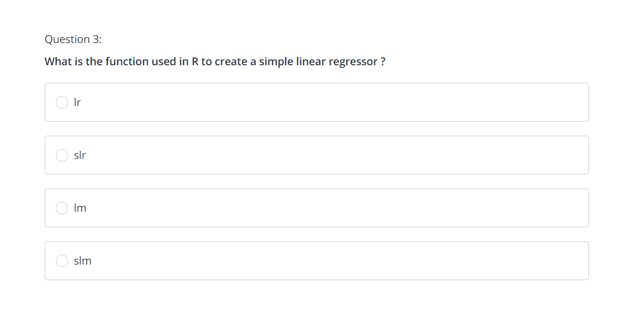
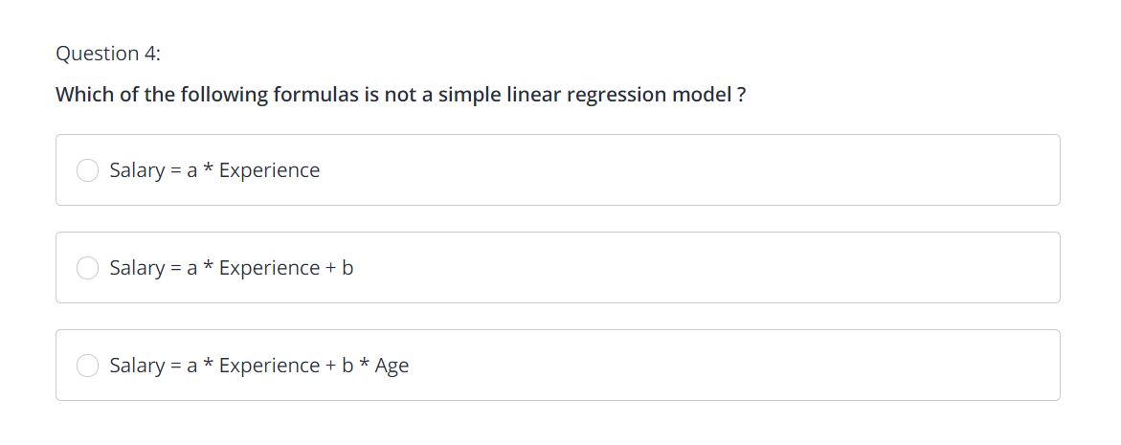
Simple Linear Regression Quiz

Slide 10
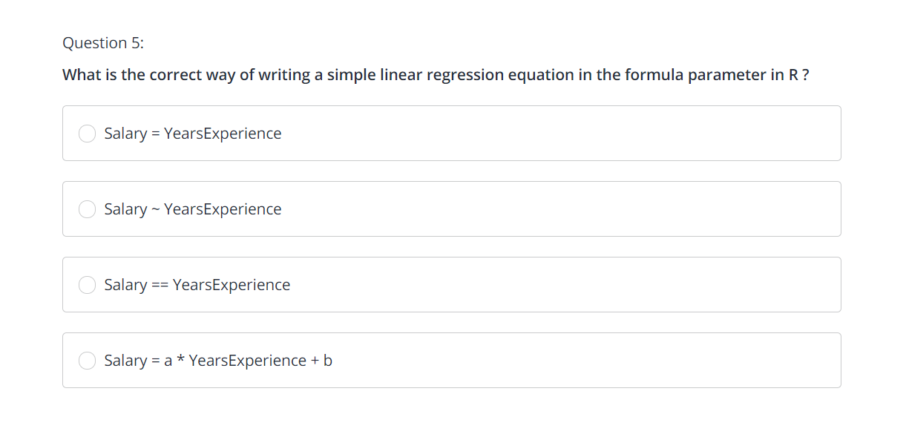
Simple Linear Regression Quiz

Slide 11
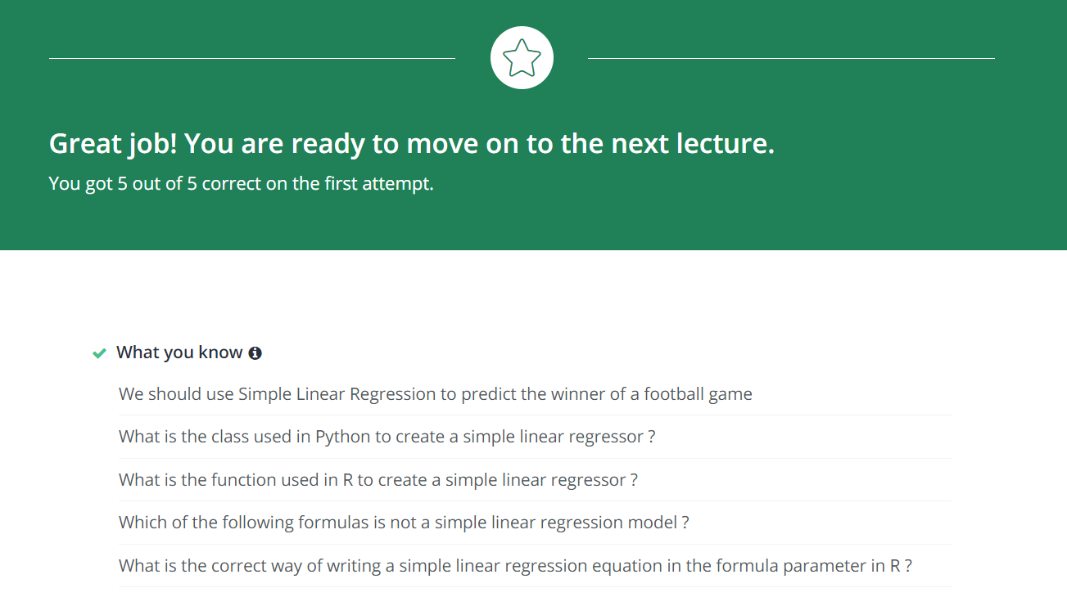
Simple Linear Regression Quiz

Slide 12
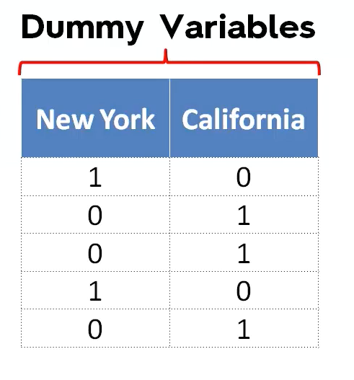
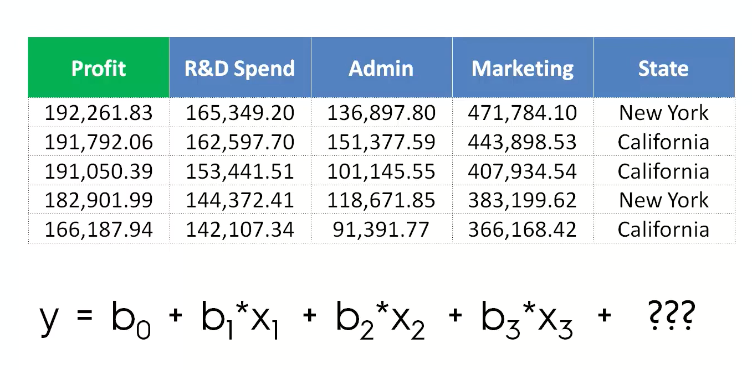
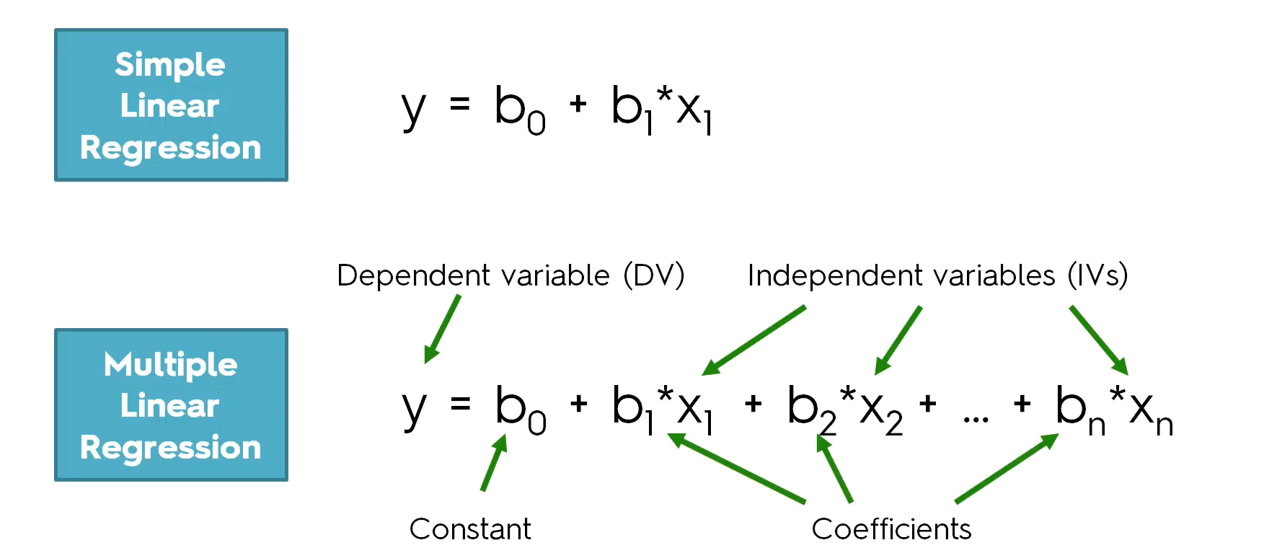
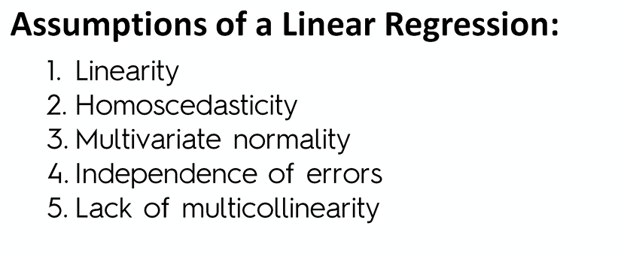
Multiple Linear Regression
What is the Dummy Variable Trap, and how to avoid it?
Hint: Multicollinearity
What is P-value? https://www.mathbootcamps.com/what-is-a-p-value/

Slide 13
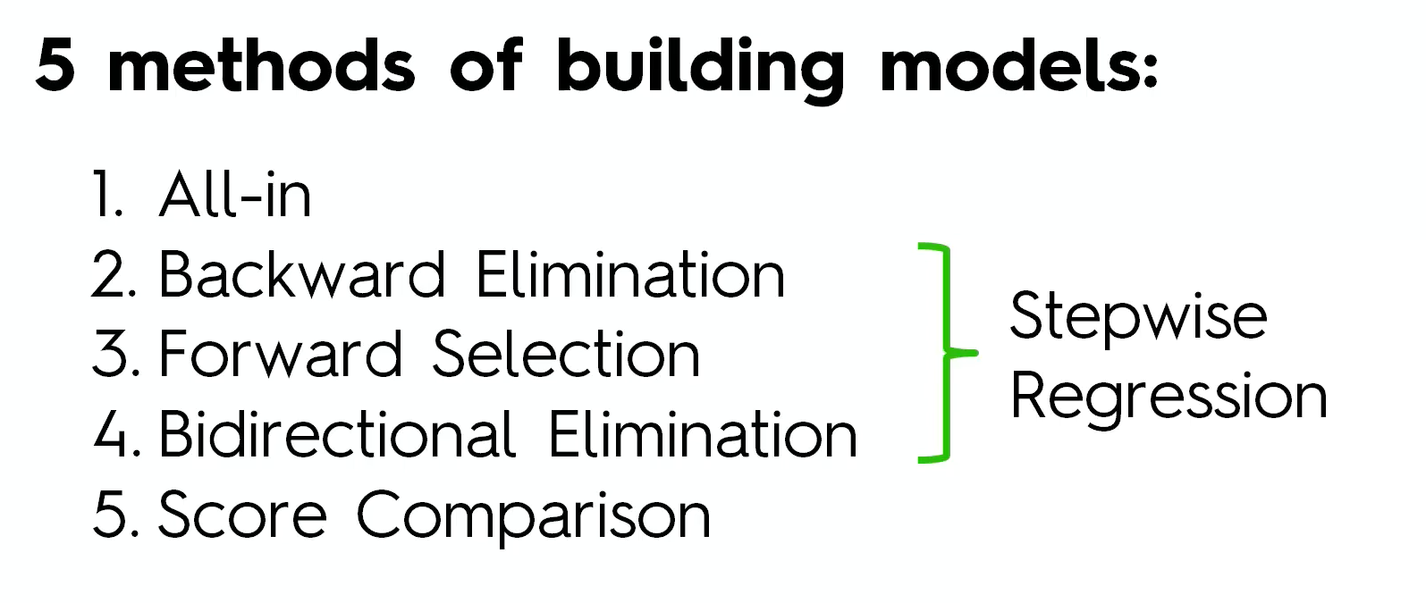
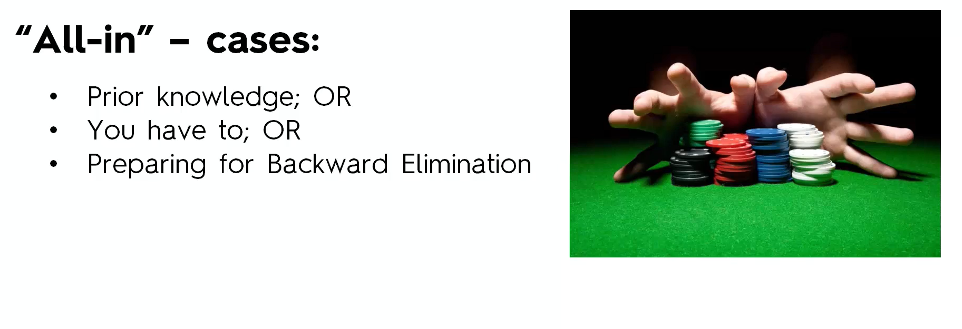
How to build a model?

Slide 14
Backward Elimination
1
Select a significance level to maintain the variable in the model
2
Fit the model with all the predictors
3
Consider the predictor with the highest P-value. Only if P-value is over SL, go to step 4. Otherwise the model is finished.
4
Remove the predictor
5
Fit the model without the variable

Slide 15
Forward Selection
1
Select a significance level to enter a variable in the model
2
Fit all Simple Linear Regression Models and select the one with the lowest P-value
3
Keep this variable and fit all the possible models with one extra predictor
4
Consider the predictor with the lowest P-value. Only if P-value is under SL, go to step 3. Otherwise the model is finished.

Slide 16
Stepwise Selection
1
Select a SL to enter a variable in the model and also a SL to stay
2
Perform the next step of forward selection (New variables will need a P-Value < SL)
3
Perform all the steps of Backward Elimination (Old variables will need a P-Value > SL to stay)
4
No new variables can enter and no old variables can exit
What is AIC?
And BIC?
The model is ready

Slide 17
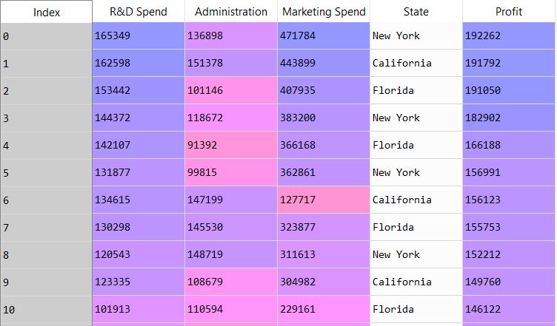
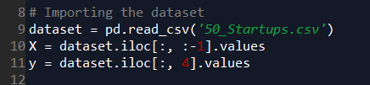
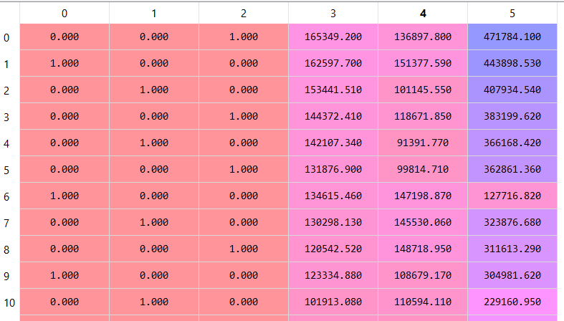
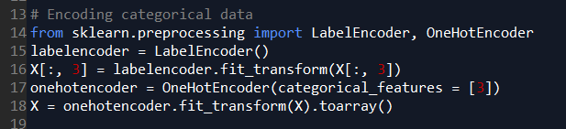
Multiple Linear Regression in Python
1
2
3

Slide 18


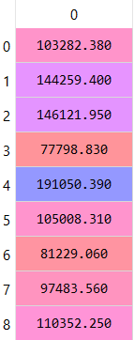
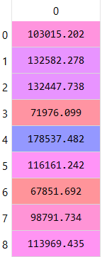
Multiple Linear Regression in Python
4
Do you see any similarity with SLR?
Why don’t we use the feature selection code?
5
6
y
y’
Why they don’t use a visualization to compare y_test (y) with y_pred (y’)?

Slide 19
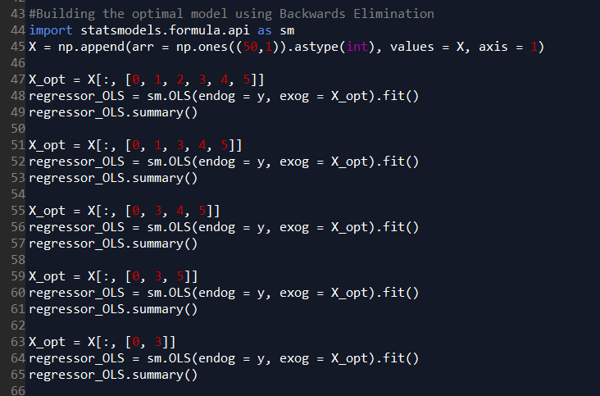
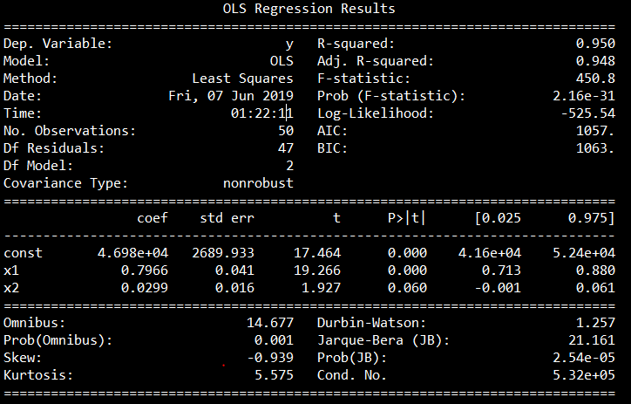
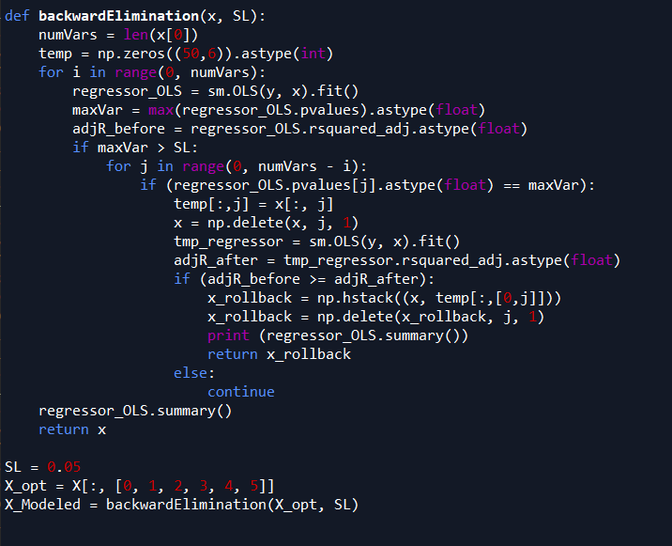
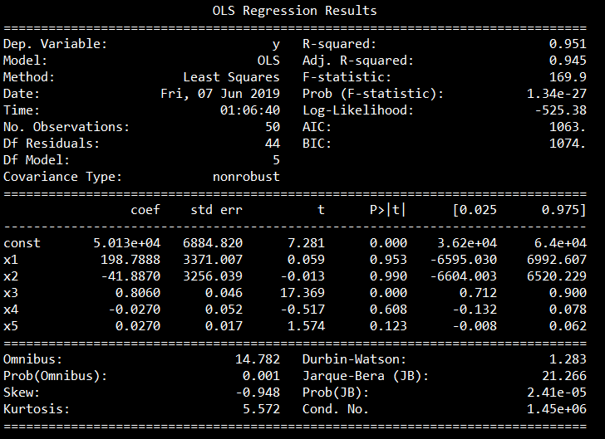
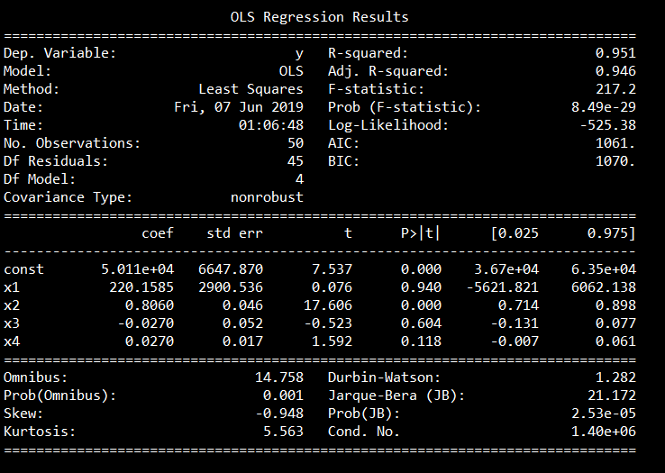
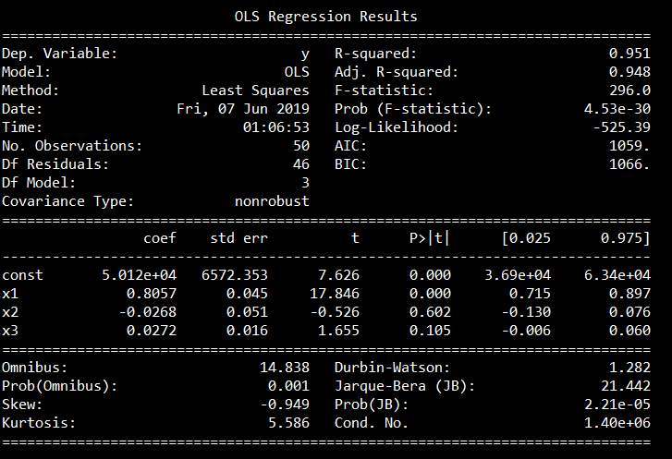
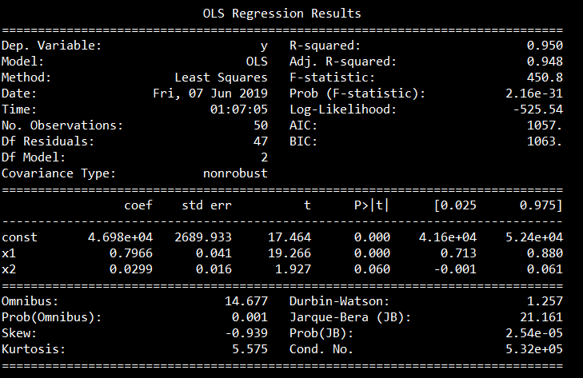
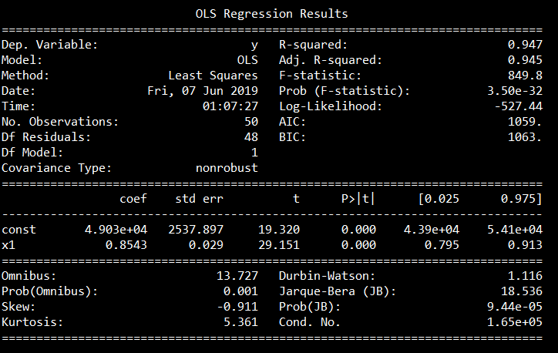
Backwards Elimination in Python

Slide 20

Multiple Linear Regression in R
Now, let’s follow Ariel, as he is going to teach us how to work with MLR
In Rstudio!

Slide 21
Backwards Elimination in R
backwardElimination <- function(x, sl) {
numVars = length(x)
for (i in c(1:numVars)){
regressor = lm(formula = Profit ~ ., data = x)
maxVar = max(coef(summary(regressor))[c(2:numVars), "Pr(>|t|)"])
if (maxVar > sl){
j = which(coef(summary(regressor))[c(2:numVars), "Pr(>|t|)"] == maxVar)
x = x[, -j]
}
numVars = numVars - 1
}
return(summary(regressor))
}
SL = 0.05
dataset = dataset[, c(1,2,3,4,5)]
backwardElimination(training_set, SL)

Slide 22
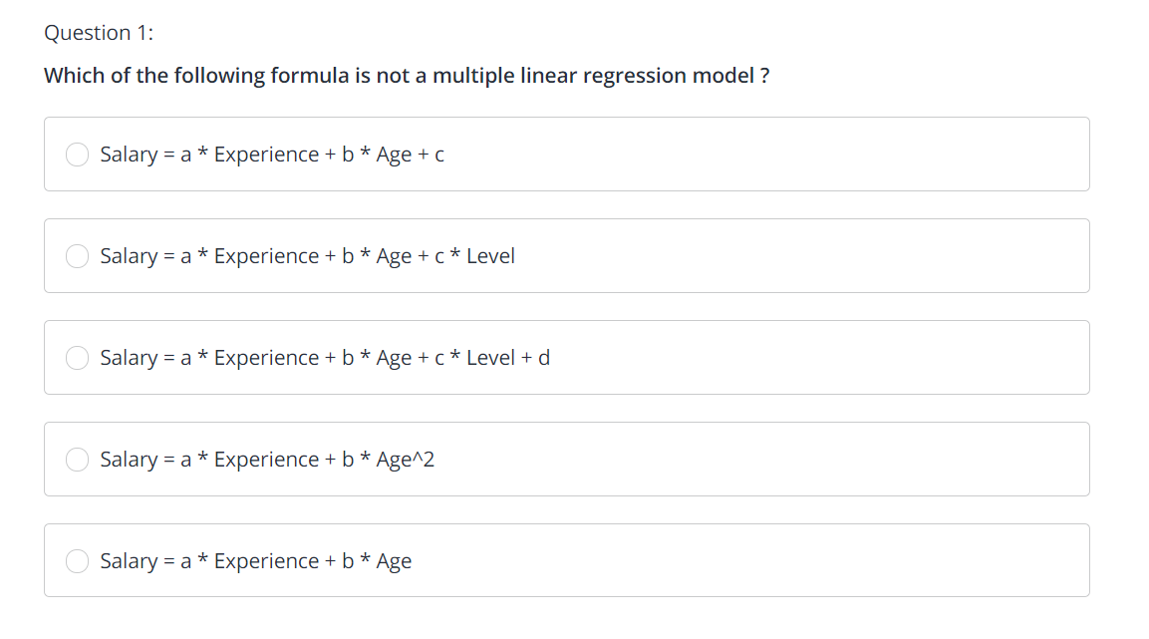
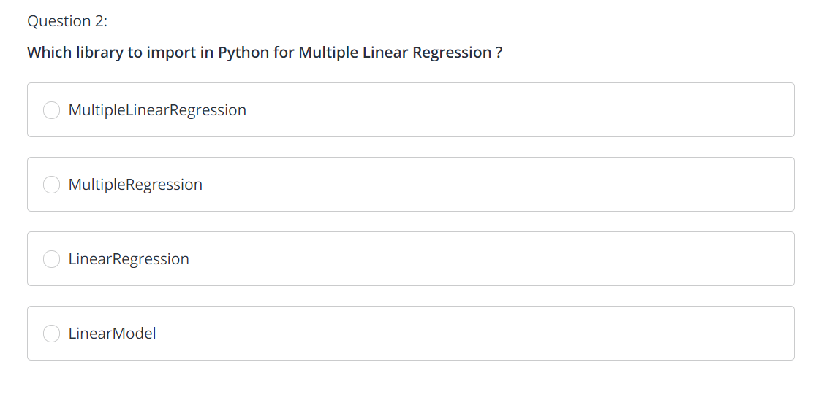
Multiple Linear Regression Quiz

Slide 23
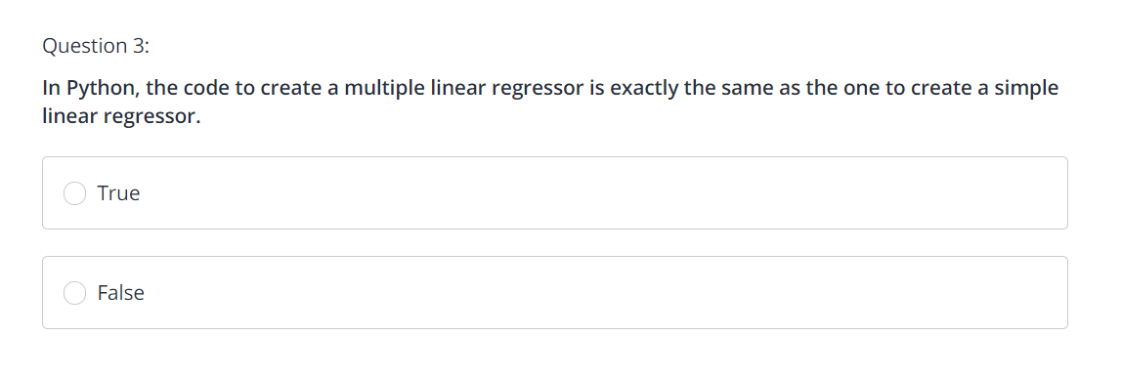
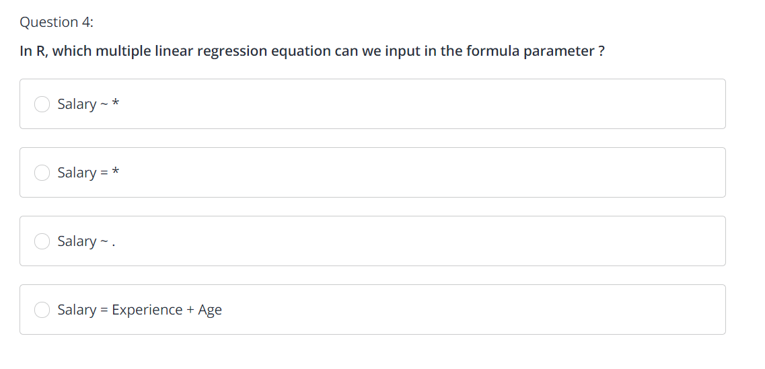
Multiple Linear Regression Quiz

Slide 24
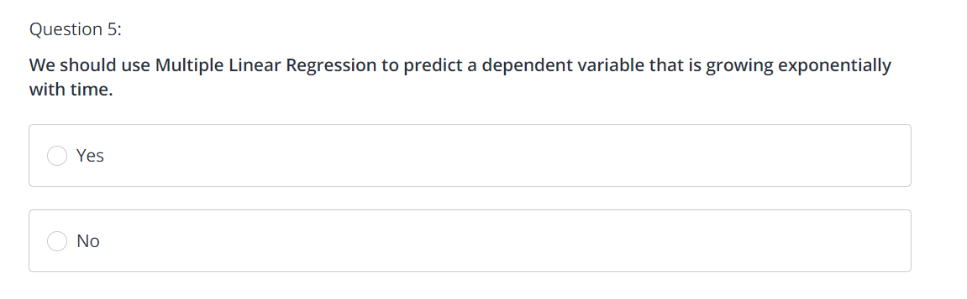
Multiple Linear Regression Quiz

Slide 25
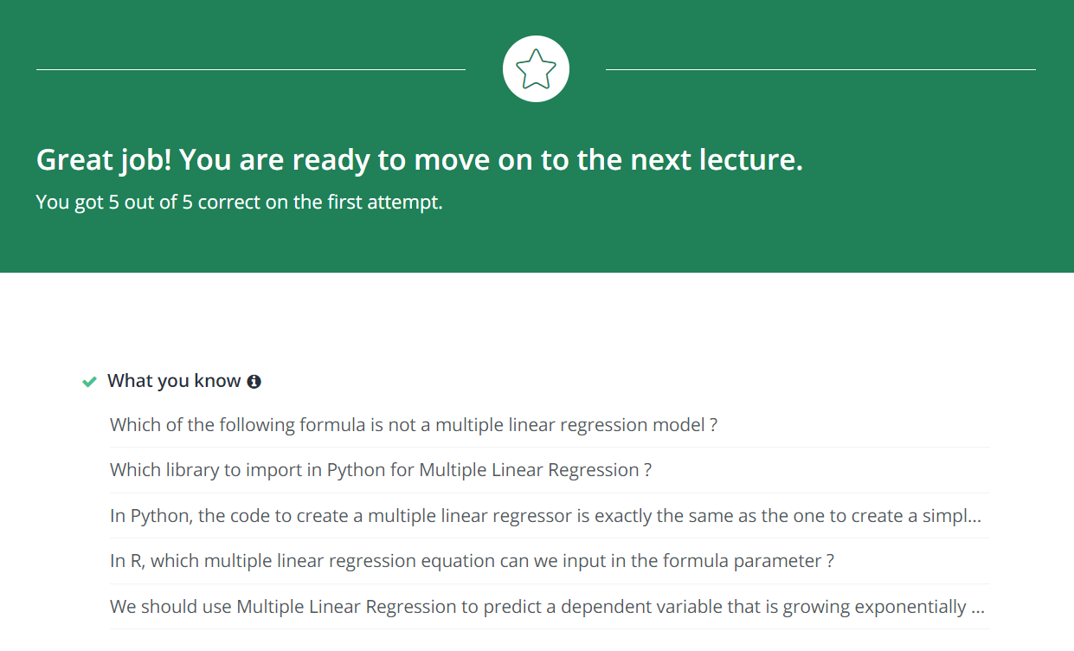
Multiple Linear Regression Quiz

Slide 26
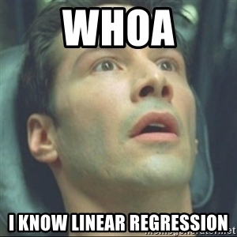
Next Session:
Logistic Regression
Thanks! Let’s make the complex simple…

Slide 27

Enjoy Machine Learning
;)

