Slide 1
Machine Learning A-Z™: Hands-On Python & R In Data Science
Linear Regression: Simple and Multiple
June 06, 2019
Ariel Capetillo
Juan Carlos Urrutia

Slide 2
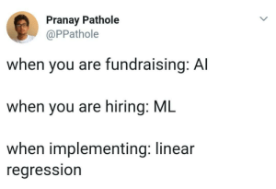
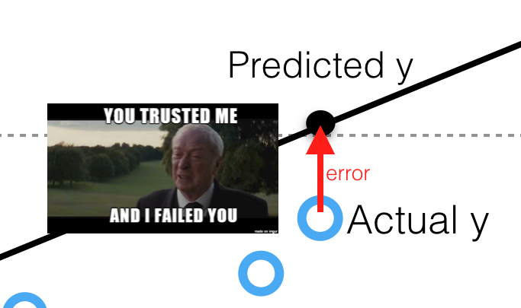
Contents
01 |  | Introduction to SLR
02 |  | SLR in Python
03 |  | SLR in R
04 |  | SLR Quiz
05 |  | Introduction to MLR and key concepts
06 |  | How to build a model
07 |  | MLR in Python
08 |  | MLR in R
09 |  | MLR Quiz

Slide 3


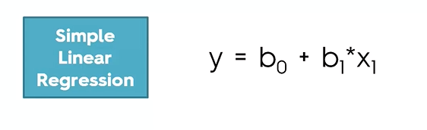
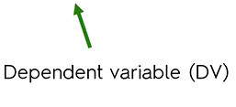
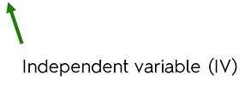
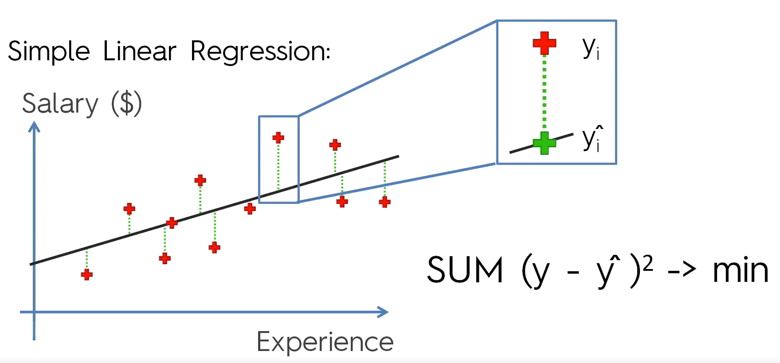
Simple Linear Regression
+ Error

Slide 4


Simple Linear Regression in Python
1
Python libraries for pre-processing:
Numpy: Mathematics library. Useful for making calculations.
Pyplot: Sub-library of matplotlib. Useful for plotting nice charts in Python
Pandas: Most famous library for importing and managing datasets.
2
We import the csv file. Then, we standardize it at our convenience (in this case, as arrays for the dependent and independent variables).
”pd” is the pandas library
iloc is used for specifying an index

Slide 5



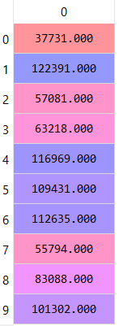
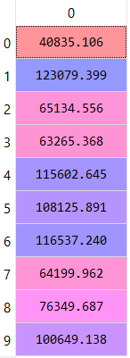
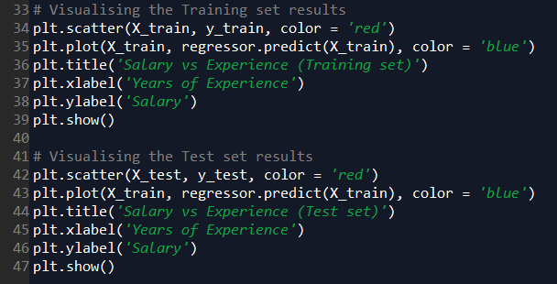
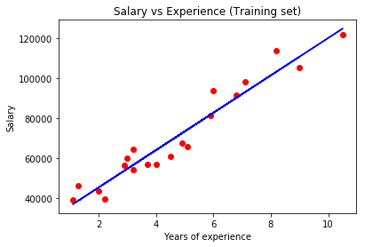
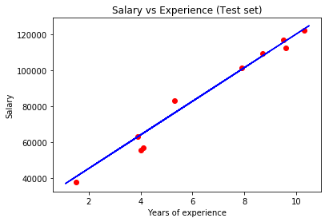
Simple Linear Regression in Python
3
4
Let’s talk a little bit about the parameters:
-fit_intercept: When shall we use it?
-normalize: What does this mean?
-n_jobs: This could optimize the process. Why?
5
y
y'
6

Slide 6

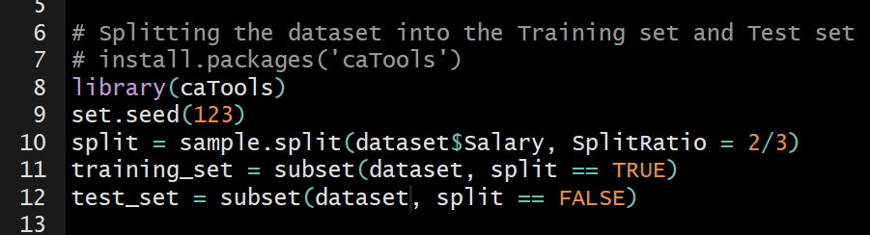
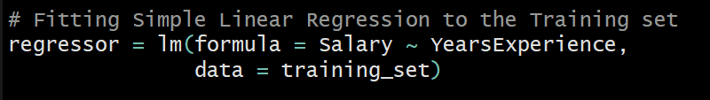
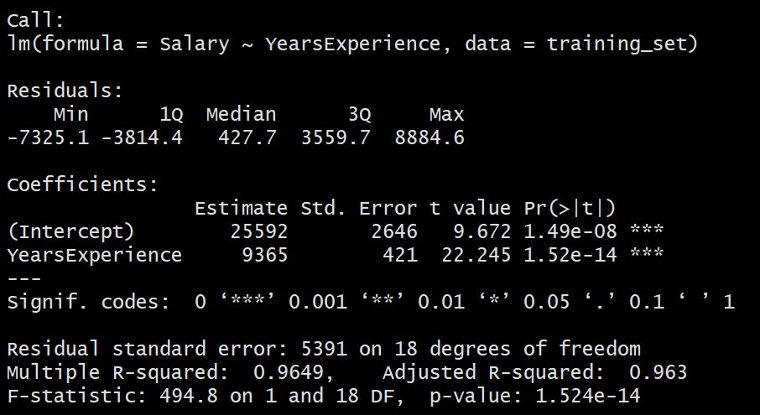
Simple Linear Regression in R
1
Which is the library we need for read.csv?
2
Remember, the library caTools is required for splitting the dataset
3
Let’s talk about:
-Residuals -Coefficients
-Estimates -Std. Error
-t value -Significance codes
-Degrees of freedom -R-squared
-Adjusted R-Squared -F-statistic
-p-value*

Slide 7

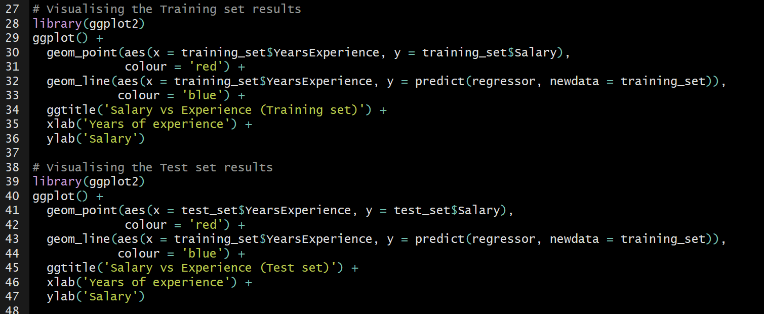
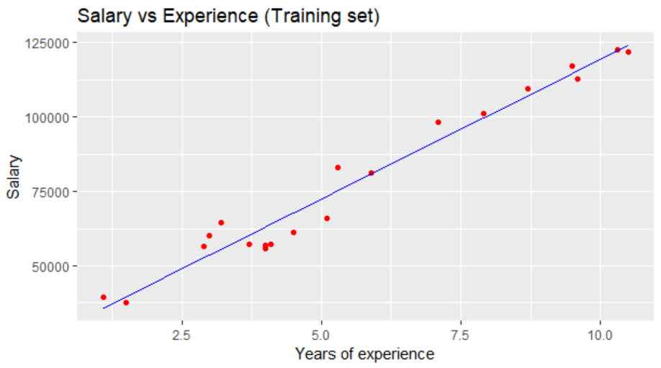
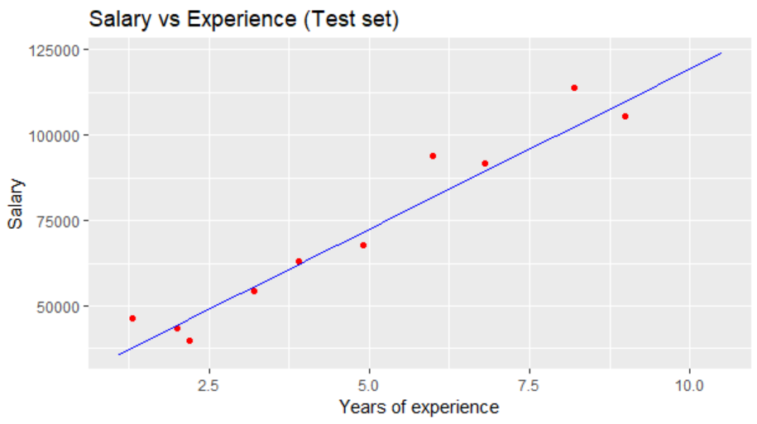
Simple Linear Regression in R
4
5

Slide 8
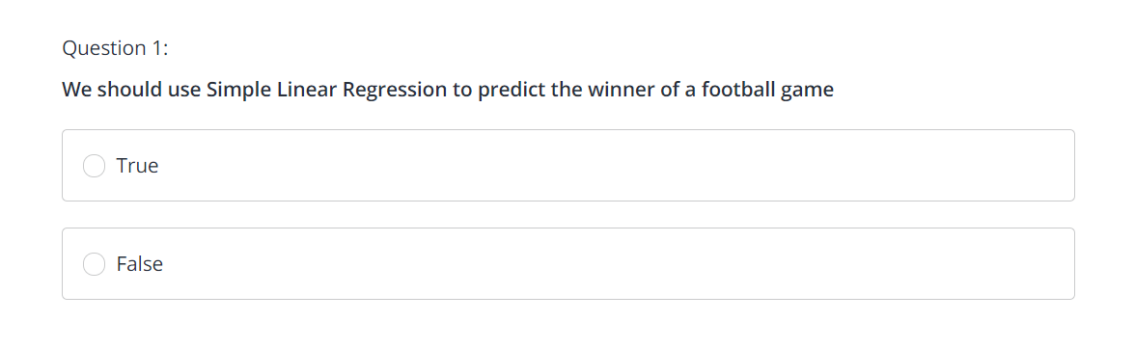
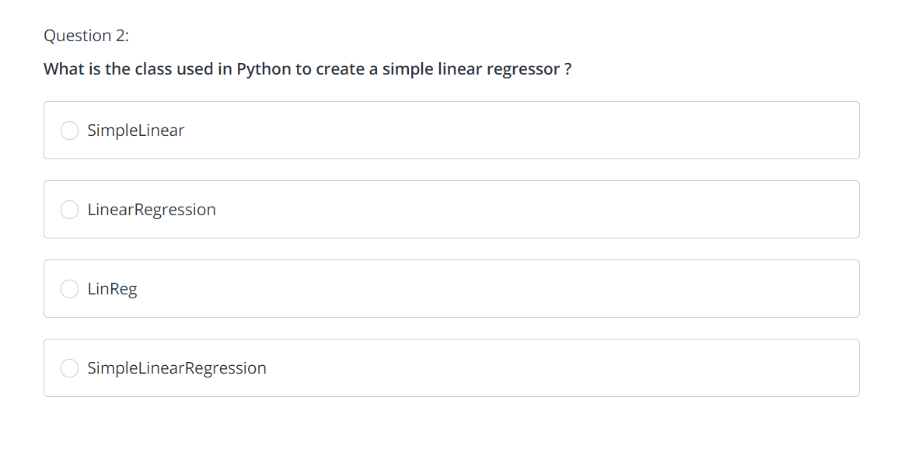
Simple Linear Regression Quiz

Slide 9
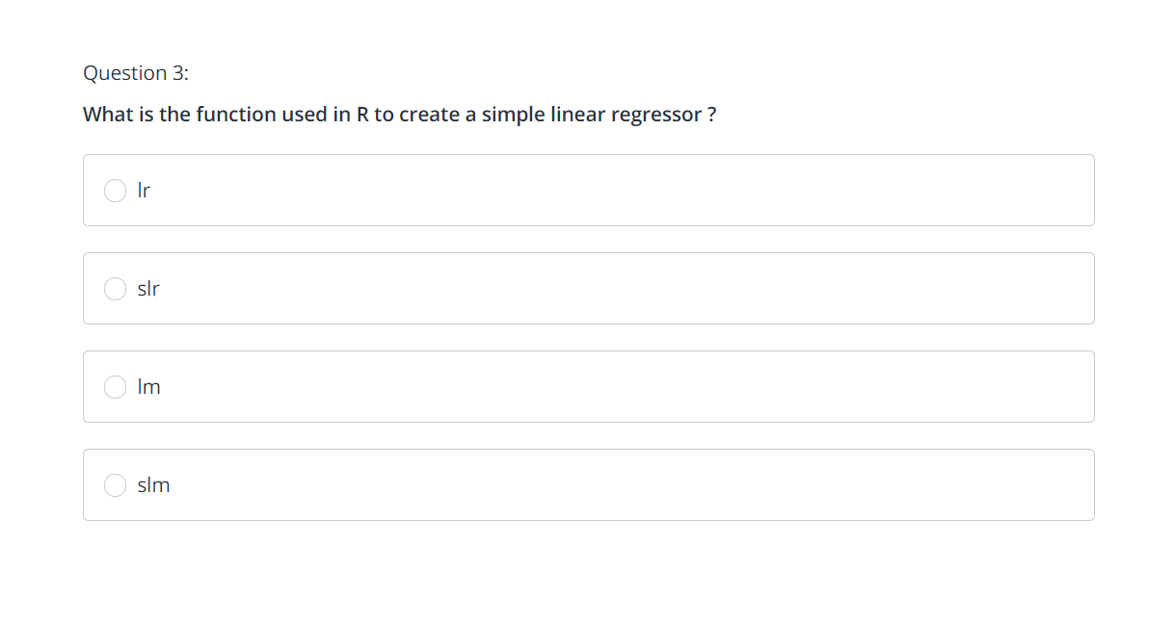
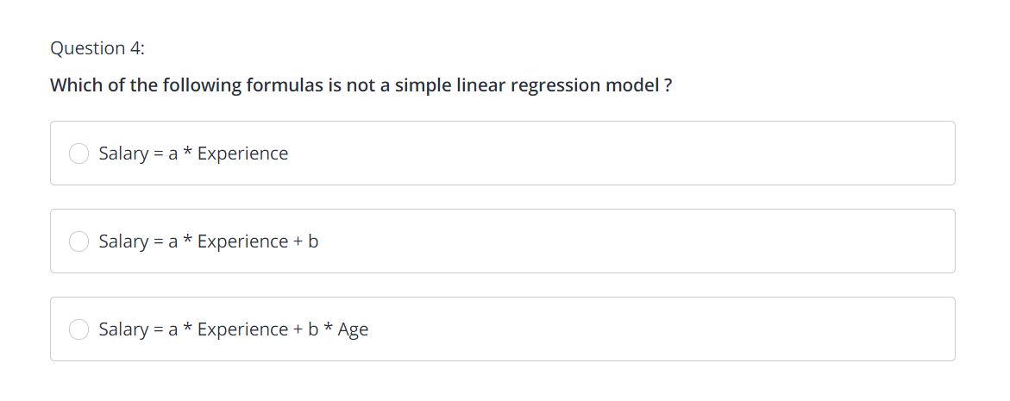
Simple Linear Regression Quiz

Slide 10
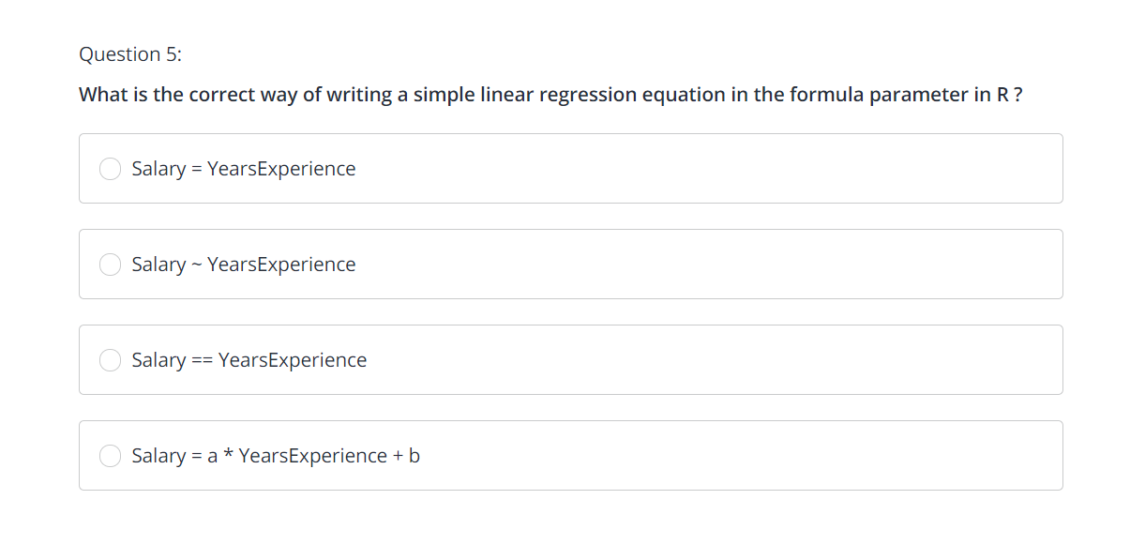

Simple Linear Regression Quiz

Slide 11
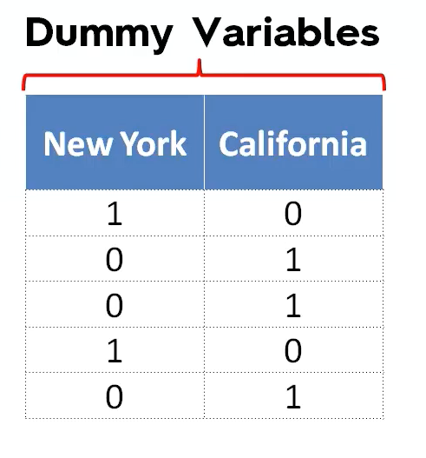
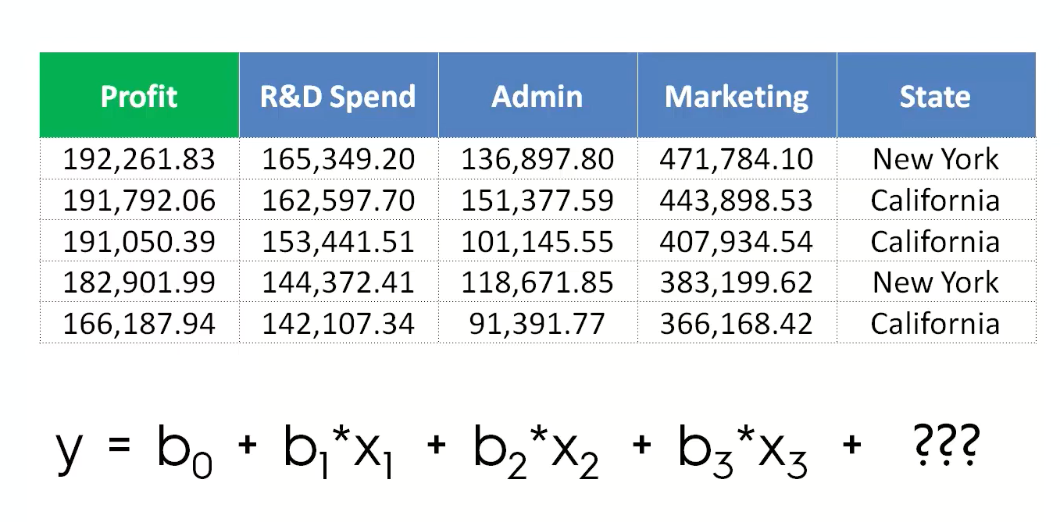
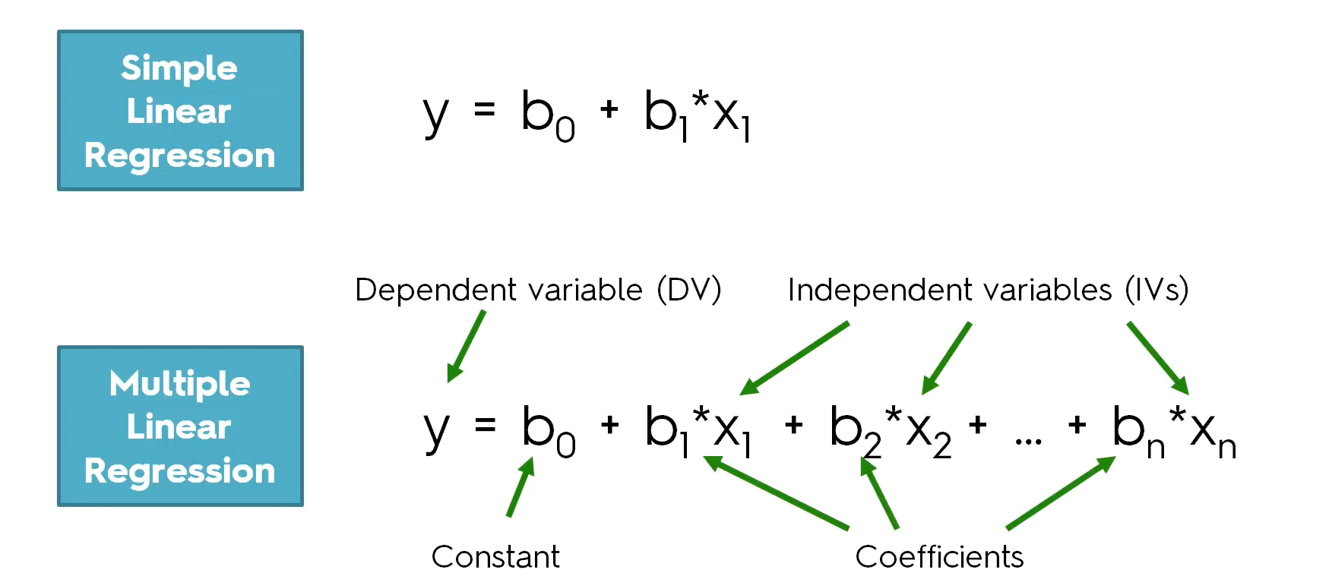
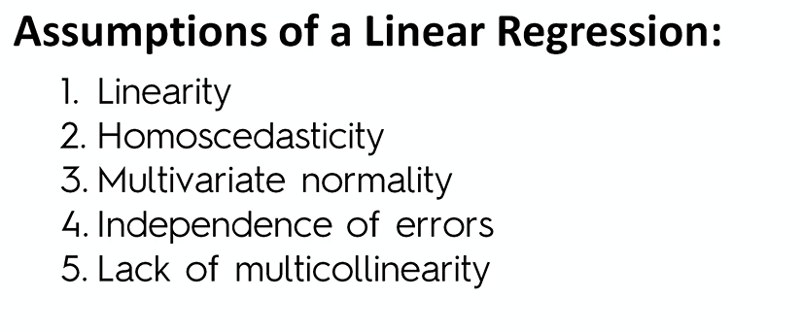
Multiple Linear Regression
What is the Dummy Variable Trap, and how to avoid it?
Hint: Multicollinearity
What is P-value? https://www.mathbootcamps.com/what-is-a-p-value/

Slide 12
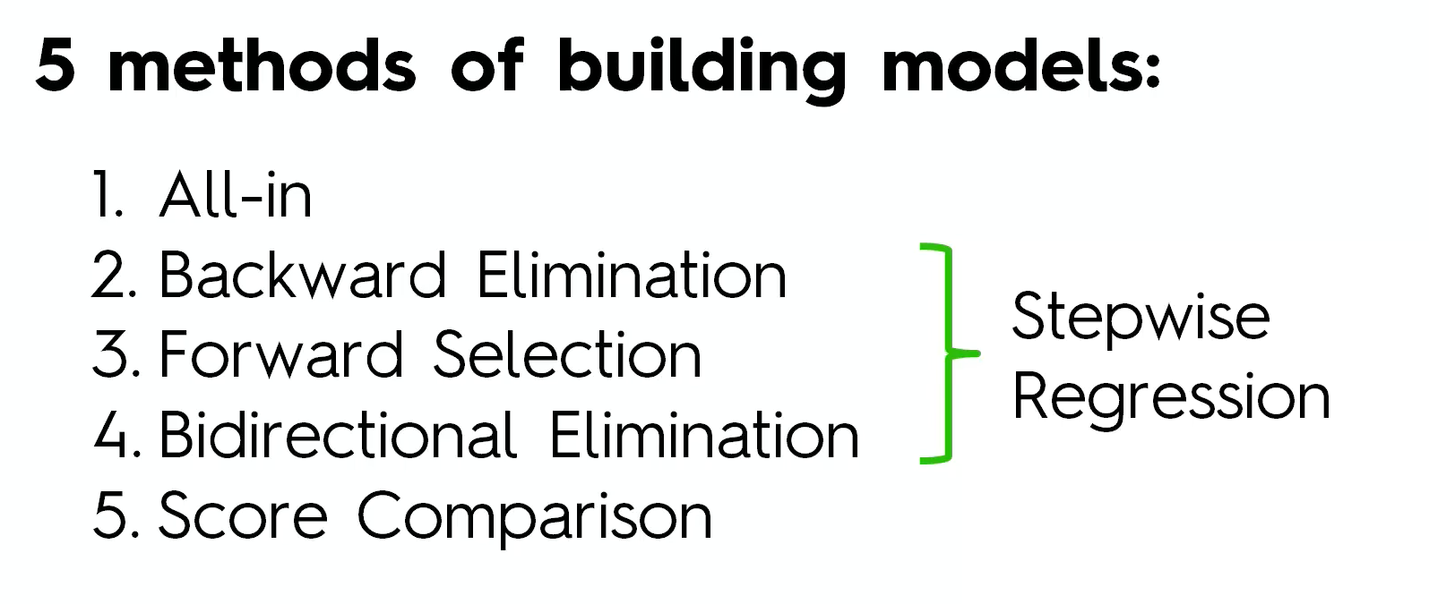

How to build a model?

Slide 13
Backward Elimination
1
Select a significance level to maintain the variable in the model
2
Fit the model with all the predictors
3
Consider the predictor with the highest P-value. Only if P-value is over SL, go to step 4. Otherwise the model is finished.
4
Remove the predictor
5
Fit the model without the variable

Slide 14
Forward Selection
1
Select a significance level to enter a variable in the model
2
Fit all Simple Linear Regression Models and select the one with the lowest P-value
3
Keep this variable and fit all the possible models with one extra predictor
4
Consider the predictor with the lowest P-value. Only if P-value is under SL, go to step 3. Otherwise the model is finished.

Slide 15
Stepwise Selection
1
Select a SL to enter a variable in the model and also a SL to stay
2
Perform the next step of forward selection (New variables will need a P-Value < SL)
3
Perform all the steps of Backward Elimination (Old variables will need a P-Calue > SL to stay)
4
No new variables can enter and no old variables can exit
What is AIC?
And BIC?
The model is ready

Slide 16
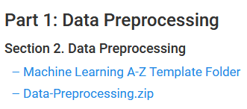
Getting the dataset
Inside https://www.superdatascience.com/machine-learning
Give your Email, then:

Slide 17




Hands on code!

Slide 18
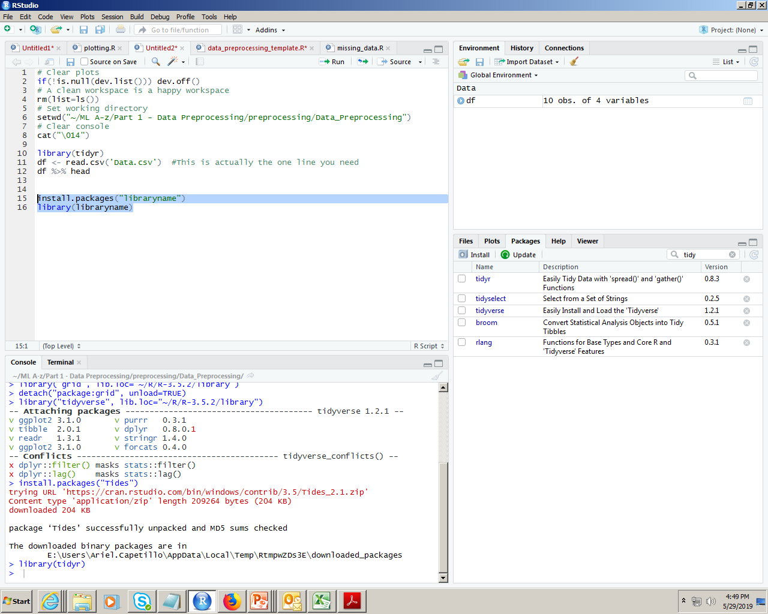
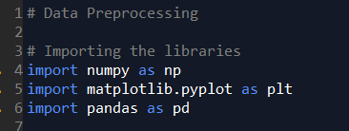
Importing the libraries
Using Rstudio, you can download and import the libraries manually and by code. For standarizing code, it’s better to use code.
With Python Spyder, you’ll need the following libraries:
Python libraries for pre-processing:
Numpy: Mathematics library. Useful for making calculations.
Pyplot: Sub-library of matplotlib. Useful for plotting nice charts in Python
Pandas: Most famous library for importing and managing datasets.
install.packages(‘libraryname’)
library(libraryname)
R Libraries in this part of the course:
readr
caTools
tidyr

Slide 19

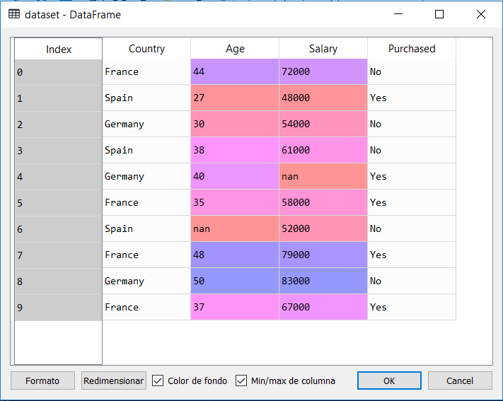
Importing the Dataset
It’s important to first import the dataset and select the libraries you will need.
This example code includes useful tips. *Recommendation for R: Always import tidyr to use the %>% operator.
For python, we import the csv file. Then, we standardize it at our convenience (in this case, as arrays for the dependent and independent variables).
”pd” is the pandas library
iloc is used for specifying an index
# Clear plots
if(!is.null(dev.list())) dev.off()
# A clean workspace is a happy workspace
rm(list=ls())
# Set working directory
setwd("~/ML A-z/Part 1 - Data Preprocessing/preprocessing/Data_Preprocessing")
# Clear console
cat("\014")
library(tidyr)
dataset <- read.csv('Data.csv') #This is actually the one line you need, it assigns the .csv file to a variable.

Slide 20
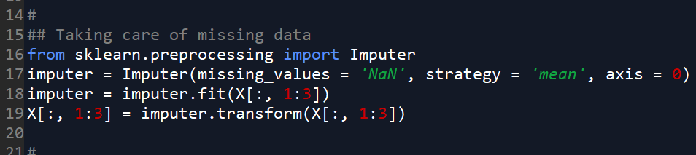
Missing data: Numeric
ML Algorithms have problems with null values. A method for dealing with them inside numerical variables is replacing them with the mean.
In Python, the sklearn library is a known tool for working with ML techniques, including the preprocessing steps.
install.packages(‘libraryname’)
library(libraryname)
dataset <- read.csv('Data.csv')
# Taking care of missing data
dataset$Age <- ifelse(is.na(dataset$Age),
ave(dataset$Age, FUN = function(x) mean(x, na.rm = TRUE)),
dataset$Age)
The Imputer class allows us to take care of missing data in a simple way.
Use CTRL+I to open the object inspector and study the parameters.
Do you see any error in the code?
Why were not imputed all the columns in this example?
With Python, the upper-bound is excluded. What does that mean?
Tip
To know how a function works, use the interrogation mark to look for it in R documentation:
?ifelse()
?ave()

Slide 21
Extra considerations
ave() function can be tricky. Let’s check it in deeper detail.
library(tidyr)
x <- c(1,NA,2,23,NA,4)
x %>% is.na() #
x %>% mean #NA
c(1,2,23,4) %>% mean
y<- ave(x, FUN=function(y) mean(y,na.rm = TRUE))
y2 <- ifelse(is.na(x), ave(x, FUN = function(a) mean(a, na.rm = TRUE)),x)
For Python:
What are the Imputer other options as “strategy”?
When do we have to choose one over the other(s)?

Slide 22
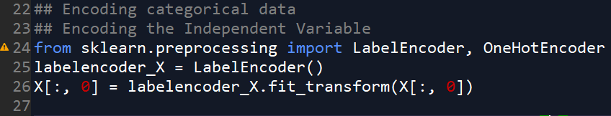
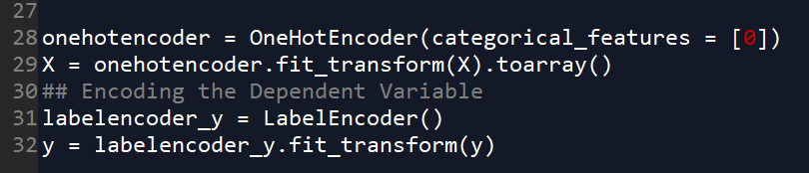
Categorical data
Categorical variables can take a limited, usually fixed number of possible values.
ML algorithms are based on mathematical equations, so we should mutate those values into numbers.
In Python, we start importing Label Encoder, which is a Class used for Hadelin to transform the Country variable to a numerical value. How?
df$Country <- factor(dataset$Country,
levels = c('France','Germany','Spain'),
labels = c(1,2,3))
df$Purchased <- factor(dataset$Purchased,
levels = c('No','Yes'),
labels = c(1,2)
)
Do you suspect any problem that could happen with this?
The solution proposed by Hadelin is: “The Dummy Encoding”
What if there are too many categories?
lev<- dataset$Country %>% levels
labels= c(1:length(lev))
Let’s see an example in the whiteboard!

Slide 23
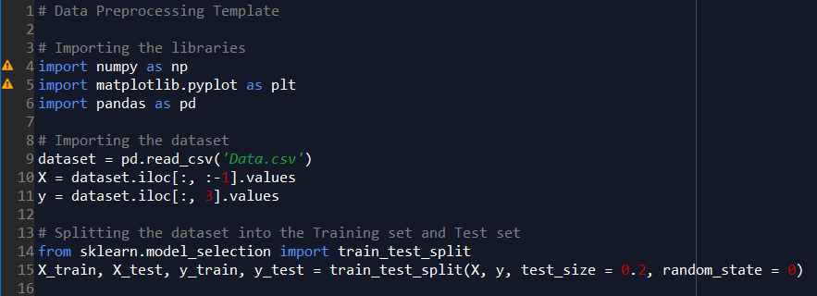
Splitting the dataset
The spirit of splitting the dataset is to make possible to train a ML model and then test its accuracy predicting the value of the dependant variable based on predictors.
library(caTools)
set.seed(123)
split <- sample.split(dataset$Purchased, SplitRatio = 0.8)
training_set <- subset(dataset, split == TRUE)
test_set <- subset(dataset, split == FALSE)
training_set
test_set
What if there are too many categories?
lev<- dataset$Country %>% levels
labels= c(1:length(lev))
Splitting the dataset in Python is straightforward, but there are way better ways to do this that we will cover in the last sessions (K-Fold, Bootstrap).

Slide 24
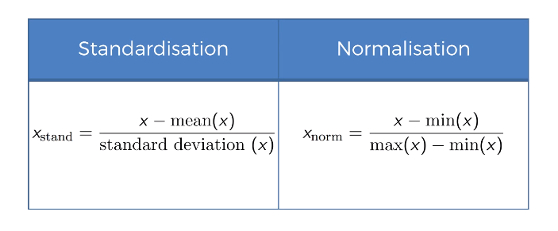
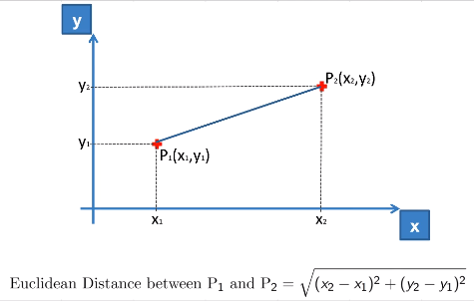
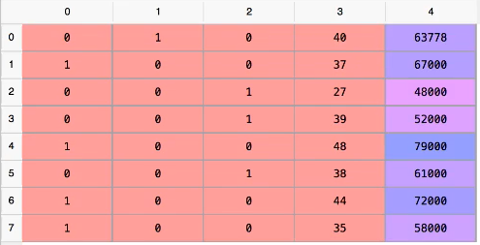
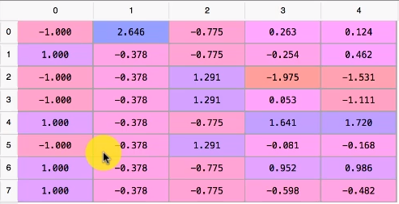
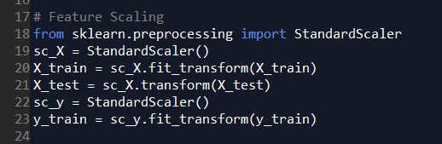
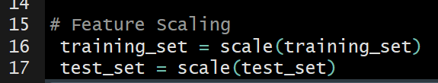
Feature Scaling
What happens if we have two columns with different level of numerical values?
Example: Age and Salary
But… What could happen with the interpretation?
What are the main advantages?

Slide 25
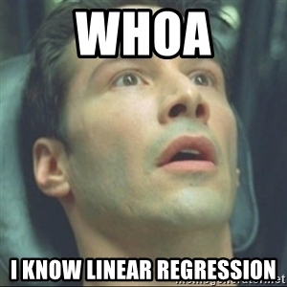
Next Session:
Simple and Multiple Regression
Thanks! Let’s make the complex simple…

Slide 26

Enjoy Machine Learning
;)

