Slide 1
Machine Learning A-Z™: Hands-On Python & R In Data Science
Data Pre-processing
May 24, 2019
Ariel Capetillo
Juan Carlos Urrutia

Slide 2
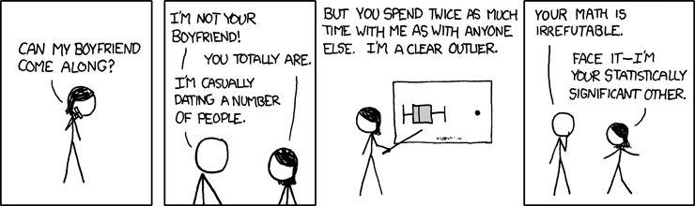
Contents
01 |  | Introduction
02 |  | Getting the dataset
03 |  | Data Preprocessing
04 |  | Linear and Multiple Regression
05 |  | Logistic Regression
06 |  | Decision Trees and Random Forests
07 |  | Clustering
08 |  | Association Rules
09 |  | Natural Language Processing
10 |  | Artificial Neural Networks

Slide 3

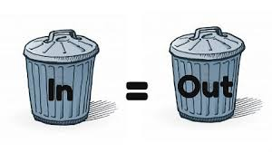
Introduction
Data in real world hardly appears clear and homogeneous. Typically, they tend to be incomplete, noisy, and inconsistent. How to solve that problem?
Today we will work on how to preprocess numerical variables and categorical variables inside a dataset to prepare it for a machine learning algorithm

Slide 4
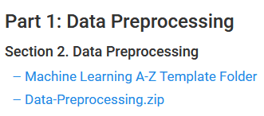
Getting the dataset
Inside https://www.superdatascience.com/machine-learning
Give your Email, then:

Slide 5
Getting the dataset
Inside https://www.superdatascience.com/machine-learning
Give your Email, then:

Slide 6




Hands on code!

Slide 7
Importing the Dataset (R)
It’s important to first import the dataset and select the libraries you will need.
This example code includes useful tips. *Recommendation for R: Always import tidyr to use the %>% operator.
# Clear plots
if(!is.null(dev.list())) dev.off()
# A clean workspace is a happy workspace
rm(list=ls())
# Set working directory
setwd("~/ML A-z/Part 1 - Data Preprocessing/preprocessing/Data_Preprocessing")
# Clear console
cat("\014")
library(tidyr)
dataset <- read.csv('Data.csv') #This is actually the one line you need, it assigns the .csv file to a variable.

Slide 8
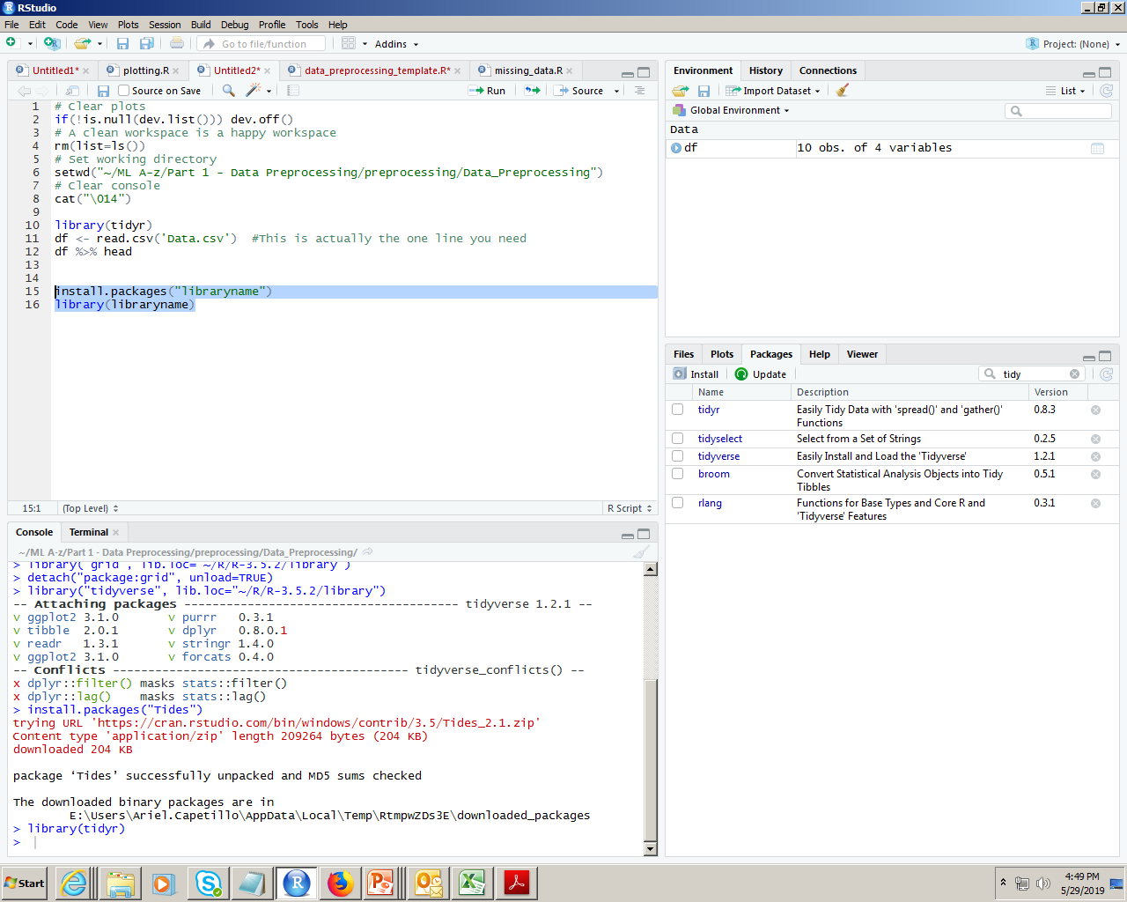
Importing the libraries
Using Rstudio, you can download and import the libraries manually and by code. For standarizing code, it’s better to use code.
install.packages(‘libraryname’)
library(libraryname)
Libraries in this part of the course:
caTools
tidyr

Slide 9

Missing data: Numeric
ML Algorithms have problems with null values. A method for dealing with them inside numerical variables is replacing them with the mean.
install.packages(‘libraryname’)
library(libraryname)
dataset <- read.csv('Data.csv')
# Taking care of missing data
dataset$Age <- ifelse(is.na(dataset$Age),
ave(dataset$Age, FUN = function(x) mean(x, na.rm = TRUE)),
dataset$Age)
Tip
To know how a function works, use the interrogation mark to look for it in R documentation:
?ifelse()
?ave()

Slide 10
Extra example
ave() function can be tricky. Let’s check it in deeper detail.
library(tidyr)
x <- c(1,NA,2,23,NA,4)
x %>% is.na() #
x %>% mean #NA
c(1,2,23,4) %>% mean
y<- ave(x, FUN=function(y) mean(y,na.rm = TRUE))
y2 <- ifelse(is.na(x),
ave(x, FUN = function(a) mean(a, na.rm = TRUE)),
x)

Slide 11
Categorical data
Categorical variables can take a limited, usually fixed number of possible values.
ML algorithms are based on mathematical equations, so we should mutate those values into numbers.
df$Country <- factor(dataset$Country,
levels = c('France','Germany','Spain'),
labels = c(1,2,3))
df$Purchased <- factor(dataset$Purchased,
levels = c('No','Yes'),
labels = c(1,2)
)
What if there are too many categories?
lev<- dataset$Country %>% levels
labels= c(1:length(lev))

Slide 12
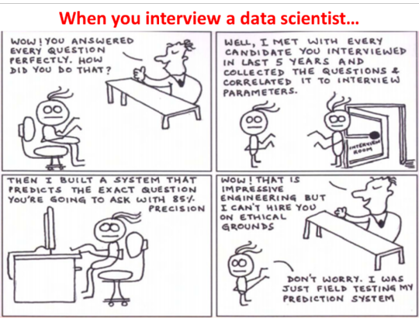
Splitting the dataset
The spirit of splitting the dataset is to make possible to train a ML model and then test its accuracy predicting the value of the dependant variable based on predictors.
library(caTools)
set.seed(123)
split <- sample.split(dataset$Purchased, SplitRatio = 0.8)
training_set <- subset(dataset, split == TRUE)
test_set <- subset(dataset, split == FALSE)
training_set
test_set
What if there are too many categories?
lev<- dataset$Country %>% levels
labels= c(1:length(lev))

Slide 14
Machine Learning Techniques
Let’s make the complex simple…

Slide 15
1: Data Preprocessing
Description
Experienced Data Scientists recommend to take a serious approach on dealing with this section.
This include (among other things):
Get and import a dataset
Import libraries
Deal with missing values
Identify Categorical data
Splitting a dataset into training and testing sets
Feature Scaling.
How an analyst can use it
This piece of work has to be applied on every one of the ML Models for every business case dealt with them.
1hr 43min

Slide 16

2: Linear and Multiple Regression
Description
By definition and simplicity, Regression for Numerical data is considered the base lesson for dealing with models.
Consists on defining a dependent variable (Y) which value can be obtained from the formula
How an analyst can use it
Even though the Simple and Multiple Regressions are not widely applied on Business Cases, they are often considered the first type of models to start learning from.
Useful for simple datasets and examples.
3hr 46min

Slide 17
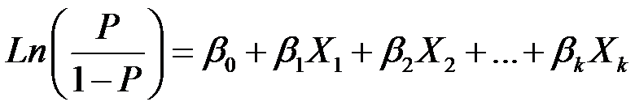
3: Logistic Regression
Description
This model consists on dealing with the Odds probabilities on a formula which can deal not only with numerical, but also categorical data.
By default, the formula is:
How an analyst can use it
By default, this technique is used for almost 80% of Business Cases for two main reasons:
Even though its formulation is not quite simple, it is understandable and can deal with any type of data.
And it is stable. The real precision tends to be near from the base logistic regression model.
1hr 43min

Slide 18
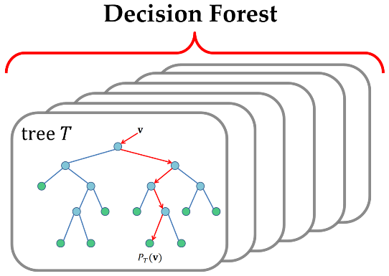
4: Decision Trees and Random Forests
Description
Classification algorithms. Decision trees work by splitting data up along its dimensions into smaller data cells, with the aim of decreasing the overall entropy of the data within each cell.
Random Forests follow that principle, but instead of using just one "Tree", it consists on computing, randomly, a series of multiple trees to improve the accuracy of the model.
How an analyst can use it
A typical application would be used to classify data into a predefined target field.
An example field might be high probability of churn or even a numeric value such as an estimated price in the case of regression trees.
Decision trees are also used to explore which are the most important fields for a particular data set, which then can be used in other algorithms and Business rules.
1hr 32min

Slide 19
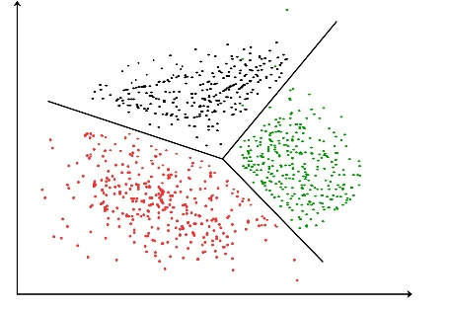
5: Clustering
Description
Cluster detection is simply the automation of finding meaningful patterns within a data set.
Often the problem in data mining is not a lack of patterns but identifying which patterns are useful amongst the noise of possibly hundreds of competing patterns within the data.
These techniques penetrate this noise by finding clusters of data that form natural groupings within the data set.
After clusters have been detected, they are often themselves the object of study.
How an analyst can use it
Clusters essentially breaks a complex problem up into much smaller manageable pieces where a human can then easily identify the underlying pattern.
In marketing, clusters are nearly always called segments, which is a popular application of the clustering technique.
2hr 34min

Slide 20
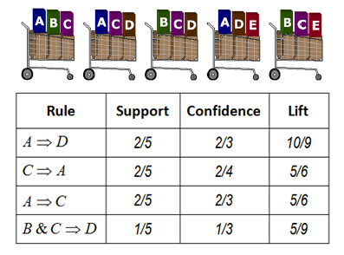
6: Association Rules
Description
Link analysis is part of a subset of mathematics called graph theory, which represents the relationship between objects as edges and the objects themselves as nodes.
This analysis falls under the category of both direct and undirected data mining.
A popular use of link analysis is to create new variables to be used by other modelling techniques, but link analysis can also be used in an undirected way by exploring the properties of the data itself.
How an analyst can use it
Areas where association rules are applied has been particularly successful:
This include identifying key sources of information on the web by analyzing links between pages, finding influential customers from call pattern data to recruit new subscribers from competing networks, etc…
Other sources of information may only imply an implicit link between objects, in these cases the data scientists challenge is to identify the links.
2hr 21min

Slide 21
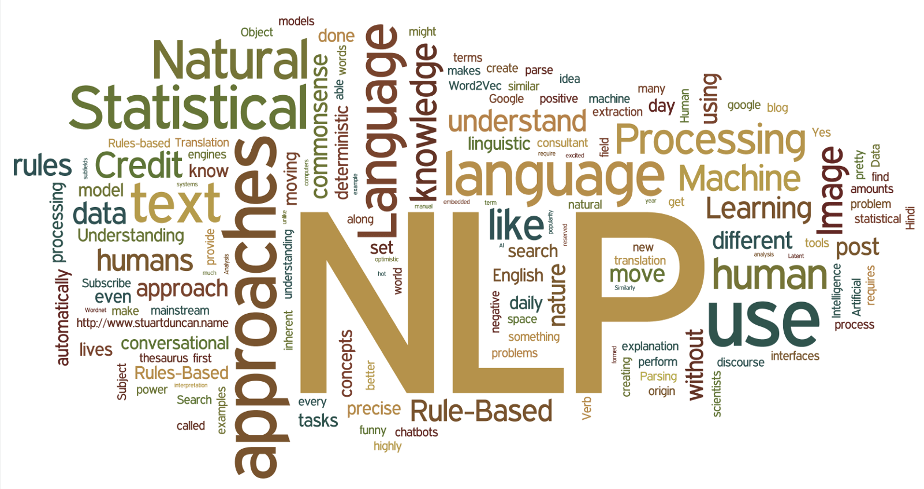
7: Natural Language Processing
Description
With the amount of text being generated in organizations, both internally on reports or CV’s and online in the social media sphere and news reports it has become humanly impossible to read all these documents.
Text analytics algorithms heavily
rely on probability theory and the rarity and occurrence of certain words, which can be used to predict the meanings and themes of the text.
Text analytic techniques are a form of classification algorithm so a target field for the algorithm is clearly defined.
How an analyst can use it
In sentiment analysis, typical target fields would be negative, neutral and positive sentiment.
Another example of target fields would be to classify news articles on whether you expect them to have or not to have an influence on the stock market.
Naïve Bayes is perhaps the popular algorithm for text analytics. Bayes formula was made famous for its use in determining the probability of medical tests false positive and false negatives rates
3hr 1min

Slide 22
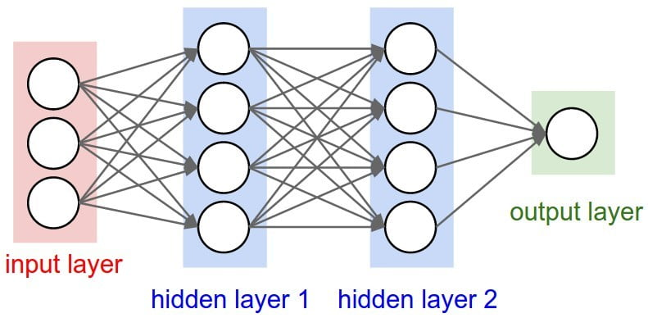
8: Artificial Neural Networks
Description
They are based on the neural networks found in biology and the human brain, where nodes are activated by a signal that in turn transmits a response signal to activate other nodes.
In artificial neural networks, each node is comprised of a combination function that receives various incoming signals and calculates the total received signal based on a set of weights.
A transfer function then outputs a signal based on the total revived signal from the combination function.
How an analyst can use it
Neural networks are a classification type algorithm. The target field would typically be a scoring function, such as the customer’s propensity towards a particular product, or an estimated value for a house.
The algorithms are, however, considered a black box, as they cannot tell you why a certain result was produced. This can restrict the use of neural networks when the question is why does person/ event A lead to action B, but they are exceptionally powerful in answering what is the most likely action B given person/event A.
3hr 47min

Slide 23
Appendix

Slide 24
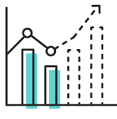
Download links
Udemy Course: https://www.udemy.com/machinelearning/
Download Rstudio: https://www.rstudio.com/products/rstudio/download/
Download Anaconda: https://www.anaconda.com/distribution/
Extra material (pass inside ml course): https://www.superdatascience.com/pages/machine-learning
Teachers profiles in Linkedin:
Hadelin
https://www.linkedin.com/in/hadelin-de-ponteves-1425ba5b/
Kirill
https://www.linkedin.com/in/keremenko/?originalSubdomain=au

Slide 25
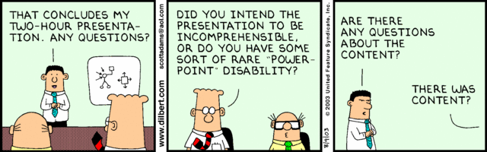
Enjoy Machine Learning
;)

