Slide 1
e.Gotainment
Torsten Thissen, Christian Stahl, Christoph Jerolimov

Slide 2
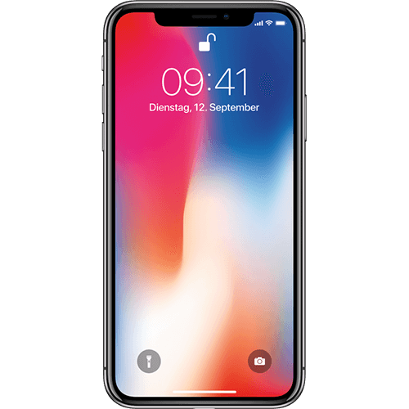
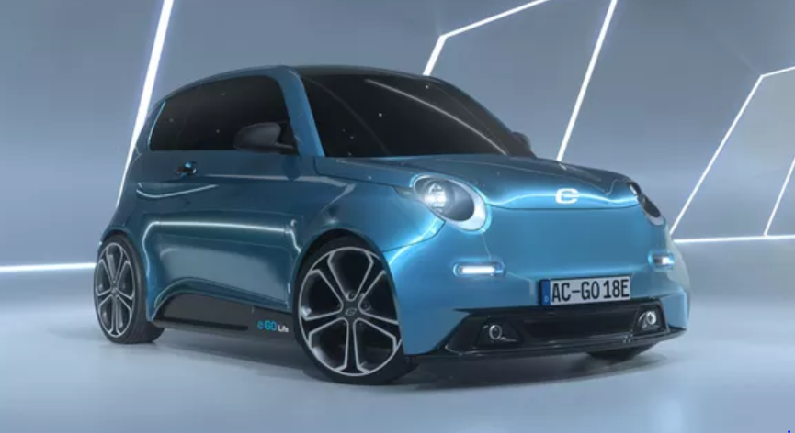

About the Idea

Slide 3
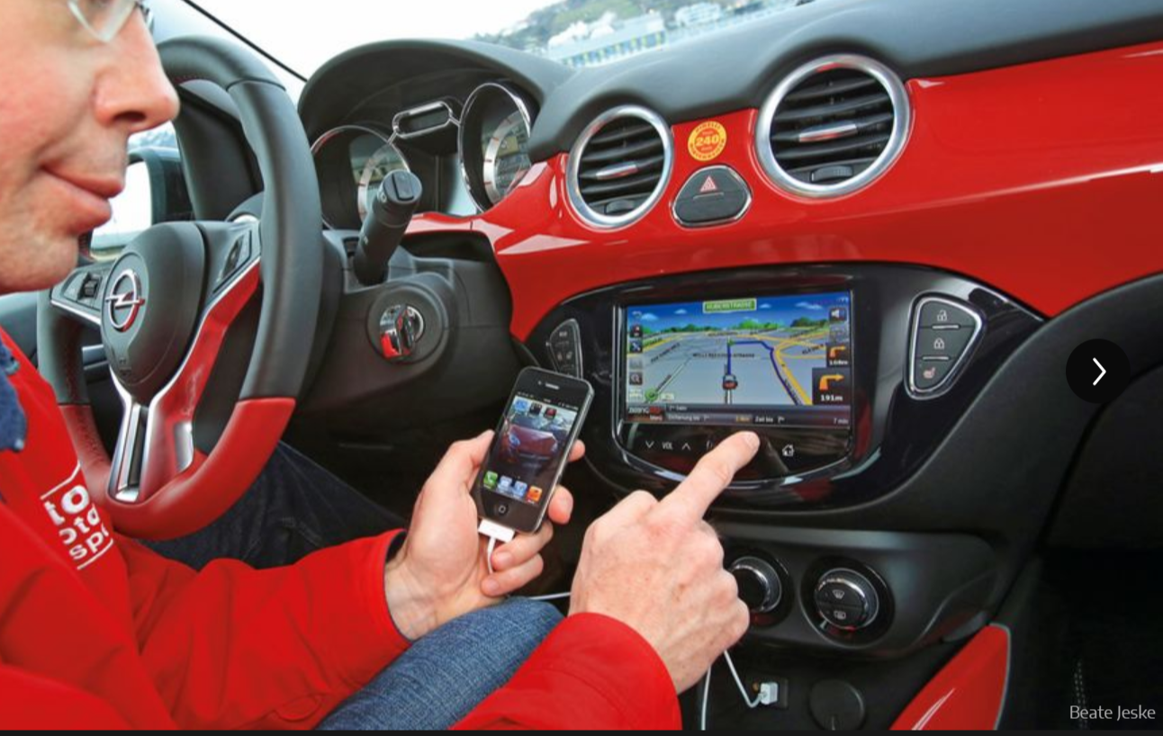
About the Idea
Current Situation:

Slide 4
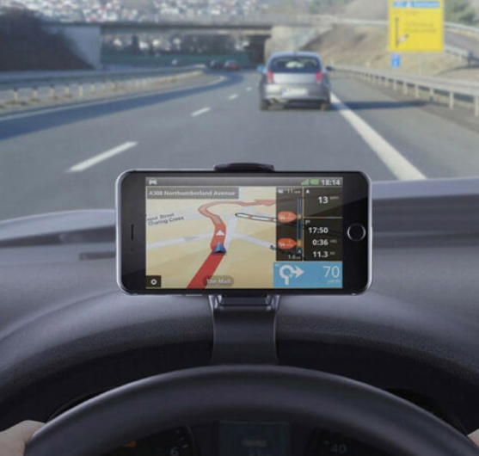
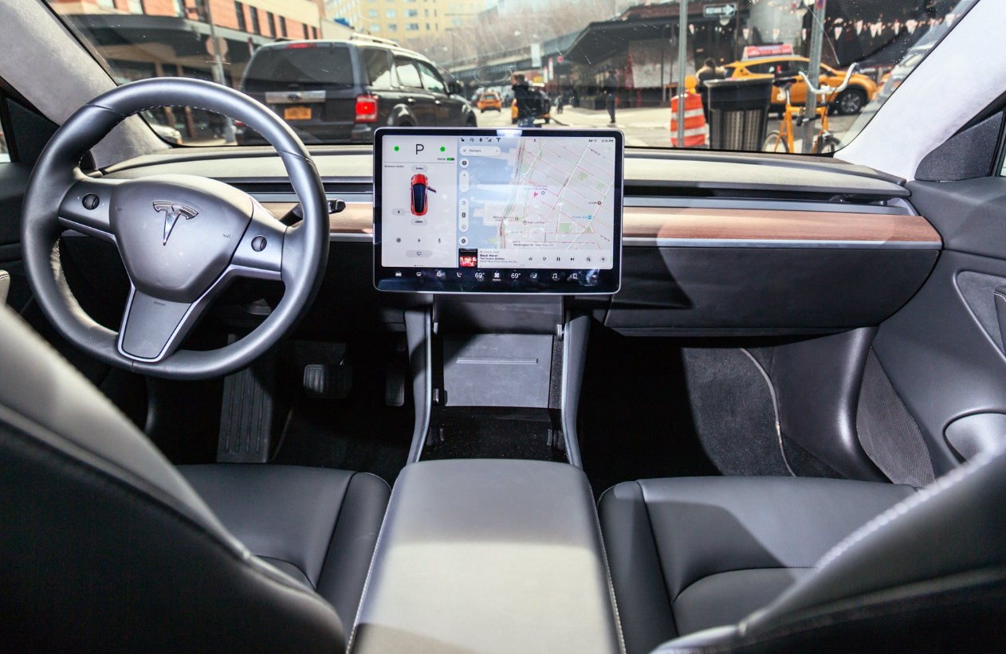
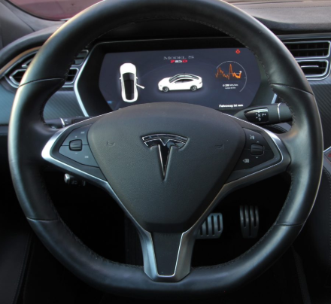
About the Idea
Our Vision
The personal and cross platform Infotainment system in the car

Slide 5
Have a look

Slide 6
Advantages
Advantages User
Advantages e.Go
Sustainable
Customized car experience
Lower Costs
A connected car
Sustainable
Lower expense
An innovative solution

Slide 7
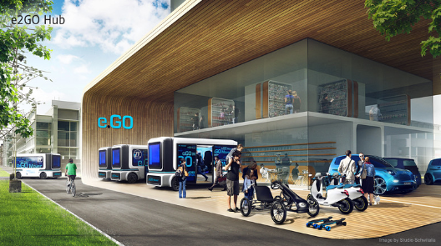
How to bring the Idea further
Future Perspective:
An individual communting experience in a shared vehicle

Slide 8
Thanks for your attention

