Slide 1
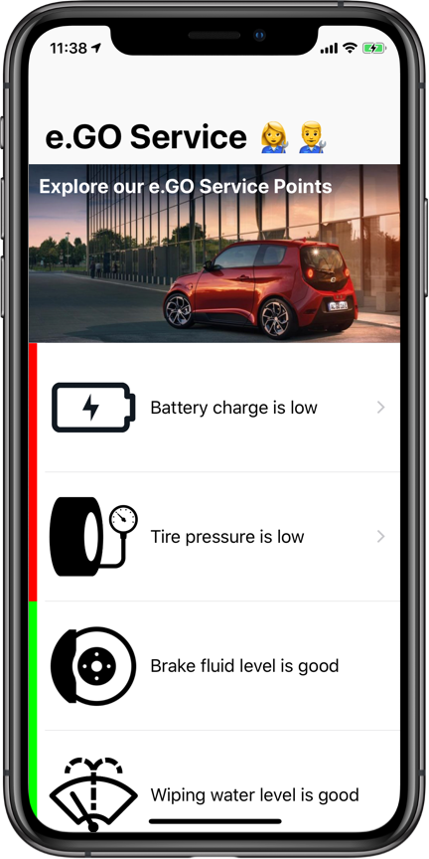

e.Go Service App
The service point companion app
Felix Wehnert
Jonas Schlabertz

Slide 2
Let a visit become an experience
e.GO Service App notifies you, when you reach a Service Point
In-Depth information about your e.GO Life‘s health
Request service when you need it
Get information about Service Points near you

Slide 3
Live Demo

