Slide 1


Slide 2
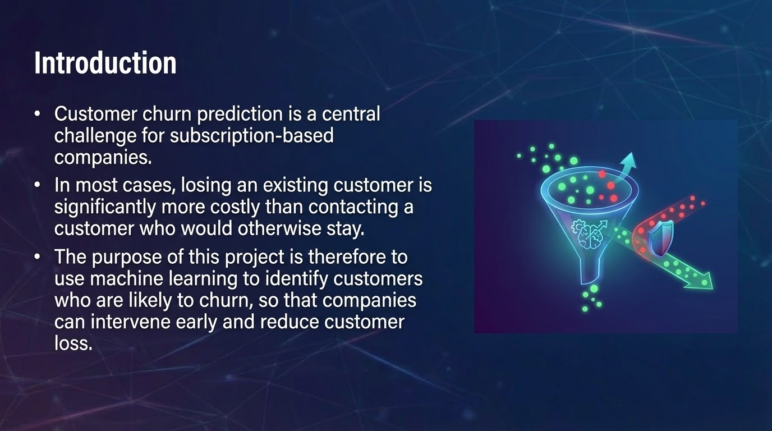

Slide 3
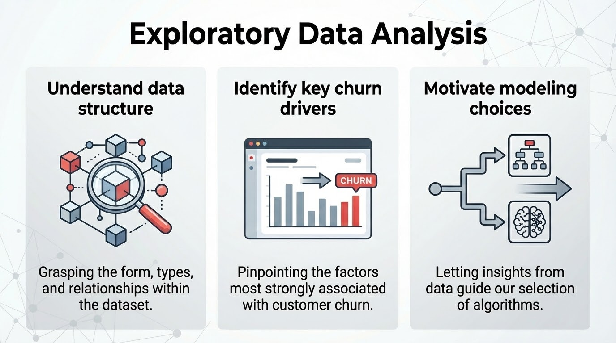

Slide 4
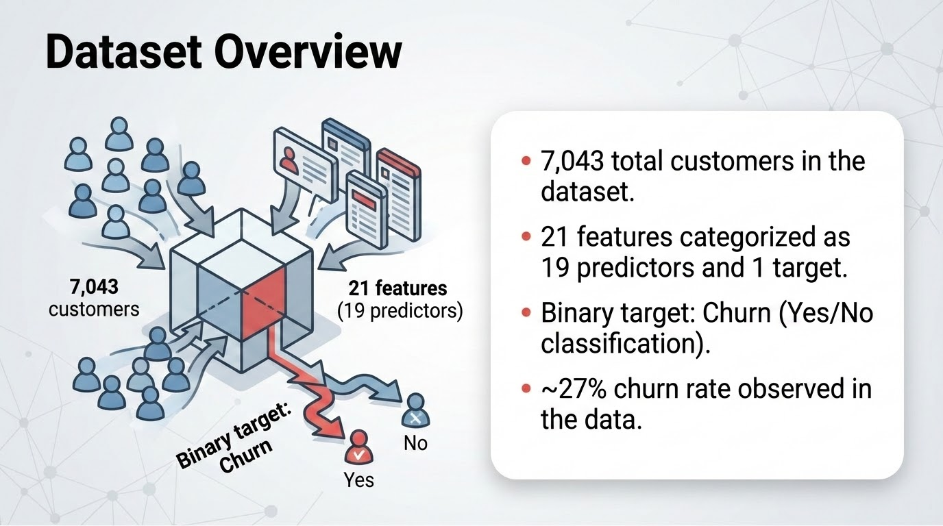

Slide 5
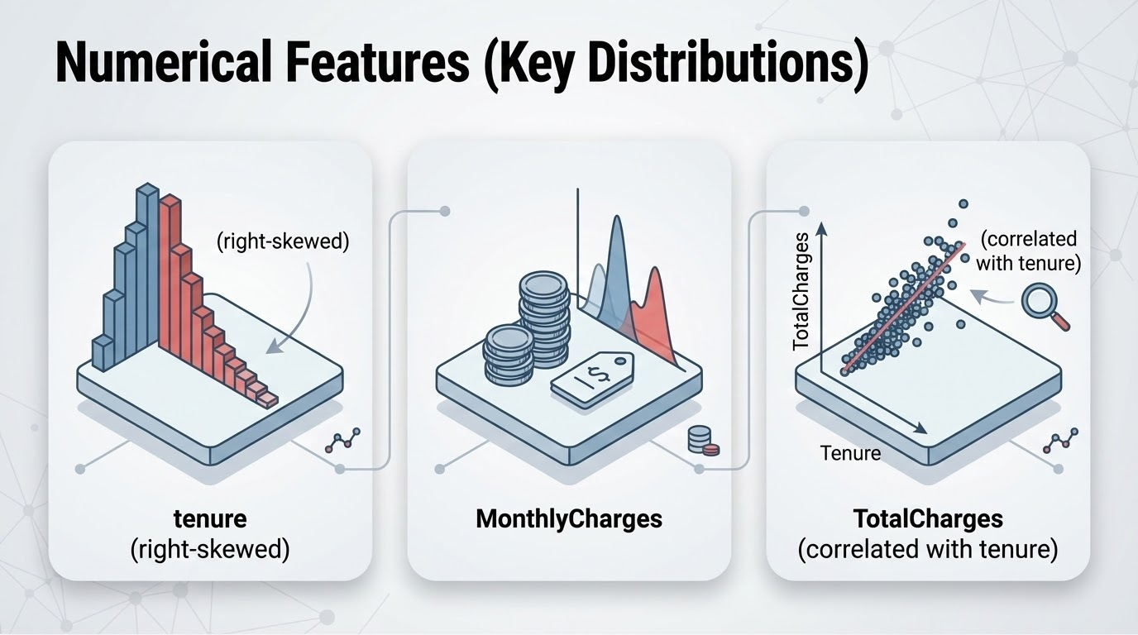

Slide 6
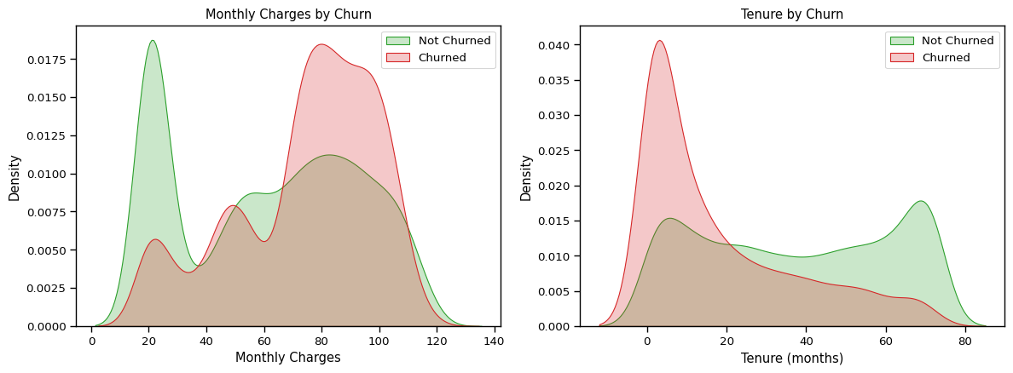
Notes:
Normalized to hide class imbalance.

Slide 7
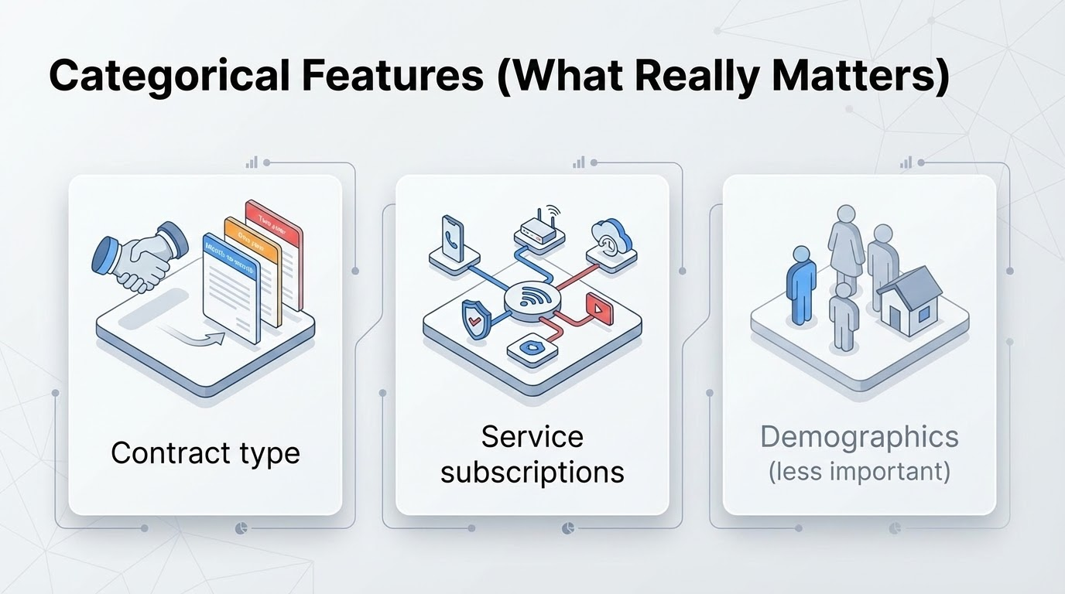

Slide 8
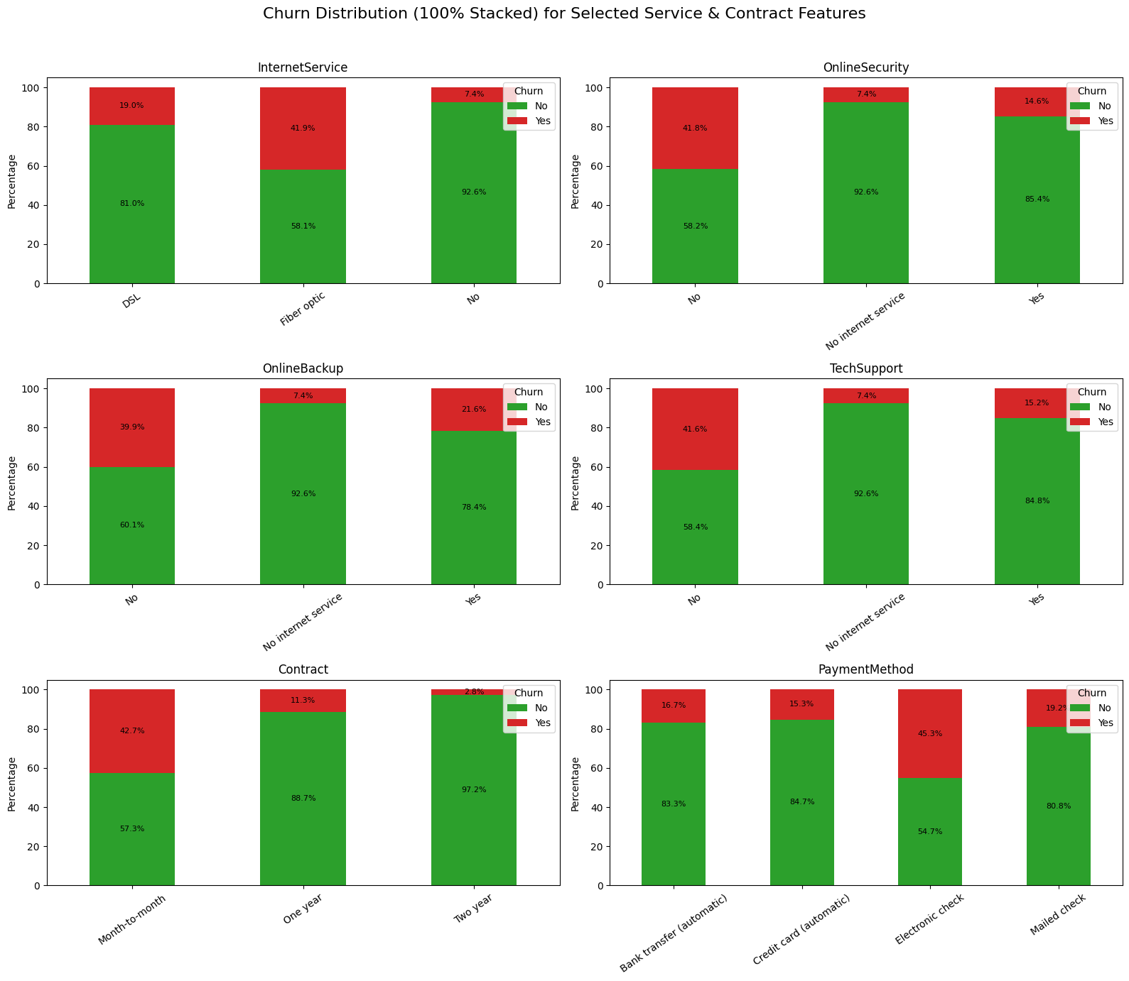
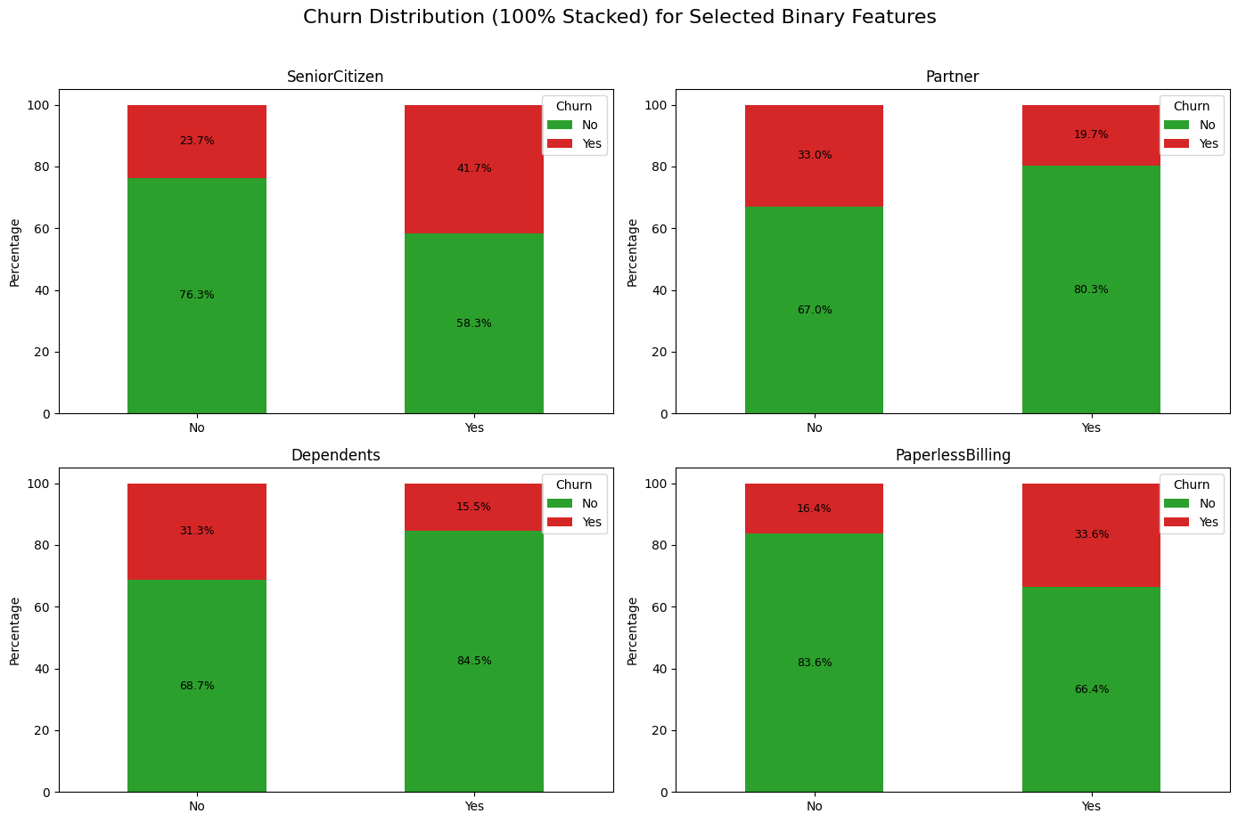

Slide 9
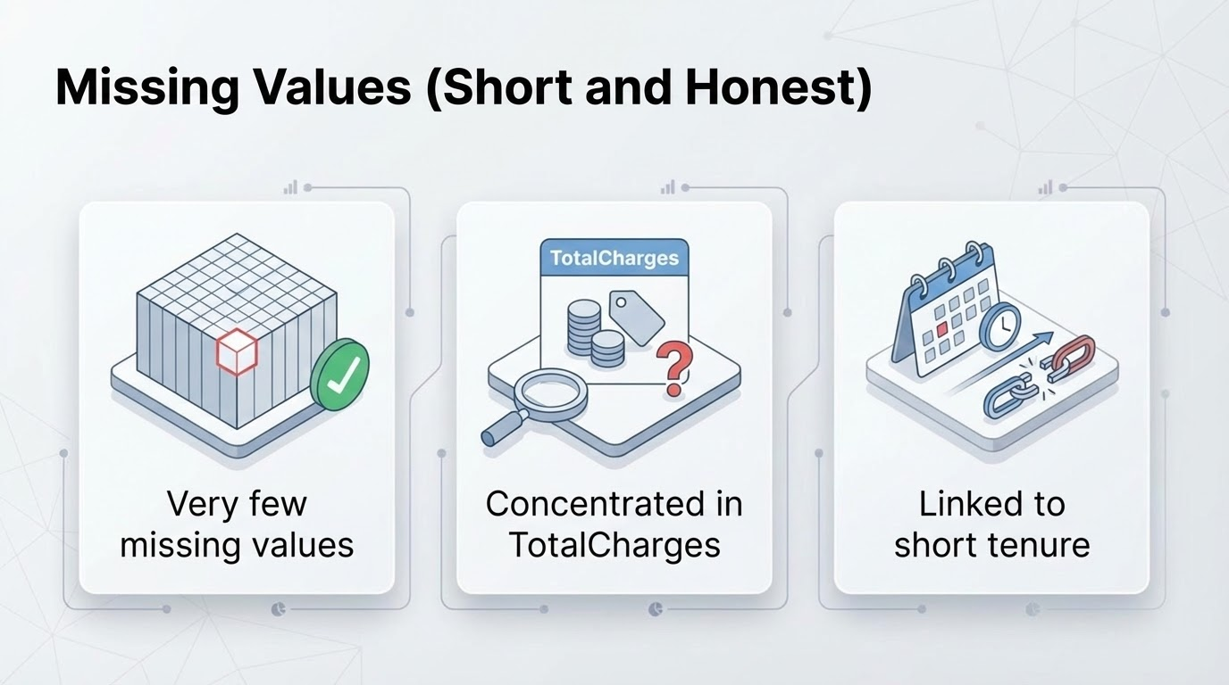

Slide 10
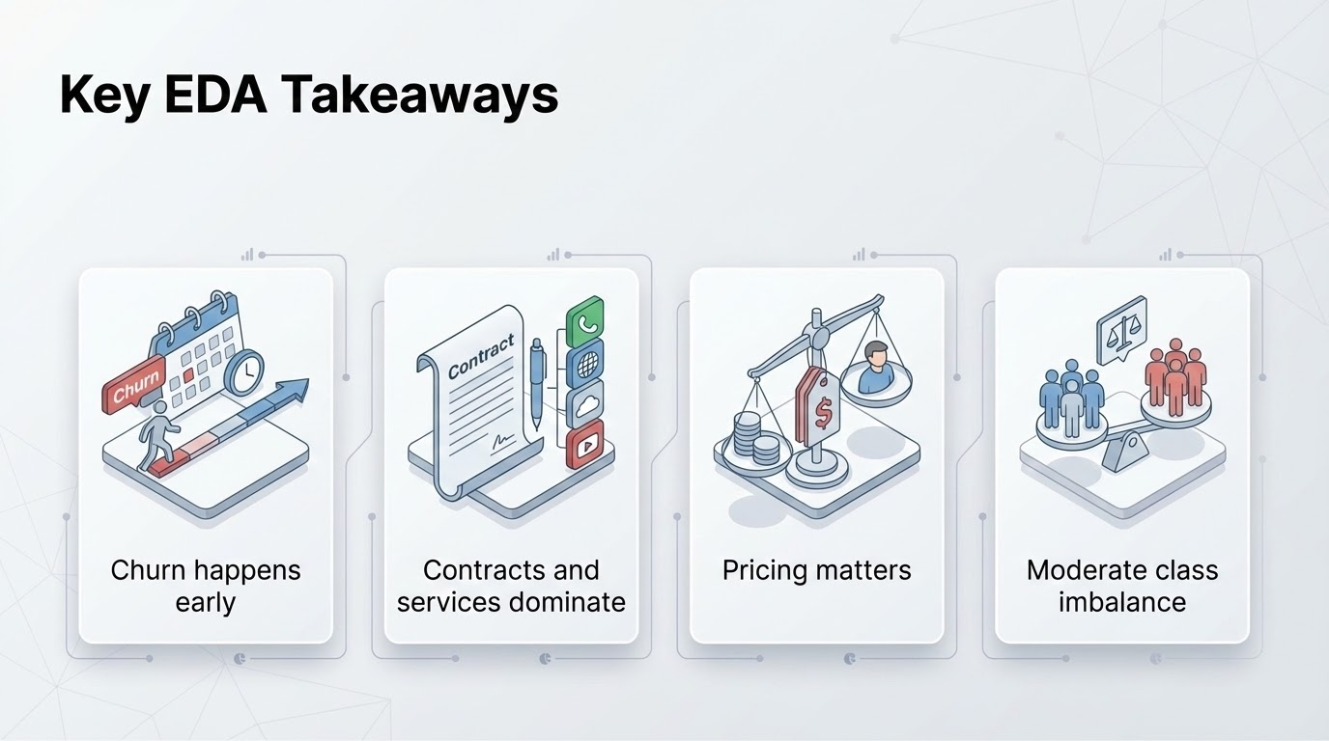

Slide 11
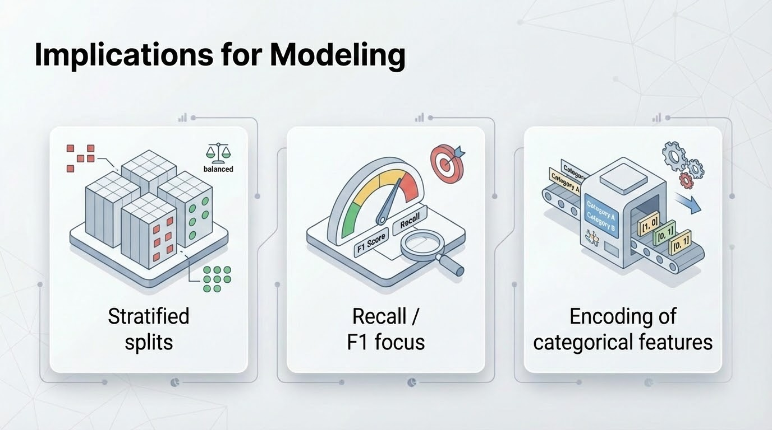

Slide 12
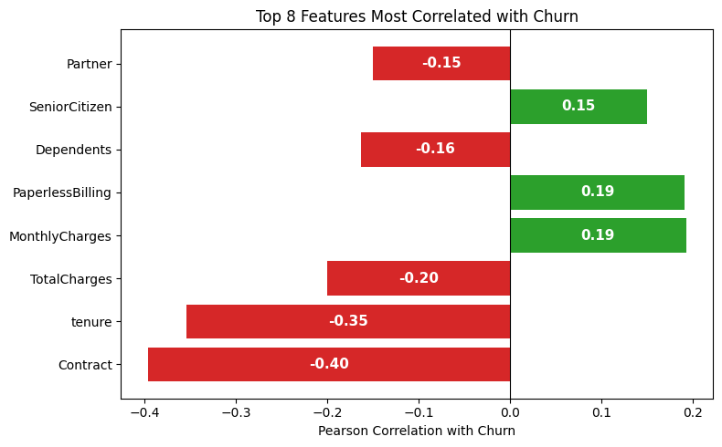

Slide 13



Metrics
Accuracy is the most common metric for classification, however can be a misleading metric for imbalanced data sets.
Precision and recall are also common metrics and should be presented together as there exists a tradeoff between them. They provide a more detailed picture than accuracy when data is imbalanced.
Fβ, that uses a positive real factor β, where β is chosen such that recall is considered β times as important as precision.

Slide 14
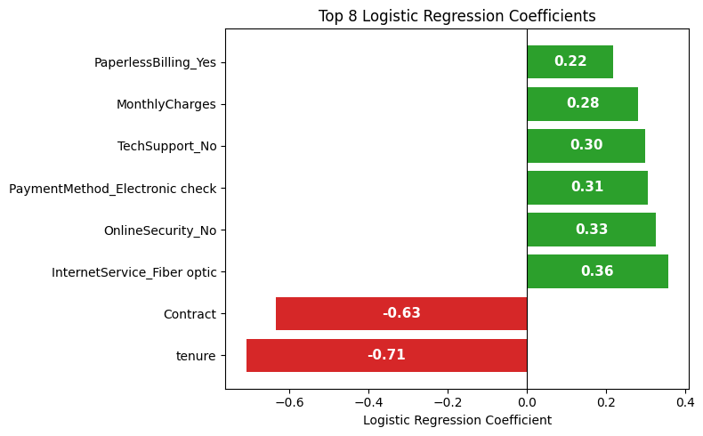
Shallow Learners: Logistic Regression
Logistic Regression is an informative baseline when performing classification, as the model is linear and learning is stable. Using a linear model as a baseline helps detect overfitting if substantial performance gains are not observed with higher-capacity models. Additionally, the model provides direct interpretability through its learned coefficients, allowing us to quantify the direction and magnitude of each feature’s contribution to churn. We therefore deliberately choose to train this model first to establish both a performance and explainability benchmark.

Slide 15
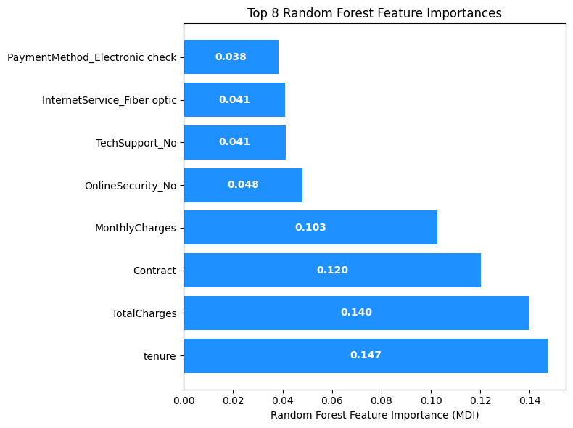
Shallow Learners: Random Forest
Random Forest is a powerful non-linear model that extends decision trees by aggregating many diverse learners, improving predictive performance and robustness. In addition to performance gains, Random Forests provide feature importance estimates based on how frequently and effectively features are used in splits, enabling insight into the key drivers of churn. Comparing these importance scores to the coefficients from the linear baseline helps assess whether non-linear patterns meaningfully influence churn behavior.

Slide 16
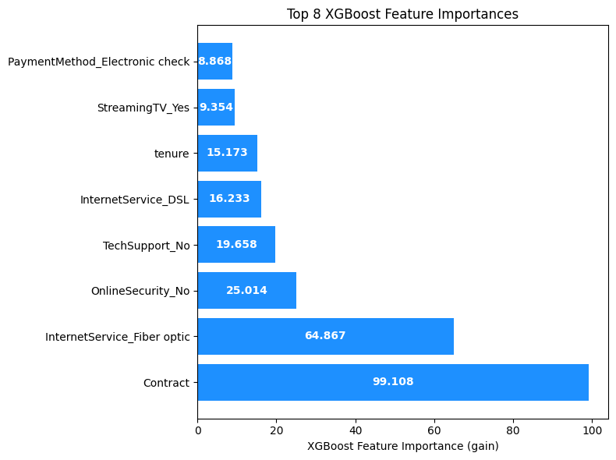
Shallow Learners: XGBoost
XGBoost is a high-capacity gradient boosting model that sequentially builds decision trees to correct the errors of previous learners, enabling it to capture complex non-linear relationships and higher-order feature interactions. Beyond performance, the model supports multiple feature importance measures (e.g., gain, cover, and frequency), which help identify the most influential drivers of churn. Notably, these importance measures (e.g., gain, cover, and frequency) often yield inconsistent feature rankings. This lack of agreement motivates the use of SHAP values, which guarantees that features are ordered correctly with respect to their contribution to the model’s predictions.

Slide 17
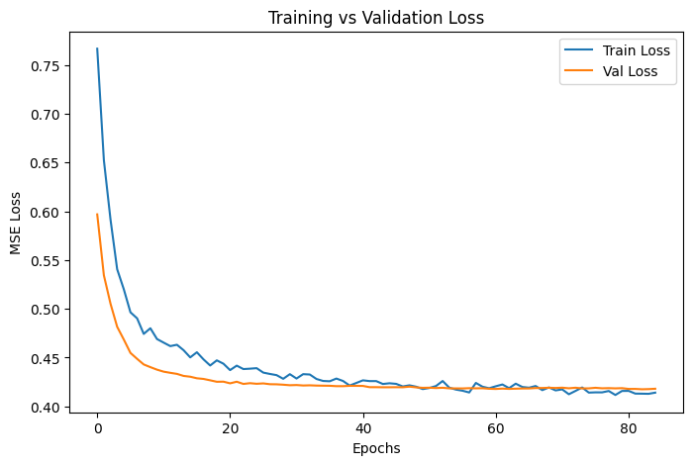
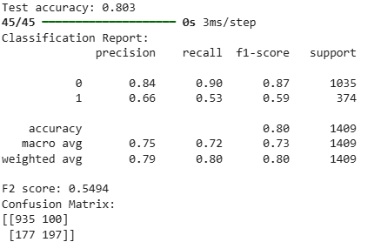
Feed Forward Neural Network (1/5)
FFNN (1 hidden layer) results:

Slide 18

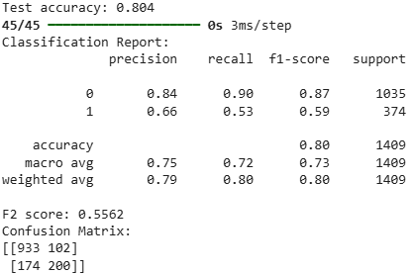
Feed Forward Neural Network (2/5)
FFNN (3 hidden layer) results:

Slide 19
Feed Forward Neural Network (3/5)
 | FFNN (1 layer) | FFNN (3 layers) | XGBoost
Accuracy | 0.803 | 0.804 | 0.808
F2 score | 0.549 | 0.556 | 0.564

Slide 20
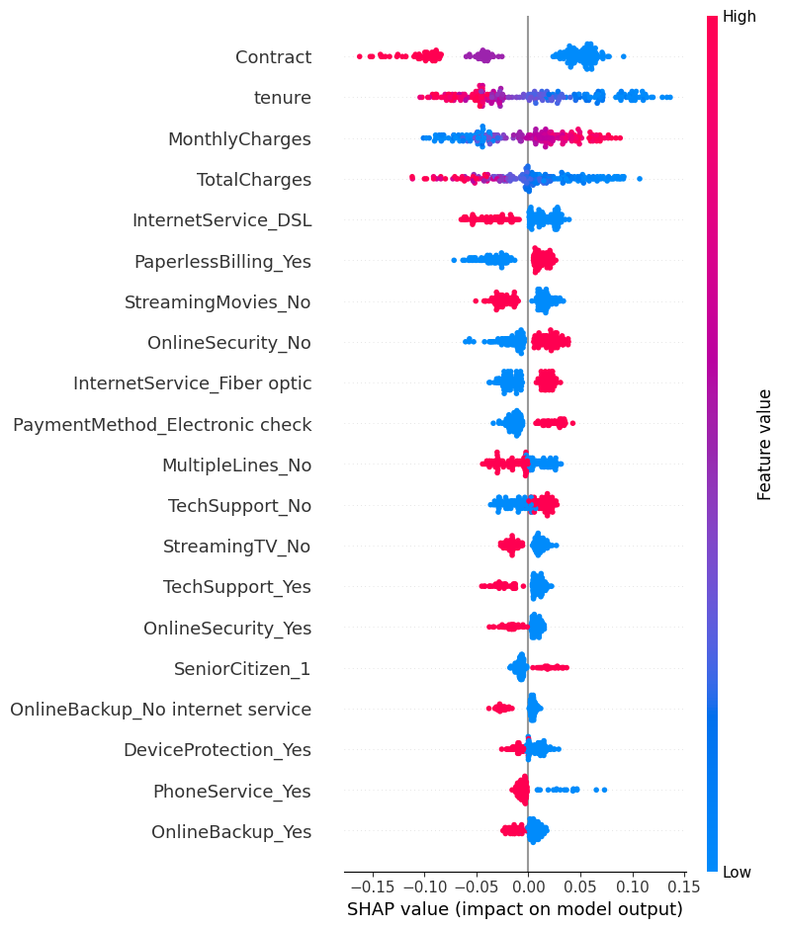
Feed Forward Neural Network (4/5)

Slide 21


Feed Forward Neural Network (5/5)
Shallow Learning
Deep Learning

Slide 22
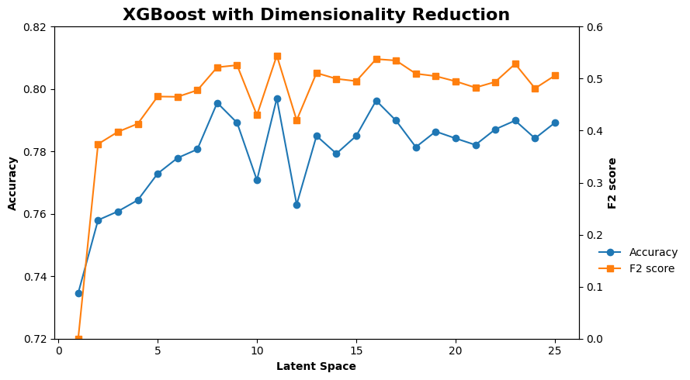
Autoencoder (1/2)
XGBoost WITHOUT Dimensionality Reduction: Accuracy 0.8077, F2 Score: 0.5642
Notes:
say that we think dim reduction doesnt justify the destruction of feature interpretability.

Slide 23
Autoencoder (2/2)
Accuracy WITHOUT dimensionality reduction
Accuracy WITH dimensionality reduction

Slide 24
Feature Engineering
Tenure Buckets
Average Monthly Spend
Month-to-Month Contract Flag
Tenure * Contract Interaction

Slide 25
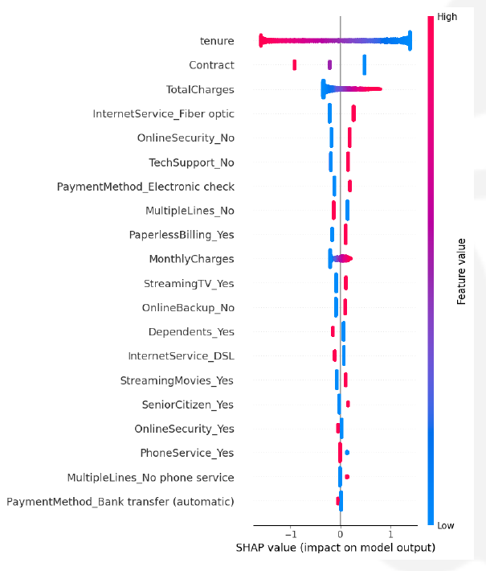
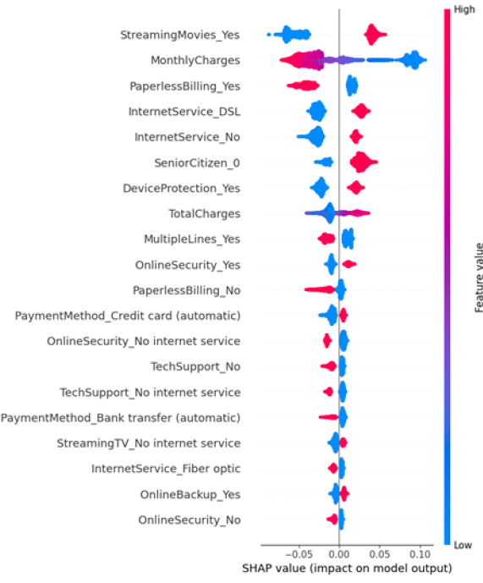
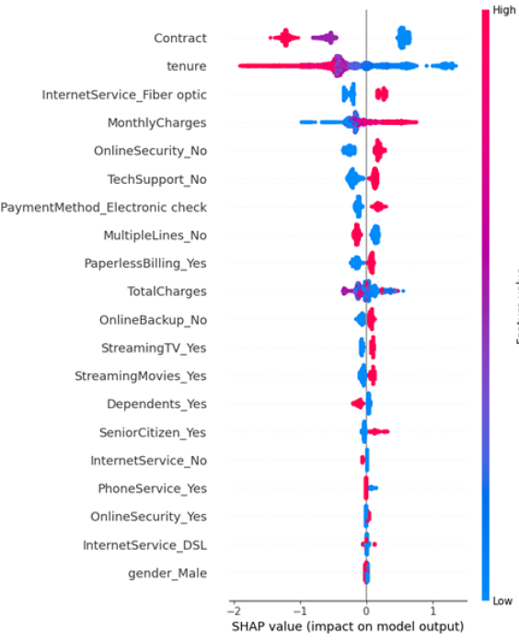
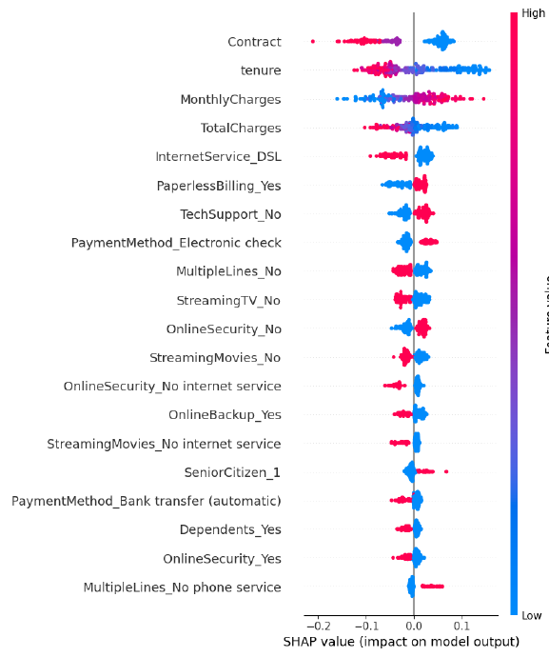
SHAP values
Logistic Regression Random forrest XGBoost FFNN

Slide 26
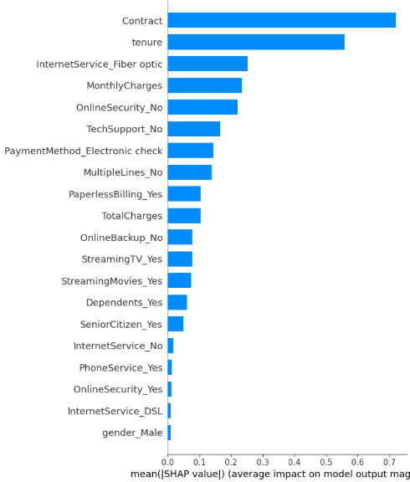
SHAP and XGB feature importance side by side
Notes:
Left : contract It provides the highest average "Gain" (reduction in loss), meaning it’s the most efficient tool the model has for separating your data into groups.
Right: In the SHAP chart: It has the highest mean impact on the model's output magnitude.
Built-in (Gain)(improvement at each split):. In tree models, a continuous feature like MonthlyCharges might be split many times, but each individual split might only provide a small "Gain."
SHAP: is better at "adding up" all those small splits across the entire model to show you the total impact. It tells you that while Contract is the most decisive, tenure is actually doing a huge amount of work in fine-tuning the final prediction for each user.

Slide 27
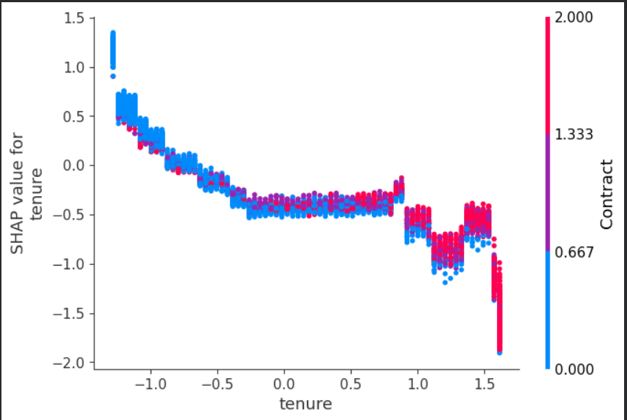
Dependency plot for the two most important features in XGB
churn
none
churn
Month-to-month → 0
One year → 1
Two year → 2
Notes:
customers with low tenure (affliation with the company), are more likely to churn. combined with contract it magnifies this.
Long-term customers (high tenure) are much less likely to churn
New Customers (Left Side): Most of the high-risk (positive SHAP) dots are blue. This shows that being a new customer on a Month-to-month contract is the highest risk state in your model.

Slide 28
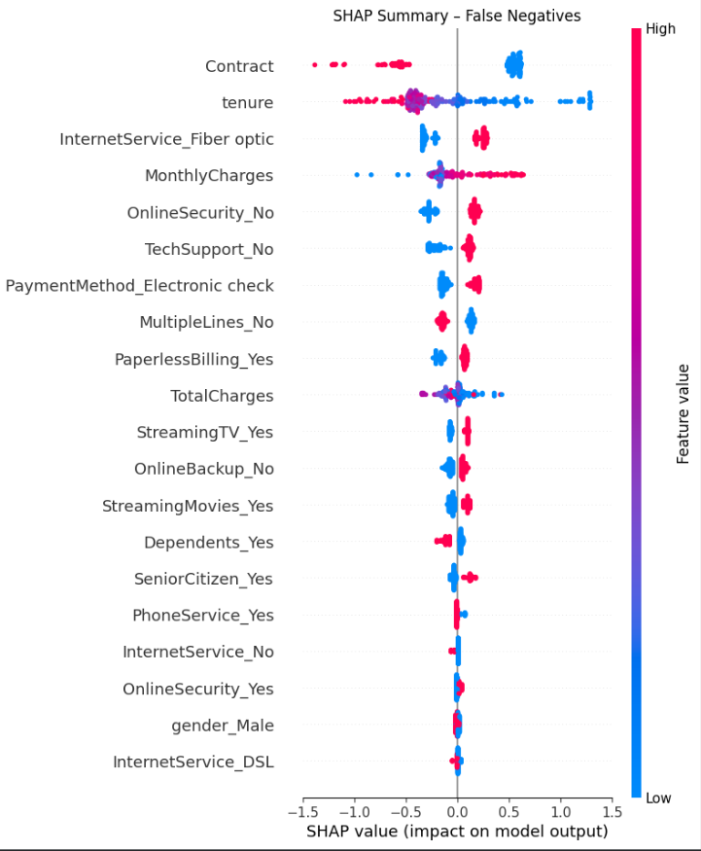
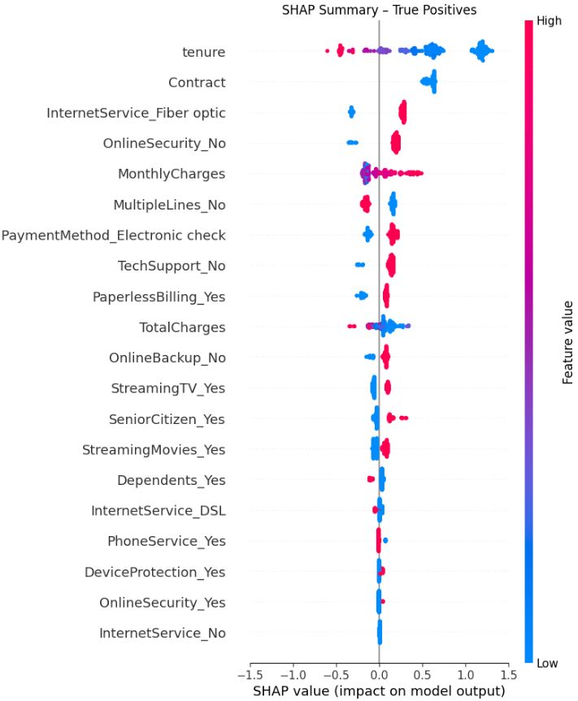
FN and TP for XGB
Notes:
FN has contract as best predictor, where a high feature values pushes the prediction toward non churn, in contrast TP has contract as the second most value feature, where we actually only has low values. This can indicate that the model has a hard time correctly classify a datapoint if it has a high contract. Further more tenure is in second and first place, with similar spread, but more high values in FN and more low values in TP. Internet service has . High similarity in internetservice Fiber optic. More spread in Monthly chares for FN.
False Negatives are likely "Loyalists who reached a breaking point." They have high tenure and long-term contracts (which usually mean they stay), but they churned anyway—perhaps due to a bad customer service experience or a competitor offer—reasons the model can't "see" in the current data.
The model tends to miss churners when features such as long contract length and high tenure strongly push predictions toward non-churn, even when churn-related indicators are present.

Slide 29
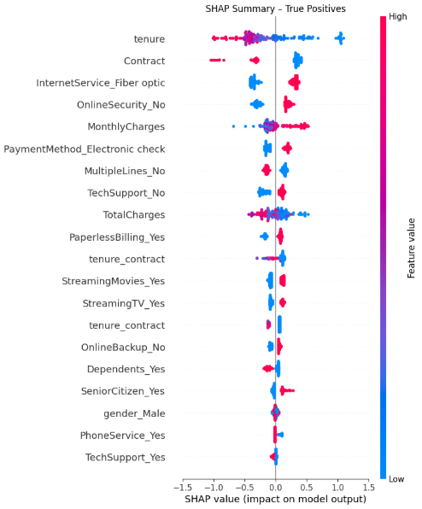
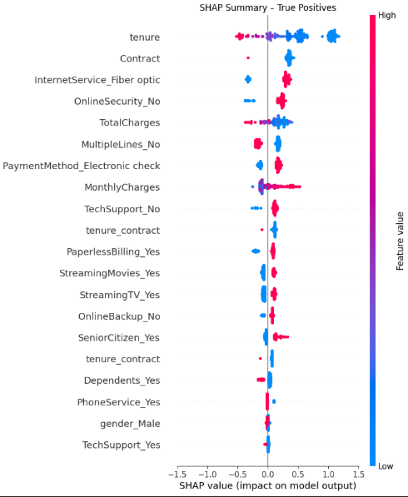
feature engineering based on SHAP (XGB)
contract x tenure
Increase acc by 0.6%
recall increase by
0.01.

Slide 30
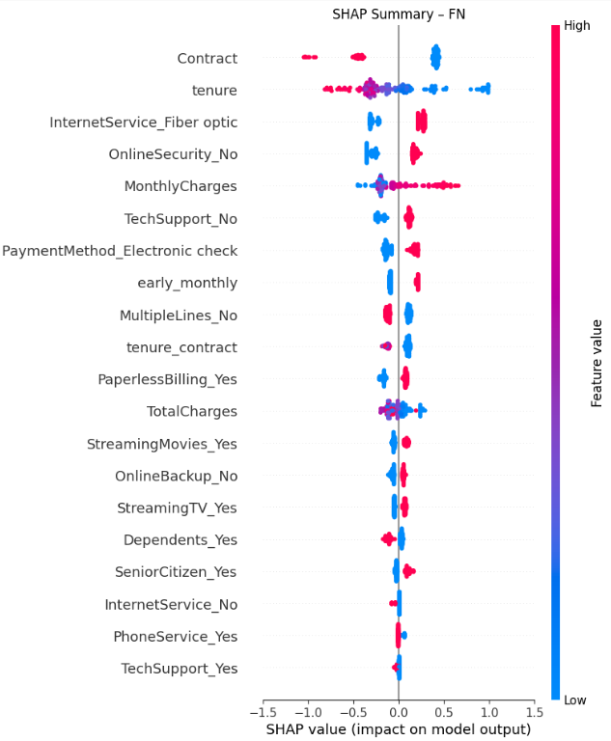
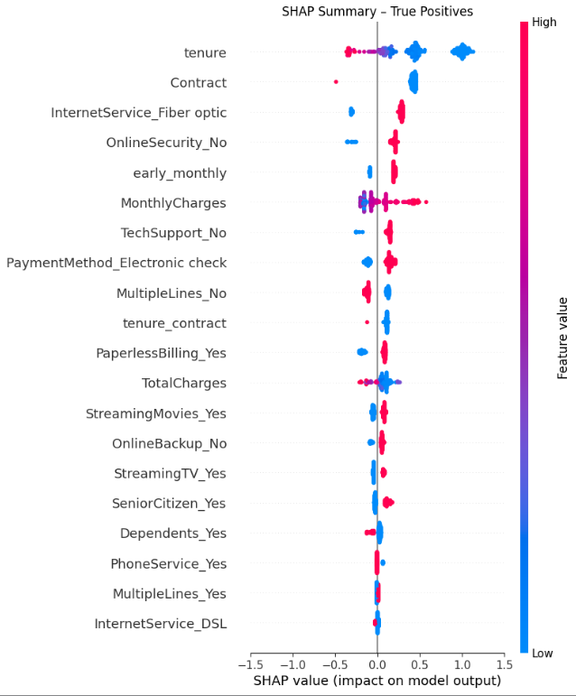
futher featureengeering (XGB)
early_monthly = (tenure < 12) AND (contract == "Month-to-month")
since these feature push FN toward non churn.
DROP in acc and recall

Slide 31
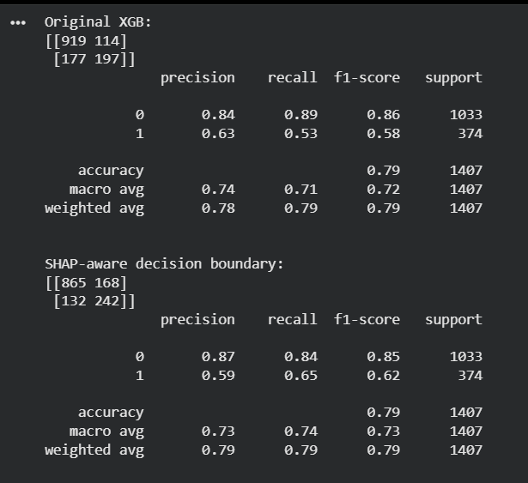
change decision boundary for a high risk subset
high_risk_mask = (
(X_test_enc[:, idx_tenure_contract] < 0) &
(X_test_enc[:, idx_online_security_no] > 0.5) &
(X_test_enc[:, idx_monthly_charges] > 0)
)
base_threshold = 0.5
shap_threshold = 0.35
y_pred_shap_aware = (
(y_proba_xg >= base_threshold) |
((y_proba_xg >= shap_threshold) & high_risk_mask)
).astype(int)
Notes:
converted 45 false negatives into true positives
At the cost of 54 additional false positives
accuracy the same.

Slide 32
feature pruning based on shap error analysis
Prune the k lowest important features, to reduce noise.
saw very slight improvement in accuracy
if any values push FN towards non churn, and don’t contribute much to TP = prune.
Notes:
If a features pushes FN to wards non churn, and dont do much in TP = prune feature
If a feature adds little to both classes, prune.

Slide 33
