Slide 1

Incident management and compliance
How Vircle Halo supports incident reporting, compliance requests and the technology-risk expectations of Bank Negara Malaysia
Product overview | October 2026
Notes:
Opening. Halo is the customer operations platform Vircle built for its own regulated business. This deck is about two modules, incident management and compliance requests, and how they support the technology-risk expectations BNM sets for its licensees.

Slide 2



Report it, decide it, prove it
Report
A security incident register with escalation clocks, an investigation record and drafts of the notices regulators and partners expect.
Decide
Compliance requests, such as account closure, with an identity check, a second person’s sign-off, statutory clocks and an operations checklist.
Prove
Append-only audit trails, evidence files with fingerprints, access logs for sensitive data and a workspace export.
Built around the controls a financial institution is expected to show, and clear about what stays with the institution.
Notes:
Three jobs, three pillars. The incident register and the compliance workflow are where a regulated team acts; the evidence layer is what lets it answer an examiner afterwards. The last line matters: later slides are explicit about what stays with the institution.

Slide 3
Incident management
A security incident register that runs the lifecycle from first report to post-incident review
Notes:
Section one. The incident module digitises the incident management register that Vircle’s own Security Incident Reporting and Management Policy requires. The incidents shown on screen are scenario data.

Slide 4
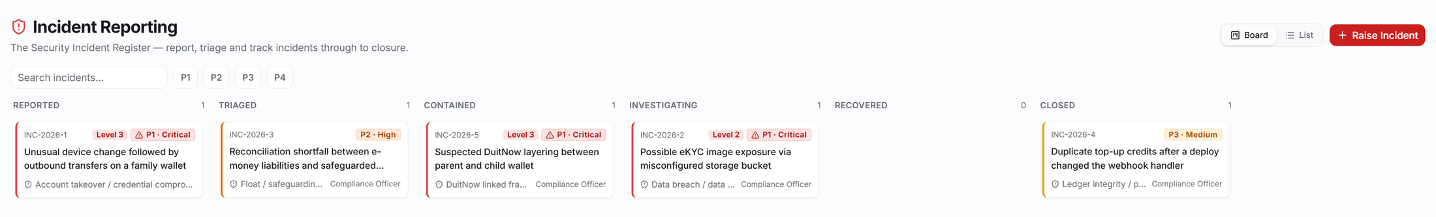
A register built for incidents, not repurposed tickets
Six statuses from reported to closed, in board or list view, with severity P1 to P4 and an escalation level on every card.
Anyone can report. Only incident managers see the full register; a reporter sees their own reports.
The type list and severity model follow Vircle’s own Security Incident Reporting and Management Policy.
Incident register, board view (scenario data, names masked)
Notes:
The register is its own domain with its own confidentiality rules. Six statuses, severity P1 to P4, an escalation level on each card and the assigned officer. The incidents shown are scenario data.

Slide 5
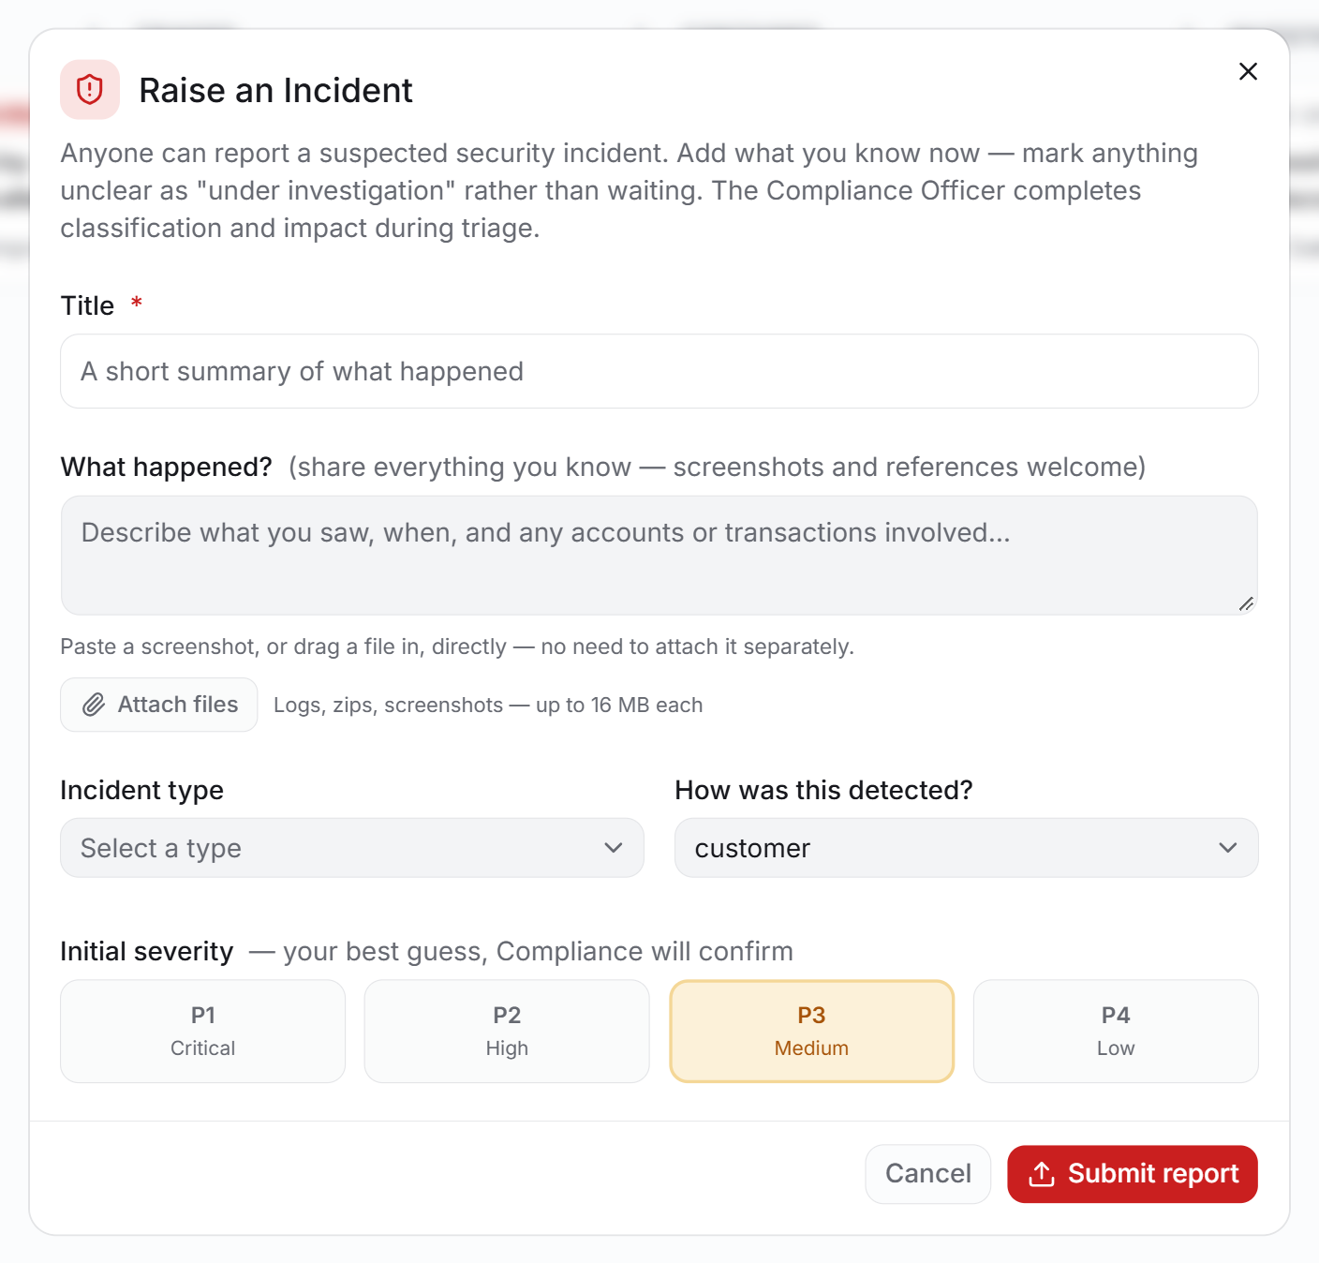
Report in minutes, classify with a shared vocabulary
Security breach
Internal fraud
Data breach or leakage
Policy violation
Float and safeguarding
Malware and ransomware
Ledger integrity
Availability and DoS
Payment and top-up fraud
Third-party incident
QR payment fraud
Suspicious activity
Account takeover
DuitNow linked fraud
Eight detection sources, from monitoring alerts and reconciliation breaks to customer, merchant and regulator reports. Data breach, float, account takeover, third-party and regulator-reported cases are flagged for at least P2; a downgrade needs a documented reason.
Raise an Incident: paste a screenshot or drag a file in
Notes:
Fourteen incident types come from section 8 of Vircle’s policy. Reports of certain types are suggested at P2 or higher; the officer can downgrade with a documented reason at triage.

Slide 6
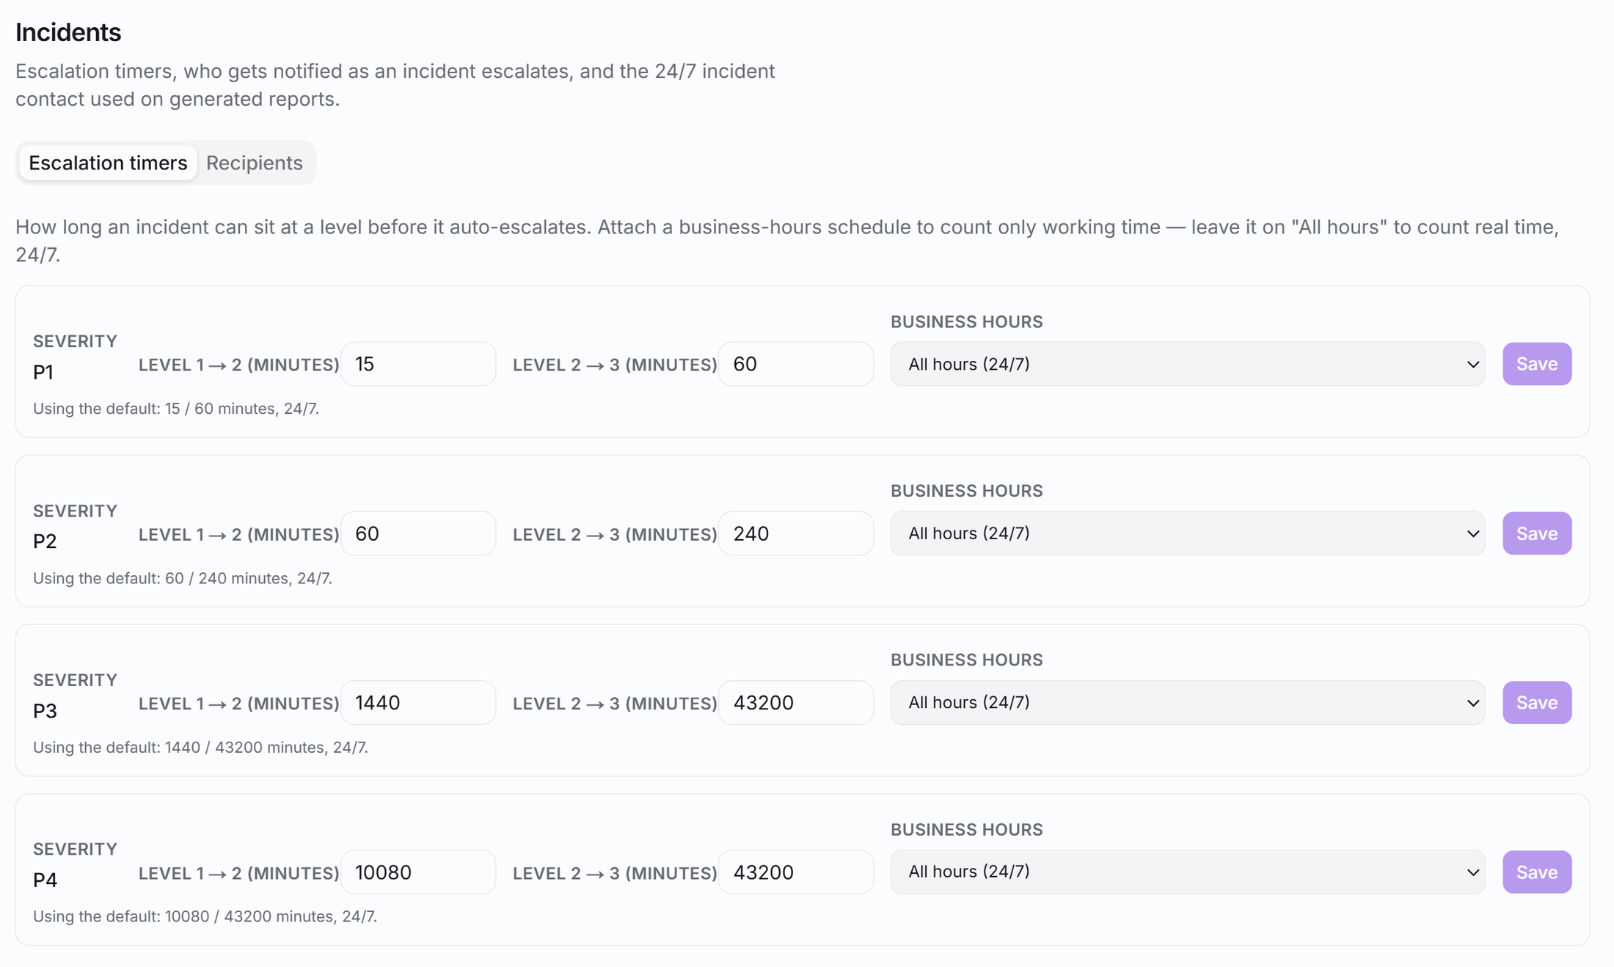
Escalation clocks that run without anyone watching
Severity | To level 2 after | To level 3 after
P1 Critical | 15 minutes | 1 hour
P2 High | 1 hour | 4 hours
P3 Medium | 1 day | 30 days
P4 Low | 7 days | 30 days
Defaults shown, editable per severity, with an optional business-hours schedule.
Recipients are configurable and include holders of the incident-manager permission.
Each escalation is notified in-app and by e-mail and written to the incident’s history.
Settings: escalation timers per severity
Notes:
The defaults come from the policy and are editable per severity; each severity can be tied to a business-hours schedule or left on 24/7. A scheduled job escalates a reported incident that is not triaged in time and notifies the configured recipients in-app and by e-mail. Every escalation is recorded.

Slide 7

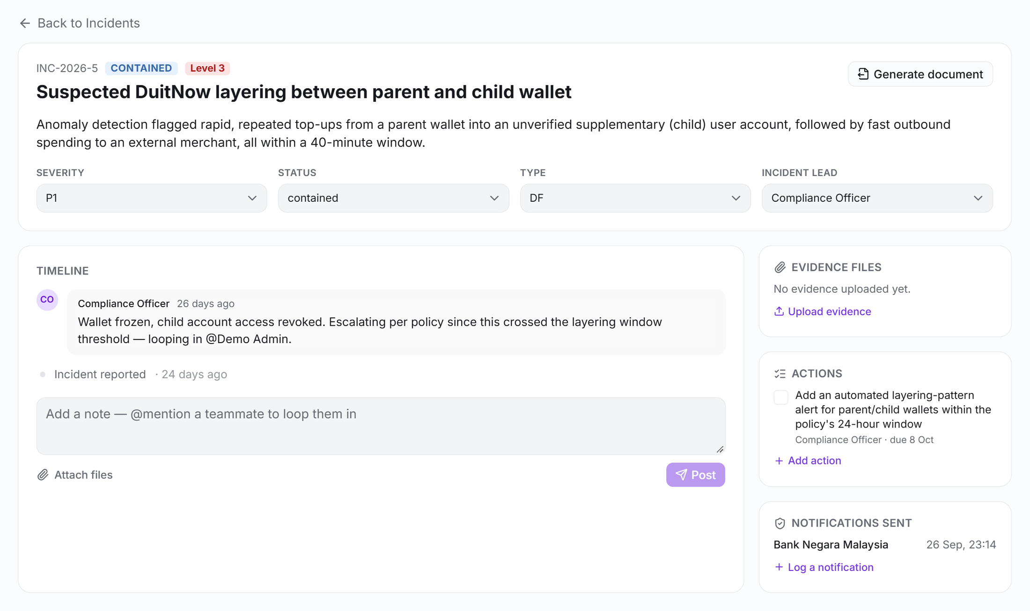



Everything an investigation needs, in one record
Timeline
Every status, severity, type and lead change is stamped with who and when. Notes support @mentions.
Evidence with chain of custody
Uploads are hashed (SHA-256) and logged automatically: who collected them and when.
Corrective actions
Owners and due dates for post-incident actions, tracked to done.
Notifications log
Record who was told and when: BNM, the sponsor e-money issuer, PDP Commissioner, MyCERT, PDRM, banks.
Incident record: timeline, evidence, actions and notifications (scenario data)
Notes:
Timeline, evidence, corrective actions and the log of external notifications. Evidence uploads are fingerprinted with a SHA-256 hash in the browser and logged to an evidence register automatically. The notifications log is where a person records that they told BNM or another party: Halo does not send those notices.

Slide 8
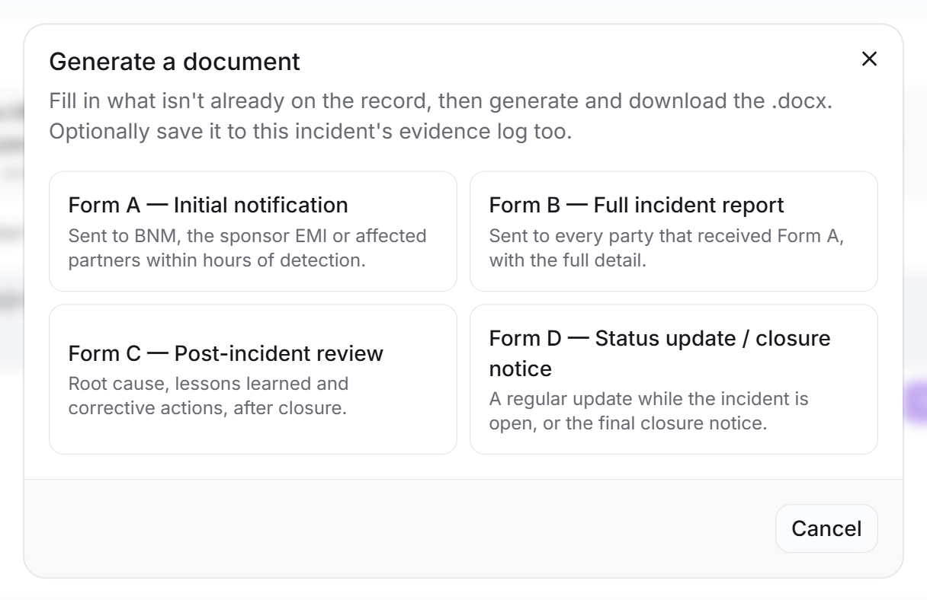
Regulator-ready notices, prepared from the record
Form A Initial notification
Within hours of detection. Policy: P1 target 1 hour (2 hour limit), P2 8 hours, P3 48 hours where notifiable.
Form B Full incident report
To every party that received Form A. Policy: P1 within 48 hours, P2 within 96 hours.
Form C Post-incident review
Root cause, lessons learned, corrective actions. Review within 5 business days, report within 10.
Form D Status or closure notice
Policy: P1 every 4 hours until contained, P2 every 8 hours, then daily. Final notice at closure.
Generate a document from the incident record
Halo fills in what is on the record and prompts for the rest; the .docx can be saved to the incident’s evidence log. Your people send it and log that it was sent. Timelines shown are Vircle’s policy values.
Notes:
Four Word documents are generated from the incident record. The timelines shown are the values in Vircle’s own policy: other institutions will have their own. Halo prepares the document; the people send it through the real channel and log that they did. Halo never contacts a regulator.

Slide 9
Compliance requests
Customer instructions Vircle must act on, and be able to prove it acted on, with the reasons
Notes:
Section two. Compliance requests cover customer instructions such as closing an account, withdrawing funds or changing account details, where the institution must show who checked identity, who approved, and when.

Slide 10
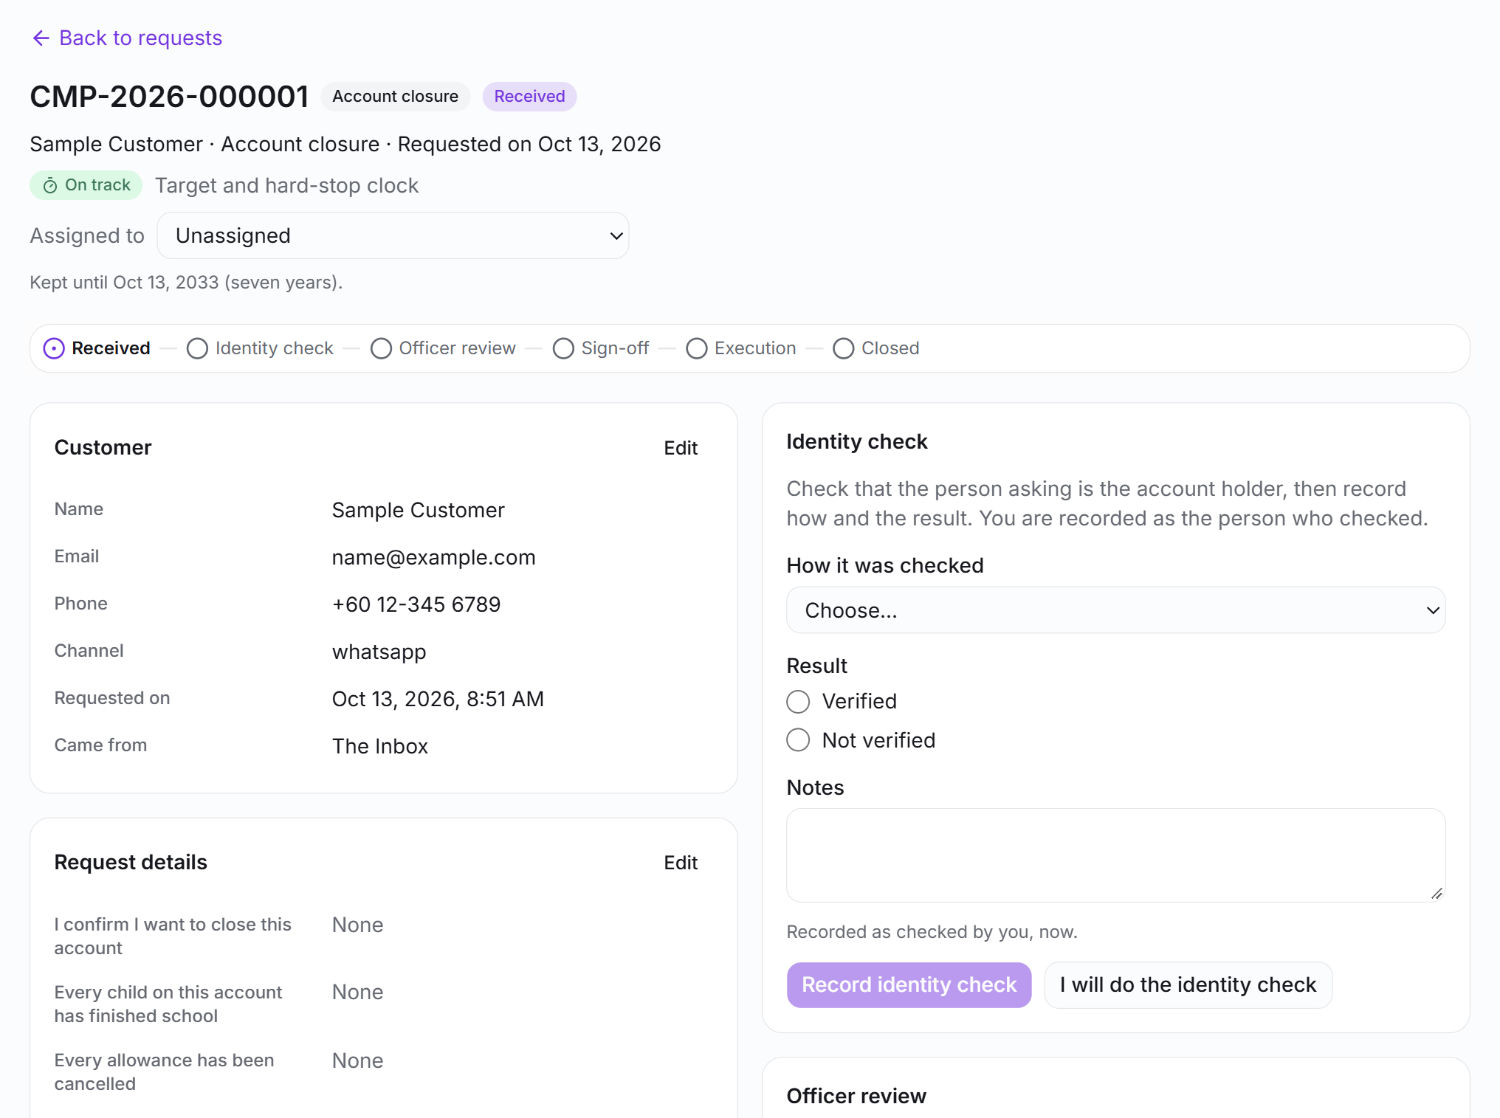
Maker-checker built into the database, not just the screen
1
2
3
4
5
6
Received, identity check, officer review, sign-off, execution, closed
The person who recorded the identity check can never sign the case off, whatever their role. The database refuses it.
Separate permissions to review, approve, reveal protected data, execute and administer. Only Owner and Admin hold them by default.
A rejection needs a reason category; a closure with dues outstanding needs a logged override reason.
Every move is a recorded event: who, when and the note they wrote.
A compliance case: identity check, review, sign-off (test request, details masked)
Notes:
The transition table lives in one SQL function. The person who recorded the identity check cannot sign the case off whatever their role, and that rule is enforced in the database, so a forgotten check in a route cannot bypass it. The case shown is a test request.

Slide 11
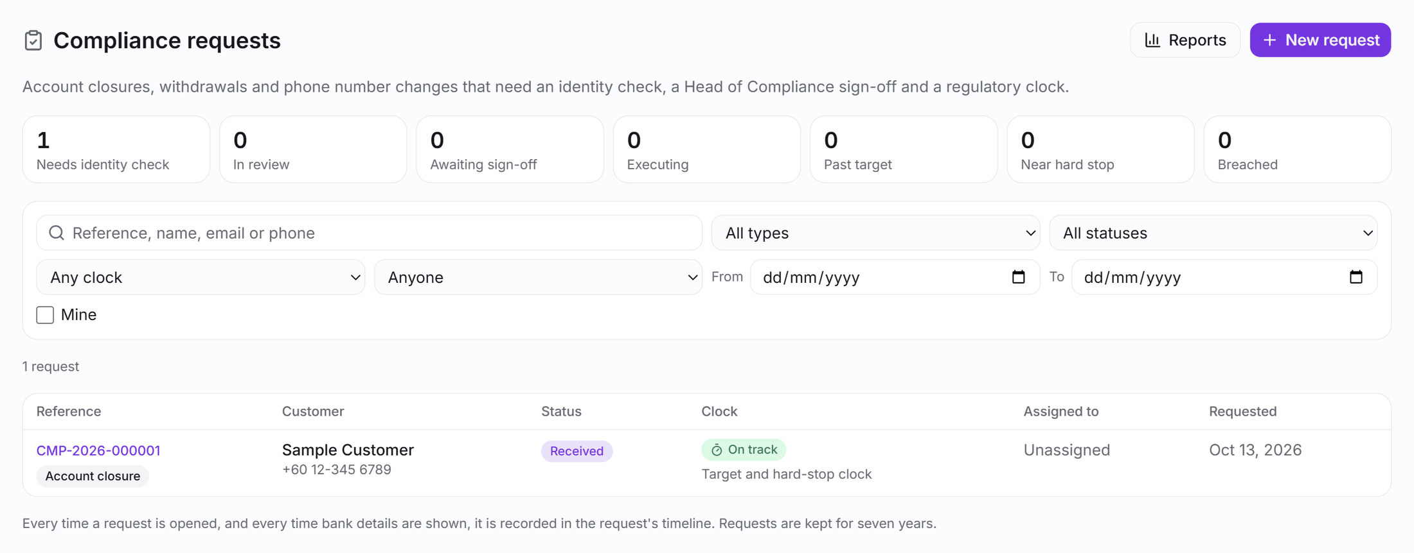
A queue that shows what is due, and what is late
A count for every stage, and filters by type, status, clock, assignee and date.
A clock on every request: on track, past target, near stop, breached or paused, shown as a word and an icon, never colour alone.
An hourly job alerts approvers and reviewers in-app and by e-mail as a case nears its hard stop.
A person without the compliance permission cannot see cases at all, even through the database.
Compliance queue (test request, customer details masked)
Notes:
Counts per stage, filters by type, status, clock state and assignee, and a clock chip on every request. The chips use a word and an icon, never colour alone. An hourly job alerts the people who can approve or review as a case nears its hard stop.

Slide 12
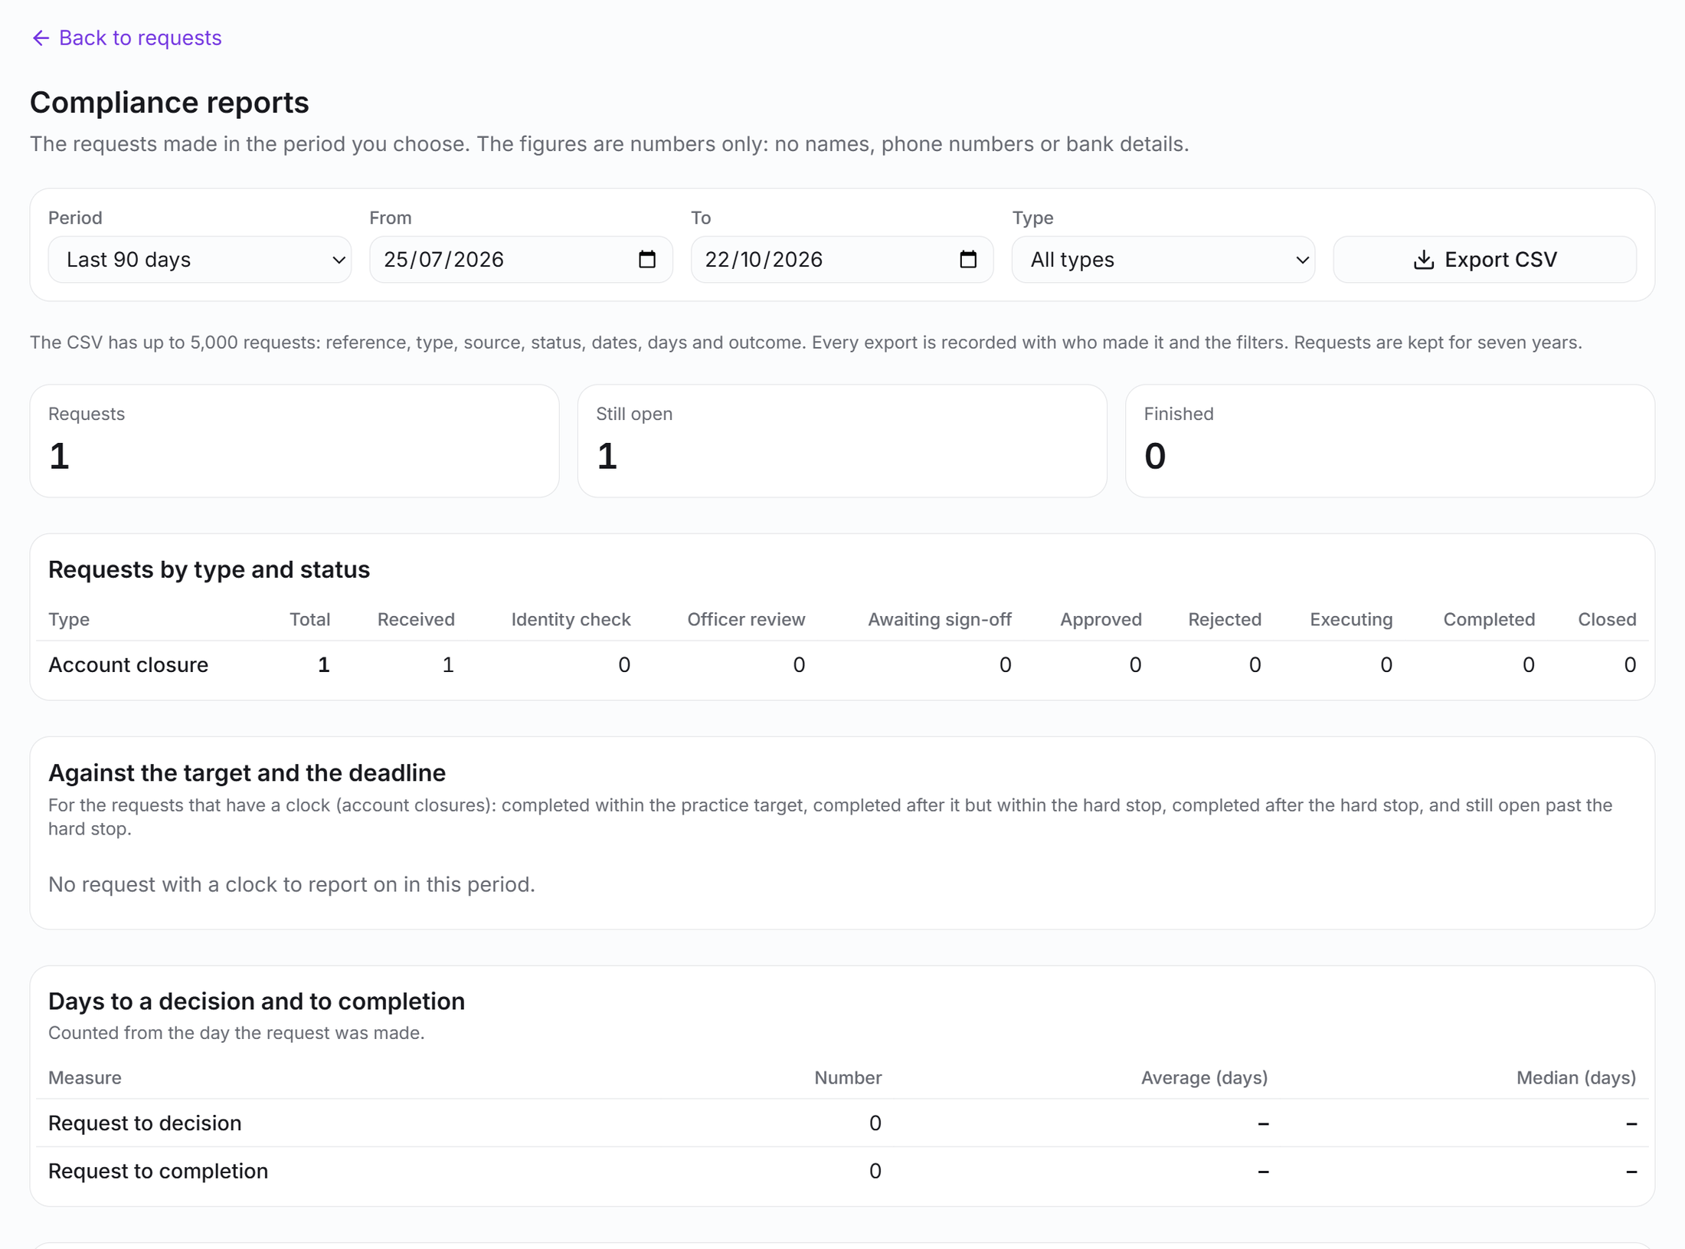
The reporting an examiner can ask for
Requests by type and status, days to decision and to completion, sign-offs by person, rejections by reason and the age of open requests.
Against the target and the deadline: completed on time, completed late within the hard stop, completed after it, still open past it.
Figures are numbers only. A CSV export of up to 5,000 requests is recorded with who made it and the filters.
Requests are kept for seven years.
Compliance reports (figures only)
Notes:
The reports page answers throughput, timeliness and rejection questions with numbers only: no names, phone numbers or bank details. The CSV export is itself logged with who made it and the filters used.

Slide 13


Protected answers and evidence stay protected
AES-256-GCM
Masked until revealed
Bank details show as the last four characters. Reveal needs its own permission, is limited to ten a minute, and hides again on its own.
Protected answers sealed with a rotating key ring
Evidence in a private store
PDF, JPEG or PNG checked by content, 10 MB a file, a SHA-256 kept with each row. Every download is logged first.
2 minutes
Reveal window; the event is logged before anything is shown
An append-only timeline
Created, edited, status, reveal, view, export, pause: nothing can be changed or removed.
7 years
Retention built in; cases cannot be deleted while retained
Notes:
Bank details and other protected answers are never stored in the ordinary answers column: they are sealed with AES-256-GCM from a key ring, masked on screen, and revealed for two minutes only after the reveal event is written. Evidence files sit in a private store and can only be fetched through a route that logs the view first.

Slide 14



Requests arrive from the customer, the chat or staff
Public form
A link the customer opens, filled in over several sittings
E-mails to the customer and to staff at each stage
In-app notifications for the people who must act
Account closure, withdrawal and account-change types built in; your own types can be added
One case
Reference CMP-year-number, clocks stamped from the request type, checklist copied in, retention date set
In the chat
A card or personal link sent in the conversation
Raised by staff
From an Inbox conversation or a ticket
Notes:
Three ways in, one case. The customer can use a public form, receive a personal link in the chat conversation, or staff can raise the case from an Inbox conversation or a ticket. All three produce the same reference and the same workflow.

Slide 15
eKYC review that shows only what the reviewer needs
ID images are fetched on demand and streamed to the reviewer. Halo stores none of the customer’s data, only the access log.
Personal details are masked until the reviewer chooses Reveal. Each reveal is logged and expires; an idle cover and a watermark discourage leaks.
Every search, list, image view and decision writes an append-only log row first: who, what and when.
Approve, reject, or amend a rejection with a required reason. The page opens on the checks that need a review.
Validation
Needs review
Name
A••• B•••••
ID number
•••• •• 9012
Date of birth
Hidden
Parent or guardian
Hidden
E-mail and phone
Hidden
Reveal (logged)
Approve
Reject
Illustration: no customer data is shown
Notes:
The screen reads the institution’s verification service. Halo keeps nothing of the customer’s data: the image is fetched each time and streamed. Every search, list, image view and decision is written to an append-only access log before the data is shown. The panel on the right is an illustration: no customer data is displayed in this deck.

Slide 16
Controls and BNM expectations
How Halo supports the technology-risk requirements Bank Negara Malaysia sets, and where responsibility stays with the institution
Notes:
Section three. The mapping that follows is to BNM’s Risk Management in Technology policy document, which applies among others to licensed banks, approved issuers of electronic money and operators of designated payment systems. It is an aid to the institution’s own compliance team, not legal advice or a certification.

Slide 17
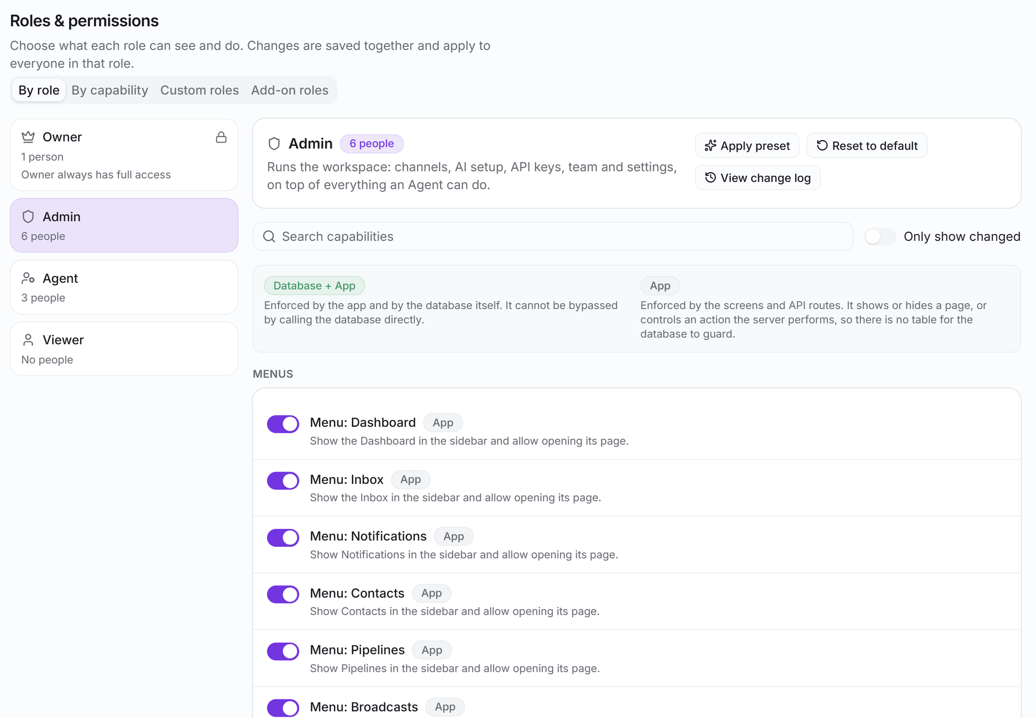
Access that is configurable and enforced in the database
A capability matrix by role, with custom roles such as Compliance Officer and Head of Compliance, and add-on roles that only ever add permissions.
Each switch is tagged App or Database + App. Database + App cannot be bypassed by calling the database directly.
Sensitive modules (incidents, compliance, eKYC) are switched off until the operator enables them, and no role holds their permissions by default except Owner and Admin.
Platform operators cannot read a customer workspace.
Settings: roles and permissions
Notes:
Roles are Owner, Admin, Agent and Viewer, plus custom roles and add-on roles that only add permissions. Each capability is enforced in the screen, the API route and the database policy, so a direct call with a person’s own login is refused too.

Slide 18
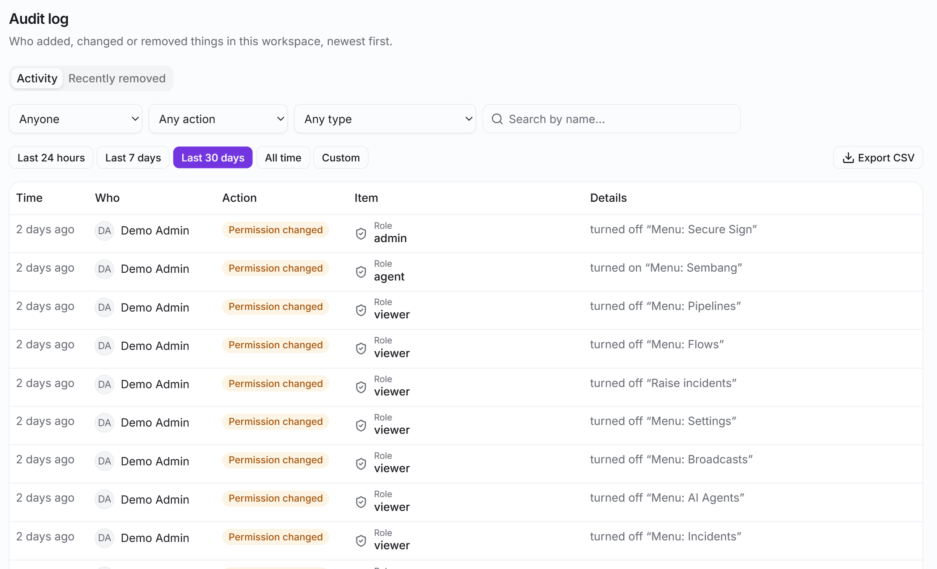



Tamper-resistant records, and data you can export or erase
Append-only audit trails
The audit log, KYC access log, compliance timeline and incident history cannot be updated or deleted, even by the service role.
Audited support access
Operators see diagnostics only, only while the owner allows it (1 hour to 7 days), and every look is logged.
Export and erasure
The owner can export the workspace as a zip and request deletion after a 30-day grace period.
Key lifecycle
Stored secrets use AES-256-GCM; keys rotate without reconnecting a channel.
Settings: audit log, who did what and when (names masked)
Notes:
The audit log is a single append-only table: even the service role cannot update or delete a row. The KYC access log, the compliance timeline and the incident history follow the same rule. Support access is time-boxed and logged; export and deletion serve access and erasure requests.

Slide 19
BNM RMiT: access control and logging
RMiT | Requirement in brief | How Halo supports it | Stays with the institution
S 10.53 | Access control policy for identification, authentication and authorisation | Per-user sign-in; role-based authorisation enforced in screen, API and database | Writing and approving the policy
S 10.54 | Deny by default; least privilege; time-bound access; segregation of duties; dual authorisation | Explicit capabilities; custom and add-on roles; time-boxed operator access; maker-checker on compliance sign-off | Role design; time-bound access for staff
S 10.55 | Multi-factor authentication for critical systems | Sign-in with Google or Microsoft work accounts, so the identity provider’s MFA applies | Enforcing MFA: Halo does not require SSO or MFA itself
S 10.56 | User access matrix, periodically reviewed | Roles and permissions screen shows the matrix; changes are audit-logged | Periodic review and approval
S 10.57 | Log user activity for audit; keep at least three years; review | Append-only audit log, KYC access log, case and incident histories; CSV export | Retention policy, log review, anomaly detection
Source: Bank Negara Malaysia, Risk Management in Technology (RMiT), issued 25 September 2026.
Notes:
Paragraph numbers refer to the RMiT policy document issued 25 September 2026 (effective 28 November 2025 except where stated). The right-hand column is deliberate: several requirements are met by the institution’s own processes, and Halo does not enforce multi-factor authentication by itself.

Slide 20
BNM RMiT: incident response and cryptography
RMiT | Requirement in brief | How Halo supports it | Stays with the institution
S 11.13 | Incident response plan: preparedness, detection and analysis with evidence preserved, containment, recovery, post-incident review | Register with six statuses; escalation clocks; evidence with SHA-256 chain of custody; Form C post-incident review with corrective actions | The response plan, the response team and drills
S 11.18 | Notify the Bank of cyber incidents under its other policy documents | Forms A, B and D prepared from the record; a log of who was told, when and by what reference | Submitting to BNM and others, and meeting the deadlines
S 12.9 | Extra measures when an incident involves potential fraud or customer data compromise | Reports of data breach, account takeover and fraud types flagged for at least P2; customer and PDP Commissioner notifications logged | Heightened account monitoring; customer communication
S 10.20 | Cryptography policy covering key lifecycle | AES-256-GCM for stored secrets; versioned key ring; rotation with re-encryption and no reconnection | The institution’s cryptography policy and annual review
Source: Bank Negara Malaysia, Risk Management in Technology (RMiT), issued 25 September 2026.
Notes:
S 11.13 sets out the stages of a cyber incident response plan. The incident module follows the same stages. S 11.18 requires notification to the Bank per its other policy documents: Halo prepares the notice and logs that it was sent, but does not send it.

Slide 21
Beyond RMiT: other obligations Halo helps evidence
Customer information
BNM policy on management of customer information and permitted disclosures
Masked data, logged reveals, audited support access, private file storage
AML/CFT and eKYC
BNM AML/CFT/CPF/TFS and eKYC policy documents
eKYC review with a full access log; compliance cases with identity checks and sign-off. Filing suspicious transaction reports and screening are outside Halo
Personal data
Personal Data Protection Act
Workspace export for access requests, 30-day erasure, retention by design, PDP Commissioner notices tracked in incidents
Operational resilience
BNM business continuity and operational risk reporting
Incident clocks and post-incident review support reporting. Hosting, backup and recovery are deployment choices of the institution
Notes:
These are areas, not clause-by-clause claims. Each licensee confirms the exact obligations with its own compliance team. The common thread is that Halo produces records and controls the institution can point to.

Slide 22
What Halo does, and what it does not
Halo provides
The institution keeps
The register, cases, clocks and workflows
Evidence, access and audit records that cannot be rewritten
Document drafts for regulator notices
Controls on who sees and changes what
Export and erasure of a workspace
Policies, response plans, drills and training
Submitting notices to BNM, PDP Commissioner, MyCERT and others
Enforcing MFA and single sign-on at the identity provider
Transaction monitoring, sanctions screening, STR filing
Hosting, backup and recovery arrangements, log review and retention policy
Notes:
Be direct about limits. Halo does not file anything with BNM or any authority, does not enforce multi-factor authentication or SSO-only login by itself, is not a transaction monitoring or sanctions screening system, and the mapping on the previous slides is an aid, not a certification.

Slide 23
Getting started
A pilot on one workspace, from set-up to a rehearsed incident
1
Configure
Roles, request types, escalation timers
2
Rehearse
A tabletop exercise on a scenario incident
3
Go live
One workspace first, then scale
Notes:
Close. The incident taxonomy follows Vircle’s own policy today, so aligning it with another institution’s policy is scoped during onboarding rather than a setting. Offer a walkthrough and a short pilot.

