Slide 1
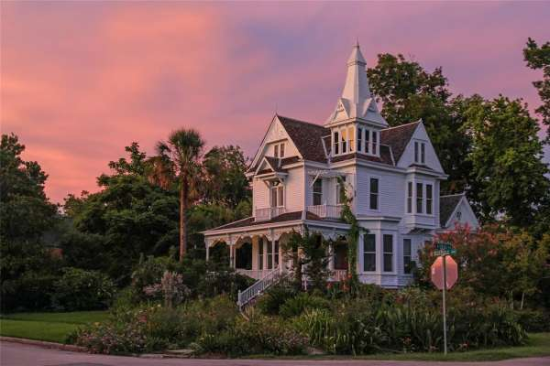

Classification of Architectural Style
Ex Machinas
Ed Gomez
Carlos Quiroz
Maria Soria
Nehemias Vicente
Ivy Chen
USC Data Analytics Boot Camp
November 18, 2019

Slide 2


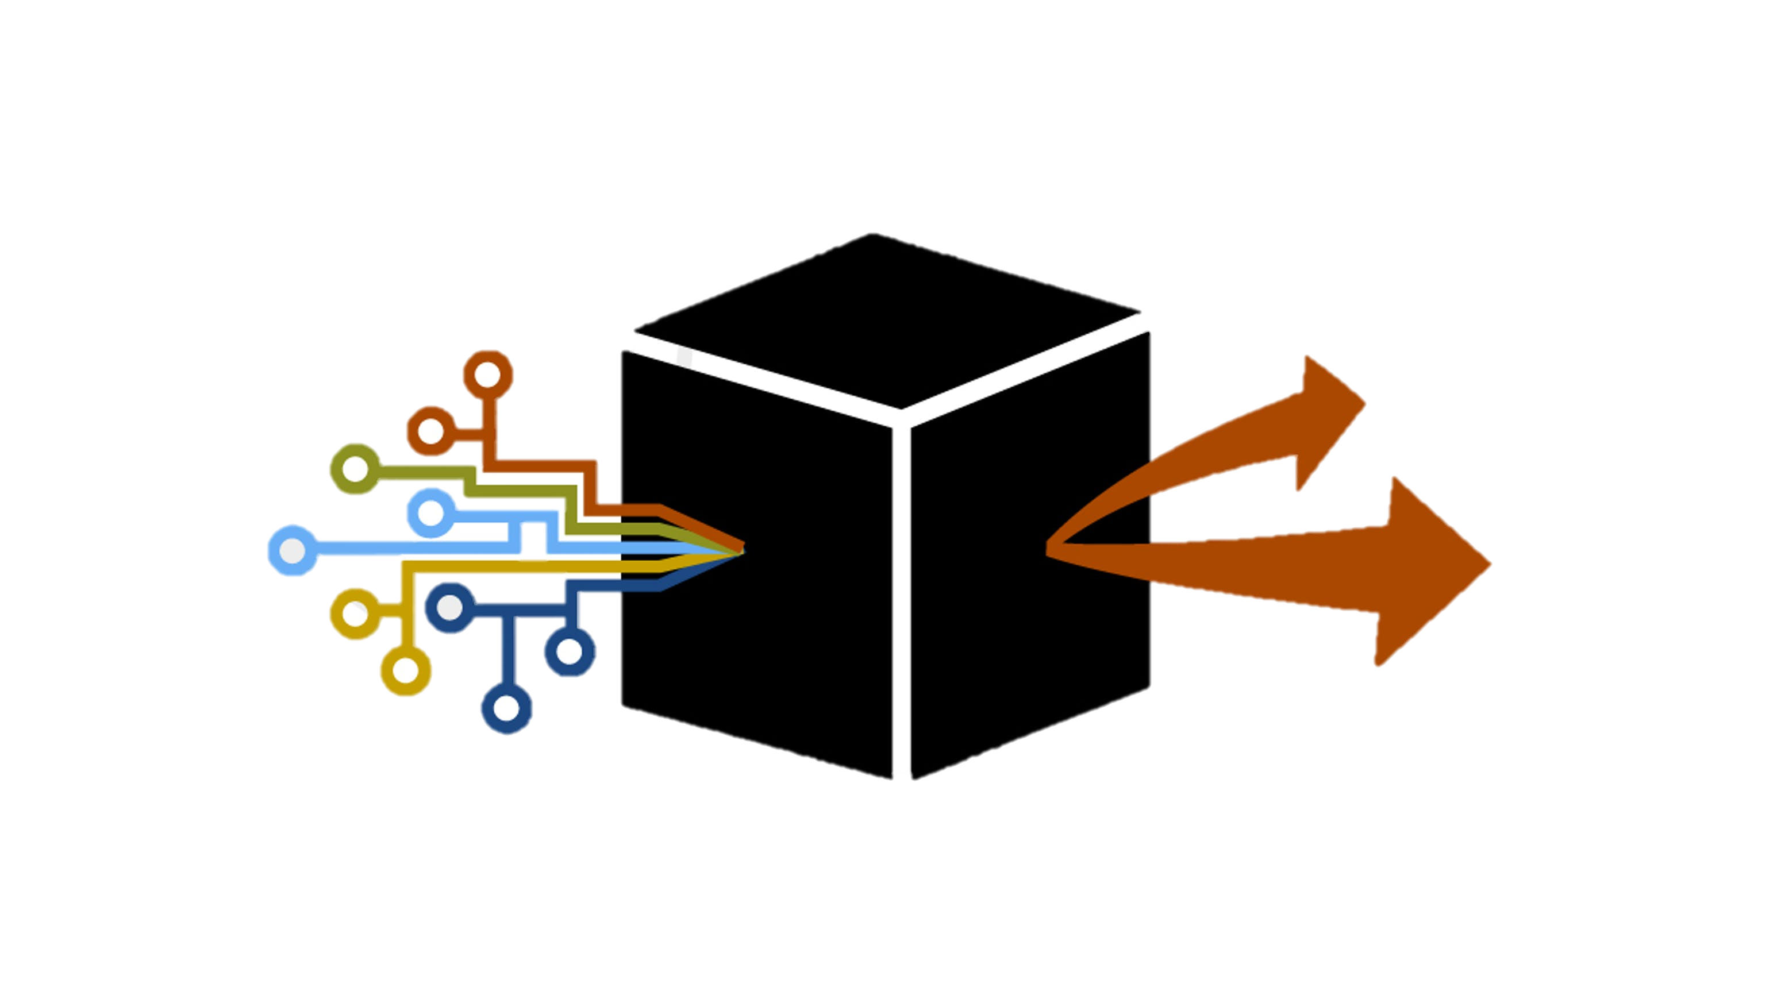
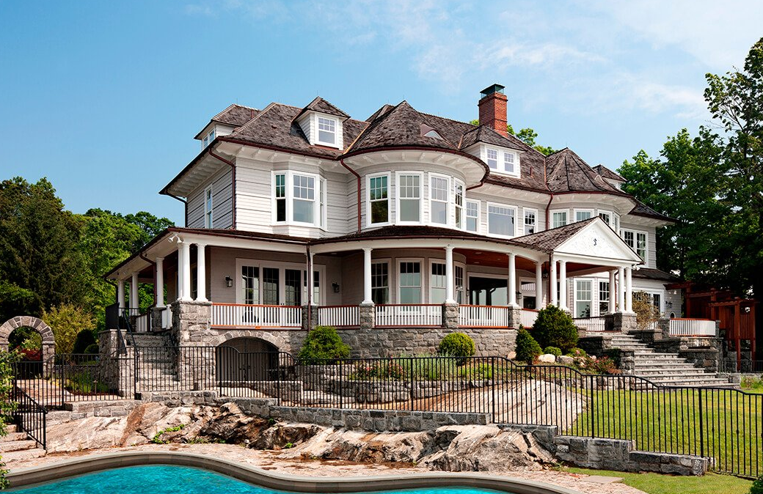
Overview
Project Description:
Use ML in the context of technologies learned and apply it to solving a problem
Decided on a classification approach to predict the architectural style of a house image for following architectural style:
- Modern - Spanish - Tudor - Victorian
Objectives:
Evaluated ML models (VGG19 and Xception) that analyze complex images to detect patterns in our housing image dataset
Developed and deployed a ML model that could read an image and classify the
architecture style of a house from one of the four categories

Slide 3
Awesome Teamwork!
The responsibilities listed below were their respective primary tasks. However, we always assist each other and collaborate on various tasks demonstrating the true spirit of teamwork!
Maria Soria
Carlos Quiroz
Ed Gomez
Nehemias Vicente
Ivy Chen
Data scraping, cleaning and transformation, and assisted with ML model
Data scraping, cleaning and transformation, and assisted with ML model
AWS deployment, database, web design, and created interface for website
Machine Learning algorithm model evaluation and optimization
Assisted with ML model and Power Point presentation

Slide 4
Project Timeframe
Two weeks, from beginning to success!

Project
Integration &
Presentation

Data Collection

Develop ML
Model
✓
Integrated ML model onto website PPT and all sources to better delivery awesome work
✓
✓
Evaluated VGG19 and Xception ML models utilizing shared collaborative tool (COLAB) to optimize model
Downloaded several thousand (over 3000) images for all four architectural styles selected for project
1
3
5

Data Cleaning

Web
Development
✓
Cleaned data: Used Python to rename images to correspond to category. Resized images and removed duplicates and irrelevant
✓
AWS site design, development and deployment
2
4

Slide 5
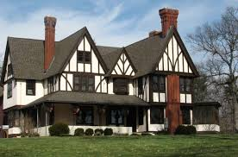
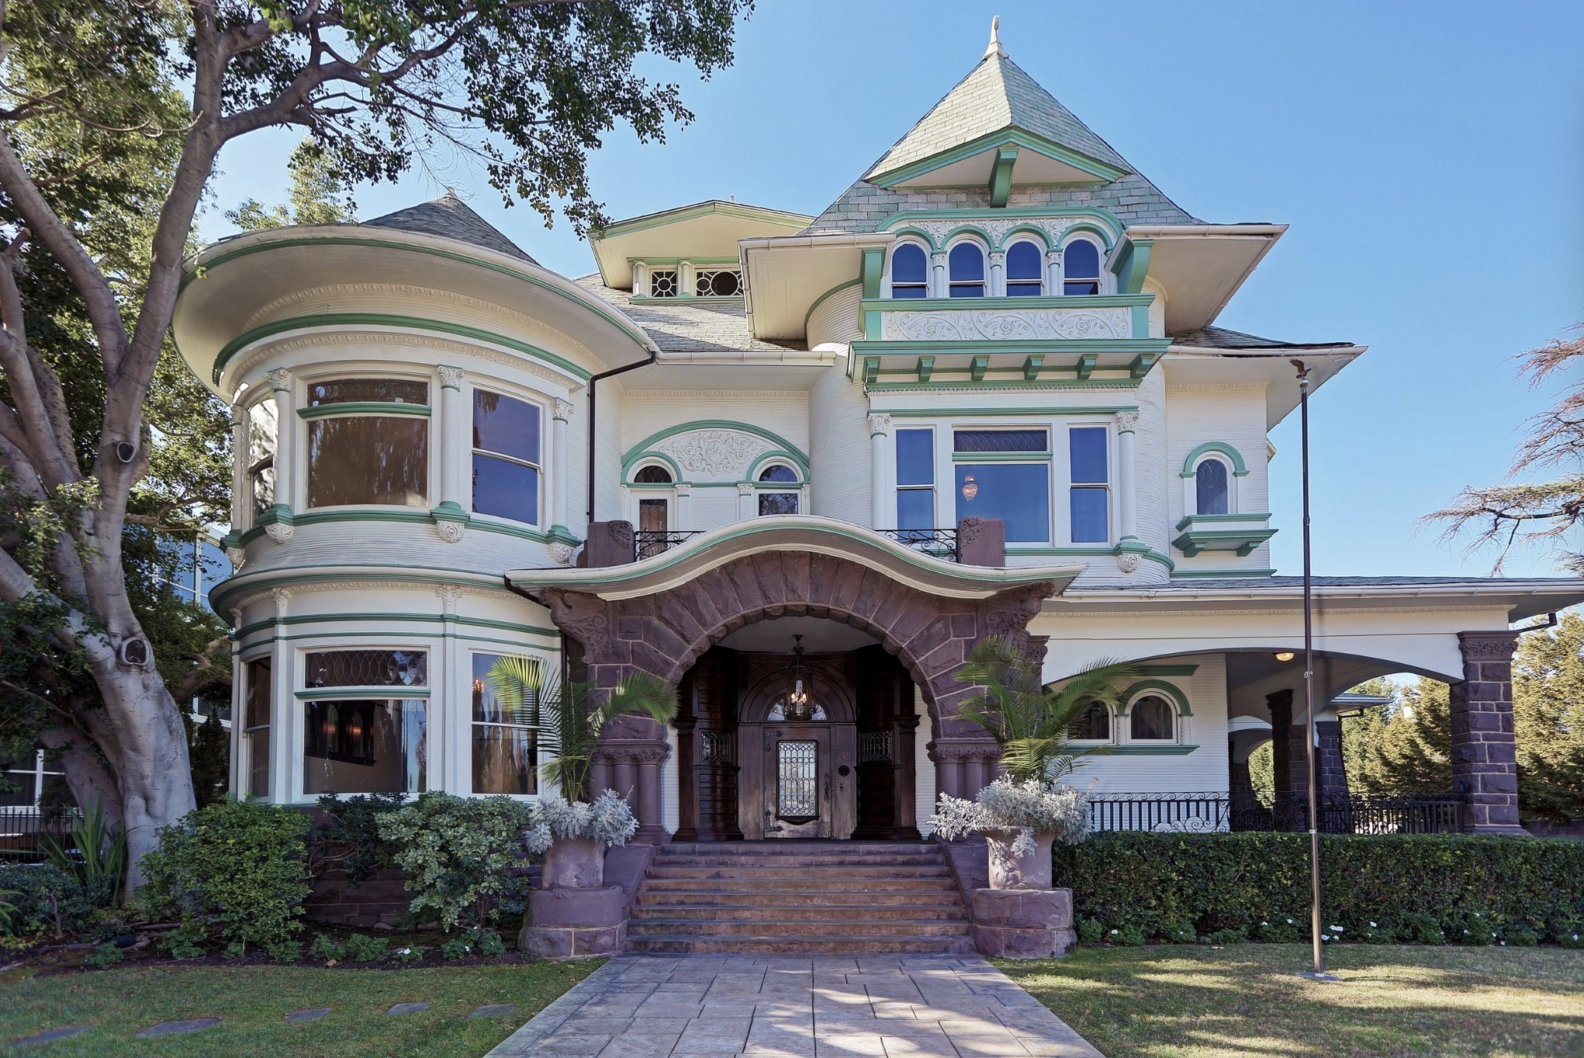
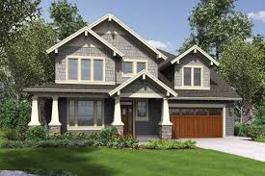
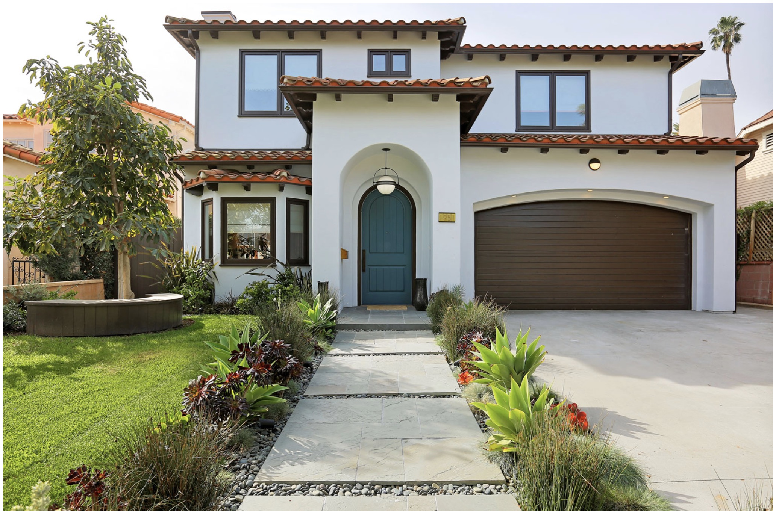
Tudor
Victorian
Architectural
Styles
Craftsman
Spanish

Slide 6
Project Technology

Github
HTML, CSS, Javascript, Bootstrap

Tensorflow.JS
Open source platform was used to build the machine learning model
✓
✓

dupeGuru
Cross-platform GUI tool was used to find and remove duplicate images

Chrome Extension
Imageye - Image downloader chrome extension was used to download images
✓
✓

Python
Phython script was used to rename thousands of images by category
Matplotlib was used to plot loss and
accuracy for ML models

AWS
Amazon Simple Storage Service (S3) was used as the interface between the database and website
Amazon Web Services (AWS) platform was used to deploy website
✓
✓

Website
http://exmachinas.ml
✓

Slide 7
Challenges
Success
Google and Bing APIs had limitations per request and image sizes varied significantly.
Jupyter notebook was extremely slow at running script involving thousands of images.
Sharing & Editing Colab notebooks on Google Drive was complicated and often overrode code
Organizing and tracking the multitude of tests ran
Deploying ML model on website
Multiple parameters that could be tuned and
difficult to determine which improved the ML model
Found tools such as Imageye and dupGuru to assist in data preparation
COLAB executed code much faster than jupyter notebook due to the larger GPU than on a typical laptop
Found that saving your own copy resolved the conflicts
Cataloged changes on spreadsheet to track progress
TBD…
Achieved over 89% accuracy!!!
Challenges
&
Success

Slide 8
epochs/Learning rate/#images | loss | acc
5E/lr00005/2800 | 0.7389 | 0.8400
5E/lr00006/2800 | 2.2954 | 0.5628
6E/lr00005/2800 | 0.7953 | 0.7657
7E/lr000035/2800 | 0.6866 | 0.8357
7E/lr00004/2800 | 0.6796 | 0.8500
7E/lr000045/2800 | 0.6429 | 0.8514
7E/lr00005/2800 | 0.7232 | 0.8371
7E/lr00006/2800 | 0.9215 | 0.6100
8E/lr00003/2800 | 0.7974 | 0.8543
8E/lr00005/2800 | 2.8718 | 0.4557
9E/lr000045/2800 | 1.2792 | 0.5714
10E/lr00003/2800 | 0.7778 | 0.8400
14E/lr00003/2800 | 0.7389 | 0.8400
10E/lr00001/3130 | 0.6010 | 0.8914
Parameter
Tracking

Slide 9
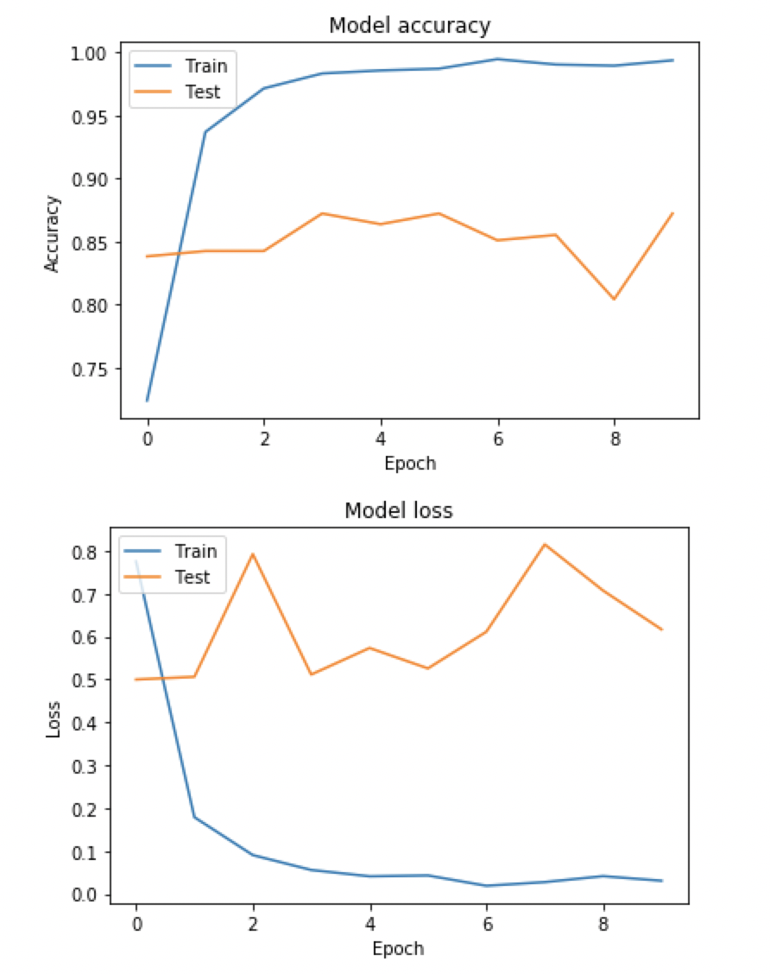
Accuracy
& Loss

Slide 10


GitHub Repo: https://github.com/egome007/final_project
Website: https://exmachinasfinal.s3.us-east-2.amazonaws.com/Home_Site/index.html

