Slide 1
The dataset GSE106589
Friederike Ehrhart, PhD
Assistant professor
Maastricht University
Department of Bioinformatics – BiGCaT

Slide 2
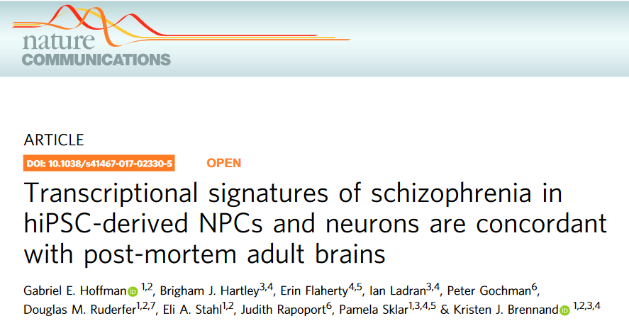
The dataset : original publication
The paper:

Slide 3
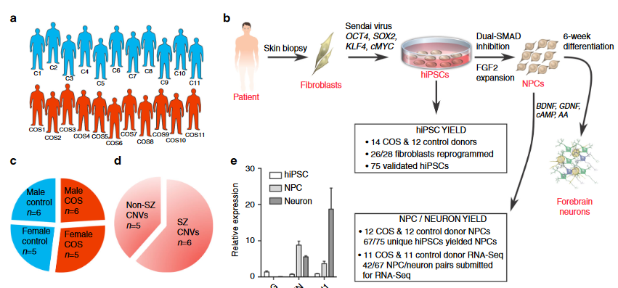
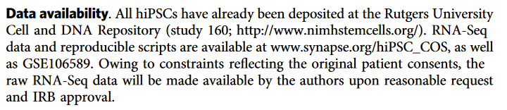
Experimental design
childhood-onset-schizophrenia (COS) vs. healthy control (C) -> 94 samples in total
These are our samples

Slide 4
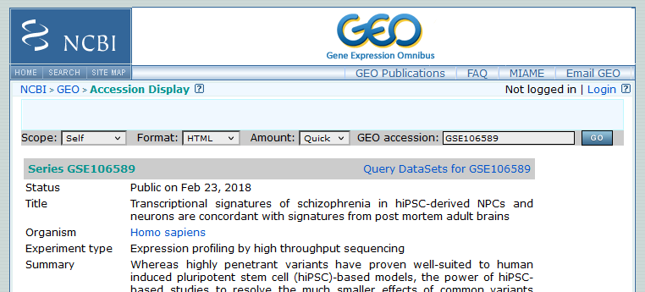

The data
GEO database https://www.ncbi.nlm.nih.gov/geo/, accession number GSE106589:
…
raw counts dataset:
“GSE106589_geneCounts.csv”
Notes:
https://www.ncbi.nlm.nih.gov/Traces/study/?query_key=4&WebEnv=MCID_6565af25392c306f7737da9d&o=acc_s%3Aa

Slide 5
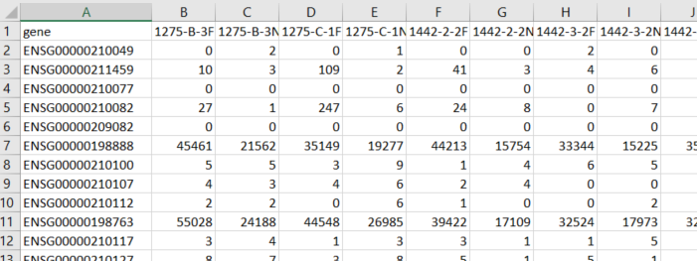

GSE106589_geneCounts
Ensembl gene identifiers
Feel free to open in Excel but do not save when closing!!
Sample numbers
Transcript counts per sample and gene

Slide 6
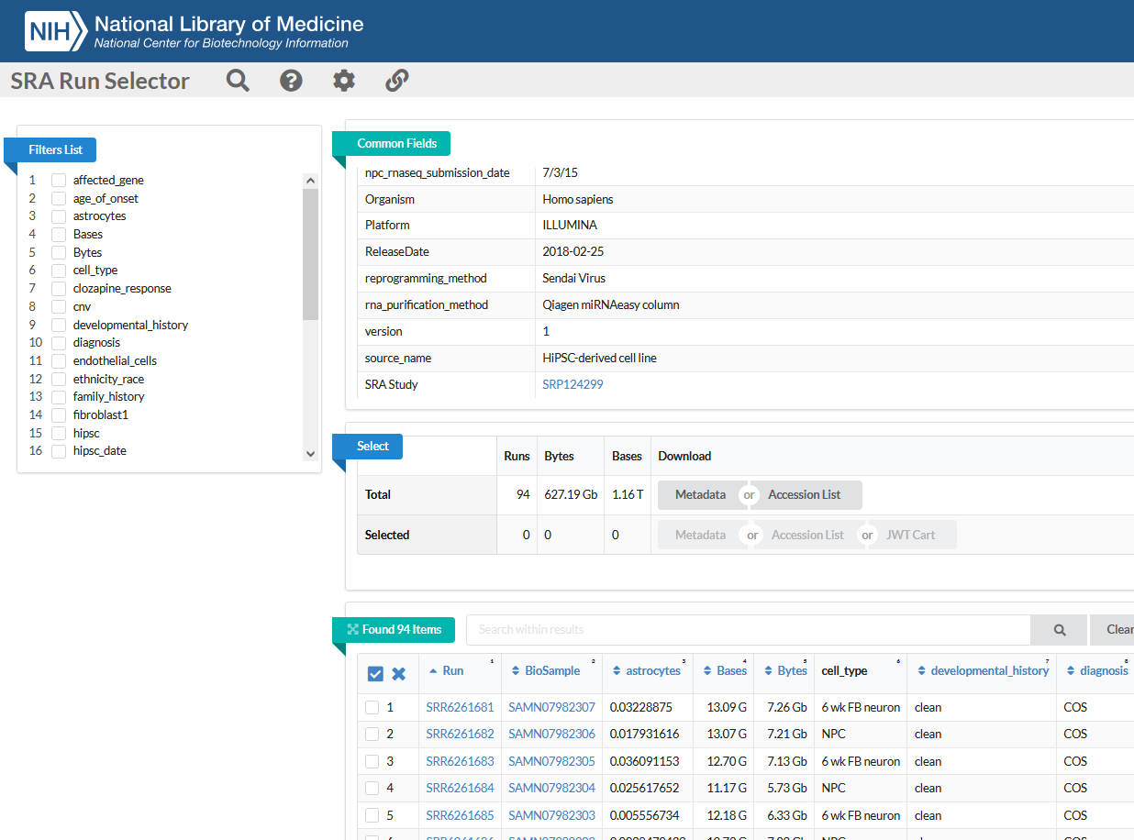
The metadata
Data – sample description found on BioProject: https://www.ncbi.nlm.nih.gov/bioproject
SRA run selector:
https://www.ncbi.nlm.nih.gov/Traces/study/?query_key=4&WebEnv=MCID_6565af25392c306f7737da9d&o=acc_s%3Aa
Metadata file:
“SraRunTable.txt”

Slide 7
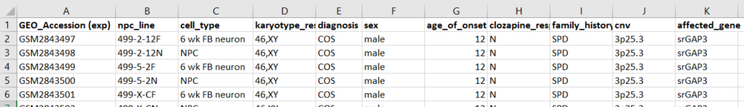
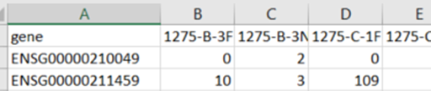

Sample description in the metadata file
Please open the “SraRunTable_for_inspection.xls”

