Slide 1
DESeq2
Friederike Ehrhart, PhD
Assistant professor
Maastricht University
Department of Bioinformatics – BiGCaT

Slide 2

DESeq2

Slide 3
From raw counts to differentially expressed genes (DEGs)
DESeq2 R package
Original publication: Love, M.I., Huber, W., Anders, S. (2014) Moderated estimation of fold change and dispersion for RNA-seq data with DESeq2. Genome Biology, 15:550. 10.1186/s13059-014-0550-8
Improved version of DESeq
Other options are: limma/voom, edgeR, DSS
What does it do?
Input: Raw counts and metadata (sample description)
Operation: Uses a statistical model to calculate the difference in gene expression between two or more groups of samples
Output: Produces fold change (FC) and log2FC for difference, and p-value and adj. p-value (FDR) for significance

Slide 4
Advantages of DESeq2
Accurate correction for variability: DESeq2 uses a statistical model to correct for variability in the sequencing data, leading to more accurate results.
Support for complex designs: DESeq2 can handle complex experimental designs, such as multiple groups with multiple replicates.
Widely used and well-documented: DESeq2 is a widely used tool in the bioinformatics community, with a large user base and a well-documented user manual.

Slide 5
DESeq2 workflow – in short
Importing raw count data and metadata
Creating a “dds object” by merging count and metadata and determining the experimental design (e.g. disease vs. control)
Run DESeq on the dds object
Export the results – a table with difference and significance of gene expression per gene between the groups
(Visualisation and interpretation of the results)

Slide 6
DESeq2 function - in detail
Starting point: count matrix K with one row for each gene i and one column for each sample j -> K_{ij}
Normalization: generalized linear model with a negative binomial distribution (sometimes also called a gamma-Poisson distribution) with mean μ _{ij} and dispersion α _{i}
Normalization factors
Size factors (can be gene specific: GC content, gene length)
Design (experimental design e.g. treated vs. untreated)

Slide 7
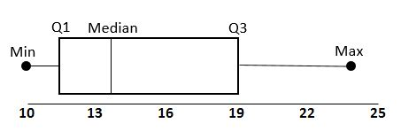
Data boxplot before and after normalization (and filtering)

Slide 8
Principle Components Analysis (PCA)
Gene 2
PC2
PC1
Gene 1
Expression values
This is a simplified example: in reality we have about 20 000 Genes = 20 000 dimensions!
PCA is used to reduce the dimensions of a multi-dimensional data set to 2 or 3 dimensions

Slide 9
Principle Components Analysis (PCA)
PC2
70%
PC1
30%
PC1
PC2
Percentage of variation explained
PC1
Now we reduced the two dimensional data set to one dimension, thereby explaining (keeping) 70% of the original variation

Slide 10
PCA (before and after normalization)
FB neurons
NPC

Slide 11
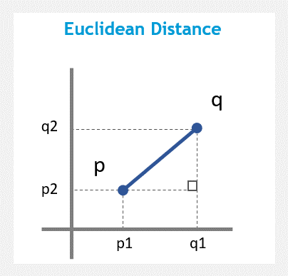
Cluster analysis
Clustering = grouping things (datasets) together which are more similar to each other than to those in other groups
K-means clustering = vector quantization: sum up all variables in the sample in form of a vector
Calculate Euclidean distances between the samples
1st sample
Gene 1
Gene 2
……
2nd sample

Slide 12
Cluster dendrogram
NPC
FB neurons
Notes:
Error? Duplicate? Cells did not differentiate?

Slide 13
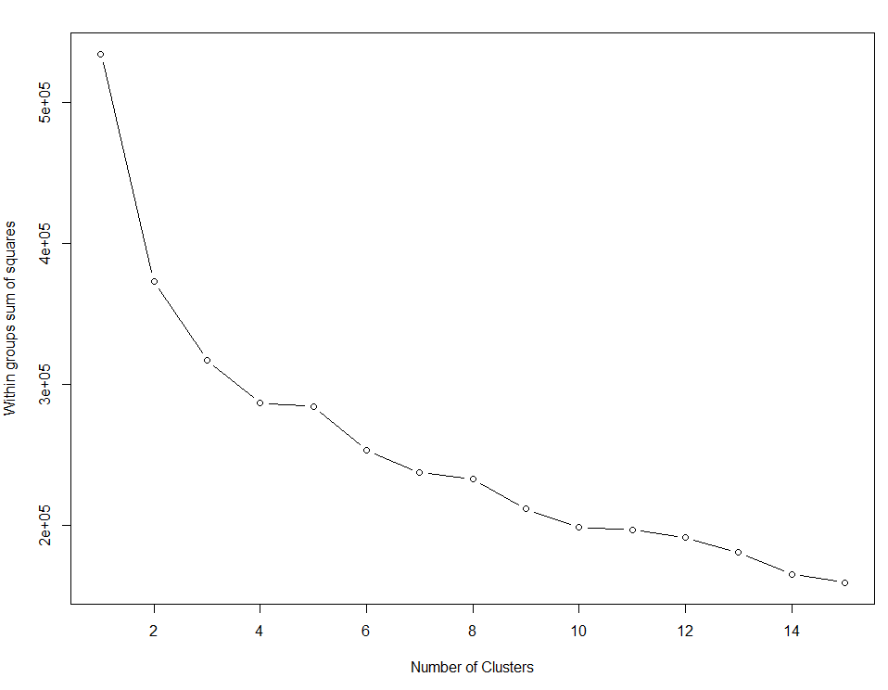
Numbers of clusters

Slide 14
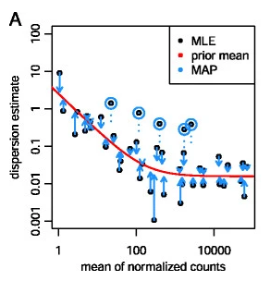

Variation between genes
Empirical Bayes shrinkage for dispersion estimation: within group variation
We assume that genes of similar average expression strength have similar dispersion
Dispersion parameter is α _{i} , which describes the variance of counts via
MAP, maximum a posteriori; MLE, maximum-likelihood estimate
Figure: Love et al. 2014
Notes:
A is easier to determine with more samples
DESeq2 estimates the width of the prior distribution from the data and therefore automatically controls the amount of shrinkage based on the observed properties of the data. In contrast, the default steps in edgeR require a user-adjustable parameter, the prior degrees of freedom, which weighs the contribution of the individual gene estimate and edgeR’s dispersion fit
Genes with low dispersion get raised – high dispersion are kept -> reduces false positives

Slide 15
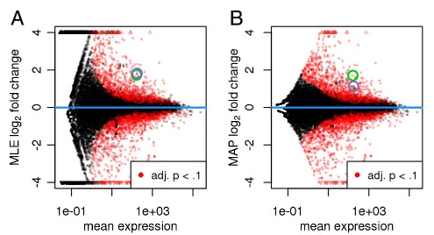
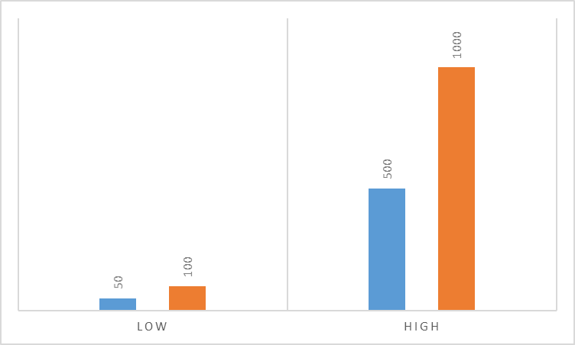
Fold Change
Filtering (“shrinking”) of genes with low counts, high dispersion, or if there are too few degrees of freedom
FC = 2!
Figure: Love et al. 2014

Slide 16
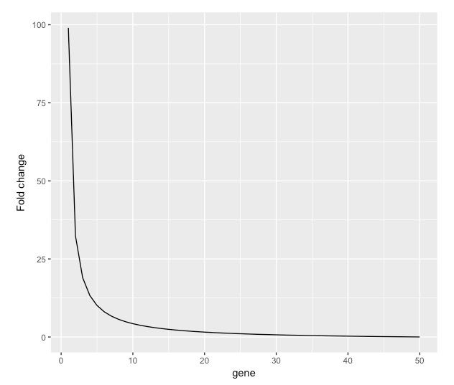
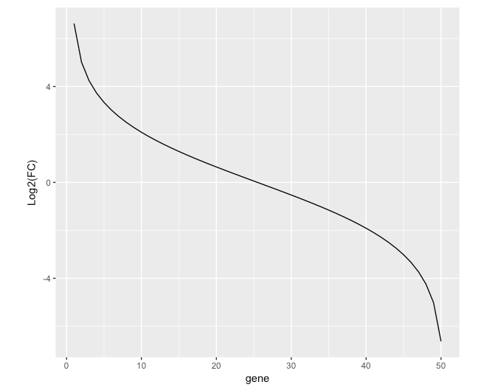
log2FoldChange – logFC or log2FC
FC – Fold Change
logFC – log 2 Fold Change
Downregulated = negative
Upregulated = positive values
Downregulated = 0 – 1
Upregulated = 1 - ∞
Source: https://www.biostars.org/p/312980/

Slide 17
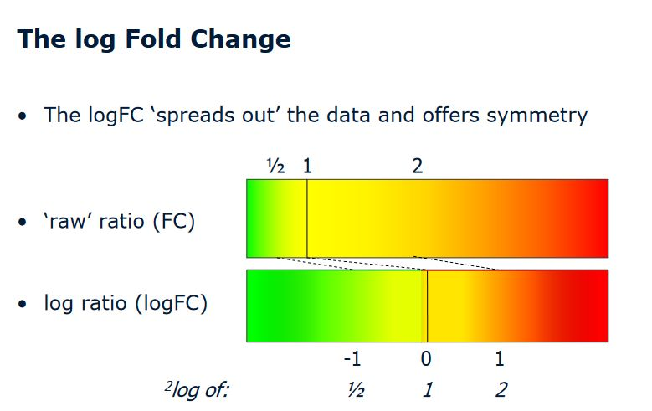
“Vulcano plot”
0
down
up
log2FC

Slide 18
Hypothesis tests for differential gene expression
P-value (significance) determined by Wald test:
The shrunken estimate of LFC is divided by its standard error, resulting in a z-statistic, which is compared to a standard normal distribution.
Adjusted p-value: Correction for multiple testing
Notes:
Not normally distributed – no t-test or Anova!

Slide 19

Multiple testing errors
E.g. perform a statistical test with a 0.05 threshold:
Probability (making a mistake) = 0.05
Probability (NOT making a mistake) = 0.95
Repeat the test 20 times:
Probability (not making ANY mistake) = 0.95²⁰ = 0.358
Probability (making at least one mistake) = 1 – 0.358 = 0.642
There is a 64.2% chance of making at least one mistake!
The higher the number of repeats, the higher the chance of making mistakes.

Slide 20
Adjusted p-value – correction for multiple testing
Examples of multiple testing correction methods:
Bonferroni – a very strict correction, very few false positives remain, but we will discount many true positives too.
Adjusted p-value = calculated p-value * number of tests done
E.g. when we test 100 genes to see if they are different between the two groups. A certain gene gives a p-value of 0.002, the adjusted p-value is: 0.002 * 100 = 0.20 – not significant.
Benjamini-Hochberg – we set the % of results which we can tolerate as false positives (False Discovery Rate or FDR control)
DESeq2 uses FDR/Benjamini-Hochberg: the average expression strength of each gene, across all samples, as its filter criterion

Slide 21
Vulcano plot FB neurons COS vs. control
Significant and different
 | Different Fold change high | Not different Fold change low
Significant P value < 0.05
Non-Significant P value > 0.05

Slide 22
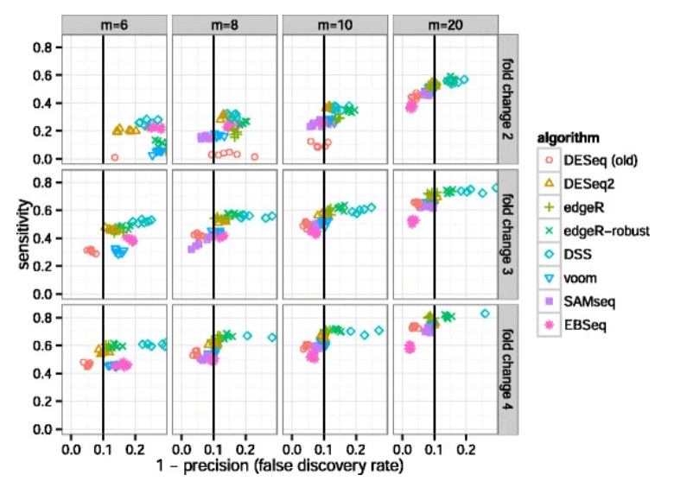
Comparison between different methods Sensitivity vs. Precision
Figure: Love et al. 2014

Slide 23
Whats next?
1. Run DESeq2 on full data
- Open R / R Studio
- Download the GSE106589_geneCounts.csv and SraRunTable.txt
- Download R script DESeq2_GSE106589_V1.R and open it in R
2. Run DESeq2 on FB neuron data
- Download R script DESeq2_GSE106589_FBneurons.R and open it
3. (optional) Run DESeq2 on NPC data
Modify Fbneurons.R so you can use it to analyse NPC data

Slide 24
More information
A simple, straight-forward DESeq2 tutorial: https://lashlock.github.io/compbio/R_presentation.html
Extensive tutorial covering all eventualities, by the original authors: https://bioconductor.org/packages/devel/bioc/vignettes/DESeq2/inst/doc/DESeq2.html
DESeq2 original paper: Love, M.I., Huber, W., Anders, S. (2014) Moderated estimation of fold change and dispersion for RNA-seq data with DESeq2. Genome Biology, 15:550. 10.1186/s13059-014-0550-8
R Tutorial on clustering: https://www.statmethods.net/advstats/cluster.html

