Slide 1
DESeq2
Friederike Ehrhart, PhD
Assistant professor
Maastricht University
Department of Bioinformatics – BiGCaT

Slide 2
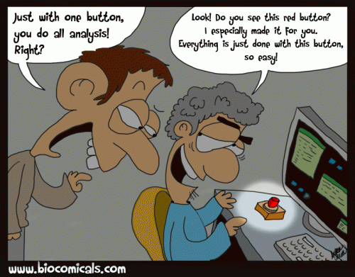

Slide 3
From raw counts to differentially expressed genes (DEGs)
DESeq2 R package
Original publication: Love, M.I., Huber, W., Anders, S. (2014) Moderated estimation of fold change and dispersion for RNA-seq data with DESeq2. Genome Biology, 15:550. 10.1186/s13059-014-0550-8
Improved version of DESeq
Other options are: limma(incl. Voom), edgeR…
What does it do?
Input: raw counts
Uses a statistical model to calculate the difference in gene expression between two or more groups of samples
Output: Produces fold change (FC) and log2FC for difference, and p-value and adj. p-value (FDR) for significance

Slide 4
Advantages of DESeq2
Accurate correction for variability: DESeq2 uses a statistical model to correct for variability in the sequencing data, leading to more accurate results.
Support for complex designs: DESeq2 can handle complex experimental designs, such as multiple groups with multiple replicates.
Widely used and well-documented: DESeq2 is a widely used tool in the bioinformatics community, with a large user base and a well-documented user manual.

Slide 5
DESeq2 workflow – in short
Importing raw count data and metadata
Creating a “dds object” by merging count and metadata and determining the experimental design (e.g. disease vs. control)
Run DESeq on the dds object
Export the results – a table with difference and significance of gene expression per gene between the groups
(Visualisation and interpretation of the results)

Slide 6
Data boxplot (all data)

Slide 7
PCA (all data)

Slide 8
Vulcano plot FB neurons COS vs. control

Slide 9
More information
A simple, straight-forward DESeq2 tutorial: https://lashlock.github.io/compbio/R_presentation.html
Extensive tutorial covering all eventualities, by the original authors: https://bioconductor.org/packages/devel/bioc/vignettes/DESeq2/inst/doc/DESeq2.html
DESeq2 original paper: Love, M.I., Huber, W., Anders, S. (2014) Moderated estimation of fold change and dispersion for RNA-seq data with DESeq2. Genome Biology, 15:550. 10.1186/s13059-014-0550-8

